Slide 1
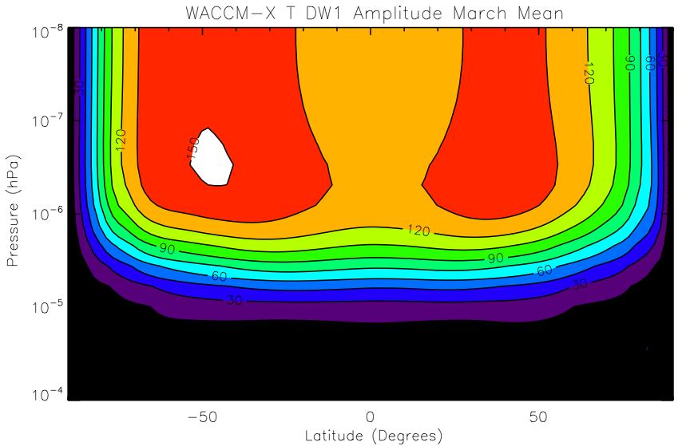
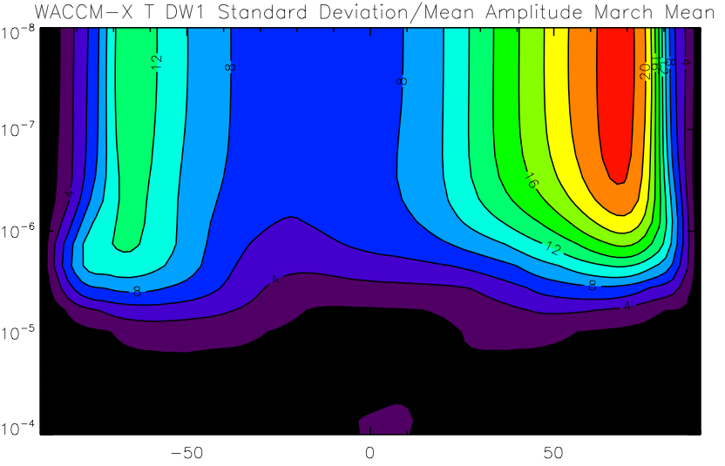
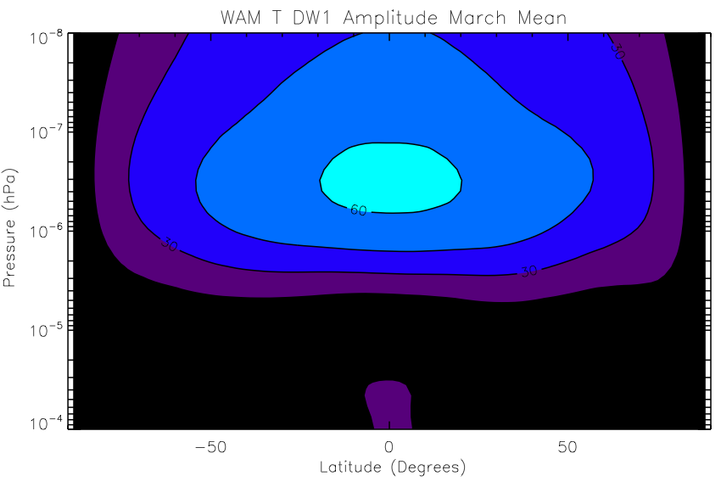
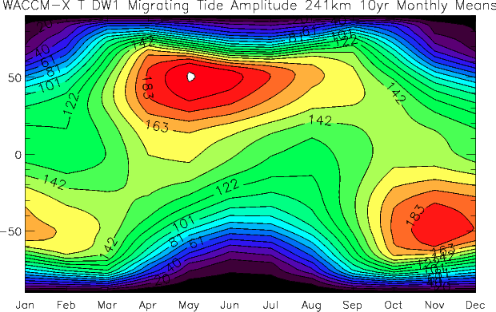
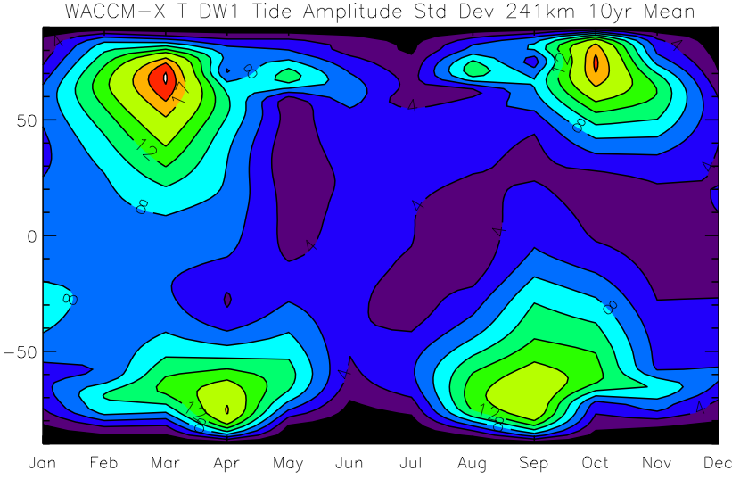
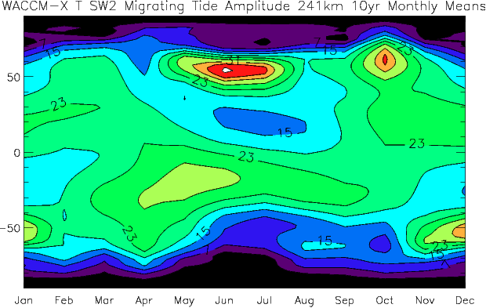
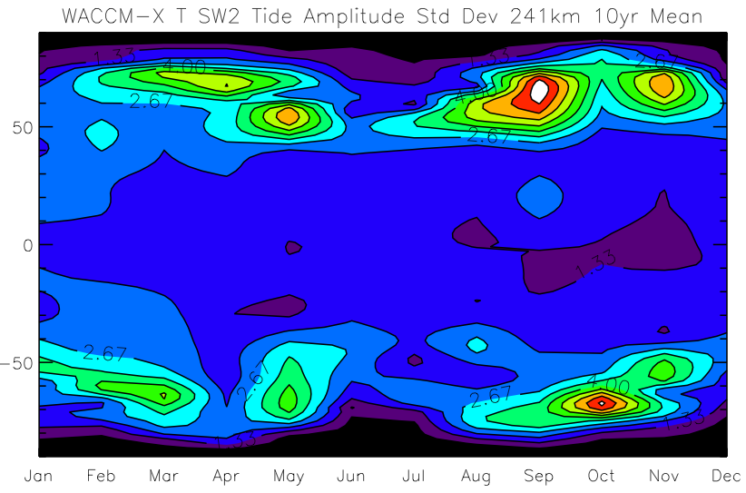
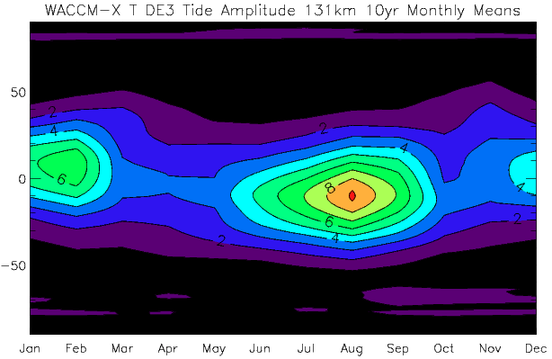
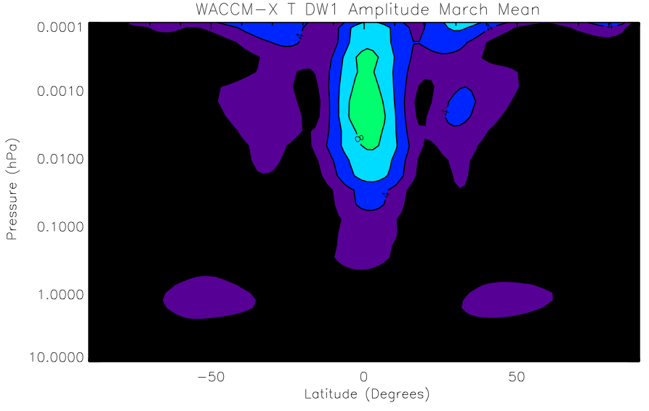
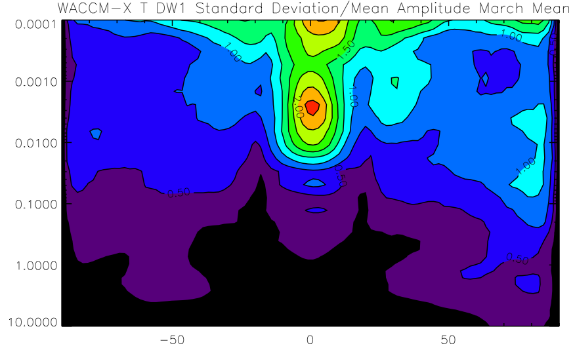
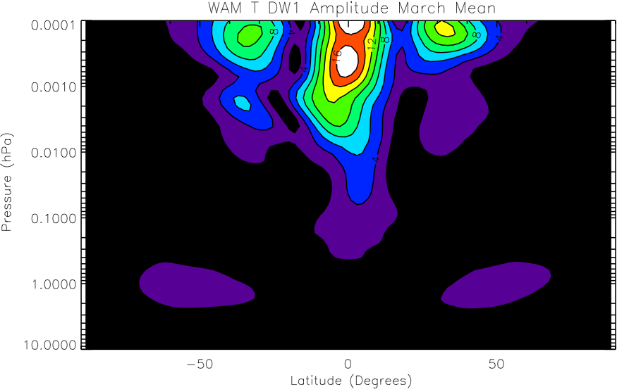
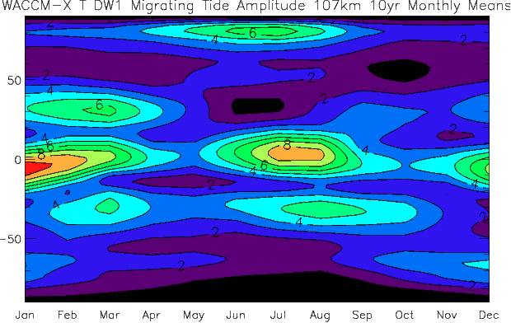
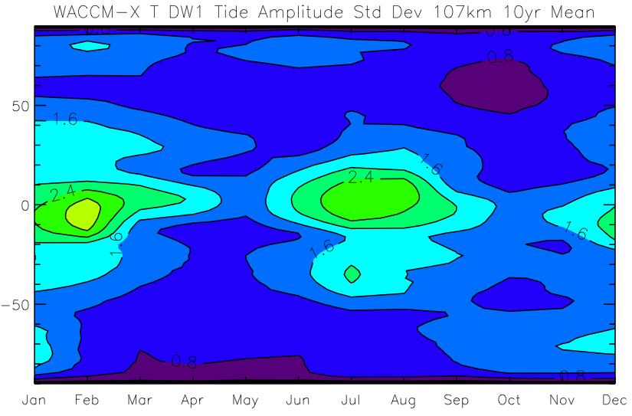
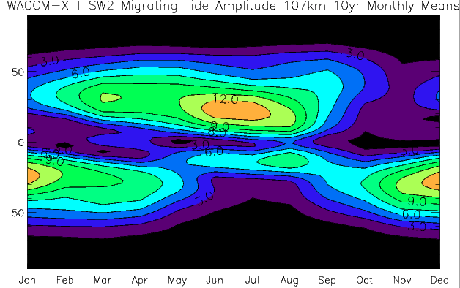
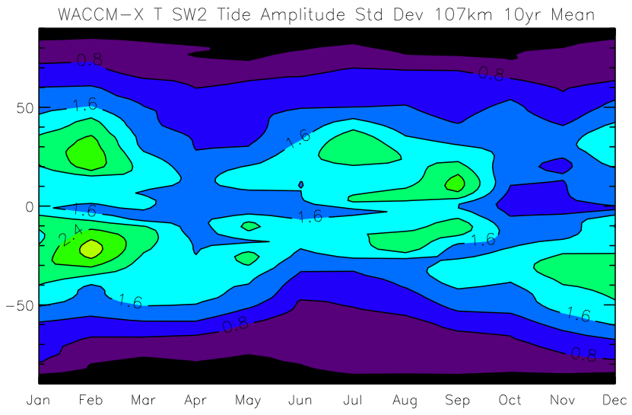
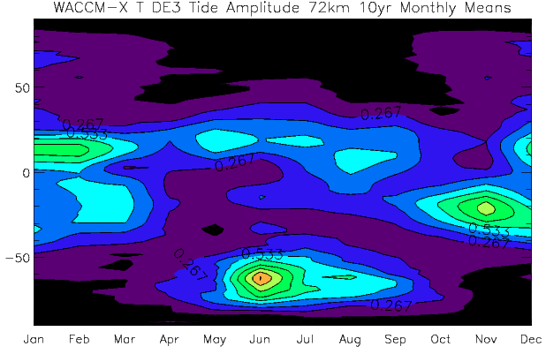
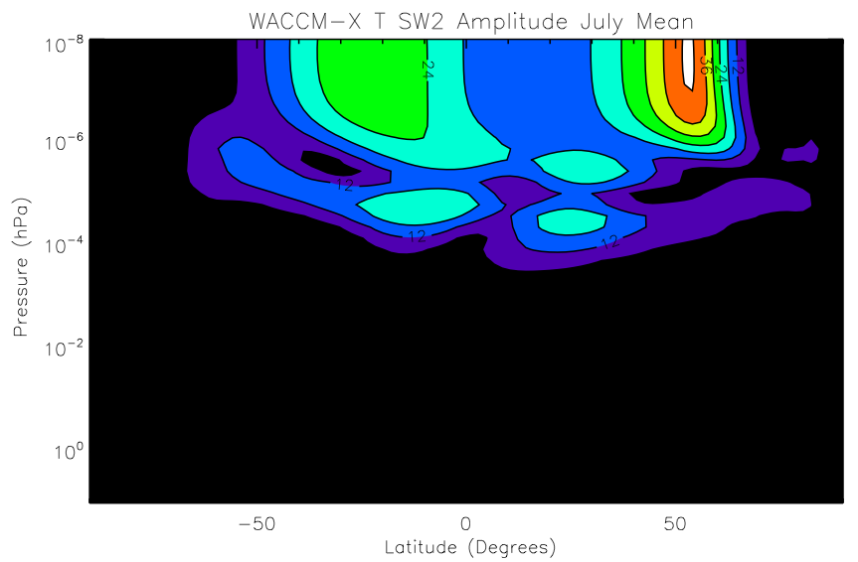
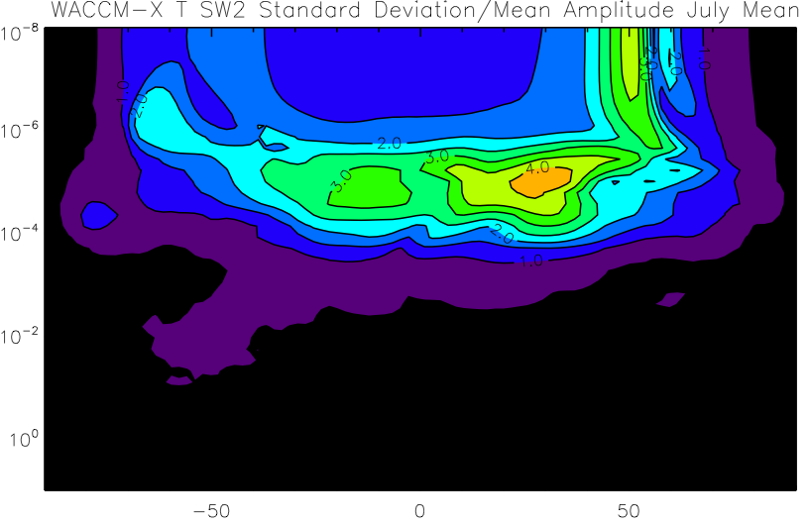
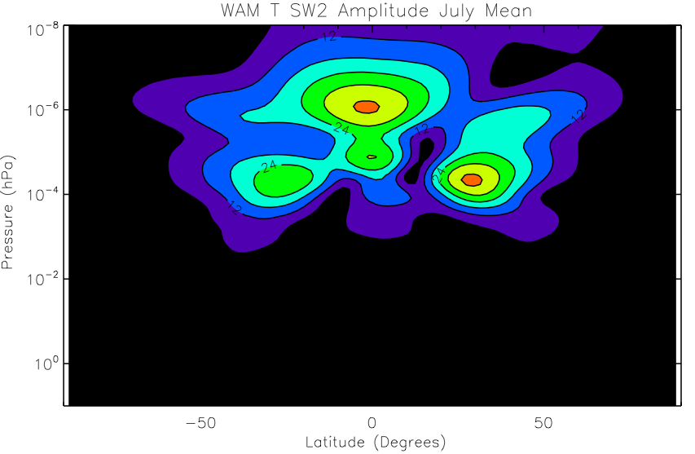
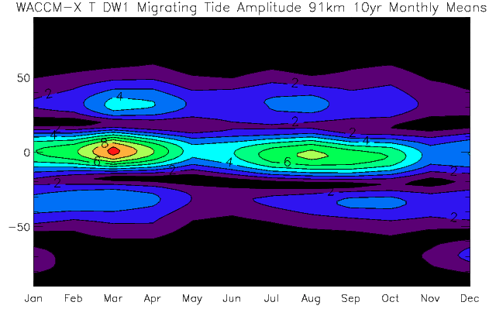
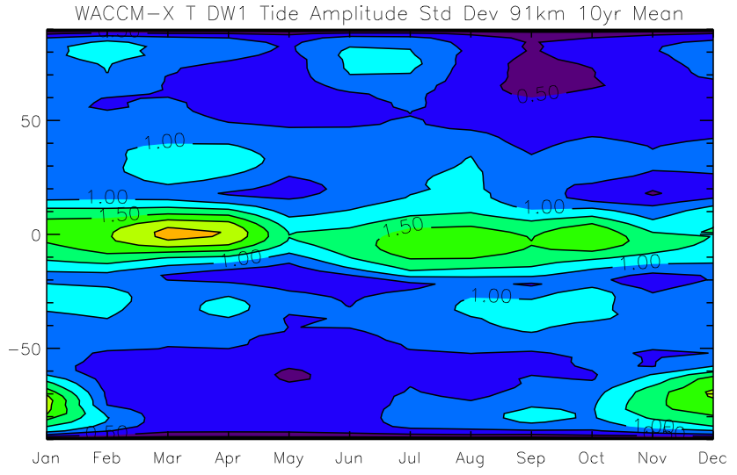
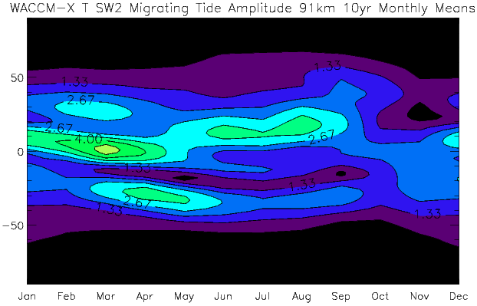
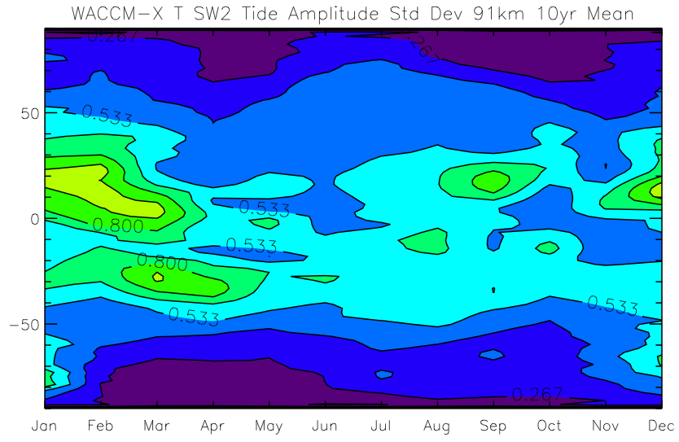
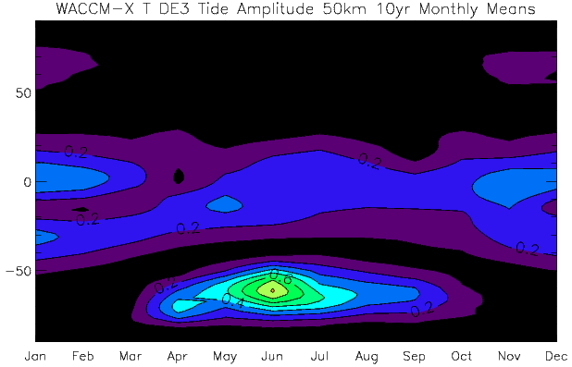
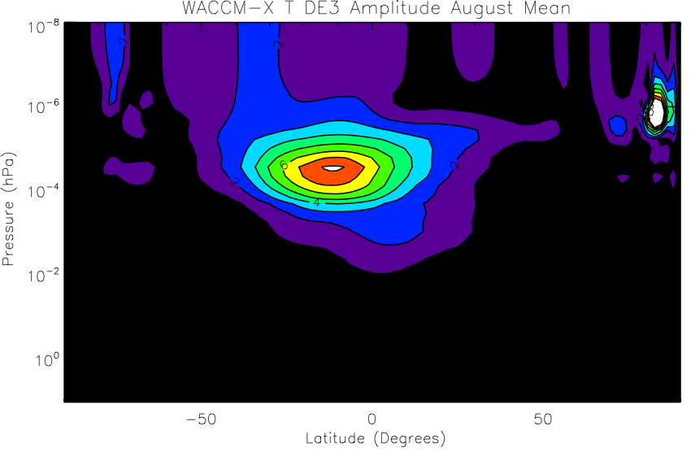
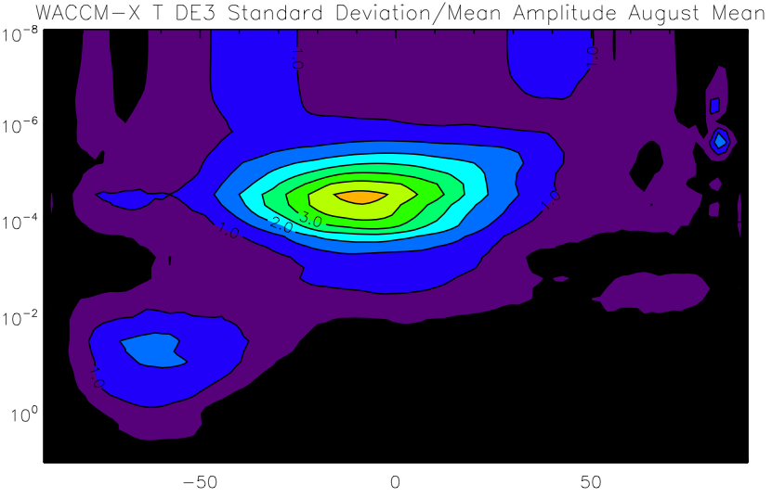
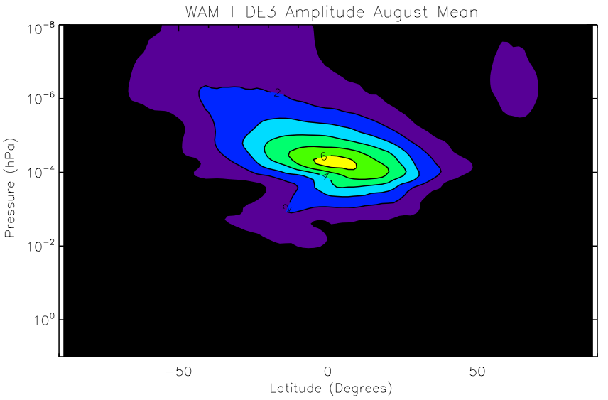
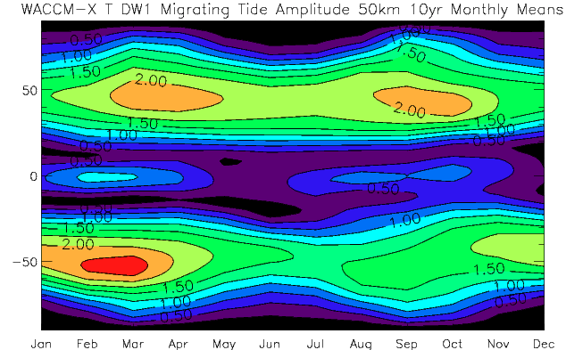
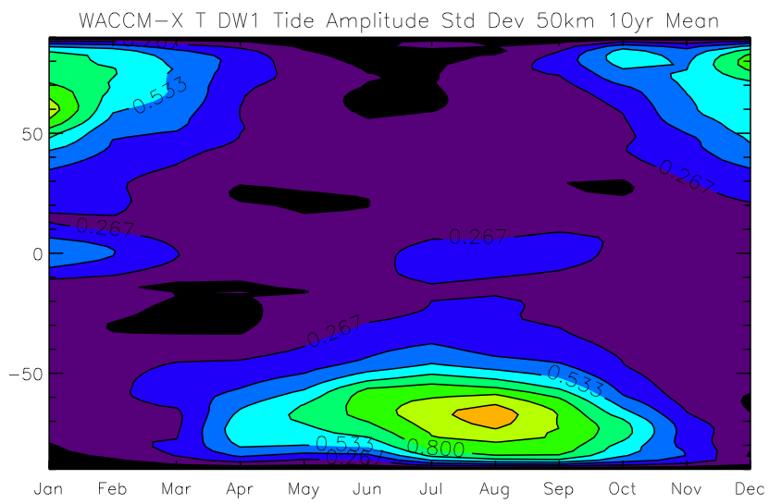
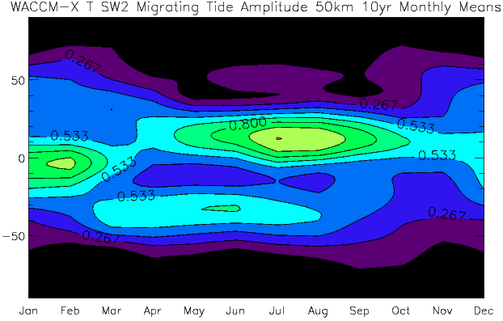
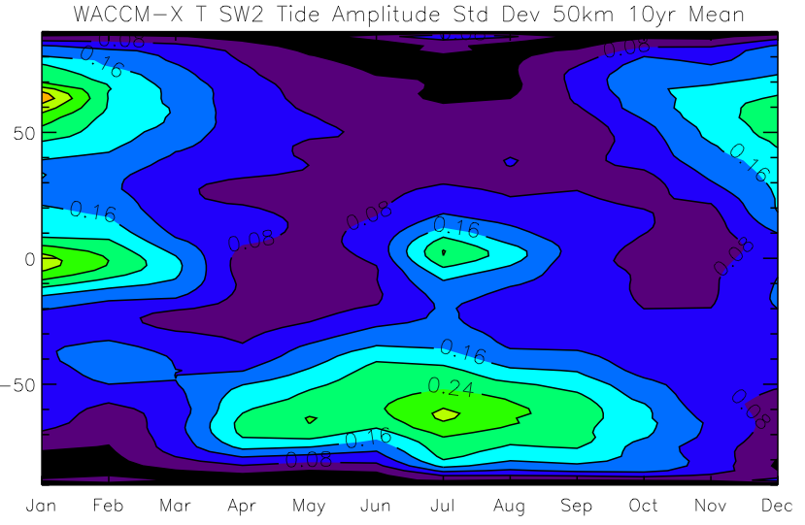
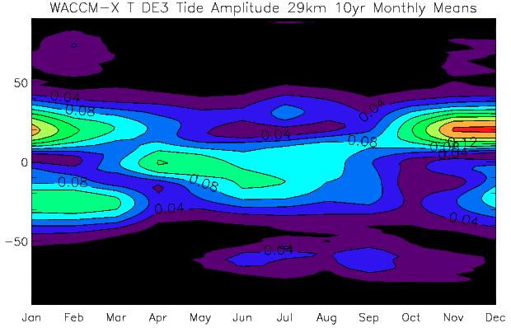
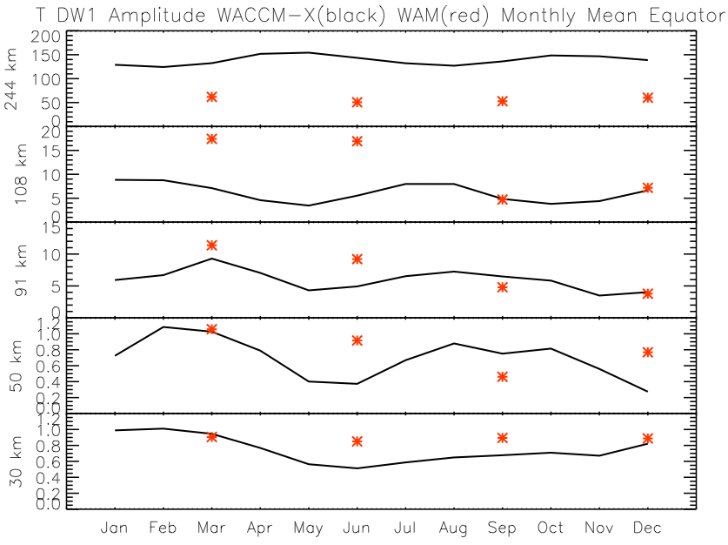
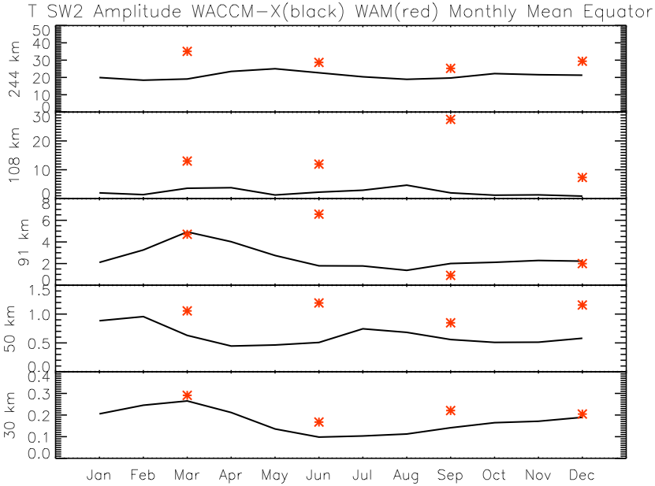
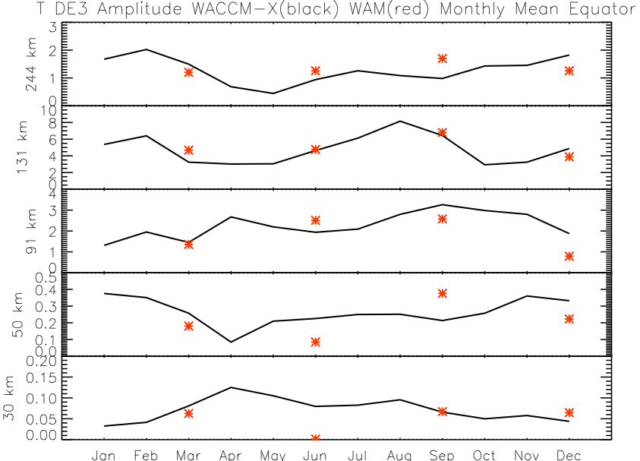
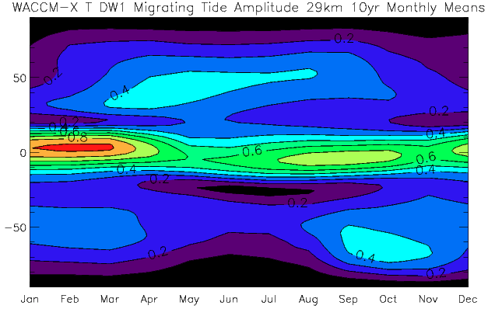
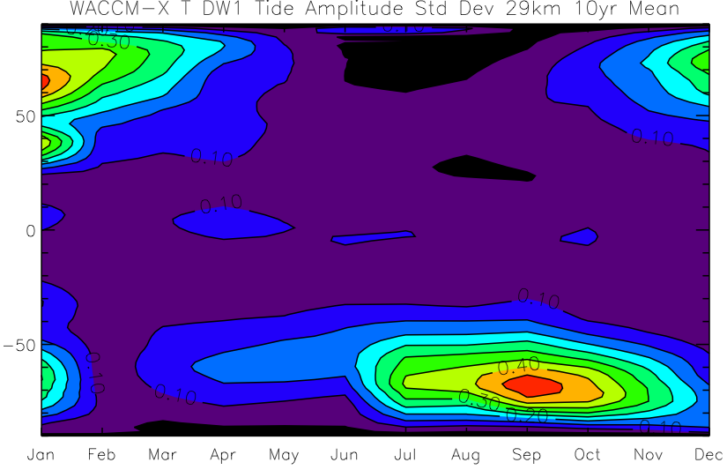
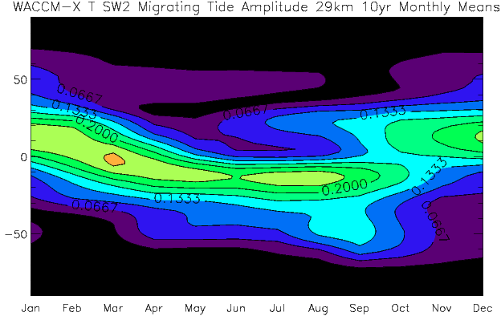
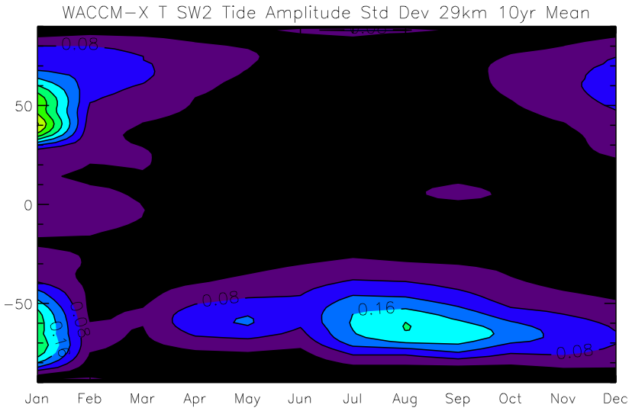
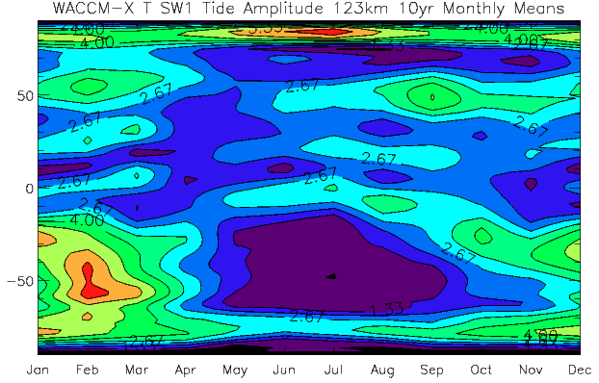
Seasonal Variation and Variability of Atmospheric Tides as Seen in the Community Earth System Model (CESM) Whole Atmosphere Community Climate Model – eXtended (WACCM-X)
Joe M. McInerney and Han-Li Liu, High Altitude Observatory (HAO), National Center for Atmospheric Research (NCAR)
Rashid A. Akmaev, Space Weather Prediction Center (SWPC), National Oceanic and Atmospheric Administration (NOAA)
Introduction:
One aspect of any atmospheric climate model is the ability to resolve atmospheric tides, that is, solar induced tides which propagate through the atmosphere. In the case of the Community Earth System Model (CESM) Whole Atmosphere Community Climate Model-eXtended (WACCM-X) (Liu, et al., 2010) resolving these tides accurately is an ongoing challenge. A couple of characteristics of these tides which warrant further investigation are the seasonal variation of tidal amplitude and the tidal variability. Here we examine these characteristics using results from a 10 year WACCM-X simulation. A number of vertical levels are shown from the stratosphere to the thermosphere. We also compare the tidal seasonality with a 1 year simulation from the Whole Atmosphere Model (WAM) (Akmaev, et al., 2008). Future work will involve further connecting the current results with physical processes in the atmosphere.
Seasonal Variation of Diurnal and Semidiurnal Migrating Tides:
Seasonal Variation of Diurnal Eastward 3 (DE3) & Semidiurnal Westward 1 (SW1) Non-Migrating Tides:
March Equinox WACCM-X and WAM Tidal Amplitudes:
Below are month vs latitude cross-sections of 10 yr mean WACCM-X diurnal westward wavenumber 1 (DW1) and semidiurnal westward wavenumber 2 (SW2) tidal mode amplitudes and standard deviation of amplitudes on thermosphere to stratosphere altitude levels
DW1 has expected large amplitude peaks near solstice in thermosphere and equatorial peaks near equinox in upper mesosphere
DW1 equatorial equinox amplitude peaks regress in time towards solstice above and below upper mesosphere
DW1 high variability in thermosphere at equinox high latitudes, in lower thermosphere and upper mesosphere at amplitude peaks, and again at high latitudes in the stratosphere
SW2 amplitude peaks at low to mid-latitudes centered near summer solstice and extending over many months
SW2 has high variability near the lower thermosphere amplitude peaks but not at peaks at other levels
SW2 variability larger at high latitudes in the thermosphere and stratosphere and at low to mid-latitudes in the lower thermosphere and mesosphere, with some larger variability near the equator in the upper stratosphere
Below are latitude vs pressure WACCM-X and WAM DW1, SW2, and DE3 tidal amplitudes and WACCM-X standard deviation for these tides
Location of amplitude peaks typically corresponds in pressure and latitude with highest variability
Variability larger at higher latitudes in DW1 (NH) and DE3 (SH)
WACCM-X DW1 and SW2 tidal amplitudes generally lower than WAM in mesosphere and higher in thermosphere
WACCM-X DE3 tidal amplitudes comparable to WAM
WACCM-X DE3 and SW1 tidal amplitudes shown below:
DE3 amplitudes peak in low latitudes near solstice with higher latitude SH winter solstice maximum in mesosphere and stratosphere
SW1 amplitudes maximize in lower thermosphere during SH high latitude winter and also at NH high latitudes
WACCM-X Tidal Amplitude
WACCM-X Standard Deviation
WAM Tidal Amplitude
WACCM-X DW1 Amplitude
WACCM-X DW1 Standard Deviation
WACCM-X SW2 Amplitude
WACCM-X SW2 Standard Deviation
241 km
Diurnal Tide Eastward Wavenumber 3
131 km
107 km
Pressure (hPa)
Latitude
72 km
91 km
Latitude
50 km
50 km
Latitude
Seasonal Variation of WACCM-X and WAM Tidal Amplitudes:
29 km
Below are DW1, SW2, and DE3 month vs tidal amplitude WACCM-X (all months) and WAM (equinox and solstice months) at select vertical levels near the equator
DW1 has best agreement between the two models in seasonal variation at 91 km
SW2 agreement is good at 30 km with WACCM-X amplitudes smaller than WAM at other vertical levels
DE3 seasonal variation agrees better in upper mesosphere/lower thermosphere and seems to have the best agreement of the three tidal modes
29 km
Semidiurnal Tide Westward Wavenumber 1
Tidal Amplitude
Month
123 km
Summary:
Seasonal variation of tides in WACCM-X has clear dependence on altitude
Short-term tidal variability in the form of standard deviation is significant for all tidal modes
WACCM-X March equinox DW1 and SW2 tidal amplitude low altitude peaks smaller and high altitude peaks larger and at different latitudes than WAM
March equinox DE3 tidal amplitudes vertical and latitudinal structure very similar in WACCM-X and WAM
DE3 tidal amplitudes have similar seasonal variation in WACCM-X and WAM but DW1 and SW2 have differences
Month
Month
References:
Akmaev, R. A., et al. (2008), Tidal variability in the lower thermosphere: Comparison of Whole Atmosphere Model (WAM) simulations with observations from TIMED, Geophys. Res. Lett., 35, L03810, doi:10.1029/2007GL032584.
Liu, H.-L., et al. (2010), Thermosphere extension of the Whole Atmosphere Community Climate Model, J. Geophys. Res., 115, A12302, doi:10,1029/2010JA015586.

