Slide 1
TIE-GCM v. 2.0 The NCAR Thermosphere-Ionosphere-Electrodynamics General Circulation Model at the Community Coordinated Modeling Center
Stan Solomon, Alan Burns, Barbara Emery, Ben Foster,
Astrid Maute, Liying Qian, Art Richmond,
Ray Roble, and Wenbin Wang
High Altitude Observatory
National Center for Atmospheric Research
Eric Sutton
Air Force Research Laboratory
CCMC Workshop • Annapolis, Maryland • 1 April 2014

Slide 2
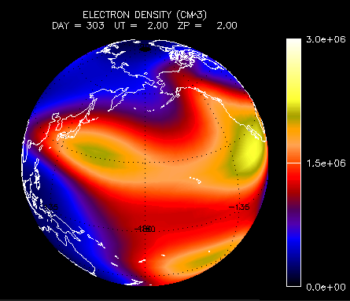
Thermosphere-Ionosphere-Electrodynamics General Circulation Model (TIE-GCM)
• Original development by Ray Roble, Bob Dickinson, Art Richmond, et al.
• The atmosphere/ionosphere element of the Coupled Magnetosphere-Ionosphere-Thermosphere (CMIT) and LFM-TIE-RCM (LTR) models
• Cross-platform community model, under open-source academic research license
• v. 1.95 release, 2013
• User manual complete
• Documentation mostly complete
• Runs-on-request at CCMC
• More information at: http://www.hao.ucar.edu/modeling/tgcm

Slide 3
Numerical Approach
• The TIE-GCM is a comprehensive, first-principles, three-dimensional, non-linear representation of the coupled thermosphere and ionosphere system that includes a self-consistent solution of the low-latitude electric field.
• The model solves the three-dimensional momentum, energy and continuity equations for neutral and ion species at each time step, using a semi-implicit, fourth-order, centered finite difference scheme, on each pressure surface.
• 29 constant-pressure levels in the vertical at H/2, from ~97 km to ~500 km altitude.
• 5° x 5° latitude / longitude grid in the horizontal.
• Assumes Hydrostatic equilibrium, constant gravity, steady-state ion and electron energy equations, and incompressibility on constant pressure surfaces. Ion velocities are specified by the potential field and ExB drifts.
• Implemented in F90 and MPI. Runs on 1 to ~32 processors. Uses netCDF for I/O.
• Time step is 120 s.
• ~0.1 s / time step on many ~4 to ~8 processor systems (> 1200 x wallclock).

Slide 4
External Forcing of the Thermosphere/Ionosphere System
Solar XUV, EUV, FUV (0.05-175 nm)
Solar energy and photoelectron parameterization (Solomon & Qian, 2005)
Default: F10.7-based solar proxy model (EUVAC)
Optional: solar spectral measurements; other empirical models
Magnetospheric forcing
High latitude electric potential: empirical models (Heelis et al., 1982; Weimer, 2005), or data assimilation model (e.g., AMIE), or magnetosphere model (LFM)
Auroral particle precipitation: analytical auroral model linked to potential pattern (Roble & Ridley, 1987), or magnetospheric model (LFM)
Lower boundary wave forcing
Tides: Global Scale Wave Model (GSWM , Hagan et al, 1999)
Eddy diffusion (with option for seasonally-varying term, Qian et al., 2009)

Slide 5
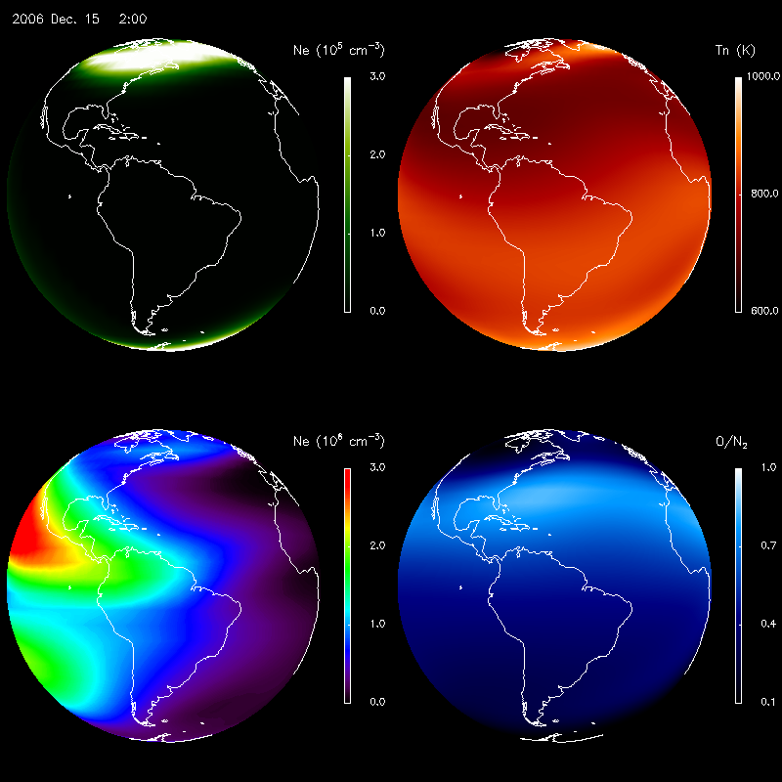
Thermosphere-Ionosphere Modeling during Storms
E-region Electron Density (~110 km)
Neutral Temperature (~160 km)
F-region Electron Density (~300 km)
O/N₂ Ratio (~160 km)

Slide 6
What’s New in TIE-GCM v. 2.0?
• TIE-GCM v. 2.0 planned release in June 2014
— “Double Resolution” (2.5° x 2.5° x H/4) supported
— Helium included as a major species
— Electrodynamics calculations parallelized
• Recommend 1-minute time step for climate; 30-second time step for storms
— Normal-resolution model runs ~1700 x wallclock on 16 processors
— Double-resolution model runs ~200 x wallclock on 64 processors
• Other minor changes, updates, and bug fixes (since v. 1.94)
Include N₂ explicitly as a major species (instead of 1-O-O₂-He)
Fixed Kp so it can’t go negative
Modified FFT filters for double-res version
Fixed error in GSWM interpolation
Added time-dependent CO₂ concentration at lower boundary
Added new diagnostics for magnetic and electric fields,
Introduced refactored Apex code apex.F90.
Change minimum EUVAC solar flux from 0.8 x Refspec to 0.1 x Refspec
Fixed bug in eddy and molecular viscosity coefficients in duv.F
Various yellowstone-specific script mods
Various performance improvements

Slide 7
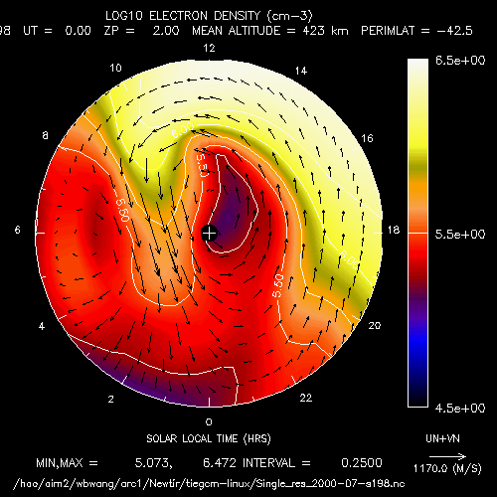
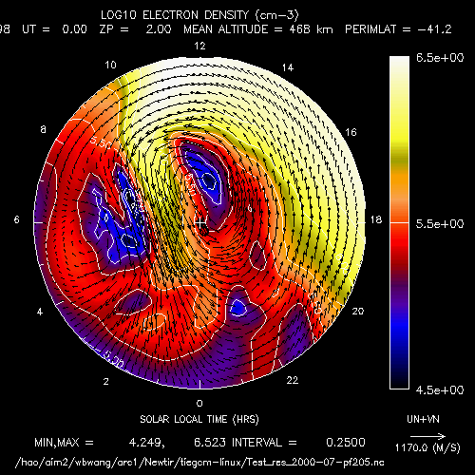
Normal (5°) vs. Double (2.5°) Resolution
Normal Resolution Double Resolution
Electron densities with neutral wind vectors superimposed over the southern hemisphere polar region during a geomagnetic storm. The “tongue” of ionization is significantly more resolved in the double-resolution version of the model.

Slide 8
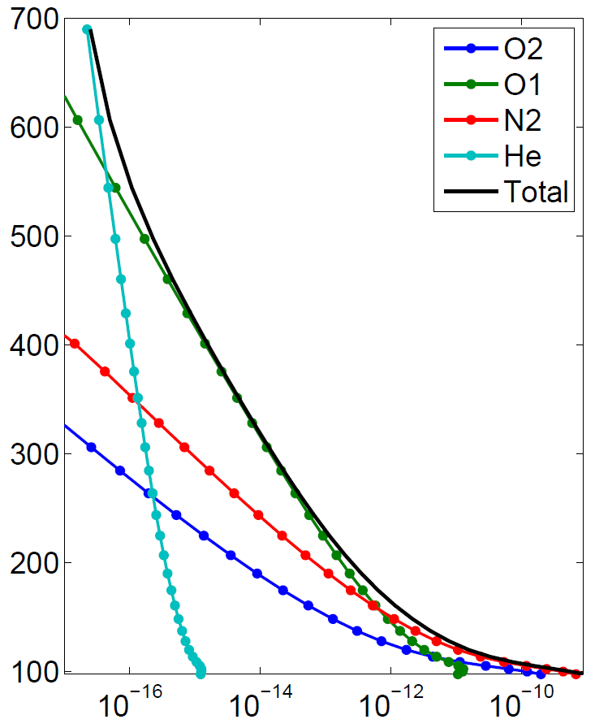
Inclusion of Helium as a Major Species
Helium has very small concentration from ground level through the turbopause
Diffusive separation causes the mixing ratio to increase, approaching unity in the upper thermosphere
Seasonal variation termed “Winter Helium Bulge”
Local Time preference near ~8:00 LT
Helium scale height is less sensitive to solar cycle variations (i.e. temperature changes) than are other species
Helium can be important for satellite drag calculations, particularly at 500–700 km, and partiuclarly during solar minimum
Mass Densities
(Dec. 2004, 72.5° N)
Height (km)
Density (g/cm³)

Slide 9
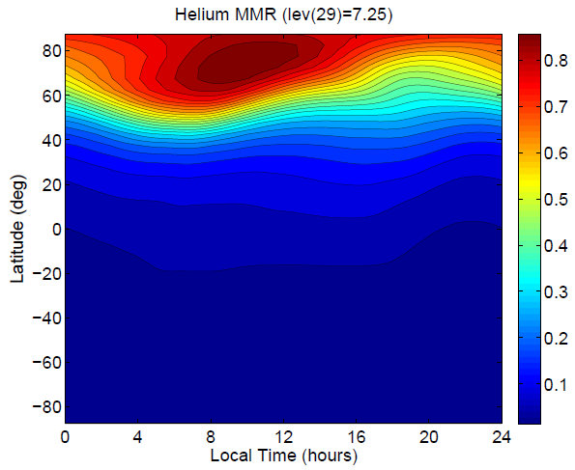
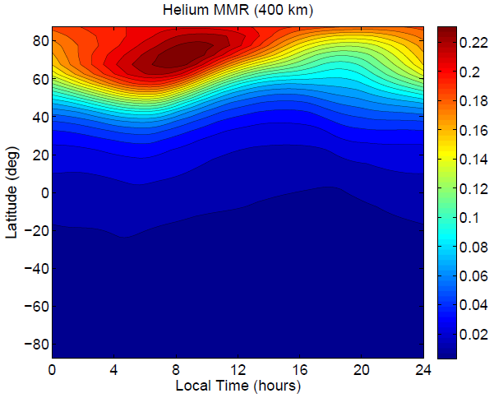
Simulation of the Winter Helium Bulge
Top Pressure Level: (Z_{p}=+7)
Constant Altitude: 400 km
On a constant pressure surface,
MMR > 0.8 in the winter hemisphere
At 400 km, the MMR is reasonably
consistent with MSIS

Slide 10
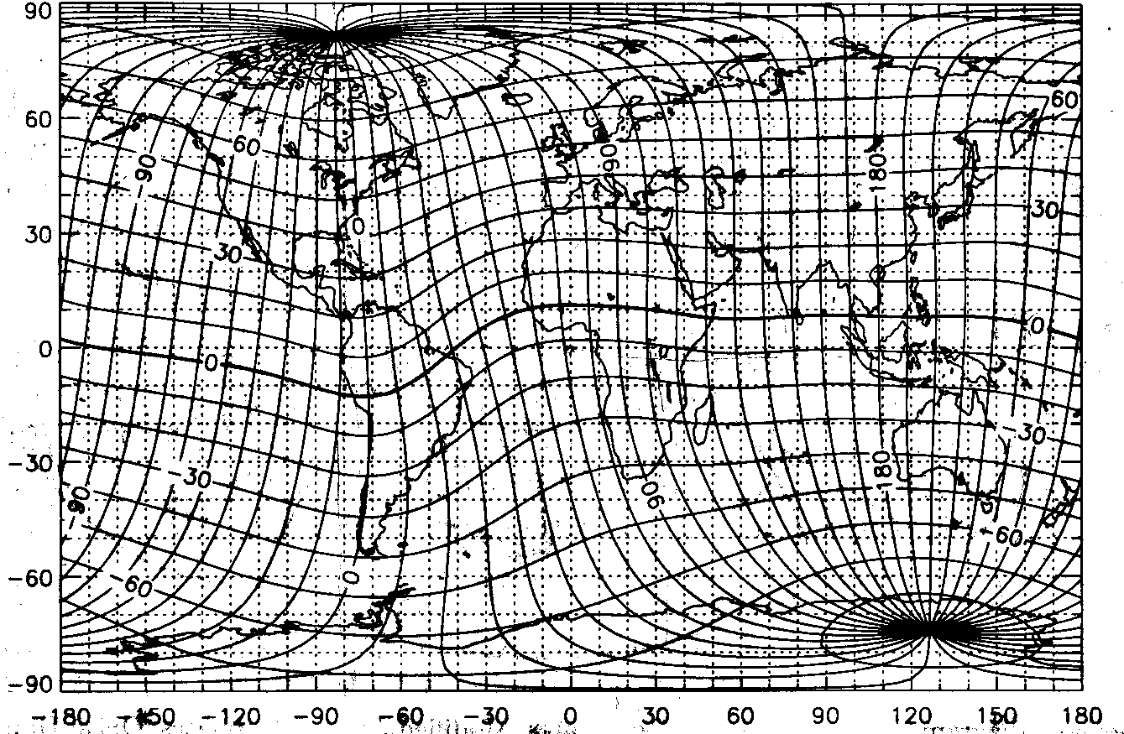
Electrodynamics
• Low and mid-latitude: neutral wind dynamo equations solved in geomagnetic Apex coordinates [Richmond et al., 1992; 1995].
• High latitude: specified by convection models such as Heelis, Weimer, or AMIE, or coupled to the LFM Magnetosphere Model.

Slide 11
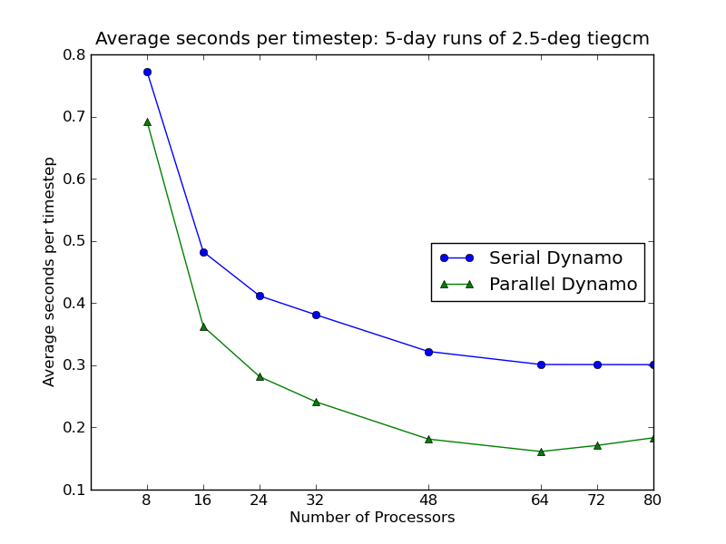
Performance Scaling using new Parallel Dynamo Module
• Uses ESMF to perform parallel grid interpolations for ion-neutral coupling.
• Low resolution (5°) model now runs at ~1700 x wallclock on 16 processors.
• High resolution (2.5°) model now runs at ~200 x wallclock on 64 processors.
(2.6-GHz Intel Xeon E5-2670)

Slide 12
Recent Work on Thermospheric Neutral Density
• The variation of neutral density in the thermosphere, on time scales ranging from an hour to a decade, has important effects on the trajectories of objects in low-Earth orbit.
• This problem has been re-discovered as an important aspect of space weather.
• It is also a tractable problem, on time scales of hours to days, and numerical models have the potential to make significant advances over the current empirical models used in operations.
• Using satellite drag observations to validate and improve numerical models has the distinct advantage that the data used for comparison are precisely the same as the data that are of operational importance.

Slide 13
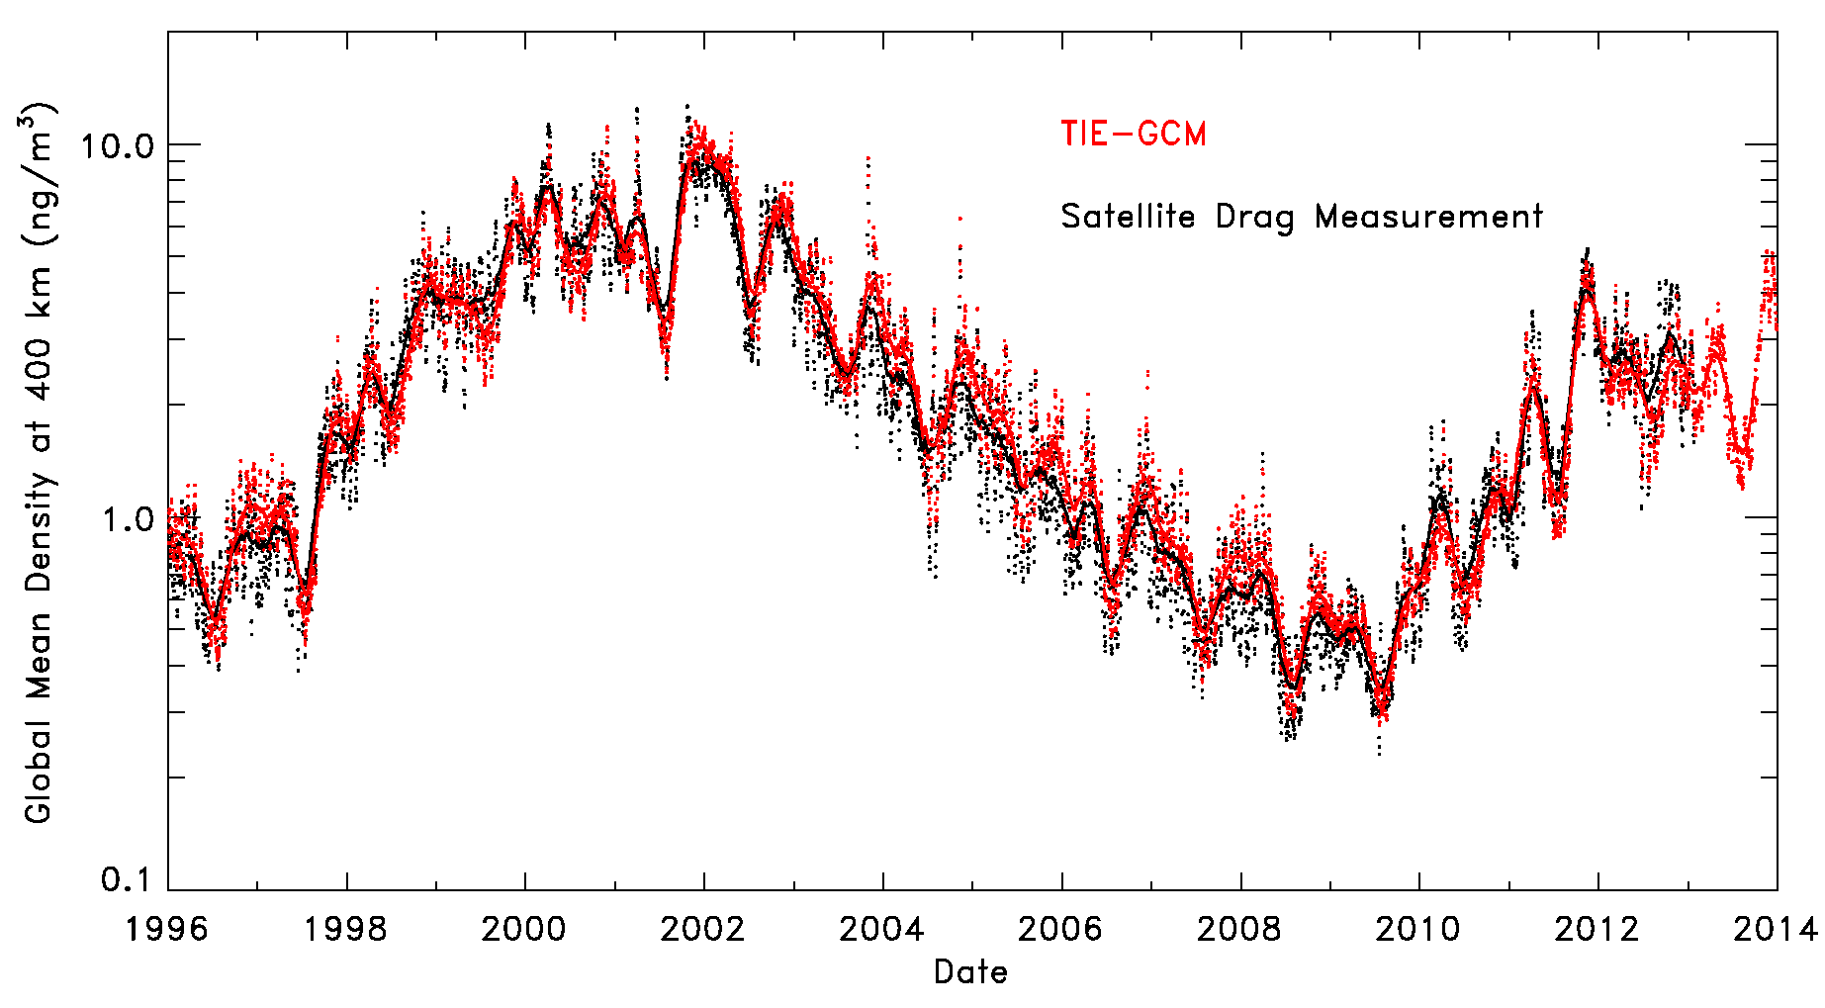
Thermospheric Density over 1.5 Solar Cycles
~30% lower at SC 23/24 minimum

Slide 14
Current Development and Future Plans
• TIE-GCM v. 1.95 released June 2013.
— Mostly minor updates and bug fixes, and yellowstone-specific changes
• TIE-GCM v. 2.0 to be released June 2014.
— High resolution version supported
— Helium included
— Parallel Electrodynamics
• Other key research developments include:
— Lower boundary conditions:
Seasonal/spatial variation of zonal mean climatolgy (T, u, v, z_{g})
Seasonal/spatial variation of lower boundary eddy diffusion
Tidal forcing updates to GSWM and data-driven methods
— External forcing:
Solar EUV from TIMED/SEE, SDO/EVE, and alternative proxies
New auroral precipitation specification based on GUVI data
— Continued development of the CMIT and LTR models
— High-altitude extension, including light ion species
— Plasmaspheric extension, and high-latitude outflow...

Slide 15
A Community Model at the Community Center
• To us, a community model means that scientific researchers can share the model results, run the model themselves, and/or participate in model development.
• The source code is available through an open-source academic research license.
Meaning, you can have the code, but you can’t sell it, and we request that you adhere to academic norms with regard to collaboration, collegiality, and citation.
• If you want to look at archived model results...
Available from the NCAR Data Portal at http://cdp.ucar.edu
• If you want to do a particular model run...
Available through “runs on request” at CCMC
• If you want to run the model yourself...
Download, install, and run the model on your computer, or,
Obtain an account on HAO/NCAR computers and run it there
• If you want to participate in model development...
...give us a call
...come for a visit

Slide 16
Information, User Guide, Documentation, Source Code...
Main page:
http://www.hao.ucar.edu/modeling/tgcm
User Guide:
http://www.hao.ucar.edu/modeling/tgcm/doc/userguide
Documentation:
http://www.hao.ucar.edu/modeling/tgcm/doc/description/model_description.pdf
Code Map:
http://www.hao.ucar.edu/modeling/tgcm/download/files/tiegcm_codestruct.pdf
Post-Processors:
http://www.hao.ucar.edu/modeling/tgcm/doc/userguide/html/postproc.html

Slide 17
Backup

Slide 18
TIE-GCM “Extraterrestrial” Inputs and Options
F_{10.7}
Solar EUV Proxy Model
Solar EUV Measurement
Solar Wind / IMF B, v, ρ
Kp
LFM
Weimer
Heelis
AMIE
MIX
TIE-GCM

Slide 19
TIE-GCM “Extraterrestrial” Inputs and Options
Basic Stand-Alone Model
F_{10.7}
Solar EUV Proxy Model
Solar EUV Measurement
Solar Wind / IMF B, v, ρ
Kp
LFM
Weimer
Heelis
AMIE
MIX
TIE-GCM

Slide 20
TIE-GCM “Extraterrestrial” Inputs and Options
Stand-Alone Model using Weimer ’05 High-Latitude Potential
F_{10.7}
Solar EUV Proxy Model
Solar EUV Measurement
Solar Wind / IMF B, v, ρ
Kp
LFM
Weimer
Heelis
AMIE
MIX
TIE-GCM

Slide 21
TIE-GCM “Extraterrestrial” Inputs and Options
CMIT Configuration
F_{10.7}
Solar EUV Proxy Model
Solar EUV Measurement
Solar Wind / IMF B, v, ρ
Kp
LFM
Weimer
Heelis
AMIE
MIX
TIE-GCM

Slide 22
Equations and Numerics
• Equations:
Momentum equation: u, v
Continuity equation: w, O, O₂, N(⁴S), NO, O⁺
Hydrostatic equation: z
Thermodynamic equation: T_{N}, T_{e}
Quasi-steady state energy transfer—electron, neutral, ion: T_{I}
Photochemical equilibrium: N(²D), O₂⁺,N₂⁺,N⁺,NO⁺
• Coordinate system:
Horizontal: rotating spherical geographical coordinates, 5°x 5° grid
Vertical: pressure surface (hydrostatic equilibrium), 0.5 scale height grid
High resolution version (2.5° x 2.5° x H/4) in test.
• Numerics:
Horizontal: explicit 4th order centered finite difference
Vertical: Implicit 2nd order centered difference
Time: 2nd order centered difference
Shapiro filter: achieve better numerical stability
Fourier filter: remove spurious high frequency zonal waves at high latitudes

Slide 23
Boundary Conditions
• Upper boundary conditions:
u, v, w, T_{N}, O₂, O: diffusive equilibrium;
N(⁴S), NO: photochemical equilibrium;
O⁺: specify upward or downward O⁺ flux;
T_{e}: specify upward or downward heat flux.
• Lower boundary conditions:
u, v: specified by tides (GSWM)
T_{N}: 181 K + perturbations by tides (GSWM)
O₂: fixed mixing ratio of 0.22
O: vertical gradient of the O density is zero
N(⁴S), O⁺: photochemical equilibrium
NO: constant density of (8x10⁶)
T_{e}: equal to T_{N}.

