Slide 1
A Model of Helium in the Upper Thermosphere
13 August 2013
Eric K. Sutton
Research Physicist
Air Force Research Laboratory

Slide 2
Abstract
The previous solar minimum exhibited sustained low levels of solar extreme ultraviolet radiation and geomagnetic activity. This affords the opportunity to study upper- atmospheric conditions that are outside the domain of the available historical data and empirical models of the thermosphere. With the decline of solar and geomagnetic activity, neutral helium becomes dominant at progressively lower altitudes and pressure levels. We present a new physics- based model of thermospheric composition – an extension of TIE-GCM – that includes the transport and dynamics of neutral helium as a major constituent. Previous models have included helium as a minor constituent, simulating the effect of the major constituents on helium while ignoring the reverse; however, these assumptions generally limit the model to non-solar minimum conditions and/or lower altitudes. The main effect of helium in the thermosphere is a seasonal modulation of the mean molecular weight. The decrease in the mean molecular weight and accompanying increase in scale height in the winter hemisphere, where helium is more densely concentrated, cause an increase in the geopotential height of the pressure surfaces. This effect further couples into the momentum equations where a difference of >20 m/s directed away from the winter helium bulge is observed. Using this model, we compare the two previous solar cycles (ca. 1996 and 2008) to resolve the differences in helium content, the amplitude of seasonal variations, and response to geomagnetic disturbances.

Slide 3
Outline
Background and Motivation
Past and Current Implementation of Helium in TIE-GCM
Upper Boundary Conditions
Salient Features
Thermodynamic Effects of Helium
Conclusions and Future Work

Slide 4
Brief History of Helium
First discovered from anomalous Solar emission line (c. 1868)
Arises in Earth’s crust and mantle from radioactive decay:
Outgassing at a rate of 2.5e6 atoms*cm-2s-1 produces atmospheric abundance of ~5.24 ppmv at ground levels
Non-thermal escape at the top of the atmosphere balances in-flux at ground levels, over a certain time scale. He+ outflow is currently thought to be responsible [Lie-Svendsen & Rees, 1996]
see Kockarts [1973]
$${Th}^{232}→{Pb}^{208}+6{ He}^{4}$$
$$U^{235}→{Pb}^{207}+7{ He}^{4}$$
$$U^{238}→{Pb}^{206}+{8 He}^{4}$$

Slide 5
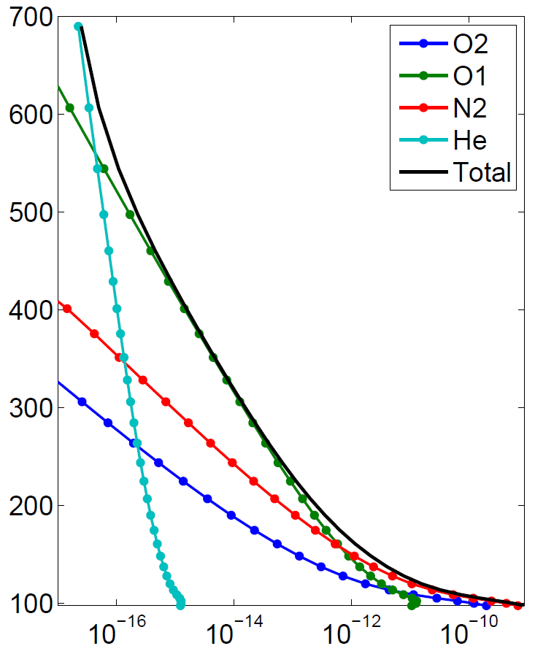
Behavior of Helium in the Upper Atmosphere
Mass Densities
(Dec. 2004, 72.5° N)
Behavior in the Thermosphere:
Helium has very small concentration from ground level thru turbopause
Diffusive separation causes the mixing ratio to increase, approaching and exceeding unity in the upper thermosphere
Seasonal variation termed “Winter Helium Bulge”
Local Time preference near ~8:00 LT
Helium’s inverse scale height is less sensitive to solar cycle variations (i.e. temperature changes) than are other species
Height (km)
Density (g/cm³)

Slide 6
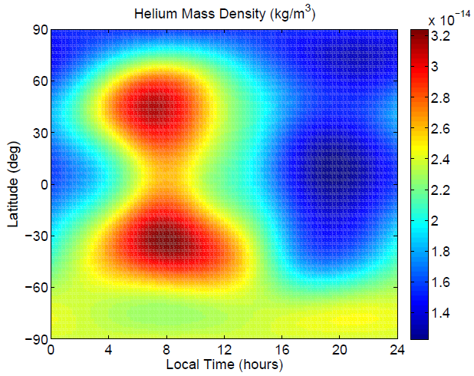
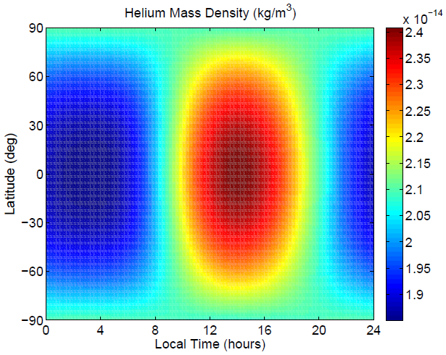
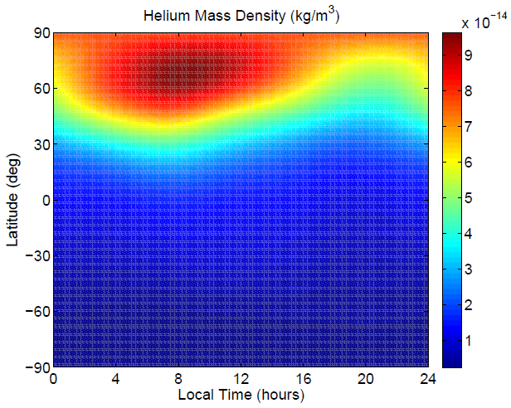
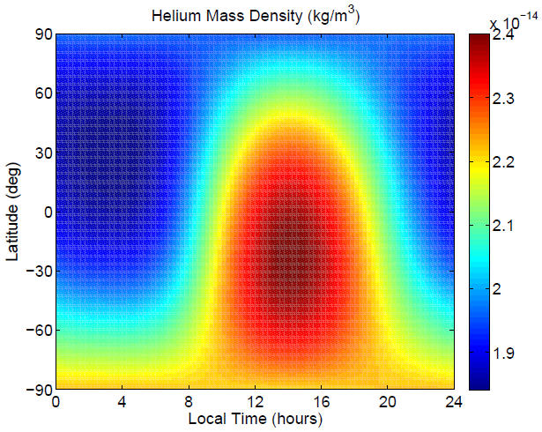
Behavior in Empirical Models
Helium Mass Densities
Models Run @ 400 km with F10.7=80
Jacchia-Bowman (right) model is currently the operational Sat. Drag model used by the Air Force
MSIS is driven by mass spectrometer data
i.e. MSIS should be reasonably accurate
Jacchia Models are based on satellite drag data, ignoring Mass Spec. data and winter helium bulge
MSIS
JB08
Equinox
Solstice
NH Winter

Slide 7
Helium in T*-GCM
Helium was initially solved as a minor constituent in various versions of T*GCMs [Roble et al., 1988; Richmond et al., 1992; Roble and Ridley, 1994]:
E. C. Ridley developed the framework to solve for helium as a minor species using an iterative (implicit) solver to include the non-escaping helium flux
It’s my understanding that:
At some point, a switch in software libraries caused the minor He code to stop working
The upper boundary of T*GCM was raised from zp=5 to zp=7
Afterward, Helium has been difficult to re-implement as a minor species

Slide 8
Major Species
Composition Equation
Dickinson et al., [1984]:
$$\frac{∂Ψ}{∂t}=−e^{z}τ^{−1}\frac{∂}{∂z}\left[\frac{\overline{m}}{m_{N2}}{\left(\frac{T_{00}}{T}\right)}^{0.25}α^{−1}LΨ\right]$$
$+e^{z}\frac{∂}{∂z}\left(K\left(z\right)e^{−z}\left(\frac{∂}{∂z}+\frac{1}{\overline{m}}\frac{∂\overline{m}}{∂z}\right)Ψ\right)−\left(v∙∇Ψ+w\frac{∂Ψ}{∂z}\right)+S−R$
Vector Diffusion Equation:
Vector Continuity Equation:
$$τ\frac{g m_{N2}}{p_{0} \overline{m}}{\left(\frac{T}{T_{00}}\right)}^{0.25}αW=LΨ$$
$$\frac{∂Ψ}{∂t}=−e^{z}\frac{g}{p_{0}}\frac{∂}{∂z}W−\left(v∙∇Ψ+w\frac{∂Ψ}{∂z}\right)+S−R$$
$W=\left[\begin{matrix}n_{O2}m_{O2}w_{O2} \\ n_{O1}m_{O1}w_{O1}\end{matrix}\right]$ is the vector of vertical mass fluxes
$Ψ=\left[\begin{matrix}ψ_{O2} \\ ψ_{O1}\end{matrix}\right]$ is the vector of mass mixing ratios
$L=diag\left(\frac{∂}{∂z}−1+\frac{m_{i}}{\overline{m}}+\frac{1}{\overline{m}}\frac{∂\overline{m}}{∂z}\right)$ is the diagonal matrix differential operator specifying
normalized pressure
Note: Eddy diffusion is neglected in the above Vector Diffusion Eq. for brevity

Slide 9
Major Species
Composition Equation
The alpha matrix from Dickinson et al., [1984]:
$$α=−\left[\begin{matrix}φ_{O_{2},N_{2}}+\left(φ_{O_{2},O}−φ_{O_{2},N_{2}}\right)ψ_{O} & \left(φ_{O_{2},N_{2}}−φ_{O_{2},O }\right)ψ_{O_{2}} \\ \left(φ_{{O,N}_{2}}−φ_{O,O_{2}}\right)ψ_{O} & φ_{O,N_{2}}+\left(φ_{O,O_{2}}−φ_{O,N_{2}}\right)ψ_{O_{2}}\end{matrix}\right]$$
The alpha matrix after inclusion of Helium as a major species:
$$α=−\left[\begin{matrix}φ_{O_{2},N_{2}}+\sum_{k=\left\{O,He\right\}}{\left(φ_{O_{2},k}−φ_{O_{2},N_{2}}\right)ψ_{k}} & \left(φ_{O_{2},N_{2}}−φ_{O_{2},O }\right)ψ_{O_{2}} & \left(φ_{O_{2},N_{2}}−φ_{O_{2},He }\right)ψ_{O_{2}} \\ \left(φ_{{O,N}_{2}}−φ_{O,O_{2}}\right)ψ_{O} & φ_{O,N_{2}}+\sum_{k=\left\{O_{2},He\right\}}{\left(φ_{O,k}−φ_{O,N_{2}}\right)ψ_{k}} & \left(φ_{O,N_{2}}−φ_{O,He }\right)ψ_{O} \\ \left(φ_{He,N_{2}}−φ_{He,O_{2}}\right)ψ_{He} & \left(φ_{He,N_{2}}−φ_{He,O }\right)ψ_{He} & φ_{He,N_{2}}+\sum_{k=\left\{O_{2},O\right\}}{\left(φ_{He,k}−φ_{He,N_{2}}\right)ψ_{k}}\end{matrix}\right]$$
When solving for He as a minor species, the major constituents are considered fixed and some of these terms are neglected, i.e. terms that describe the behavior of O1, O2, and N2 diffusing through He
When solving for O1, O2, and N2, only an upper 2x2 is used

Slide 10
Modifications to TIE-GCM
Changes made in order to add Helium as a Major Component:
$$Ψ=\left[\begin{matrix}ψ_{O2} \\ ψ_{O1}\end{matrix}\right] ⇒ Ψ=\left[\begin{matrix}ψ_{O2} \\ ψ_{O1} \\ ψ_{He}\end{matrix}\right]$$
$$ψ_{N2}=1−ψ_{O2}{−ψ}_{O1} ⇒ ψ_{N2}=1−ψ_{O2}{−ψ}_{O1}{−ψ}_{He}$$
$L=δ_{ij}\left(\frac{∂}{∂z}−1+\frac{m_{i}}{\overline{m}}+\frac{1}{\overline{m}}\frac{∂\overline{m}}{∂z}\right)$ is expanded
$α$ matrix and TriDiagonal solver (inline code in comp.F) is expanded to include Helium diffusion terms and other related terms (note: now inverting a [3x3] matrix, instead of a [2x2], which is still efficient using direct methods)
MISC.: Added thermal diffusion; added Helium to calculation of geopotential, density, mbar, cp, kt, km, and several related quantities; Constant MMR at L.B.; extensive U.B. work (to be covered).

Slide 11
Upper Boundary Conditions
Thermal Escape
Diffusive Equilibrium for O₂ and N₂ (as in original TIE-GCM):
$$\left(\frac{∂}{∂z}−1+\frac{m_{i}}{\overline{m}}+\frac{1}{\overline{m}}\frac{∂\overline{m}}{∂z}\right)ψ_{i}=0$$
For i = {O₂, N₂ }
Thermal Escape mass flux:
$n_{He}m_{He}w_{He}=p_{0}e^{−z}\frac{ψ_{He}\overline{m}v_{p}}{2\sqrt{π}RT}\left(1+λ_{c}\right)\exp\left({−λ}_{c}\right)≈0$,
where $λ_{c}=v_{e}^{2}/v_{p}^{2}$
$v_{e}^{}≈10.7$ km/s
→
$\exp\left({−λ}_{c}\right)=4.5$e-16
$v_{p}^{}≈$ 1.8 km/s
Exponential term ensures that thermal flux is orders of magnitude too low to affect the global Helium content

Slide 12
Upper Boundary Conditions
Non-Escaping Flux
Non-Escaping Flux of Helium atoms with ballistic trajectories in collision-less exosphere as approximated by Hodges and Johnson [1968] and Hodges [1973]:
$Φ=−∇^{2}\left(n\left\langle v\right\rangle H^{2}P_{2}\right)$, where
$n, \left\langle v\right\rangle {, H}^{2}$ are number density, mean thermal velocity, and scale height for helium
$P_{2}$ is an integral quantity from the references above, with small temp. dependence
Imposed as a diffusive flux at the top of the atmosphere using the vector diffusive flux equation:
$$W=\left[\begin{matrix}0 \\ \frac{p_{0}e^{−z}}{g^{2}}\sqrt{\frac{8}{π}\frac{R^{3}}{m_{He}^{5}}}∇^{2}\left(\overline{m}ψ_{He}T^{3/2}P_{2}\right) \\ −\frac{p_{0}e^{−z}}{g^{2}}\sqrt{\frac{8}{π}\frac{R^{3}}{m_{He}^{5}}}∇^{2}\left(\overline{m}ψ_{He}T^{3/2}P_{2}\right)\end{matrix}\right]=τ^{−1}\frac{p_{0}\overline{m}}{m_{N2}g}{\left(\frac{T_{00}}{T}\right)}^{0.25}α^{−1}LΨ$$
Vector of mass flow rates

Slide 13
Upper Boundary Conditions
Non-Escaping Flux
The non-escaping flux U.B.C. can be implemented in a couple of ways:
Implicitly, using finite differences (slow, but stable)
Explicitly, using finite differences (unstable, needs filtering)
Explicitly, using a truncated spectral approximation (filtering is globally consistent if a triangular truncation is used)

Slide 14
Upper Boundary Conditions
Non-Escaping Flux
Non-Escaping Flux:
$$Φ=−∇_{h}^{2}\left(n\left\langle v\right\rangle H^{2}P_{2}\right)$$
Treated explicitly. The function $n\left\langle v\right\rangle H^{2}P$ is represented using a non-aliasing, truncated spectral approximation:
using an efficient quadrature transform of the form [Swarztrauber, 1979, SINUM]:
The Laplacian is then synthesized using the well-known relation:
$$∇_{h}^{2}\left\{{\overline{P}}_{n}^{m}\left(θ\right)\left(a_{n,m}\cos{mφ}{+b}_{n,m}\sin{mφ}\right)\right\}=$$
$$\left(\frac{m^{2}}{\sin^{2}{θ}}−n\left(n+1\right)\right){\overline{P}}_{n}^{m}\left(θ\right)\left(a_{n,m}\cos{mφ}{+b}_{n,m}\sin{mφ}\right)$$

Slide 15
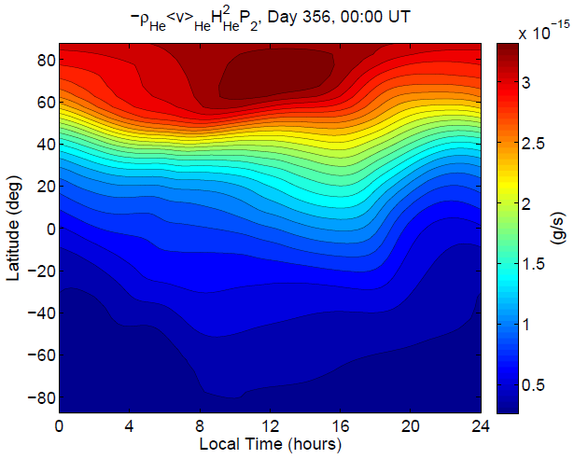
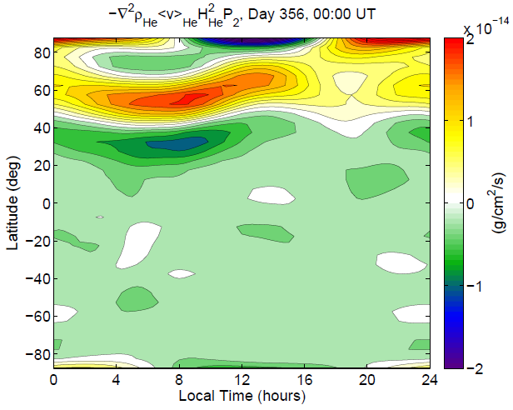
Upper Boundary Conditions
Non-Escaping Flux
Fit to a SH Expansion:
$$ρ\left\langle v\right\rangle H^{2}P_{2}$$
Synthesized from SH Expansion:
$$−∇^{2}\left(ρ\left\langle v\right\rangle H^{2}P_{2}\right)$$
Return
Flow

Slide 16
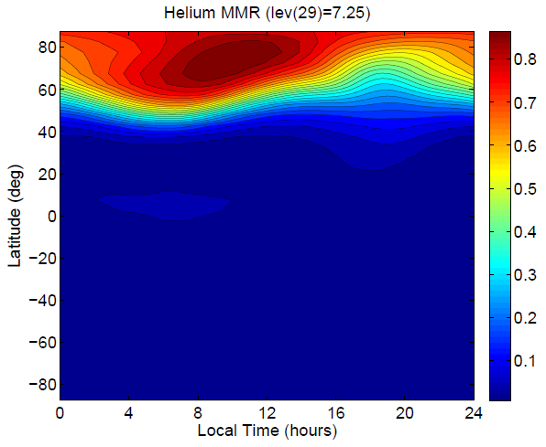
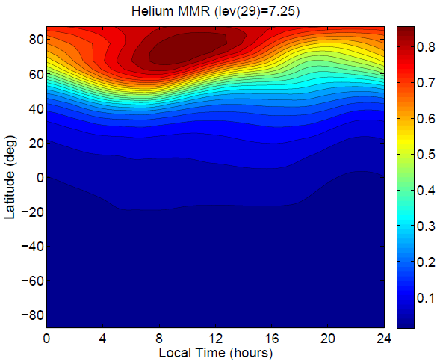
Upper Boundary Conditions
Non-Escaping Flux
Zero Diffusive
Flux UBC:
Accounting for
Non-Escaping Flux:
Exospheric return flow accounts for increased Helium away from the Winter Bulge region; gradients are smoothed.

Slide 17
Model Comparison
2008
Helium Movie

Slide 18
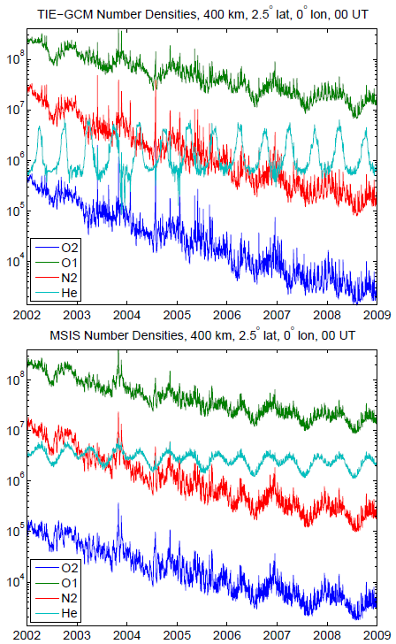
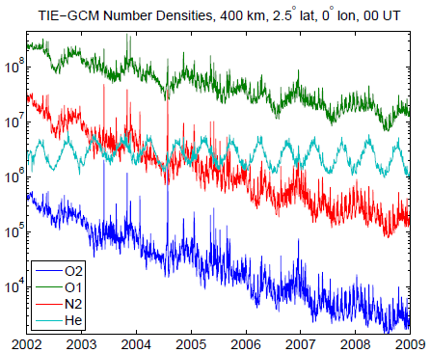
Solar Cycle Comparison
(near equator)
Zero Diffusive Flux UBC:
Non-Escaping Flux
UBC:
Steep Peaks during equinox, Low valleys during solstices
Less dramatic Peaks/Valleys. More consist-ent w/ MSIS
MSIS
Large annual oscillation in MSIS is not apparent in either version of TIE-GCM

Slide 19
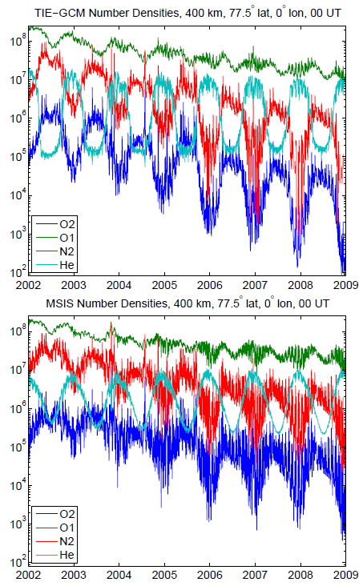
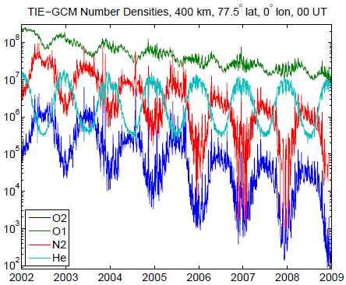
Solar Cycle Comparison
(near north pole)
Zero Diffusive Flux UBC:
Non-Escaping Flux
UBC:
Quick/steep transition during equinox
Slope is much more consistent w/ MSIS
MSIS

Slide 20
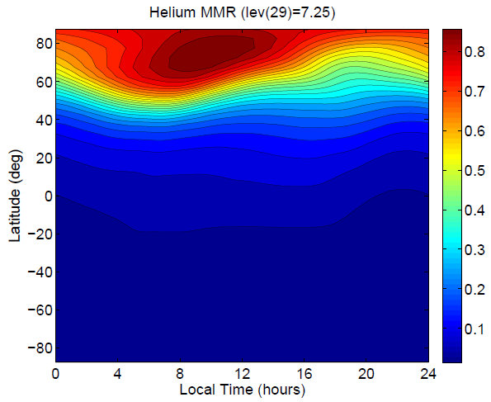
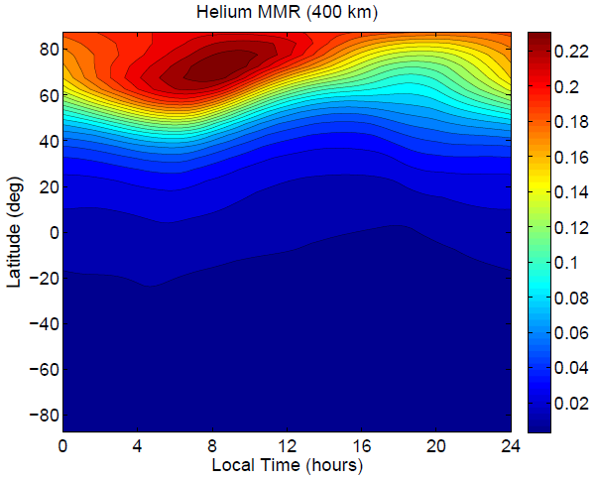
Helium Mass Mixing Ratio
Dec. 2008
Top Pressure Level ZP=7.25
Constant Altitude: 400 km
On a constant pressure MMR reaches
>0.8 in the winter hemisphere
Note: the geopotential is much higher
here because Helium increases the
scale height
At 400km, the MMR is reasonably
consistent with MSIS

Slide 21
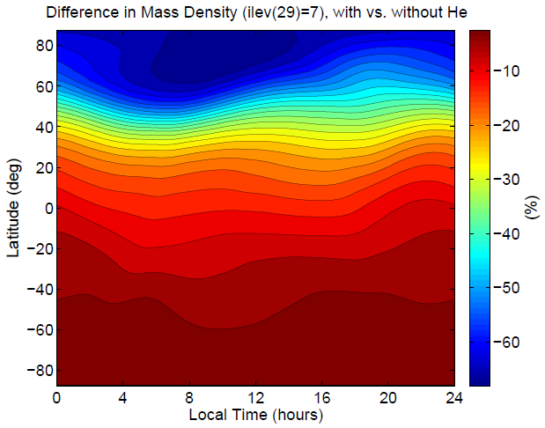
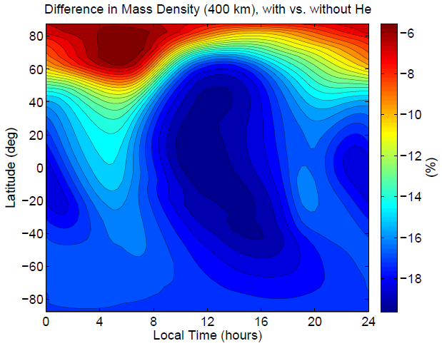
Difference in Mass Density
Dec. 2008
Top Pressure Level ZP=7.25
Constant Altitude: 400 km
On a constant pressure surface: $ρ∝\frac{\overline{m}}{T}$
Competing factors of $ρ, \overline{m}, T,$ and
geopotential height

Slide 22
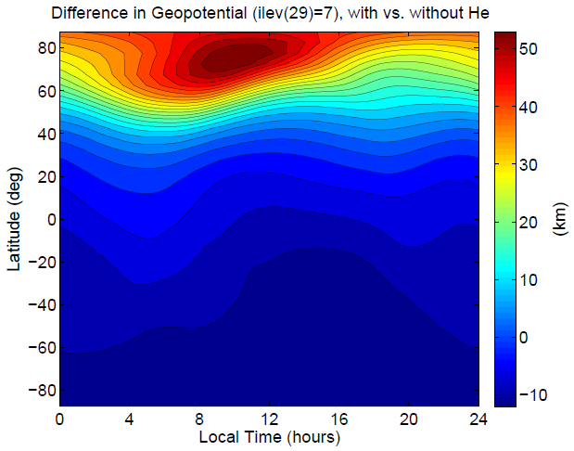
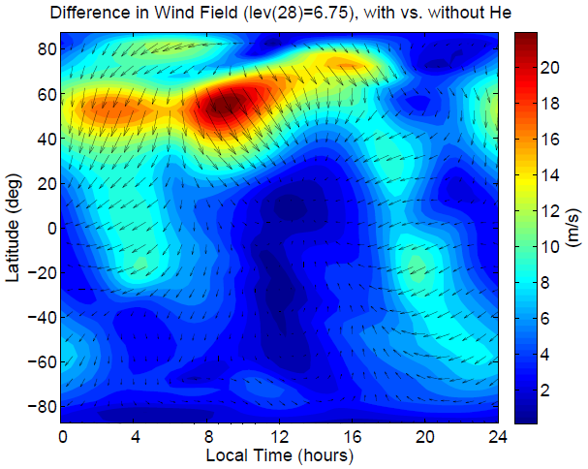
Difference in Geopot./Winds
Dec. 2008
Geopotential Difference
Top Pressure Level ZP=7.25
Horizontal Wind Difference
Near Top Pressure Level ZP=6.75
$$\frac{∂u}{∂t}=−\frac{1}{r\cos{φ}}\frac{∂Φ_{G}}{∂λ}+⋯$$
$$\frac{∂v}{∂t}=−\frac{1}{r}\frac{∂Φ_{G}}{∂φ}+⋯$$
$$\frac{∂Φ_{G}}{∂z}=\frac{RT}{m}$$
$$⇒$$

Slide 23
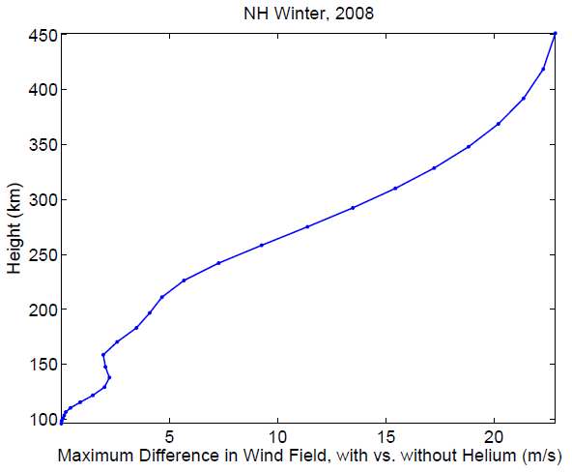
Global Max. Difference in Winds
Dec. 2008
Helium sets up a general winter-to-summer perturbation wind at high altitudes:
5 m/s @ 200km altitude
15-25 m/s above 300km altitude

Slide 24
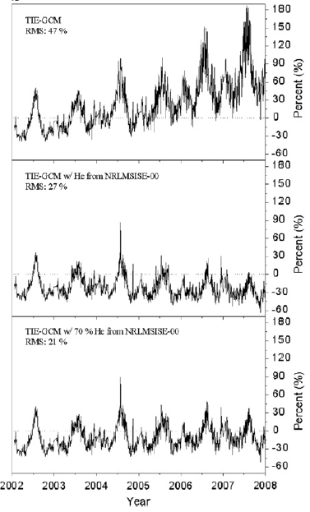
Revisit of
Kim et al. [2011] Study
Premise:
Using MSIS Helium, specific heat, thermal conductivity, and molecular viscosity is updated within TIE-GCM
Outcome:
RMS error with CHAMP density measurements improves from 47% to 21%

Slide 25
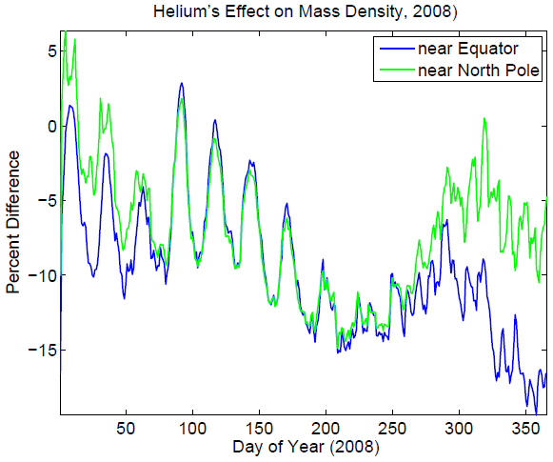
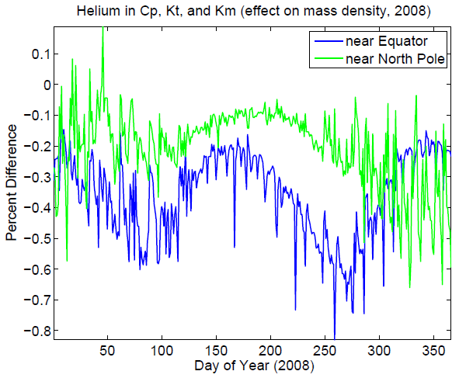
Revisit of
Kim et al. [2011] Study
Recalculating Mass Density after adding the effect of Helium on the mean mass (@ 400 km)
Recalculating Mass Density after adding the effect of Helium on Cp, Kt, Km (@ 400 km)
Largest Effect:
Helium’s effect on mass density via changes in mean mass/scale height are responsible for most of the differences
Smaller Effect:
Helium’s effect on mass density via changes thermodynamic properties or an order of magnitude less effective

Slide 26
Conclusions
Including Helium in TIE-GCM has significant implications on the:
Vertical structure,
Mass Density,
Geopotential height,
Winds, and
Seasonal and Local Time variations in the upper thermosphere
Changes due to thermodynamics alone (i.e. including helium in cp, kt, and km calculations) appear to be small
Implications on the E- and F-region ionosphere appear to be small initially, but need more attention

Slide 27
Future Development
Features to include/remedy:
Update photo-absorption and photoionization of Helium
Currently treated as excess N₂ by qrj.F (i.e., qrj.F is unmodified)
Change n2, and 1e-5 to ‘small’ (make ‘small’ global)
Quenchfactor=factor/(mbar*tn)
Check slant column/n2/mbar (chapman.F)
Check (settei.F) for n2 calculations
Update ion/neutral conductivities (lambdas.F?)
Update O+ ambipolar diffusion (diffuse subroutine?)
Check comp_n2d.F for mbar calculation
Check dt.F for n2/mbar calculations
Check aurora.F for n2

Slide 28
Future Development (con’t)
Features to include/remedy:
Add Production/Loss terms for Helium
Add minor neutrals/ions: He⁺, metastable He(2³S), others?
Add effects of helium to the time-dependent minor species equation (i.e. N(4S) and NO)
N₂ near upper boundary suffers from artificially low values during solstices in vicinity of winter helium bulge
Add ability to use MPI
Check for compliance with NCAR software standards
Start branch for TIE-GCM-Helium code
Validation

Slide 29
Questions?
Thank you NCAR for the invitation
and for a very productive week!

