Slide 1
Thermospheric General Circulation Models (TGCM’s)
Three-Dimensional Time-Dependent Numeric Simulation Models of the Earth’s Neutral Upper Atmosphere and Ionosphere
Brief History of Software Development
Current State of the Codes
Software Challenges and Development Goals
August 17, 2010
Ben Foster NCAR/HAO

Slide 2
R.G. Roble, R.E. Dickinson, E.C. Ridley
TGCM [1970’s]
TIGCM [1989]
TIEGCM [1991]
TIMEGCM
[1990s to present]
TIEGCM
[1990s to present]
CMIT
CAM
LFM
WACCM
Community Model
Community Model
Open source
(CCMC)
MOZART

Slide 3
Software Milestones (1990-2010)
Rewrote legacy code in standard-compliant f90, and ported to a variety of platforms.
1d, then 2d domain decomposition with MPI.
NetCDF history file i/o.
Coupled with CCM at lower boundary (TIMEGCM)
Double-Resolution (2.5 deg, 4 gr/sh).
Mars and Venus adaptations (Bougher, et.al.)
Coupled with LFM at CISM (TIEGCM)
Community release of TIEGCM to CCMC (Open-source with academic license agreement)

Slide 4
Current Model Configuration and Capabilities
TIEGCM
TIMEGCM
Approx 56K lines of f90, 84 source files under SVN control
97 km LB
5 deg, dz=0.5 (72K cells), or
2.5 deg, dz=0.25 (580K cells)
1-5 minute timestep
MPI only, lat x lon decomposition geo and mag
Netcdf history restart and diagnostic output files
IBM/AIX, Linux desktop, SGI
T,U,V,O2,O,N4S,NO,O+,N2D,TI,TE,NE,O2+,W,Z,POTEN
Approx 75K lines of f90, 107 source files under SVN control
30 km LB
5 deg, dz=0.5 (124K cells), or
2.5 deg, dz=0.25 (995K cells)
0.5 – 3 minute timestep
MPI only, lat x lon decomposition geo and mag
Netcdf history restart and diagnostic output files
IBM/AIX, Linux desktop, SGI
T,U,V,O2,OX,N4S,NOZ,CO,CO2,H2O,H2,HOX,O+,CH4,O21D,NO2,NO,O3,O,OH,HO2,H,N2D,TI,TE,NE,O2+,W,Z,POTEN
Infrastructure Support: csh and perl scripts, IDL and f90 post-proc and visualization
http://www.hao.ucar.edu/modeling/tgcm/

Slide 5
Software Issues and Challenges
Model/Regime coupling
Loose coupling: separate execs, exchange disk data (GSWM in TGCMs).
Tight coupling: separate execs, under control of a mediary (TIEGCM in CMIT)
Host model incorporation: single exec, new module.(Heelis in TIEGCM)
Transfer of regime physics and dynamics into the software structure of a host model (TIMEGCM to WACCM)
Disparate temporal scales and spatial geometries (TIEGCM in CMIT)
Regime boundary transition (spatial, chemical, dynamic)
Efficient use of the hardware (e.g., load-balancing, memory structure)
Seamless in science, separate in software..

Slide 6
Software Issues and Challenges
Parallelization, performance
Distributed and/or shared memory (MPI, PVM or OpenMP)
Domain decomposition (tgcm: lat x lon in geographic and magnetic coords)
Scaling (tgcm scales only to 32 or 64 processors, due to serial dynamo)
Amdahl’s law: max speedup = 1/((1-P)+P/N) (a 3% serial code will never achieve better than 3x speedup (must strive to minimize % of code that is serial)
Hardware architecture is trending toward large numbers of commodity chips, and away from small numbers of specialized vector processors. Software must be able to scale up in this environment. Also consider GPUs, but they have limitations as well.
Significant software effort is required to optimize a problem for different hardware configurations, while maintaining portability.

Slide 7
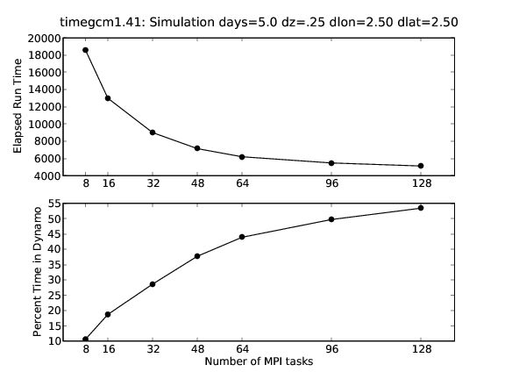
Speedup curve (top) for 5-day runs of timegcm at 2.5 deg resolution.
Percentage of wall-clock time spent in serial dynamo (bottom) demonstrates
how Amdahl’s Law limits scalability, and the importance of 100% parallel code

Slide 8
Software Issues and Challenges, cont.
Data assimilation/data drivers
Observations are used to provide initial conditions or to dynamically drive global models, but are inherently limited in space and time.
Measurements of or proxies for physical properties guide primitive equations and parameterizations used to advance the simulation.
Integration of observational data with background state of numerical models
TIMEGCM optionally uses NCEP and ECMWF data for lower boundary conditions, and solar flux/wind data to drive ionospheric dynamics.
Model benchmarking and Community support
Use SVN to provide timely updates, bug fixes, developer team coordination
Standard control runs per revision provide restart files and benchmark simulations (TIEGCM1.93 benchmark runs)
Providing model source, supporting scripts, data files, documentation, and analysis tools to the scientific community requires a considerable ongoing personnel effort.

Slide 9
Software Issues and Challenges, cont
High resolution modeling
High spatial and temporal resolution is required to resolve sub-grid scale ionospheric variability, gravity waves, thermal tides, and auroral processes.
Increasing resolution requires tuning of parameterizations
Implications for performance, memory scalability, storage, and post-processing and analysis
Parallel I/O: reorganize memory for efficient i/o
Libraries vs source code
Keep number of large libs down (tgcm: netcdf,MPI,ESMF)
Incorporate source code for targeted purposes (e.g., FFT)
Raises portability and maintenance issues

Slide 10
WACCM-X neutral species density above about 100 km is made
possible through transfer of TIMEGCM physics, dynamics and
chemistry into the WACCM software structure.

Slide 11
WACCM-X ionosphere is made possible through careful transfer
of TIMEGCM physics, dynamics and chemistry into the WACCM
software structure.

Slide 12
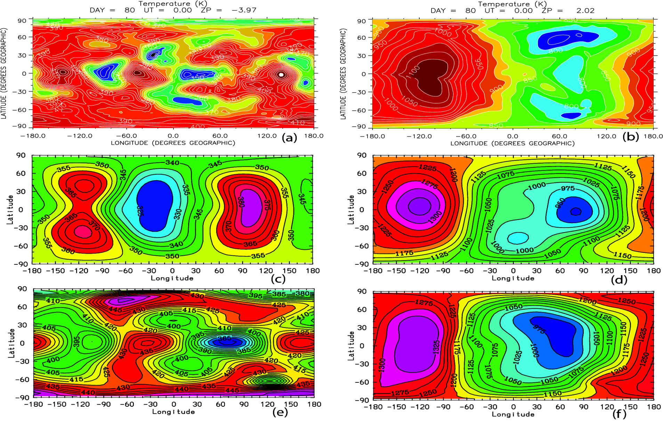
~125 km
~300 km
WACCMX
MSIS
TIEGCM
Wave structure of thermal tides in the lower thermosphere is resolved in WACCM-X by introduction of TIEGCM/TIMEGCM physics and dynamics of the MLT system.

Slide 13
