Slide 1
Recent Development Progress in TIEGCM
(Towards Release of v2.0)
Modification of FFT filtering at 2.5-degree resolution (r1010, Jan, 2014)
Helium as a major composition species, 5-deg res (r1013, Feb, 2014)
Parallel dynamo, with ESMF regridding (r1027, Mar, 2014)
Improved automation of test suites (Apr, 2014, and ongoing)
Helium at 2.5-degree resolution (working, but not yet committed)
Impose floor on O+ at low-lat above zp 2.5 for storm conditions (discussion)

Slide 2
Discussion (O+, He in storm conditions)
During a 2.5-deg simulation of the December, 2006 storm, near-zero electron density and consequent unrealistic high electron temperatures occurred at low-latitudes near the top of the model, resulting in numerical instability (NaNs) when calculating ambipolar diffusion velocities.
To apply a bandaid to the above symptom, we imposed a floor of 100 particles on O+ between +/- 15 degrees latitude above the zp=2.5 pressure level.
Preliminary results show improved stability (fewer NaNs), but the root cause of course still persists. See attached plots.
December, 2006 “AGU” storm: Peak Kp=8.5, Hp=250 GW
TIEGCM simulation: GPI (f10.7), Weimer potential model, step=30 seconds.

Slide 3
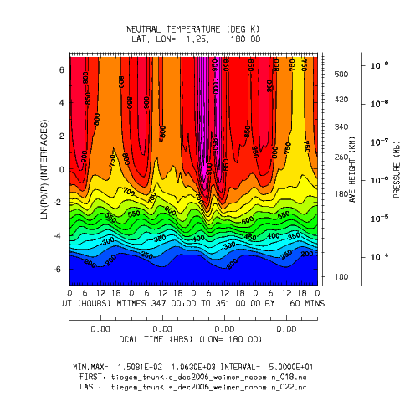
Ut (days 347-350) vs Zp
TN at latitude -1.25
Day 349 (Dec 15, 2006)
Min,Max=150,1063

Slide 4
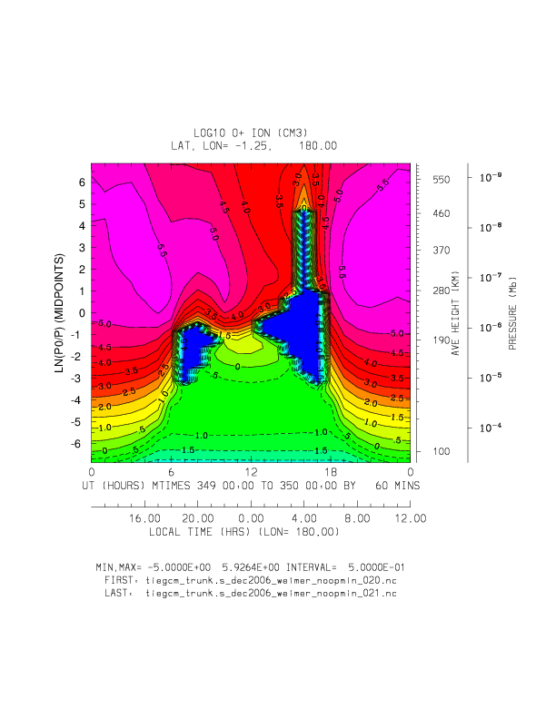
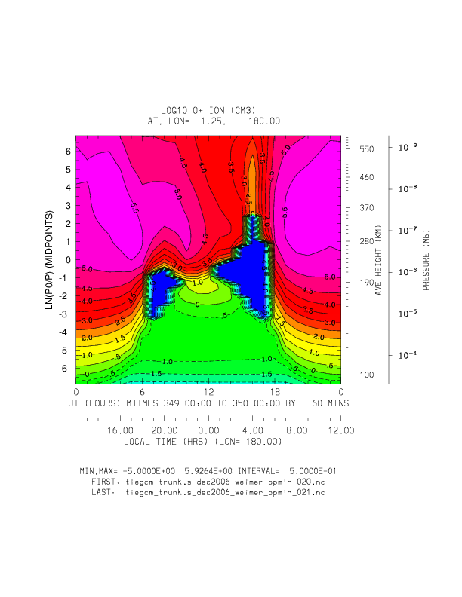
Ut (day 349) vs Zp
Log10 O+ at latitude -1.25
Without O+ minimum
With O+ minimum
+/- 15 deg latitude, zp >= 2.5

Slide 5
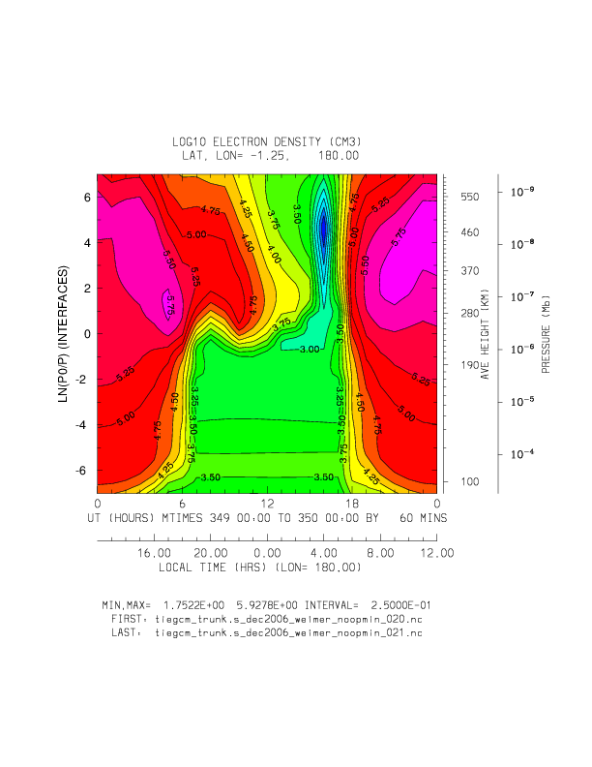
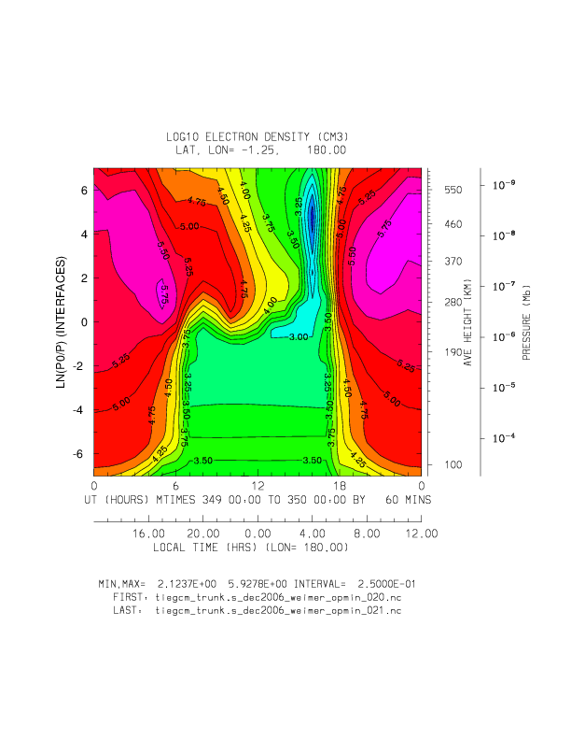
Ut (day 349) vs Zp
Log10 Ne at latitude -1.25
Without O+ minimum
(min,max=1.7,5.9)
With O+ minimum
(min,max=2.1,5.9)

Slide 6
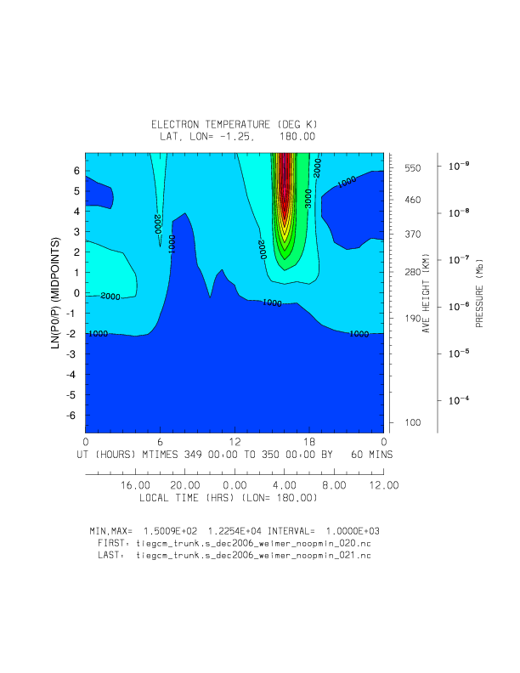
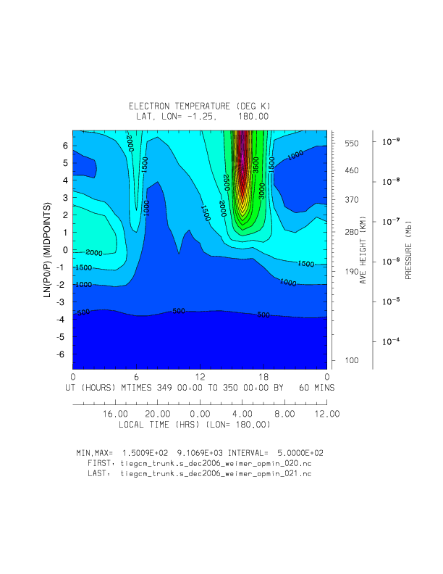
Ut (day 349) vs Zp
Te at latitude -1.25
Without O+ minimum
(min,max=150,12250)
With O+ minimum
(min,max=150,9100)

Slide 7
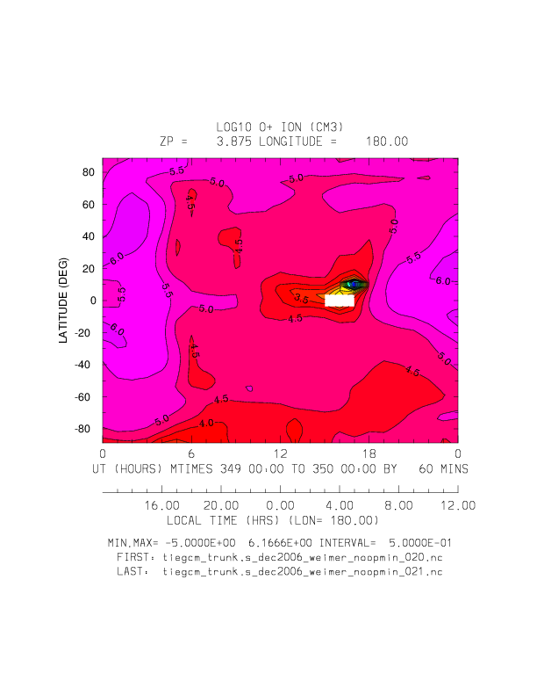
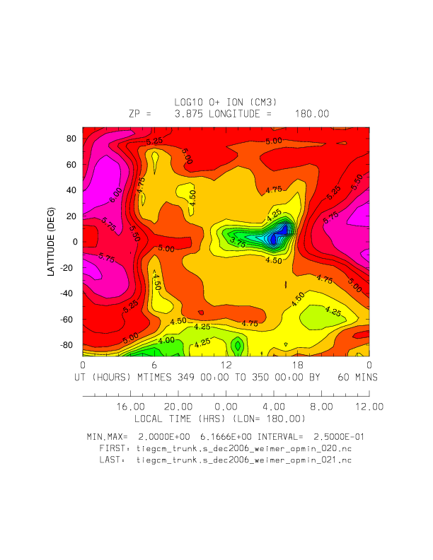
Ut (day 349) vs Latitude
Log10 O+ at Zp=3.875
Without O+ minimum
(min,max=-5.0,6.2)
With O+ minimum
(min,max=2.0,6.2)

Slide 8
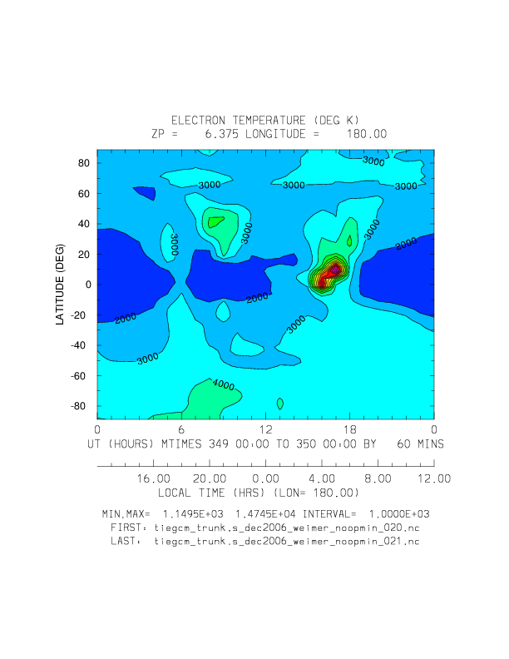
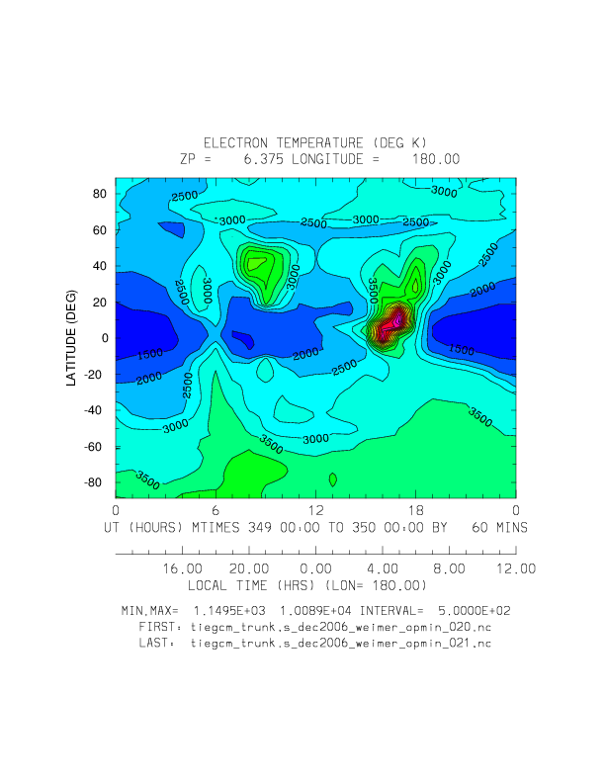
Ut (day 349) vs Latitude
Electron Temperature at Zp=6.375
Without O+ minimum
(min,max=1150,14745)
With O+ minimum
(min,max=1150,10090)

Slide 9
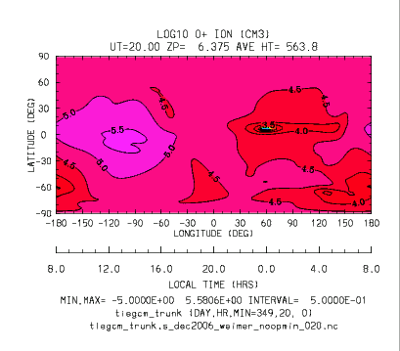
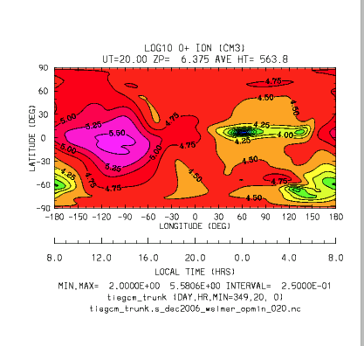

Slide 10
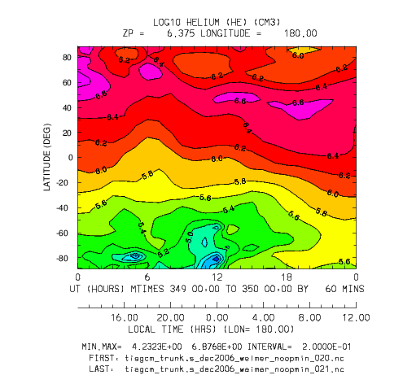
UT (day 349) vs Latitude
Log10 Helium at Zp=6.375
Min,Max=4.2,6.8

Slide 11
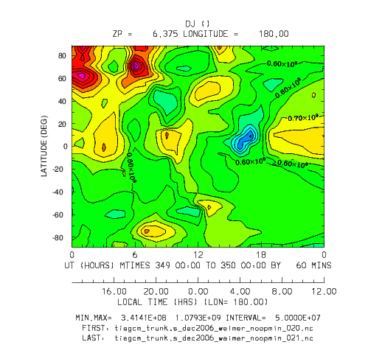
UT (day 349) vs Latitude
DJ (ambipolar diffusion) at Zp=6.375
Min,Max = 3.4E+8, 1.0E+9

Slide 12
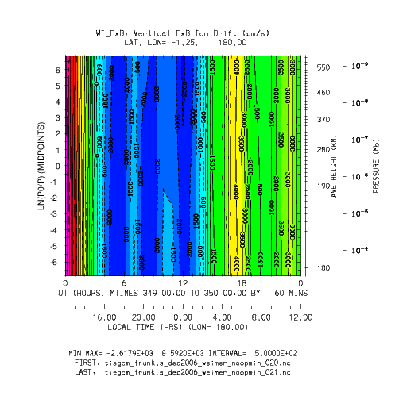
UT (day 349) vs ZP
WI ExB at latitude -1.25
Min,Max=-2617,8592

