Slide 1
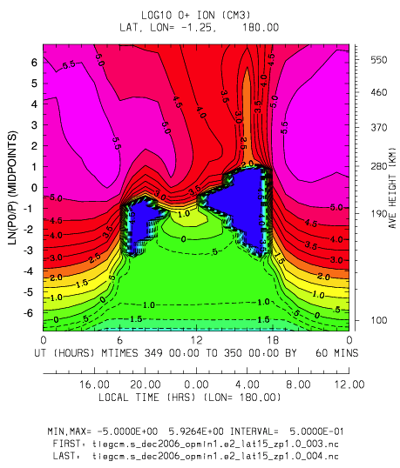
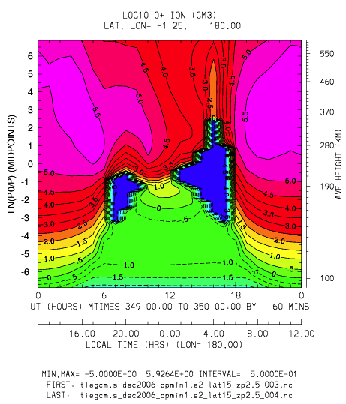
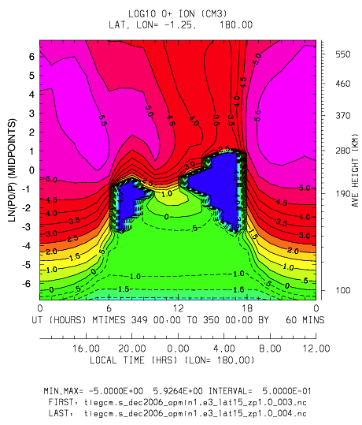
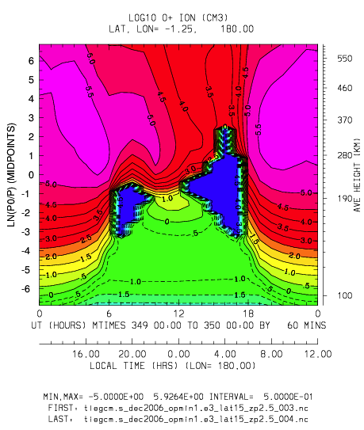
Log10 O+: -5->5.9 (all)
Min 1.e2
Zp 1.0
Min 1.e2
Zp 2.5
Min 1.e3
Zp 1.0
Min 1.e3
Zp 2.5
Notes:
Log10 O+: ut vs zp at latitude -1.25 (min,max all = -5,5.9)
Top left: O+ min=1.e2, zp >= 1.0
Top right: O+ min=1.e2, zp >= 2.5
Bottom left: O+ min=1.e3, zp >= 1.0
Bottom right: O+ min=1.e3, zp >= 2.5

Slide 2
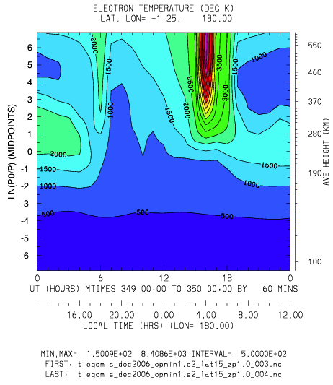
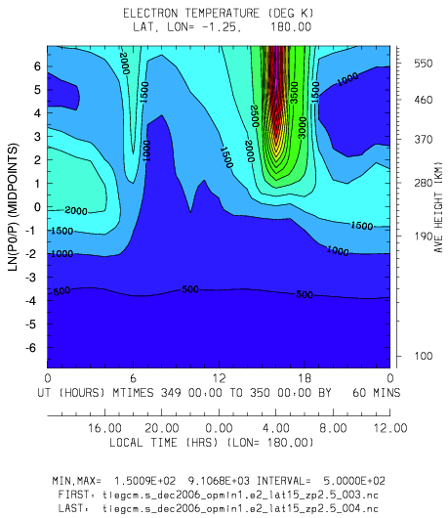
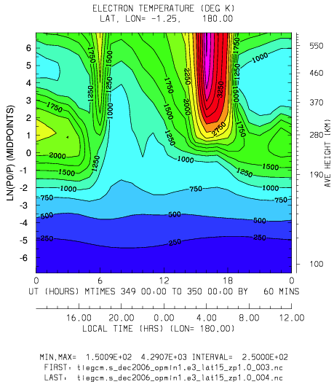
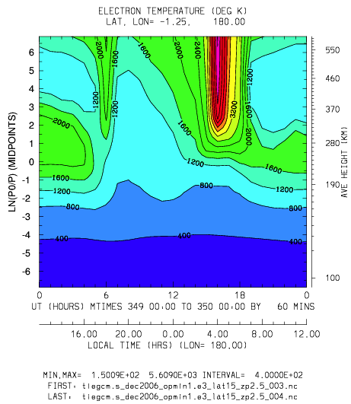
Te: 150-8408
Te: 150-9106
Min 1.e2
Zp 1.0
Min 1.e2
Zp 2.5
Te: 150-4290
Te: 150-5609
Min 1.e3
Zp 1.0
Min 1.e3
Zp 2.5
Notes:
Te: ut vs zp at latitude -1.25
Top left: O+ min=1.e2, zp >= 1.0 (min,max=150,8408)
Top right: O+ min=1.e2, zp >= 2.5 (min,max=150,9106)
Bottom left: O+ min=1.e3, zp >= 1.0 (min,max=150,4290)
Bottom right: O+ min=1.e3, zp >= 2.5 (min,max=150,kjjkk5609)

Slide 3
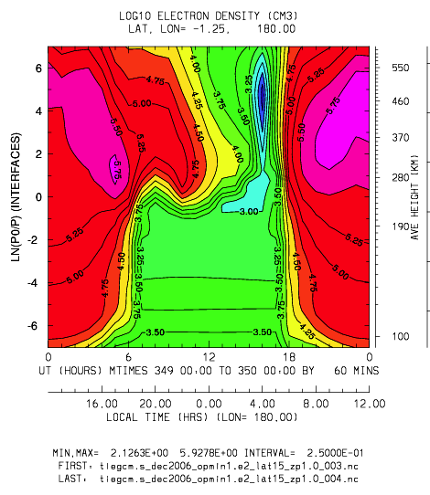
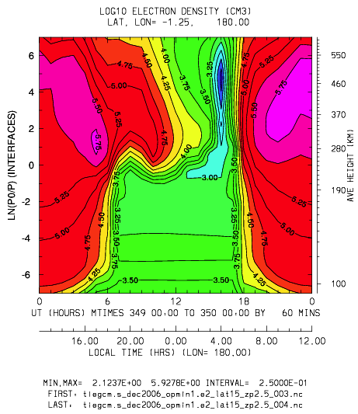
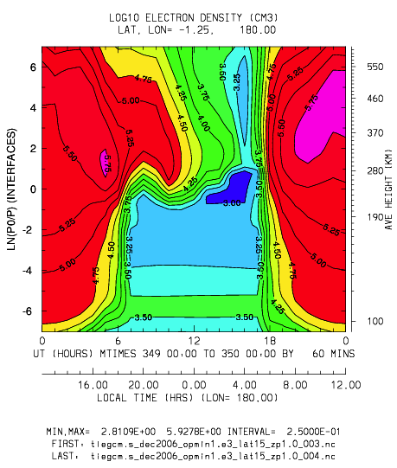
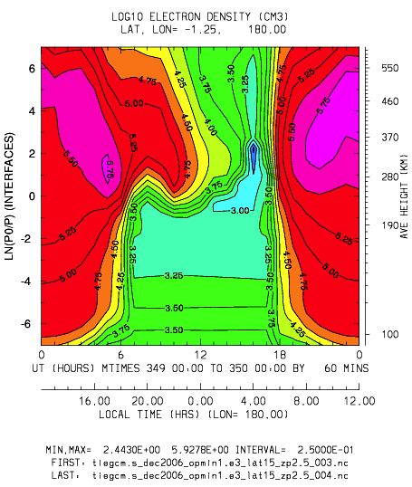
Log10 Ne: 2.1-5.9
Log10 Ne: 2.1-5.9
Min 1.e2
Zp 1.0
Min 1.e2
Zp 2.5
Log10 Ne: 2.8-5.9
Log10 Ne: 2.4-5.9
Min 1.e3
Zp 1.0
Min 1.e3
Zp 2.5
Notes:
Log10 Ne: ut vs zp at latitude -1.25
Top left: O+ min=1.e2, zp >= 1.0 (min,max=2.1,5.9)
Top right: O+ min=1.e2, zp >= 2.5 (min,max=2.1,5.9)
Bottom left: O+ min=1.e3, zp >= 1.0 (min,max=2.8,5.9)
Bottom right: O+ min=1.e3, zp >= 2.5 (min,max=2.4,5.9)

Slide 4
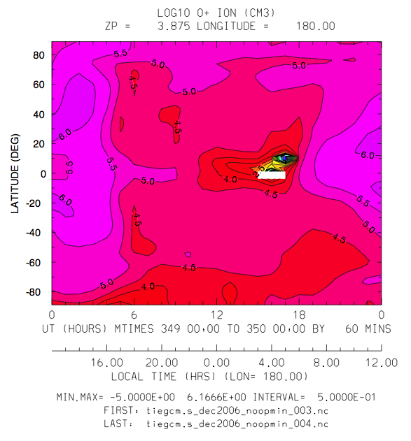
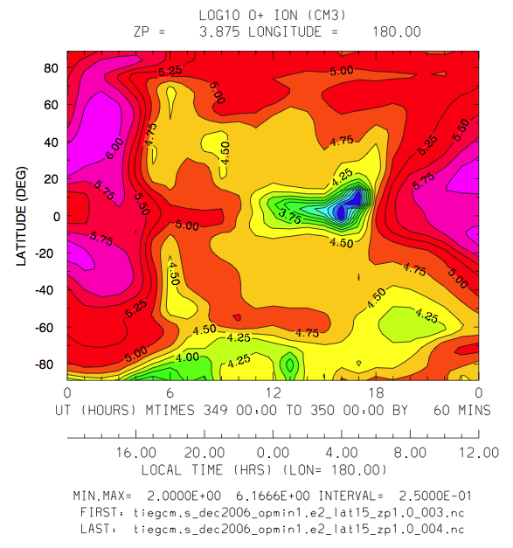
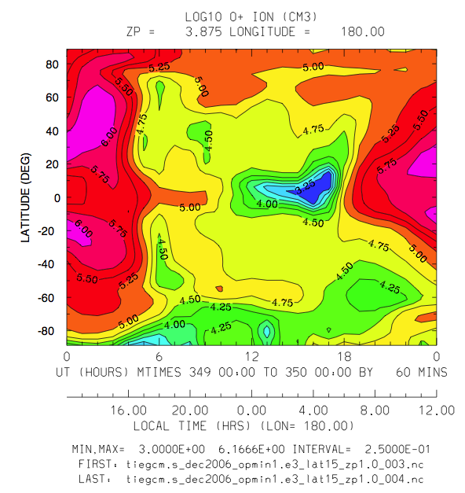
Log10 O+
No opmin
(-5->6.1)
Log10 O+
1.e2_zp1.0
(2->6.1)
Log10 O+
1.e3_zp1.0
(3->6.1)
Notes:
Log10 O+: ut vs latitude at Zp=3.8
Top: No O+ minimum (min,max=-5,6.1)
Left: opmin=1.e2, Zp >= 1.0 (min,max=2,6.1)
Right: opmin=1.e3, Zp >= 1.0 (min,max=3,6.1)

Slide 5
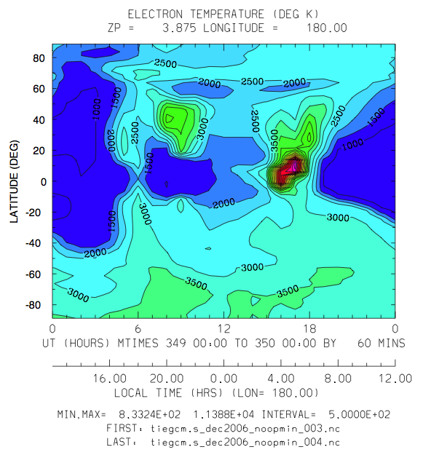
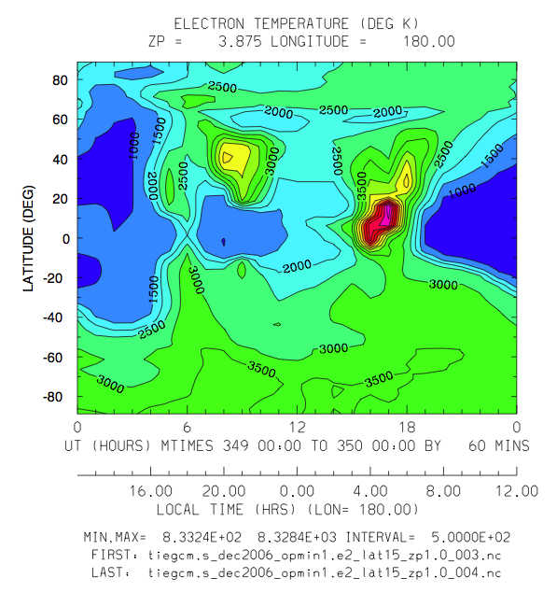
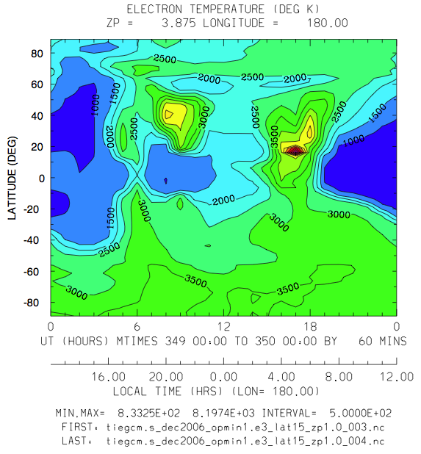
TE
No opmin
(833-11,388)
TE
1.e2_zp1.0
(833-8,328)
TE
1.e3_zp1.0
(833-8,197)
Notes:
Te: ut vs latitude at Zp=3.8
Top: No O+ minimum (min,max=833,11388)
Left: opmin=1.e2, Zp >= 1.0 (min,max=833,8328)
Right: opmin=1.e3, Zp >= 1.0 (min,max=833,8197)

Slide 6
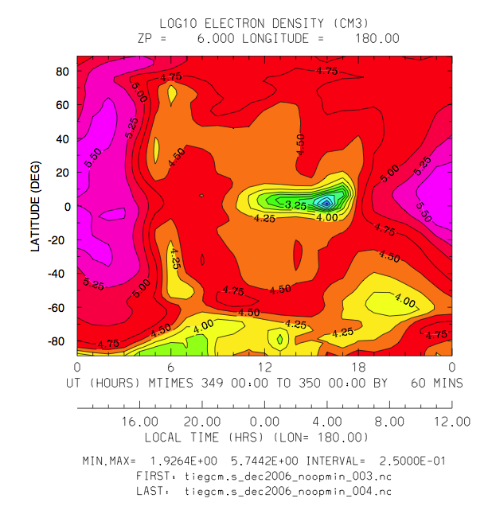
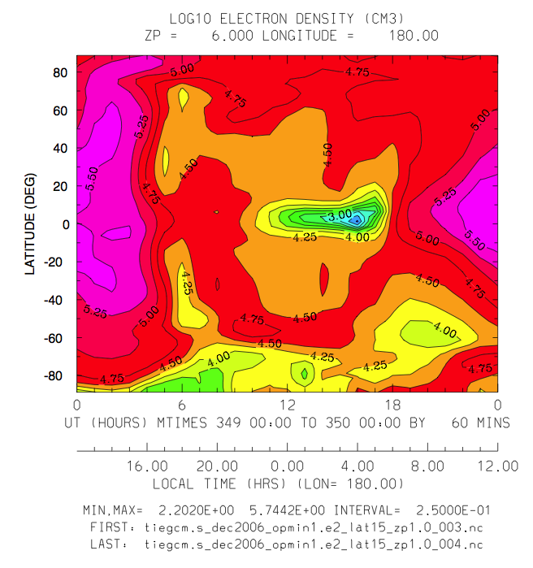
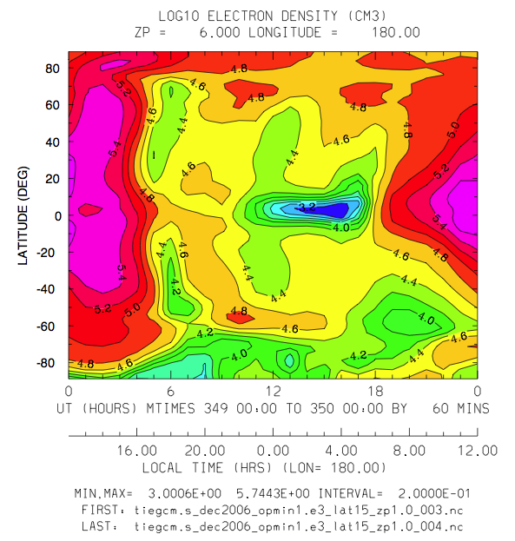
Log10 Ne
No opmin
(1.9-5.7)
Log10 Ne
1.e2_zp1.0
(2.2-5.7)
Log10 Ne
1.e3_zp1.0
(3.0-5.7)
Notes:
Log10 Ne: ut vs latitude at Zp=6.0
Top: No O+ minimum (min,max=1.9,5.7)
Left: opmin=1.e2, Zp >= 1.0 (min,max=2.2,5.7)
Right: opmin=1.e3, Zp >= 1.0 (min,max=3.0,5.7)

