Slide 1
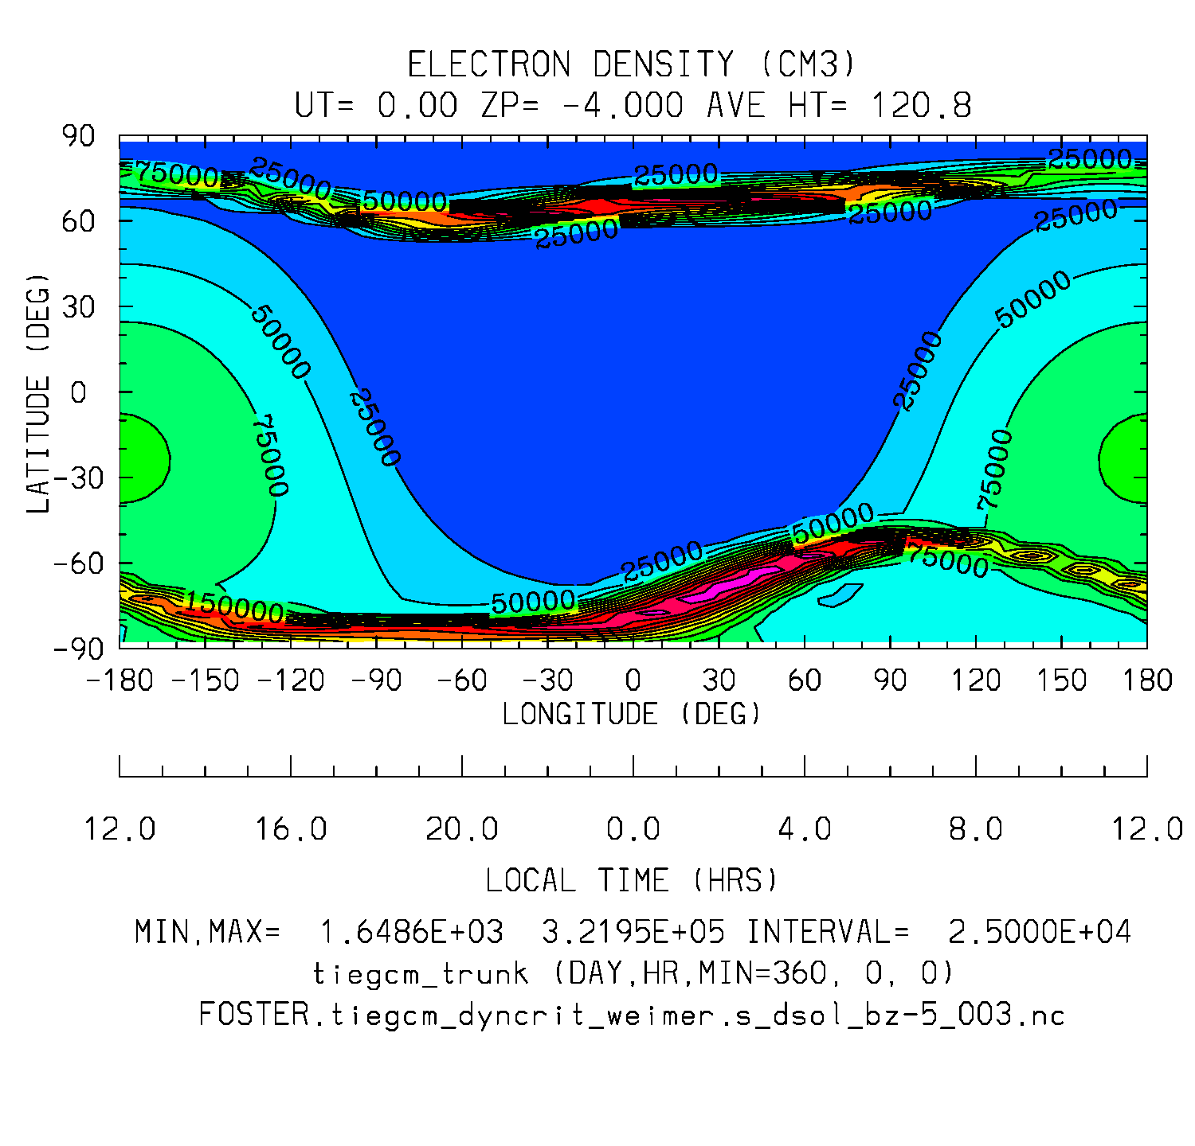
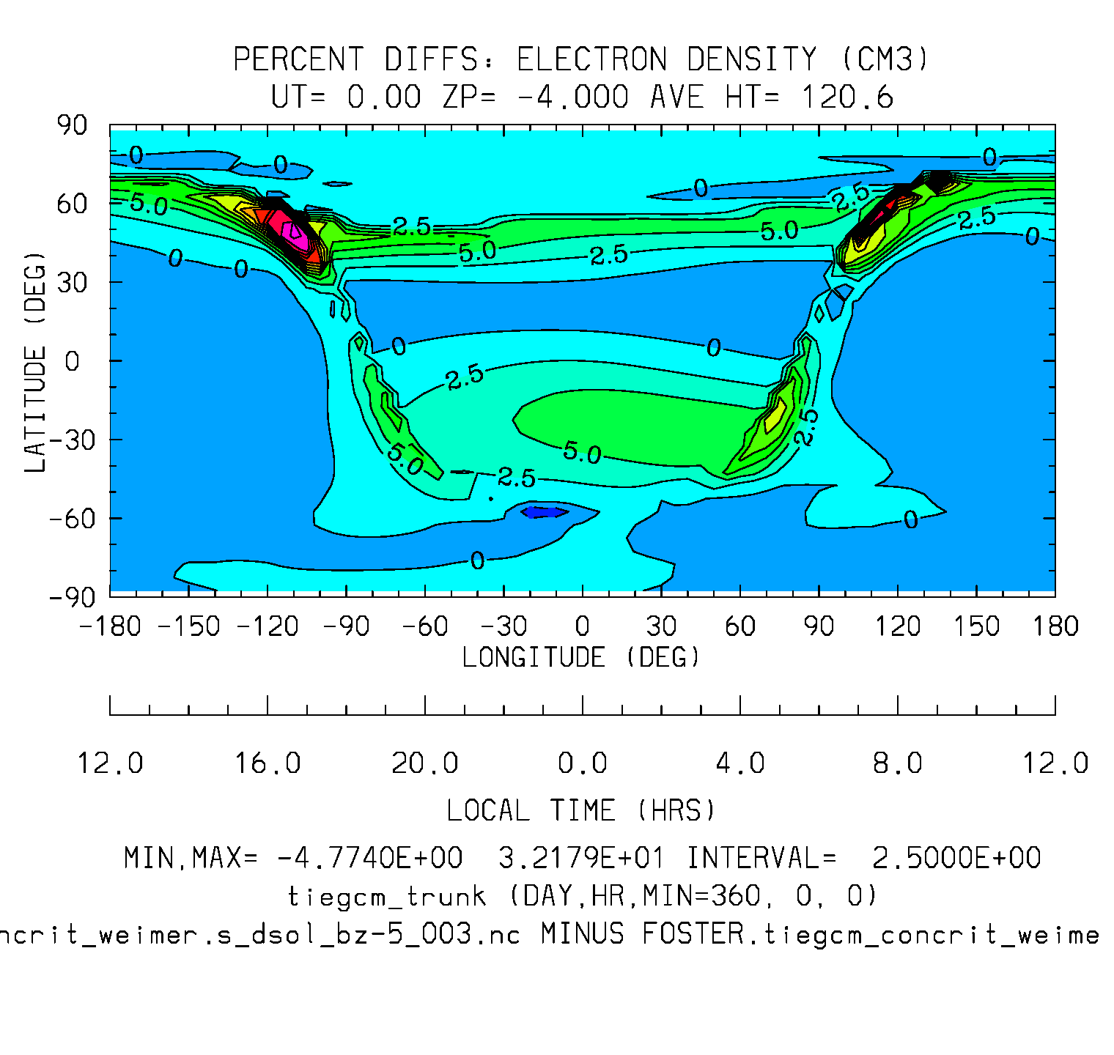
NE zp-4 dsol Full-field
NE zp-4 dsol %diffs
Min,Max = 1.6e3, 3.2e5
Interval = 2.5e4
Min,Max = -4.8, 32.2
Interval = 2.5

Slide 2
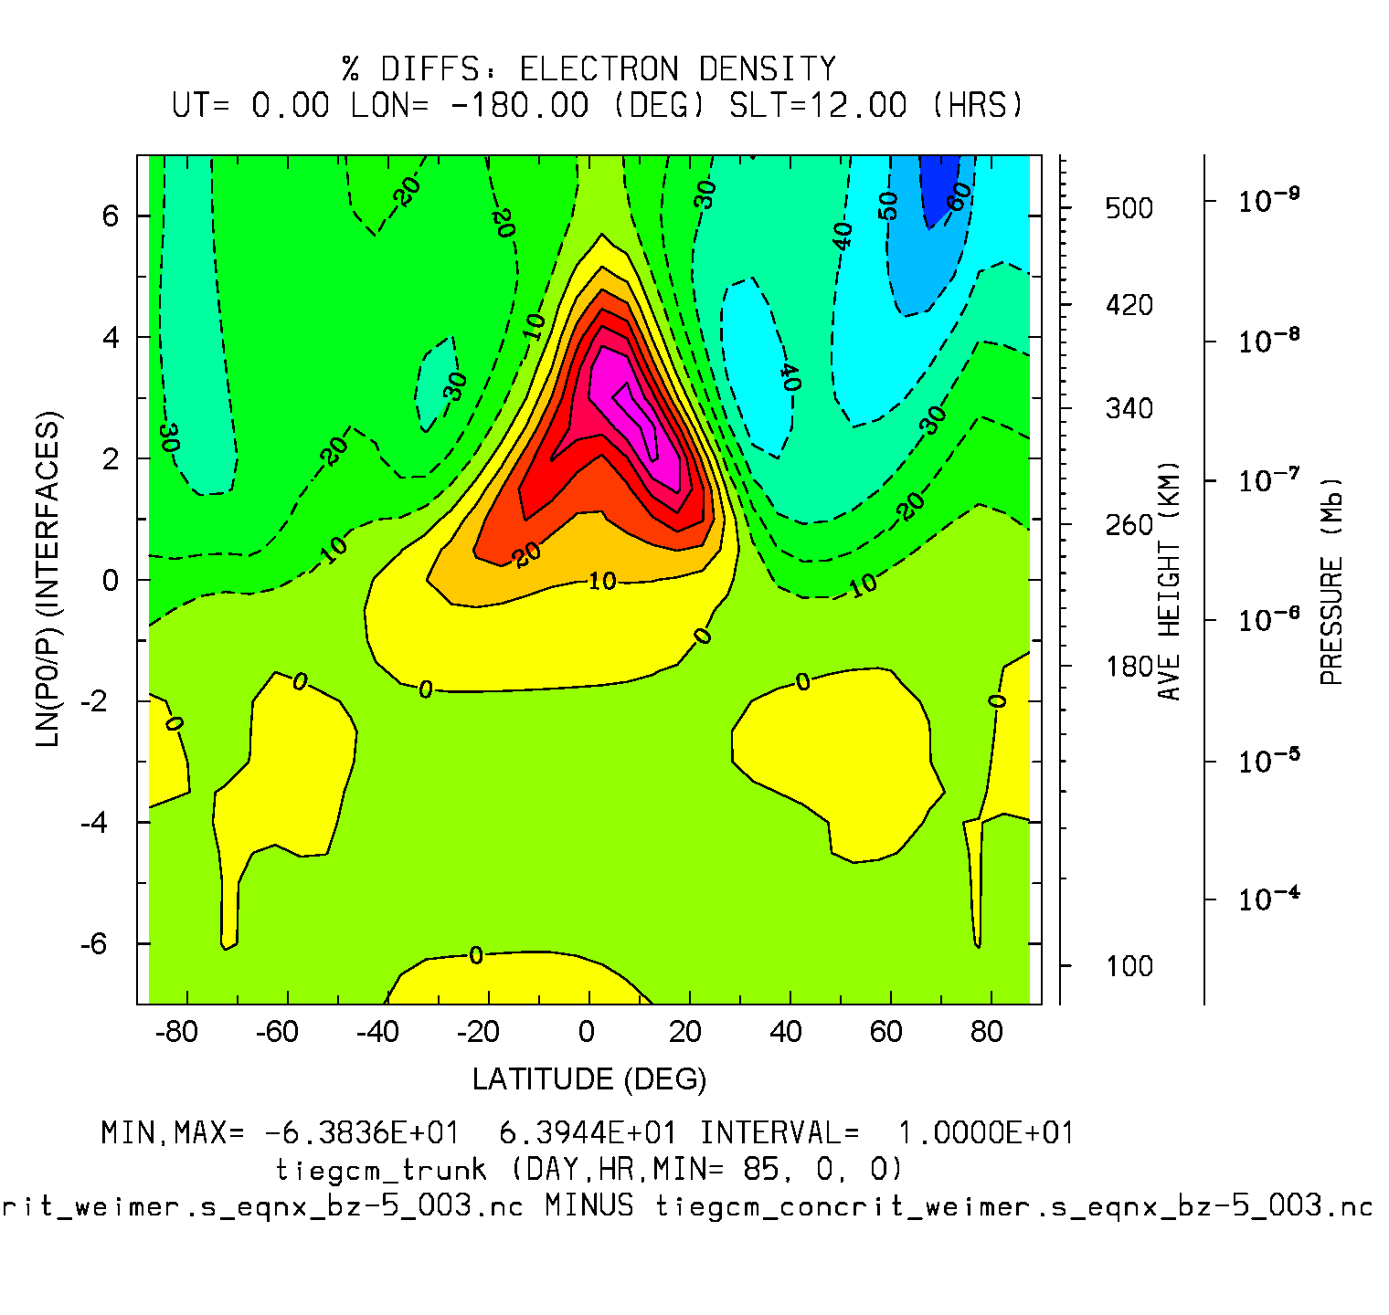
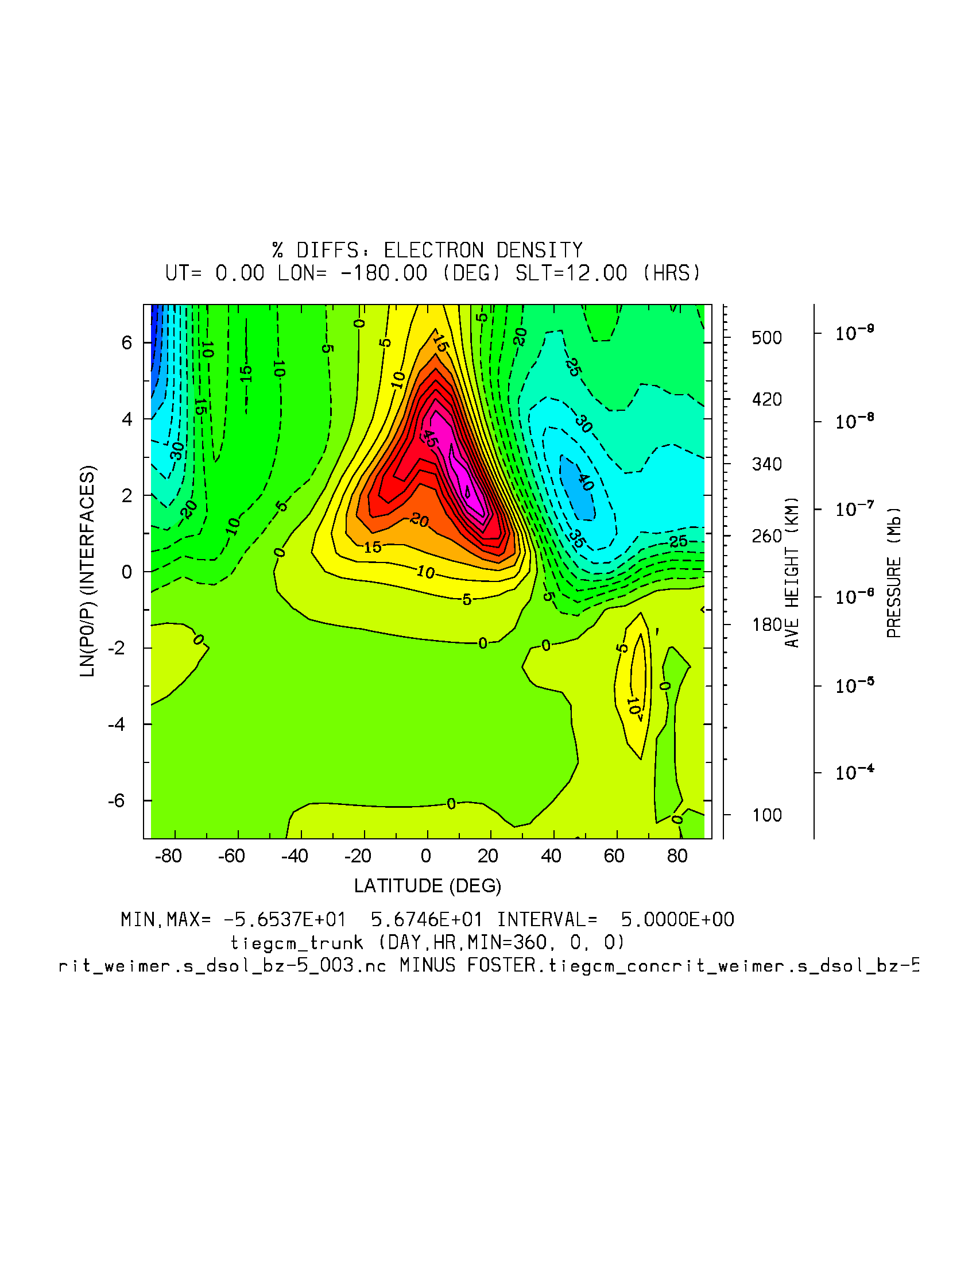
NE eqnx %diffs slt12
NE dsol %diffs slt12
Min,Max = -63.8, 63.9
Interval = 10.
Min,Max = -56.5, 56.7
Interval=5.

Slide 3
Weimer BZ=-5
dyncrit
-1.5e4,8.e3
concrit
-1.5e4,7.2e3
Diffs: -2.5e3, 4.7e3

Slide 4
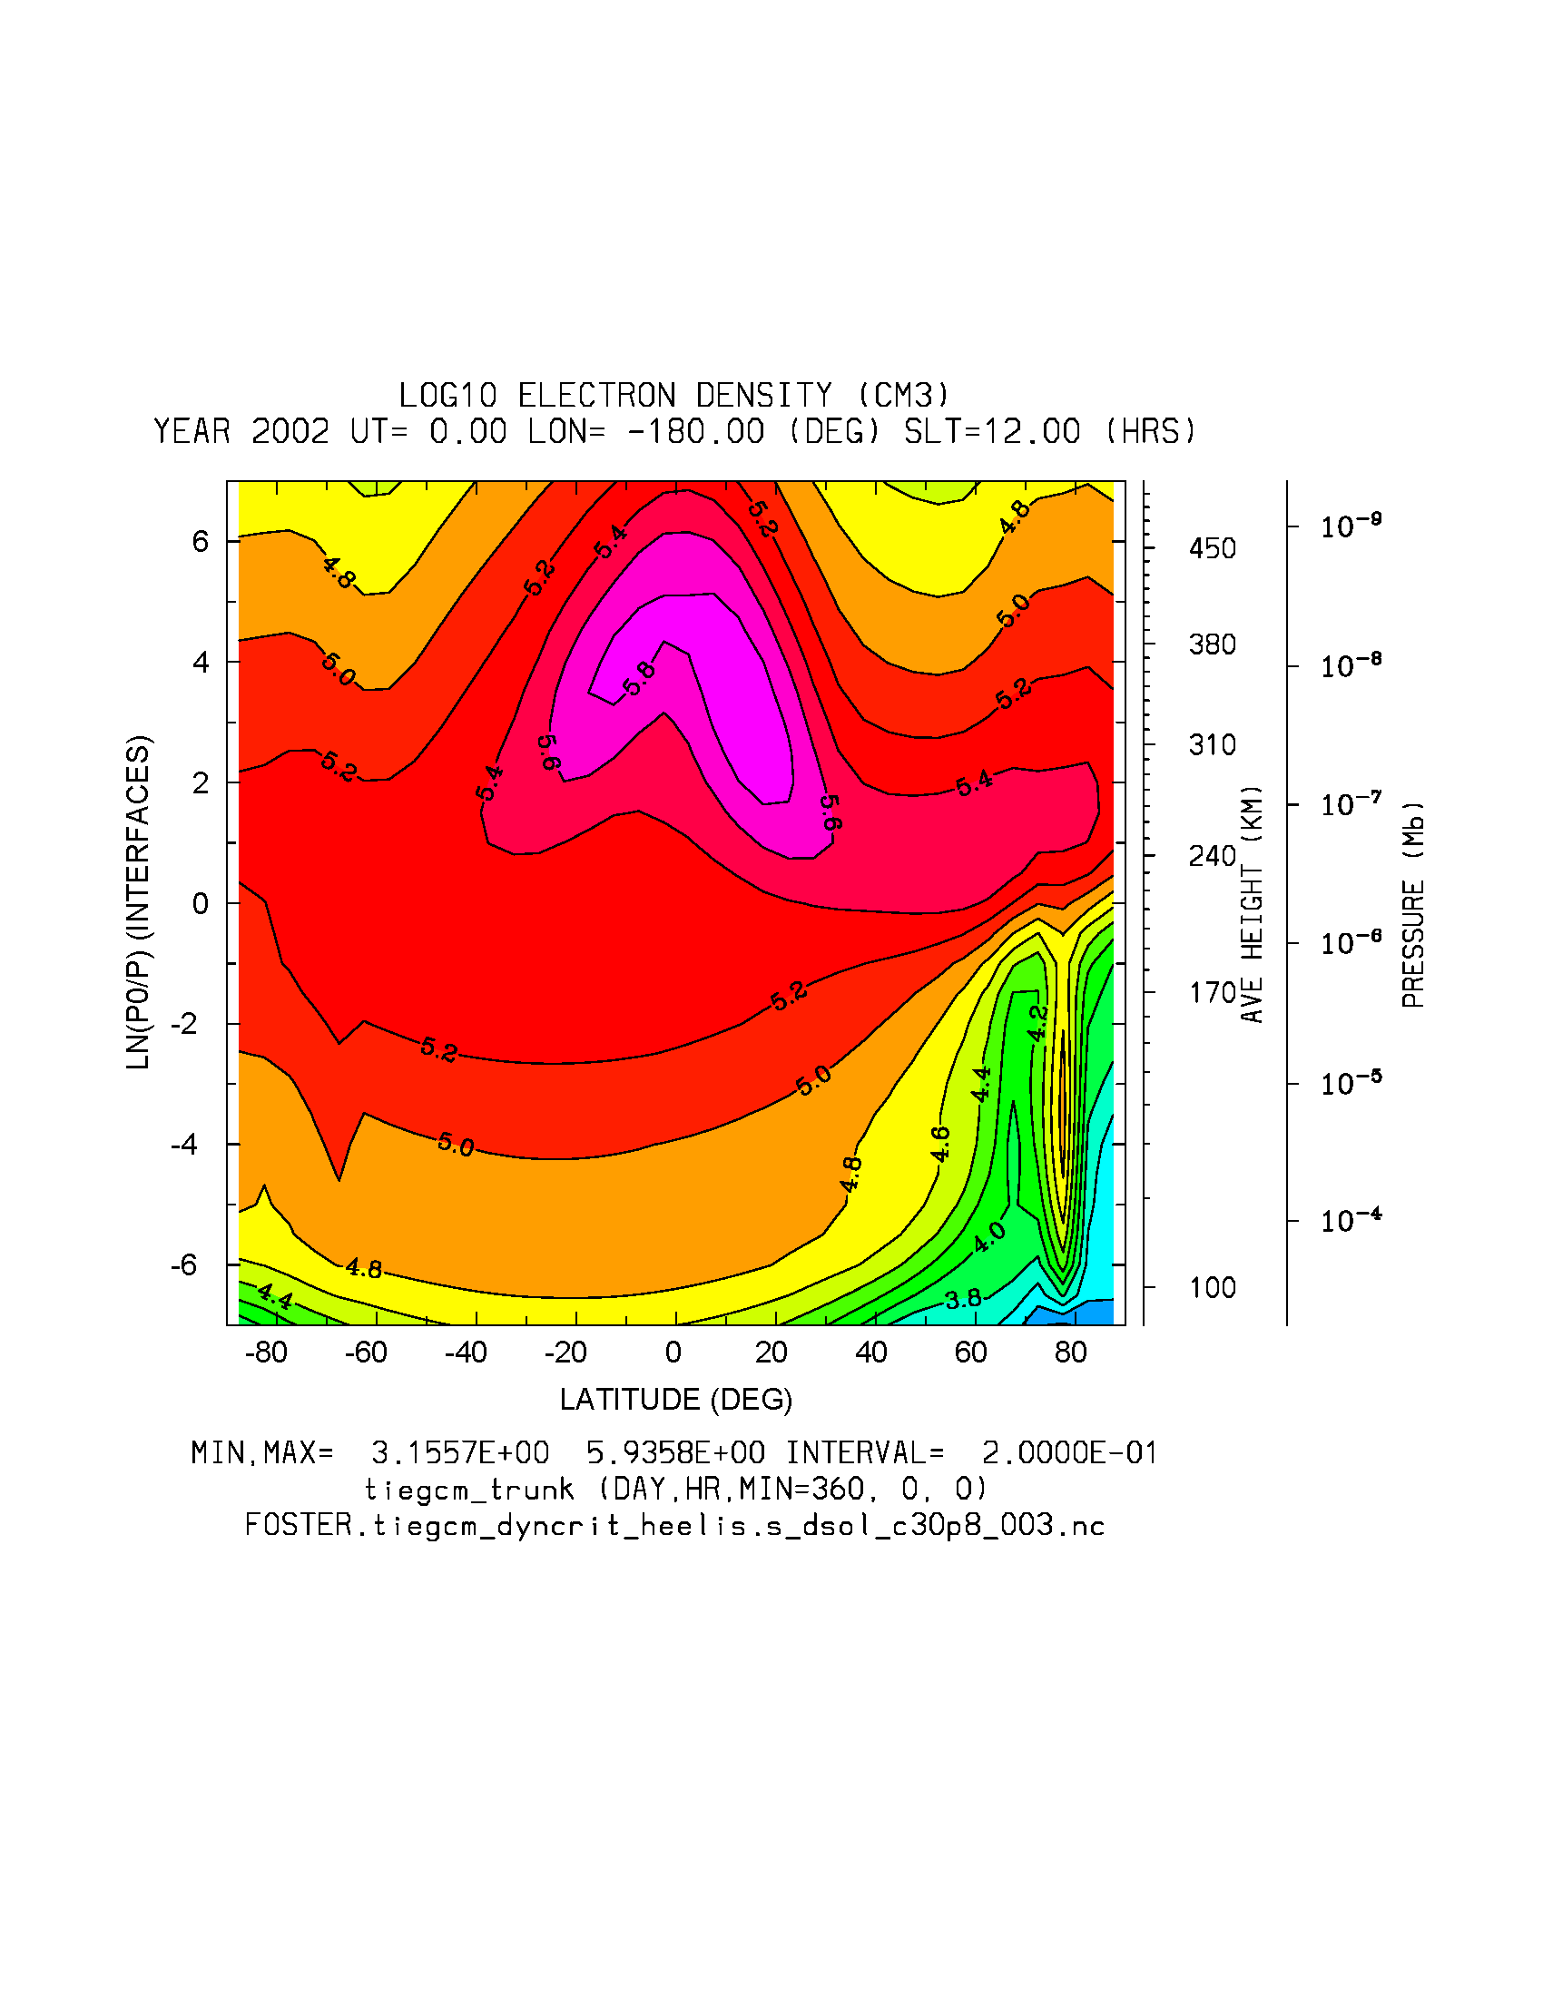
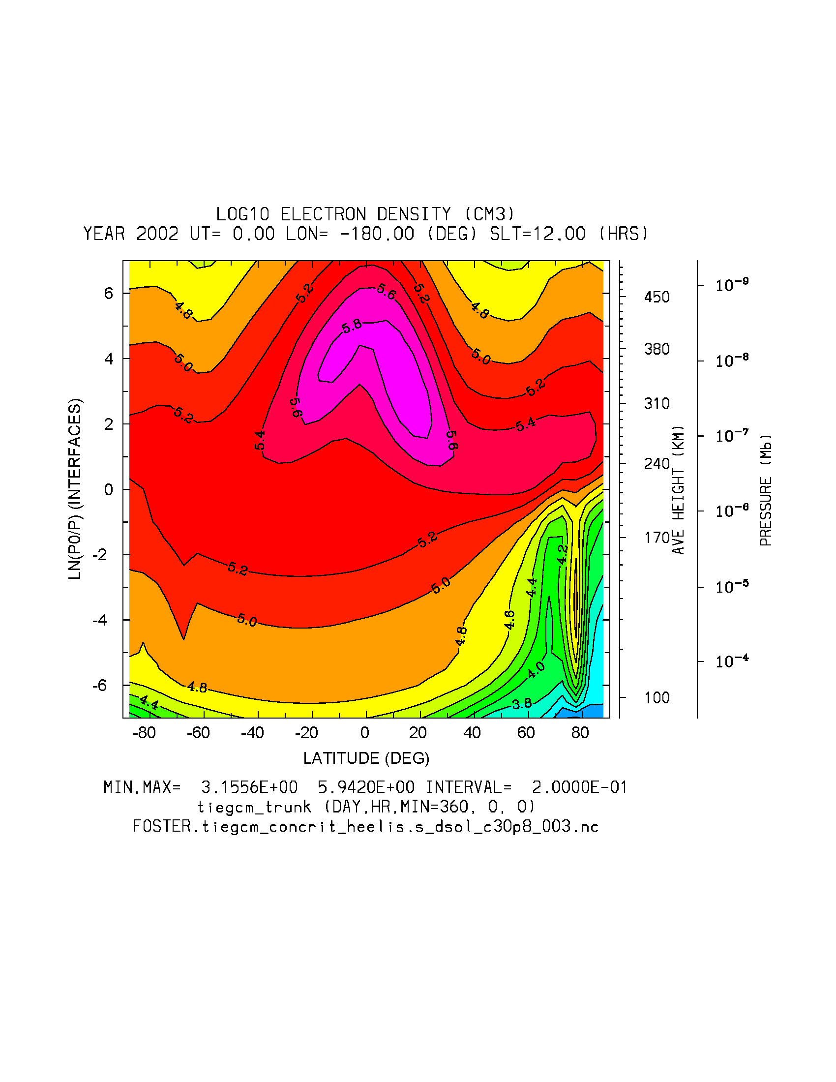
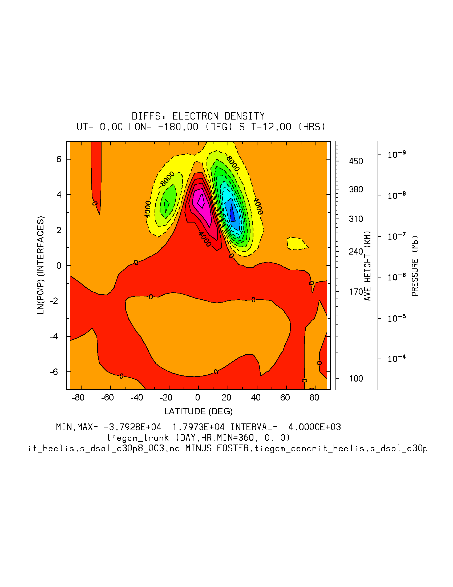
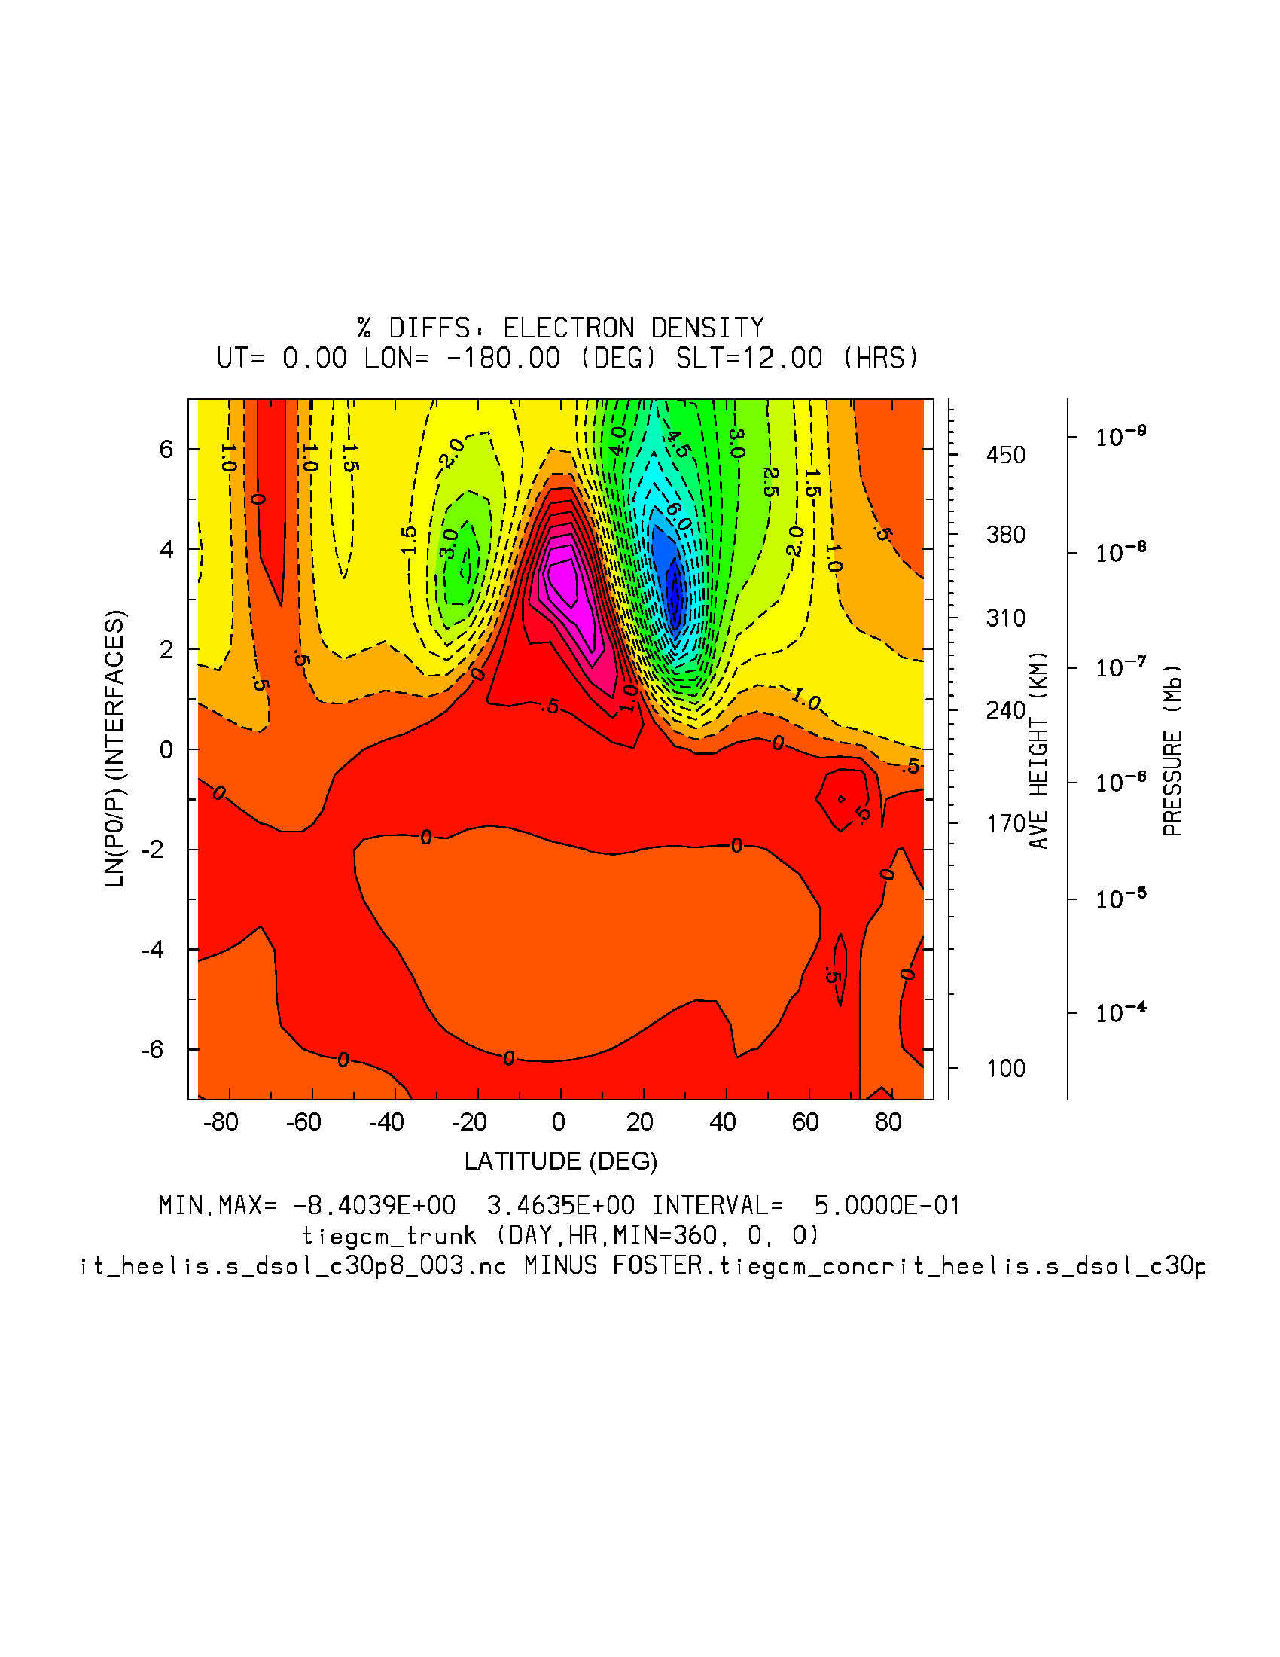
NE: Heelis c30p8
dyncrit
concrit
dyn-concrit
%dyn-concrit (-8.4, 3.5%)

Slide 5
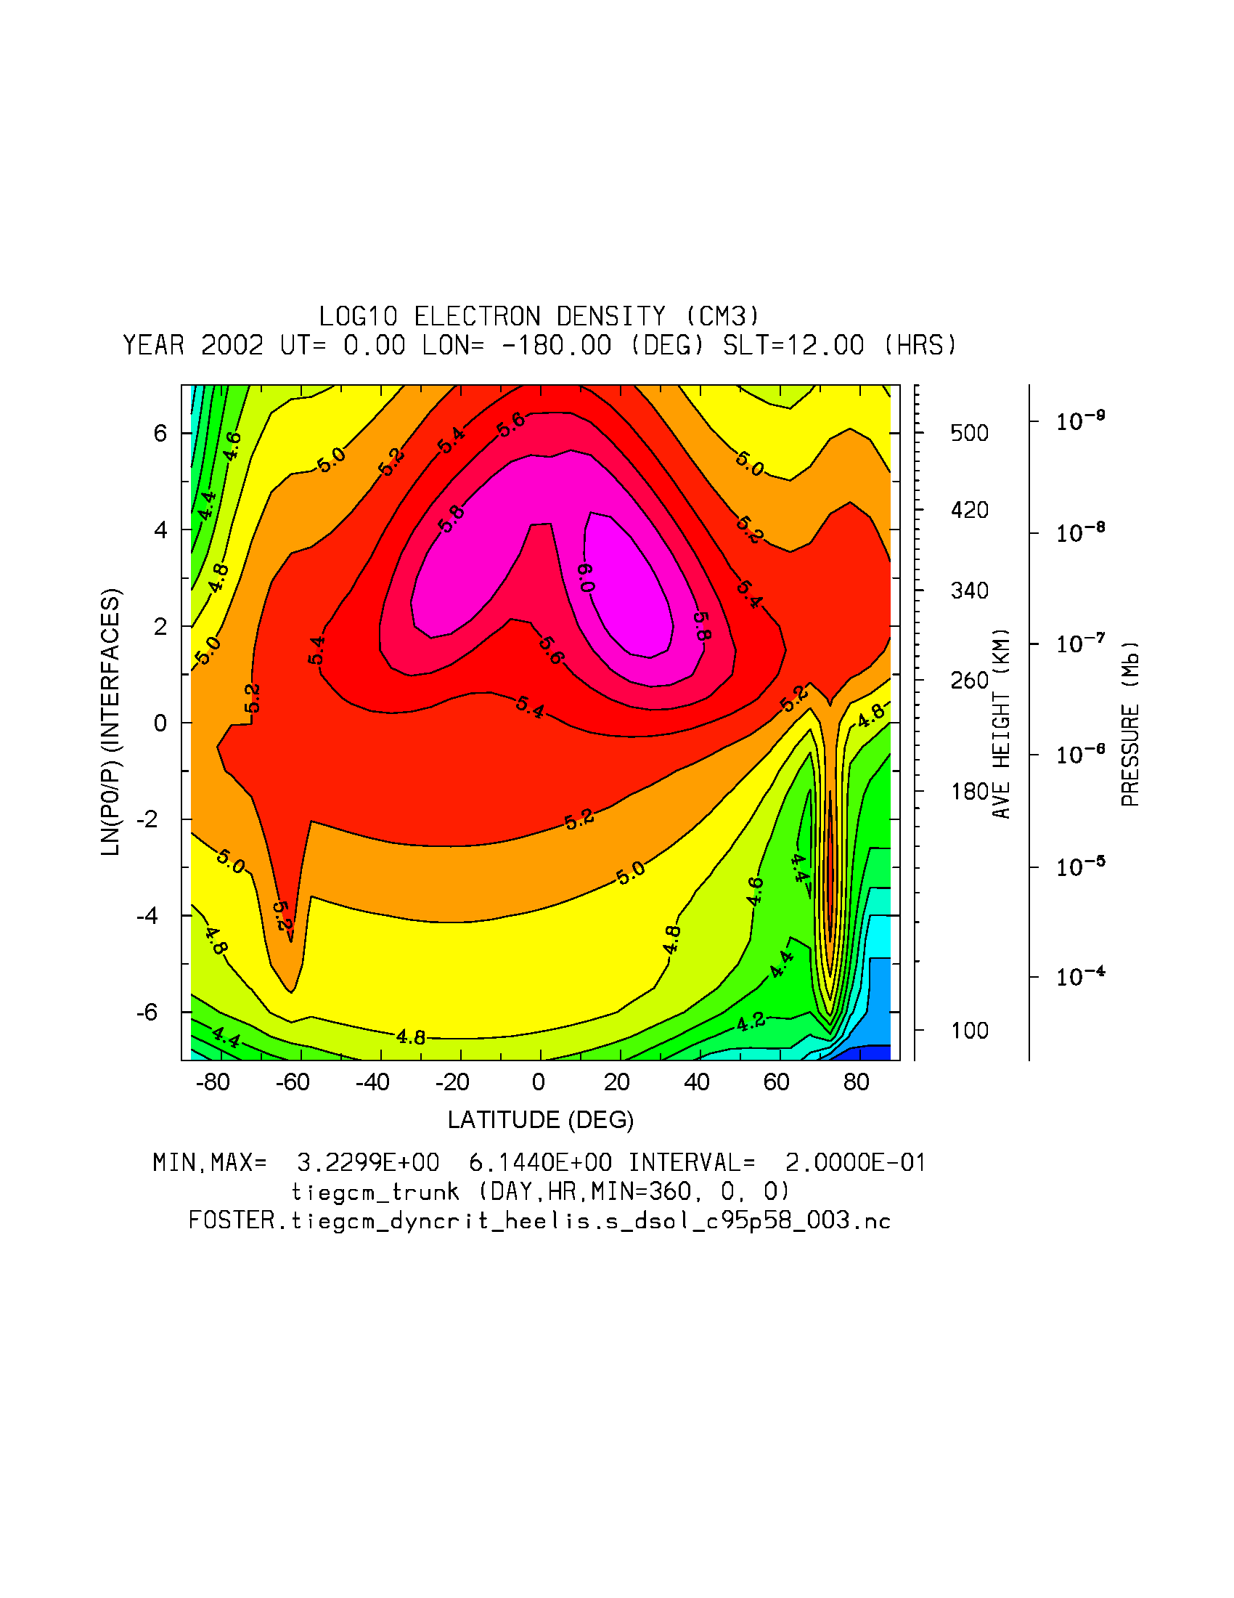
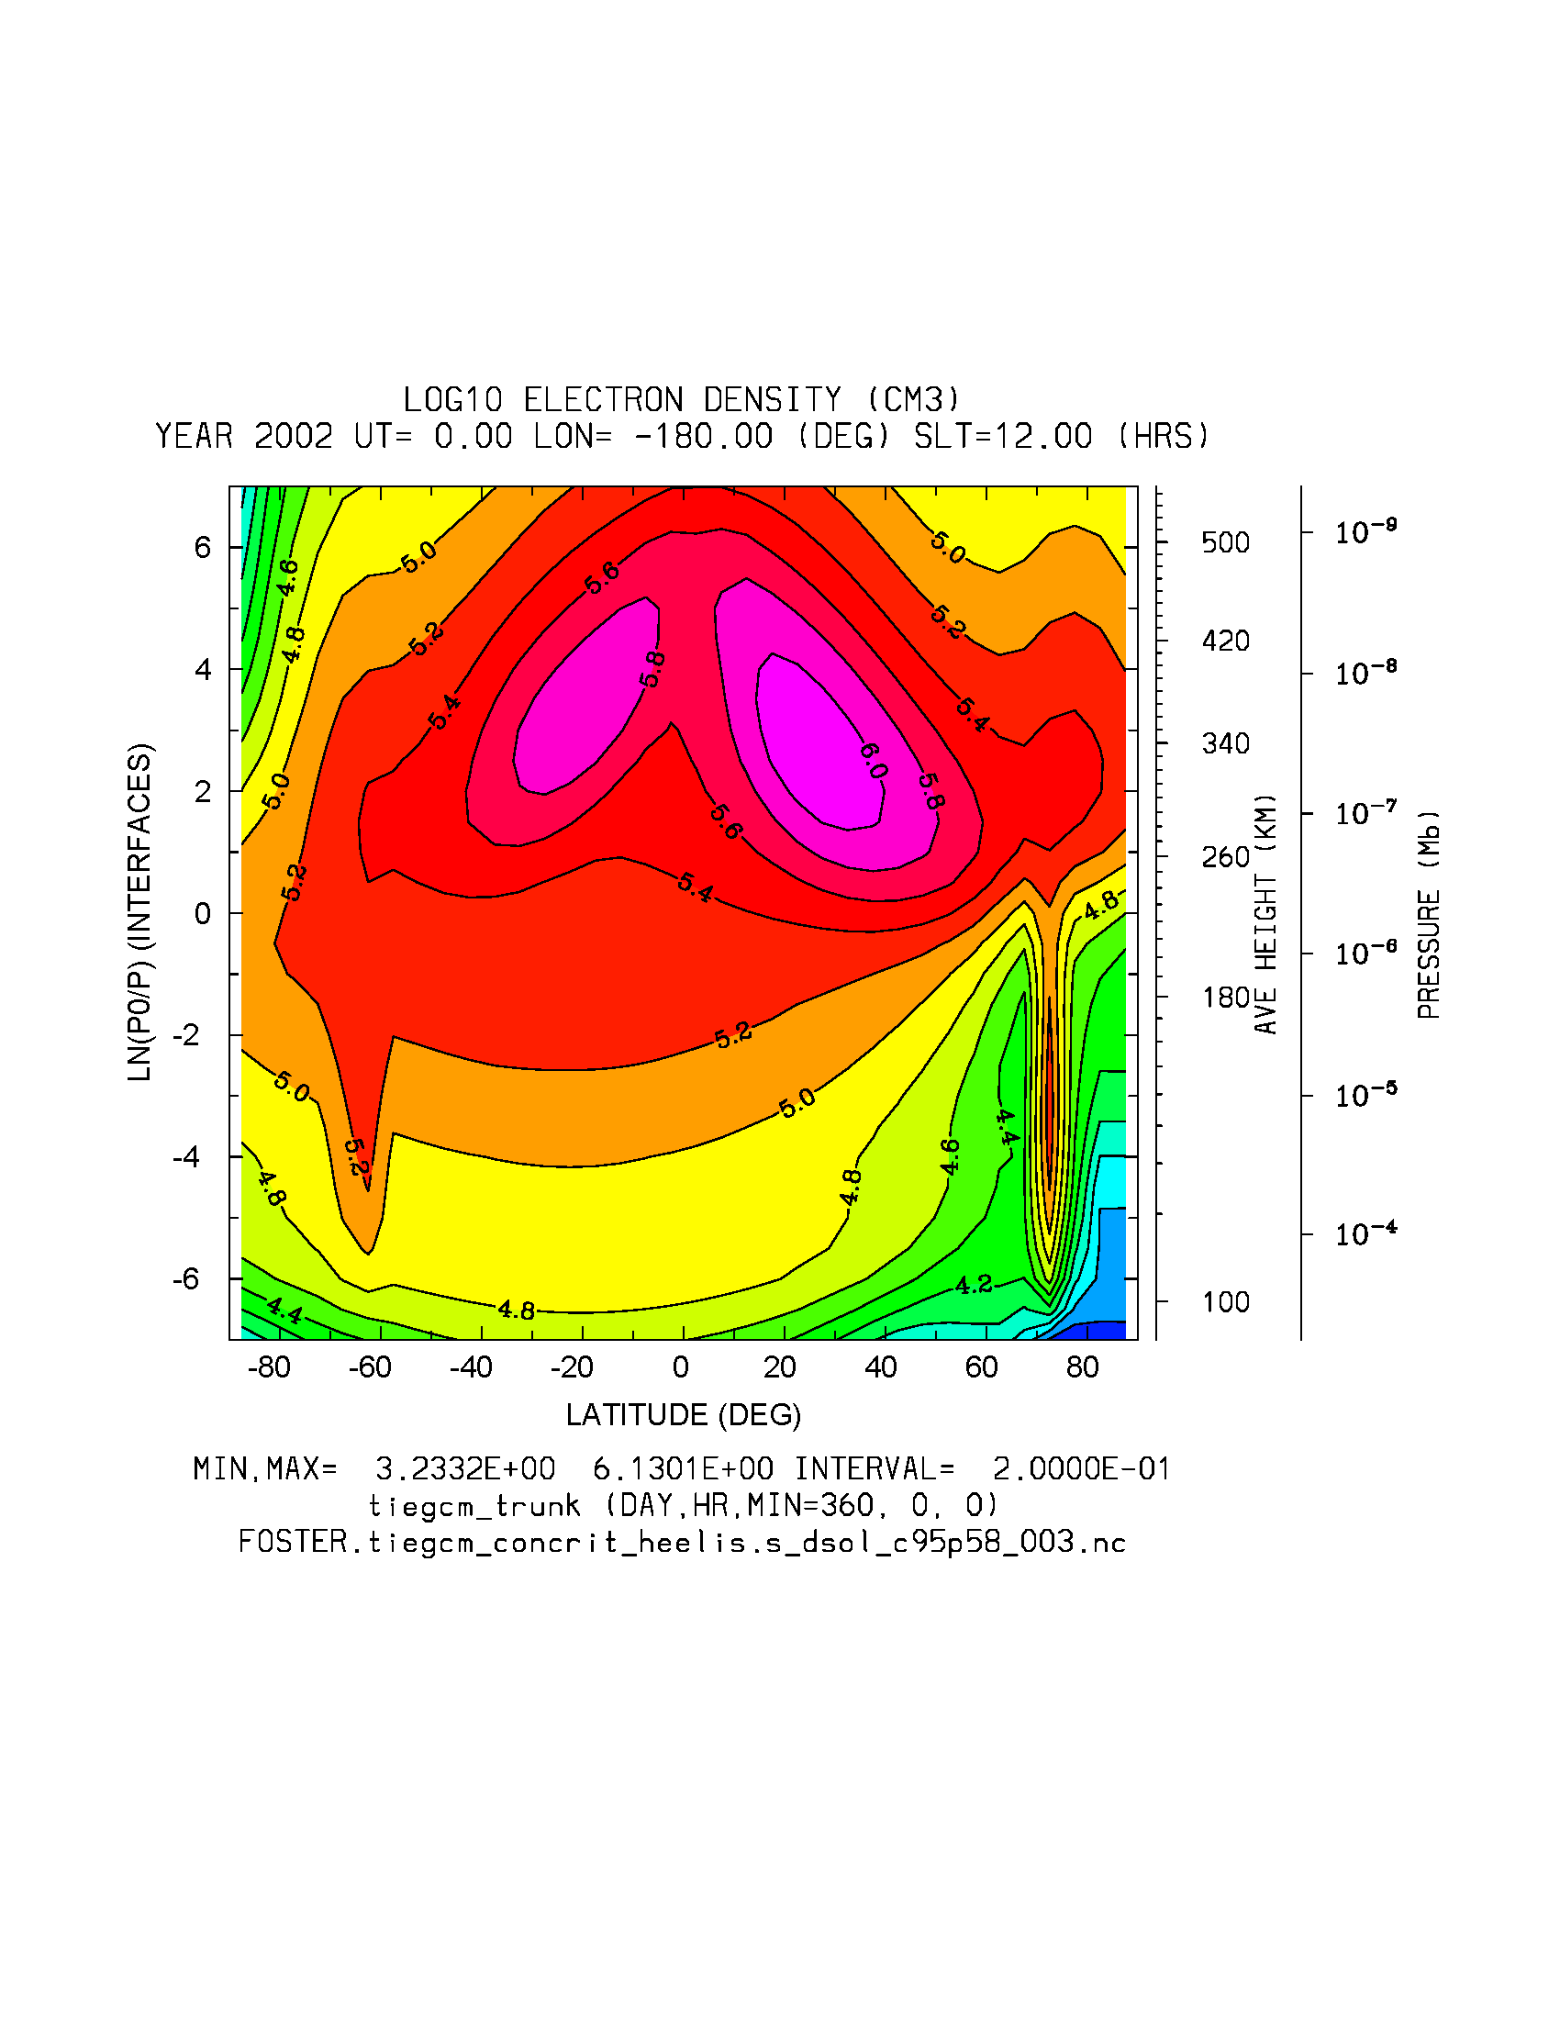
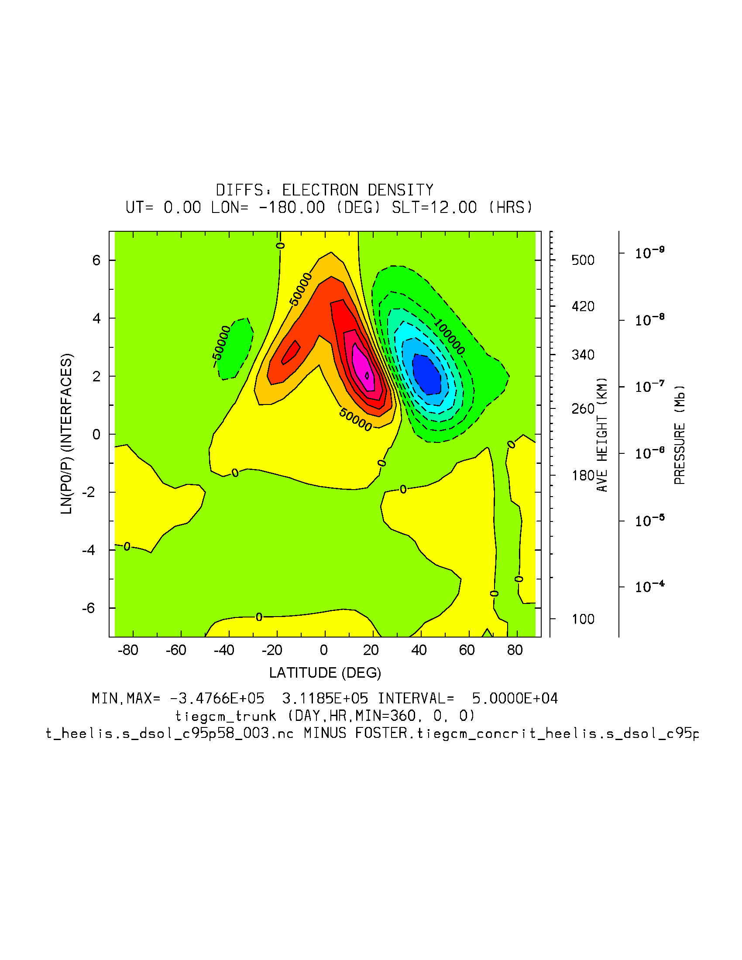
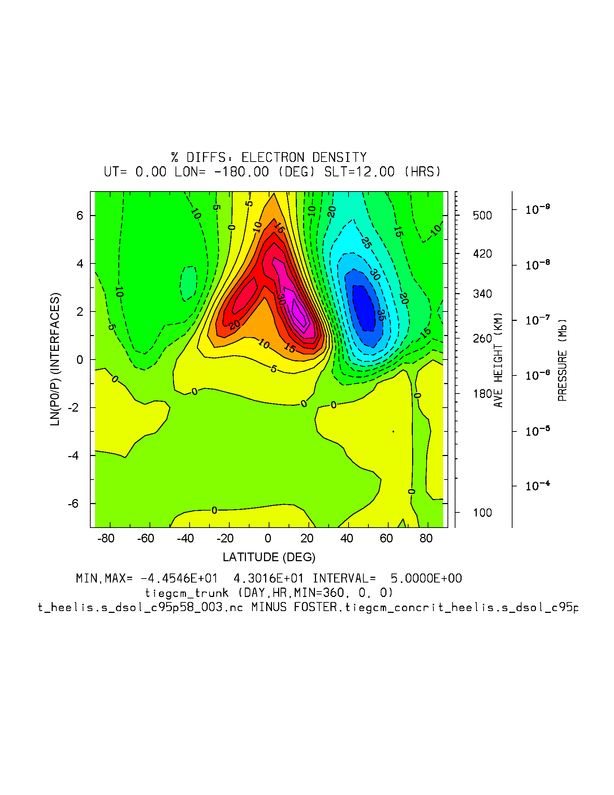
dyncrit
NE: Heelis c95p58
concrit
dyn-concrit
%dyn-concrit (-44.5, 43%)

Slide 6
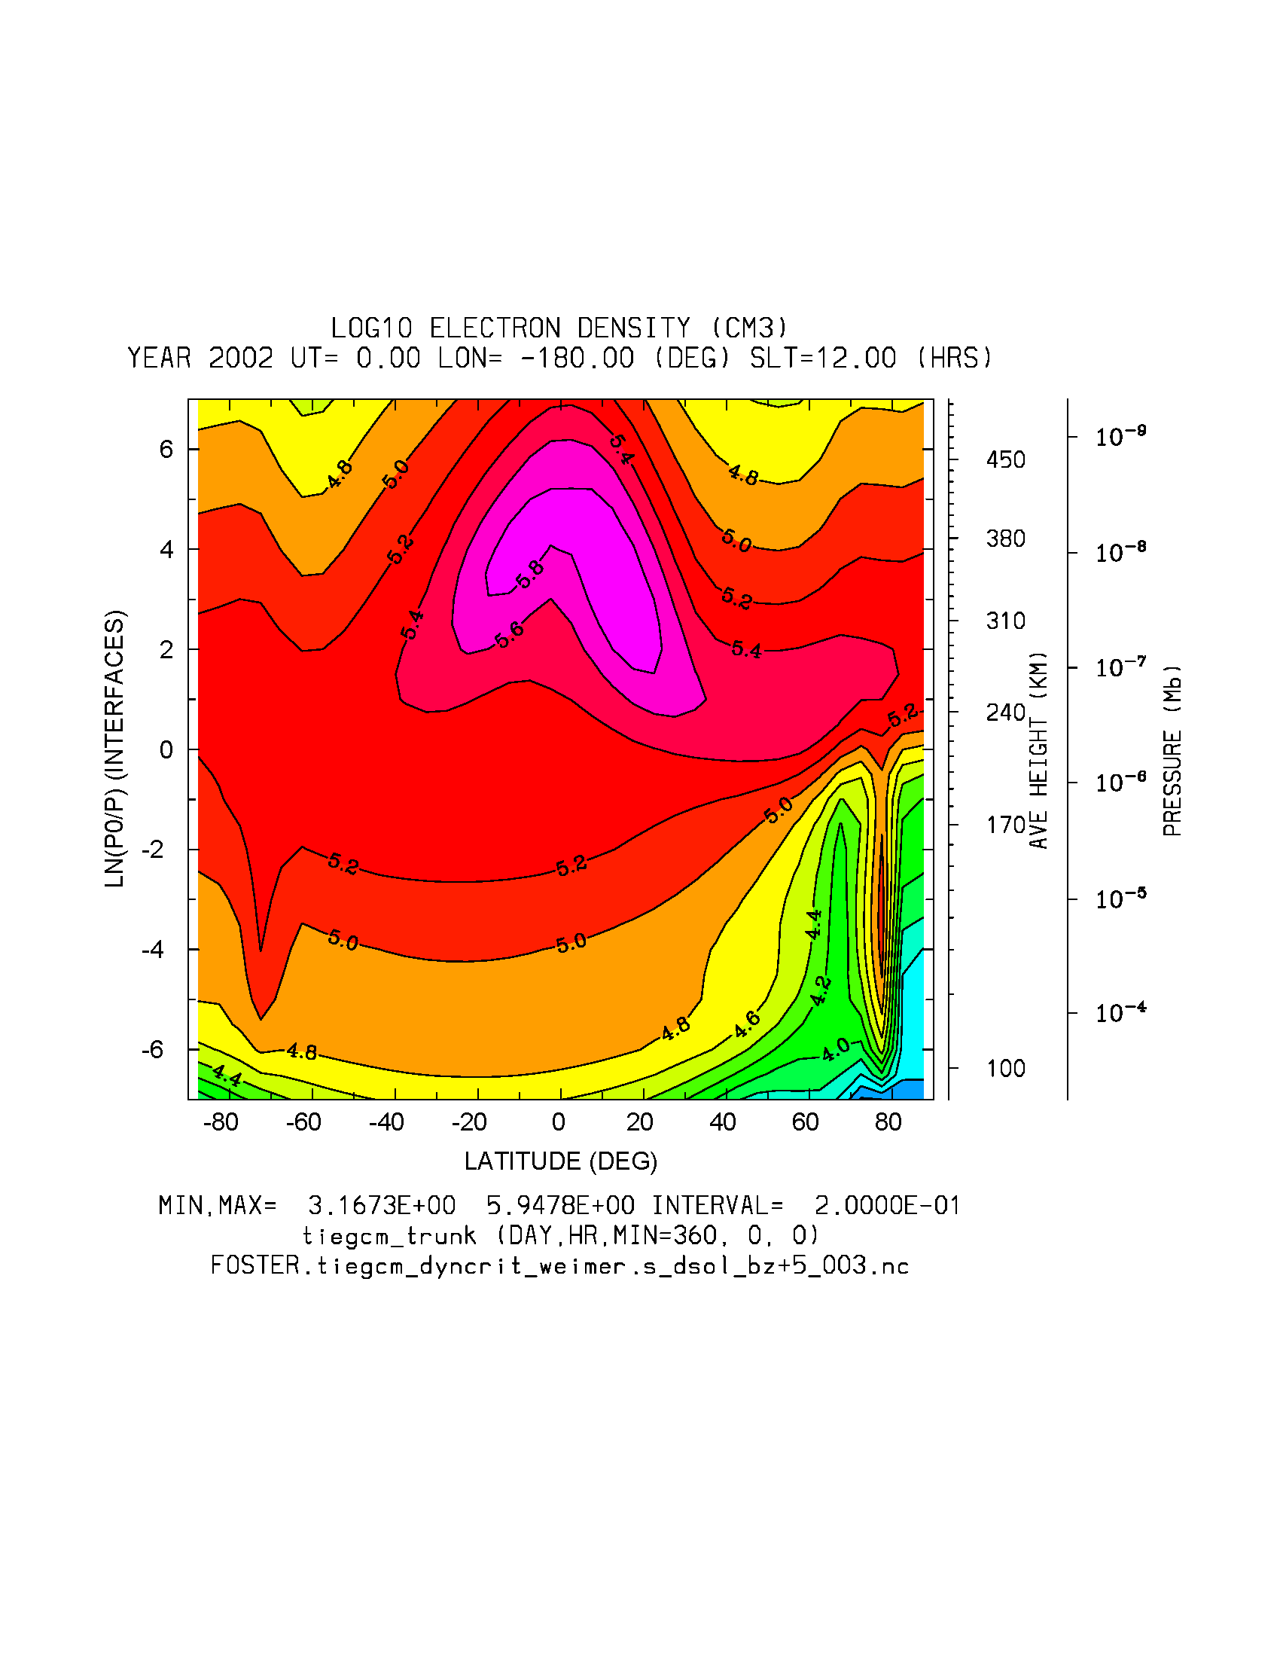
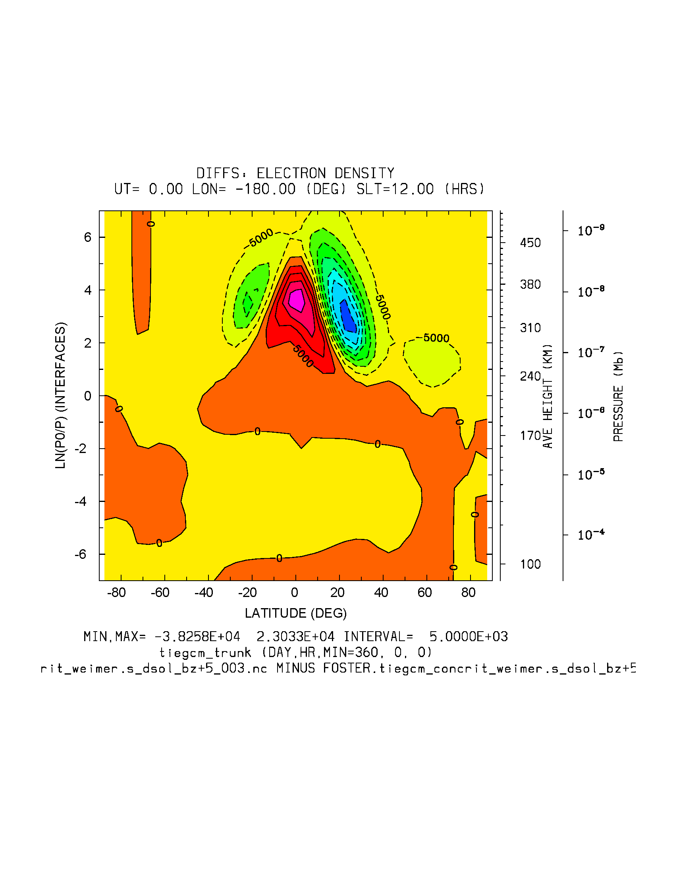
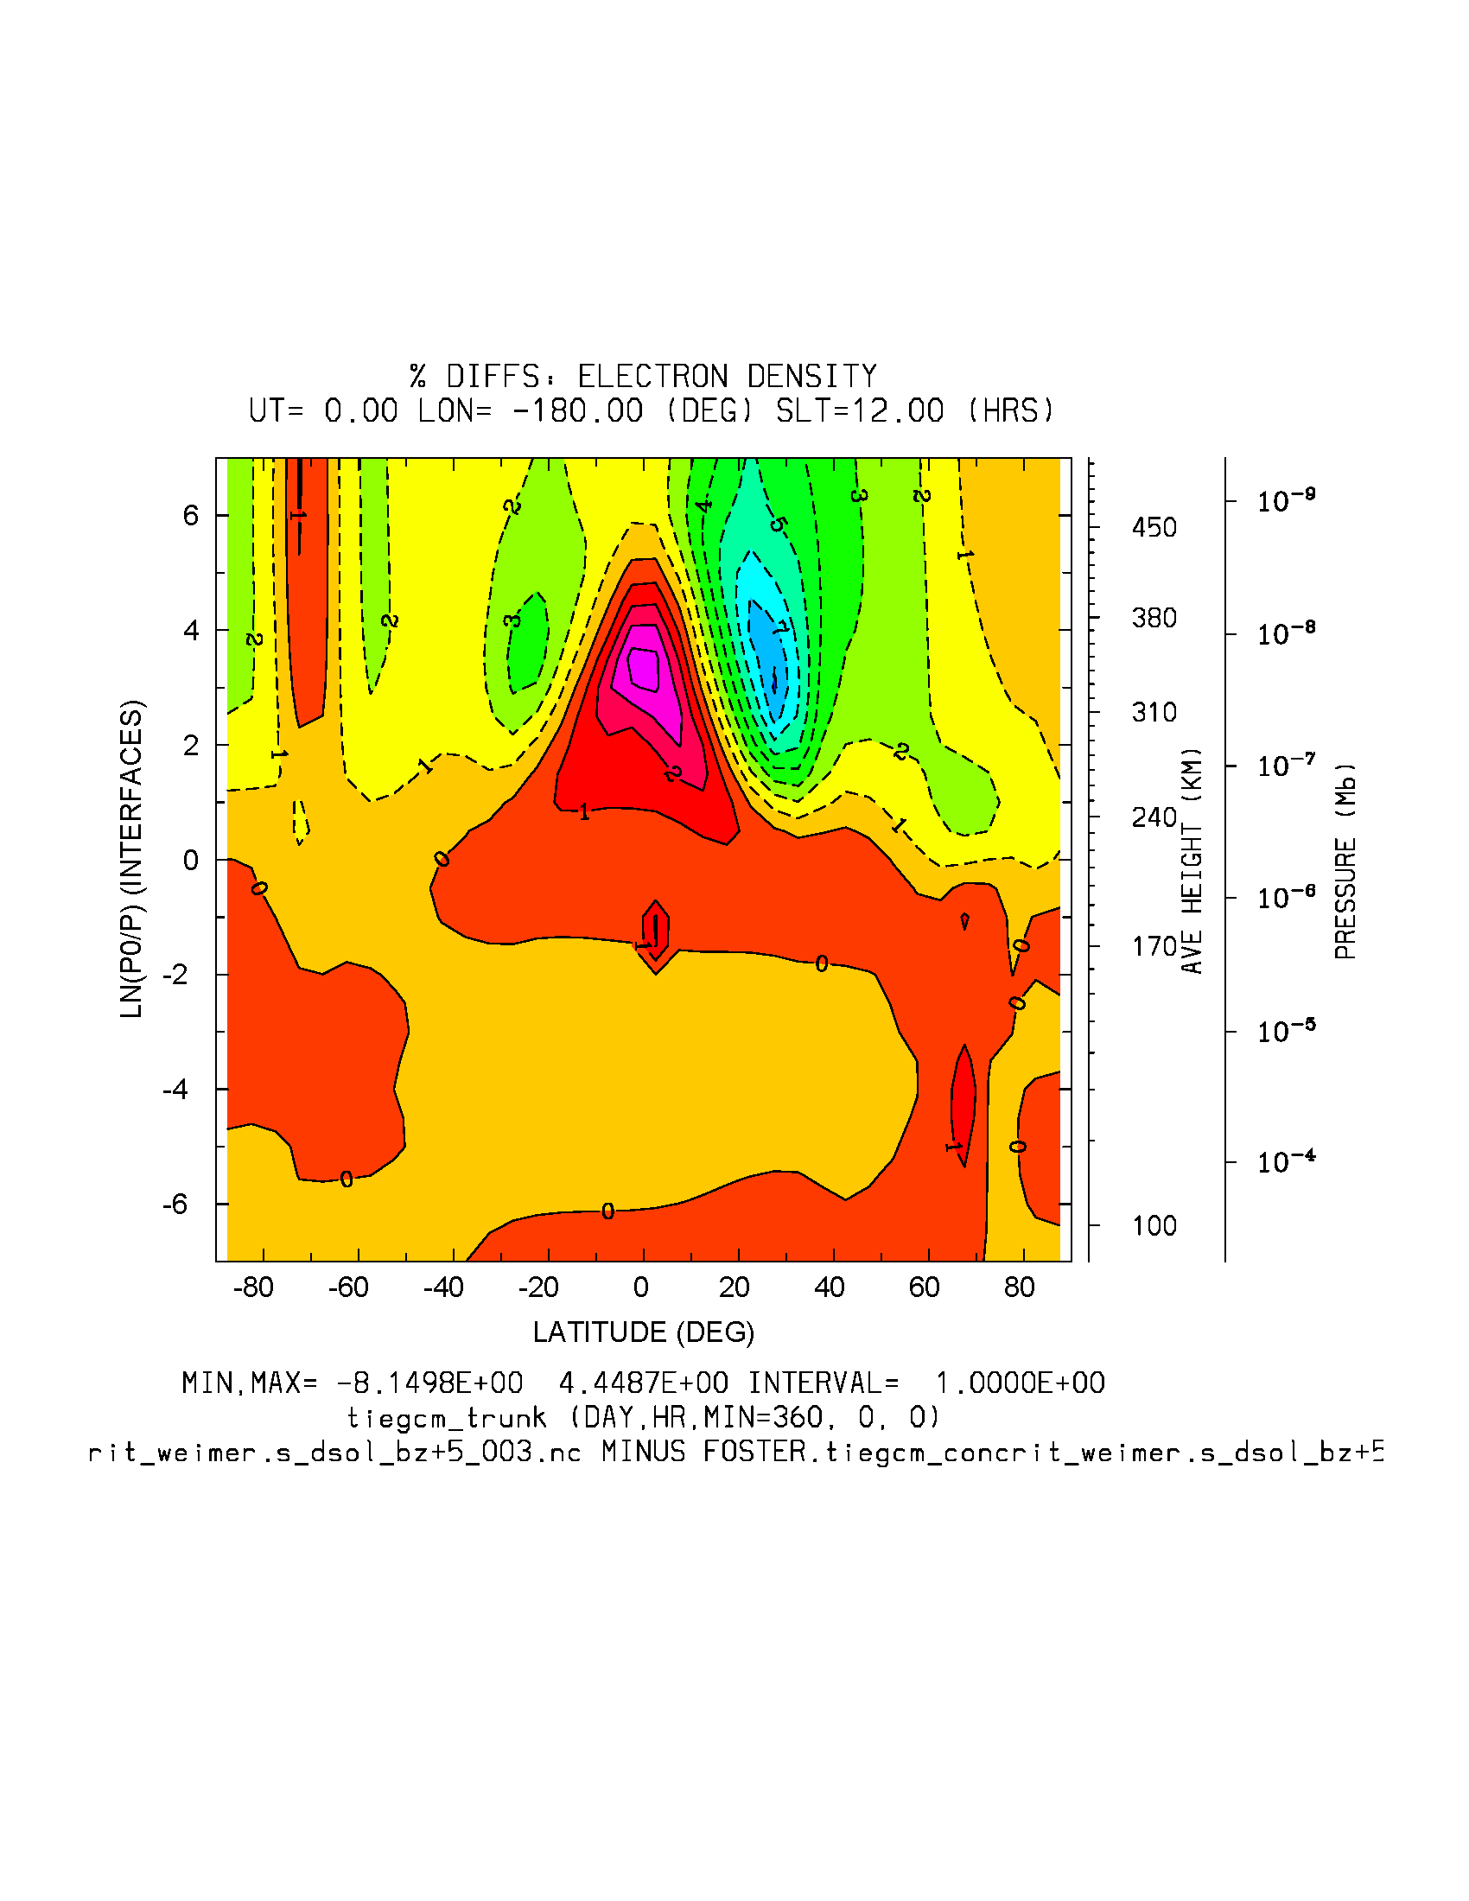
dyncrit
NE: Weimer BZ=+5
concrit
dyn-concrit
%dyn-concrit (-8.1, 4.4%)

Slide 7
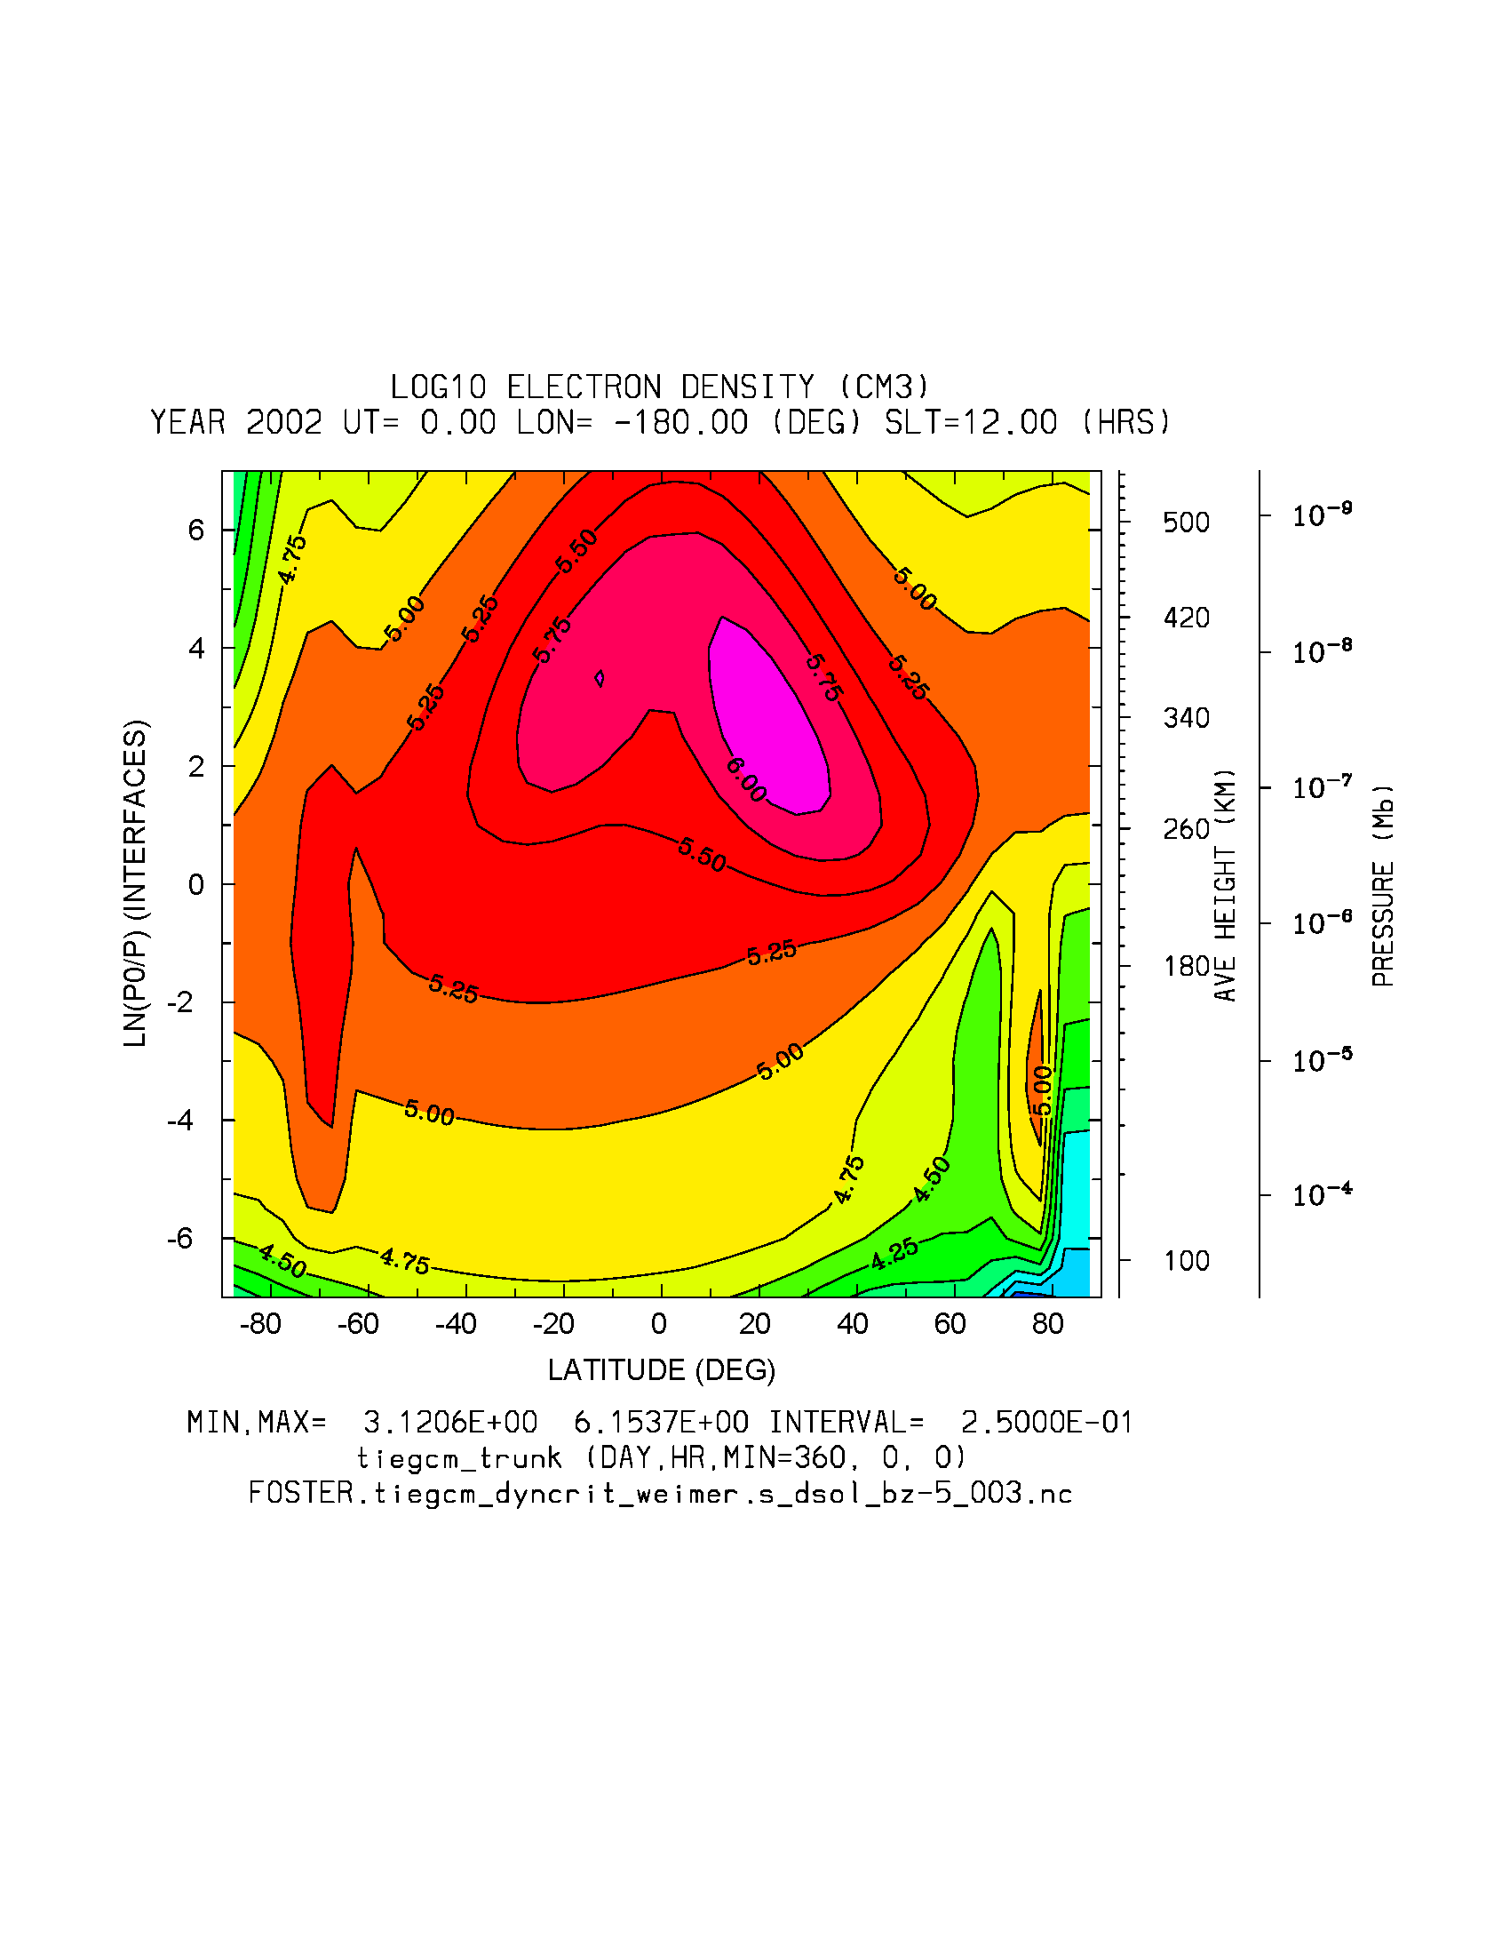
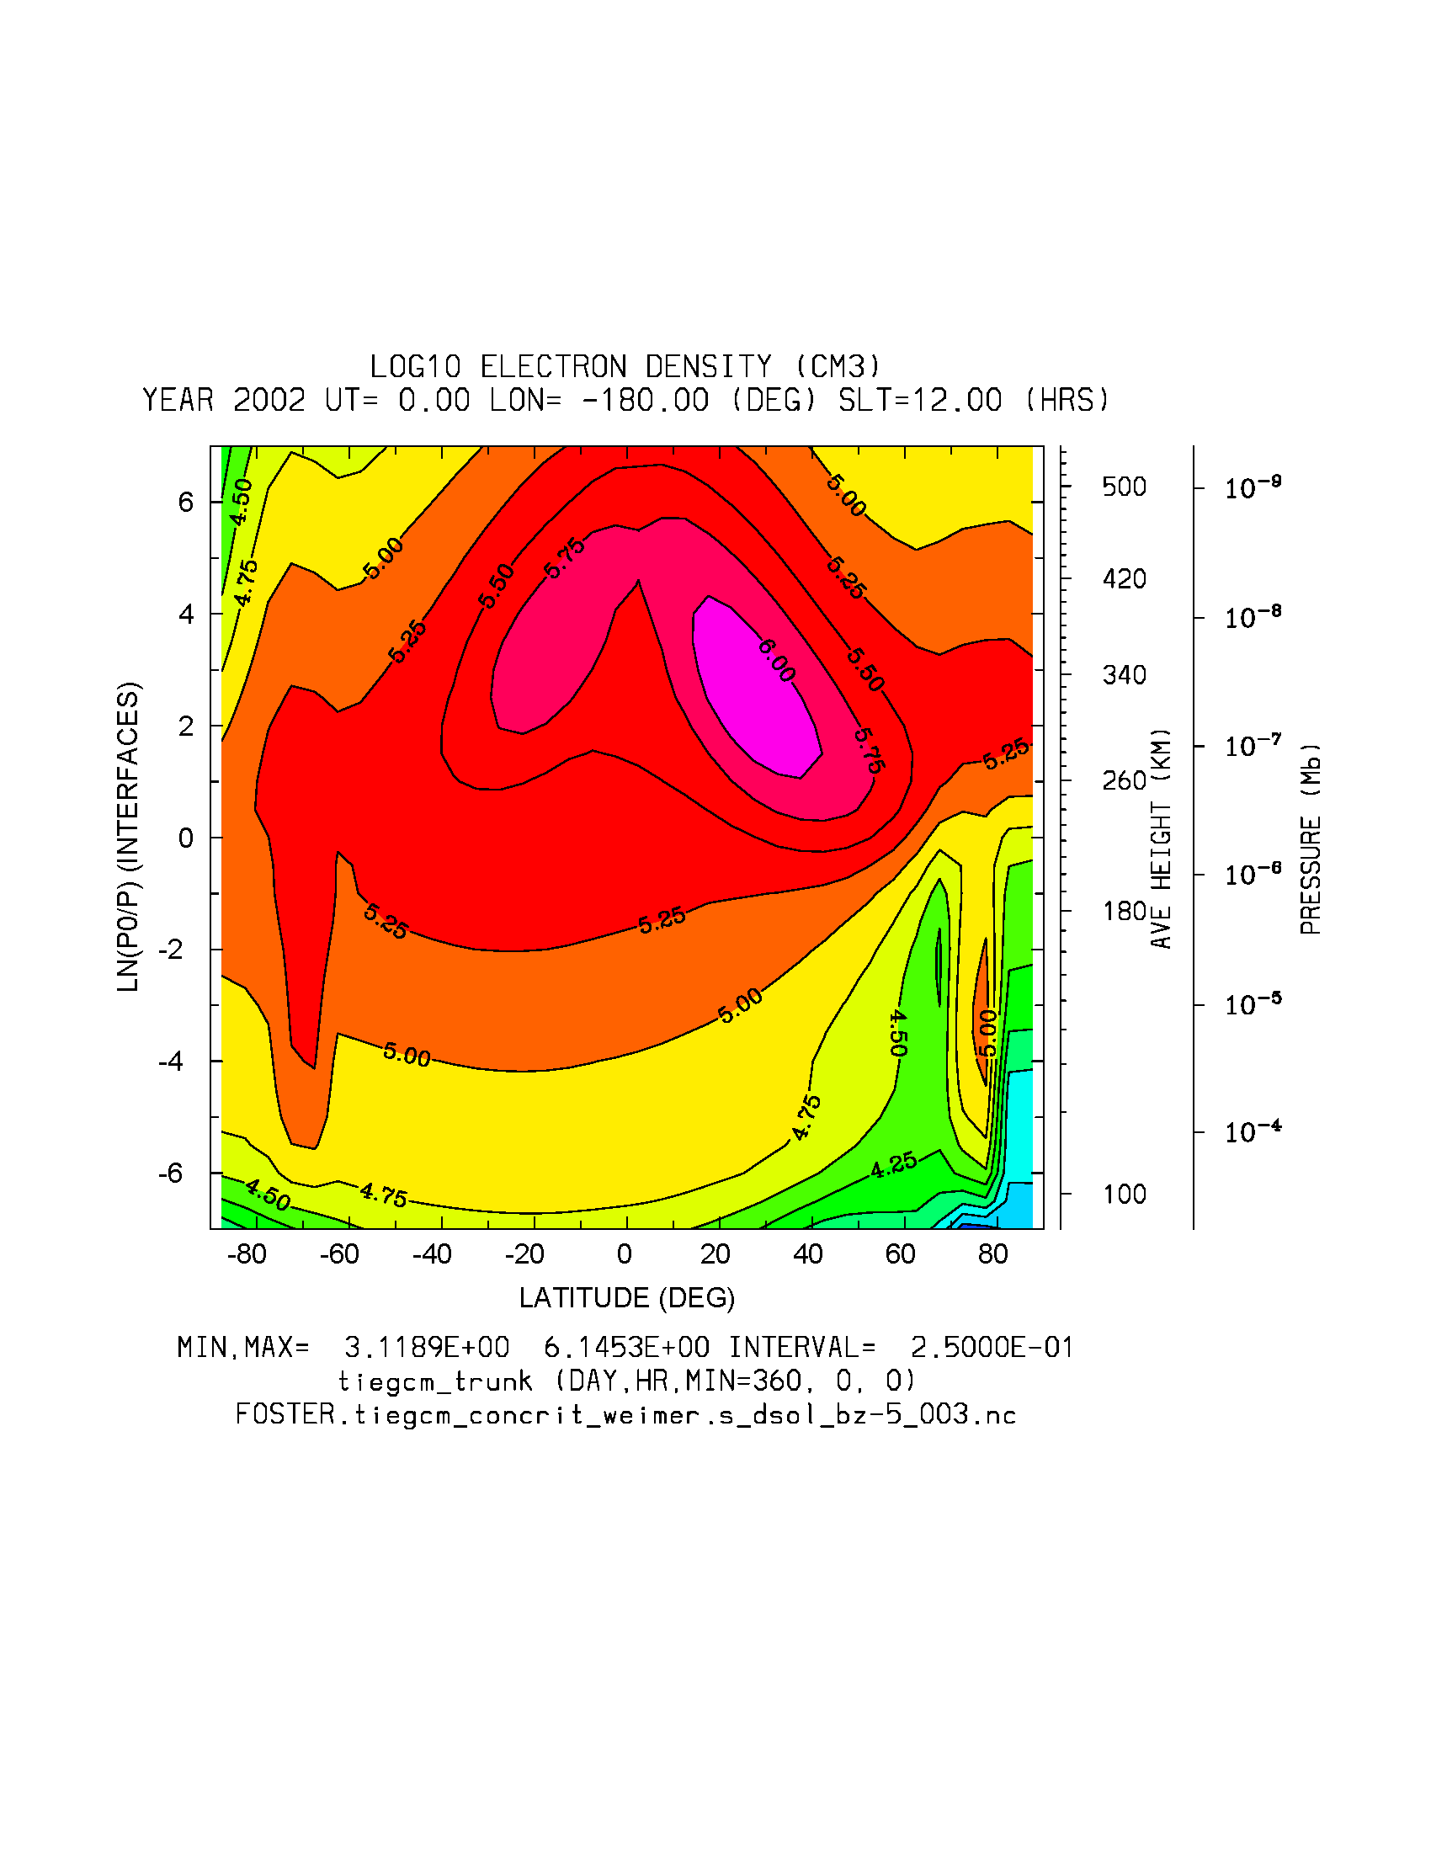
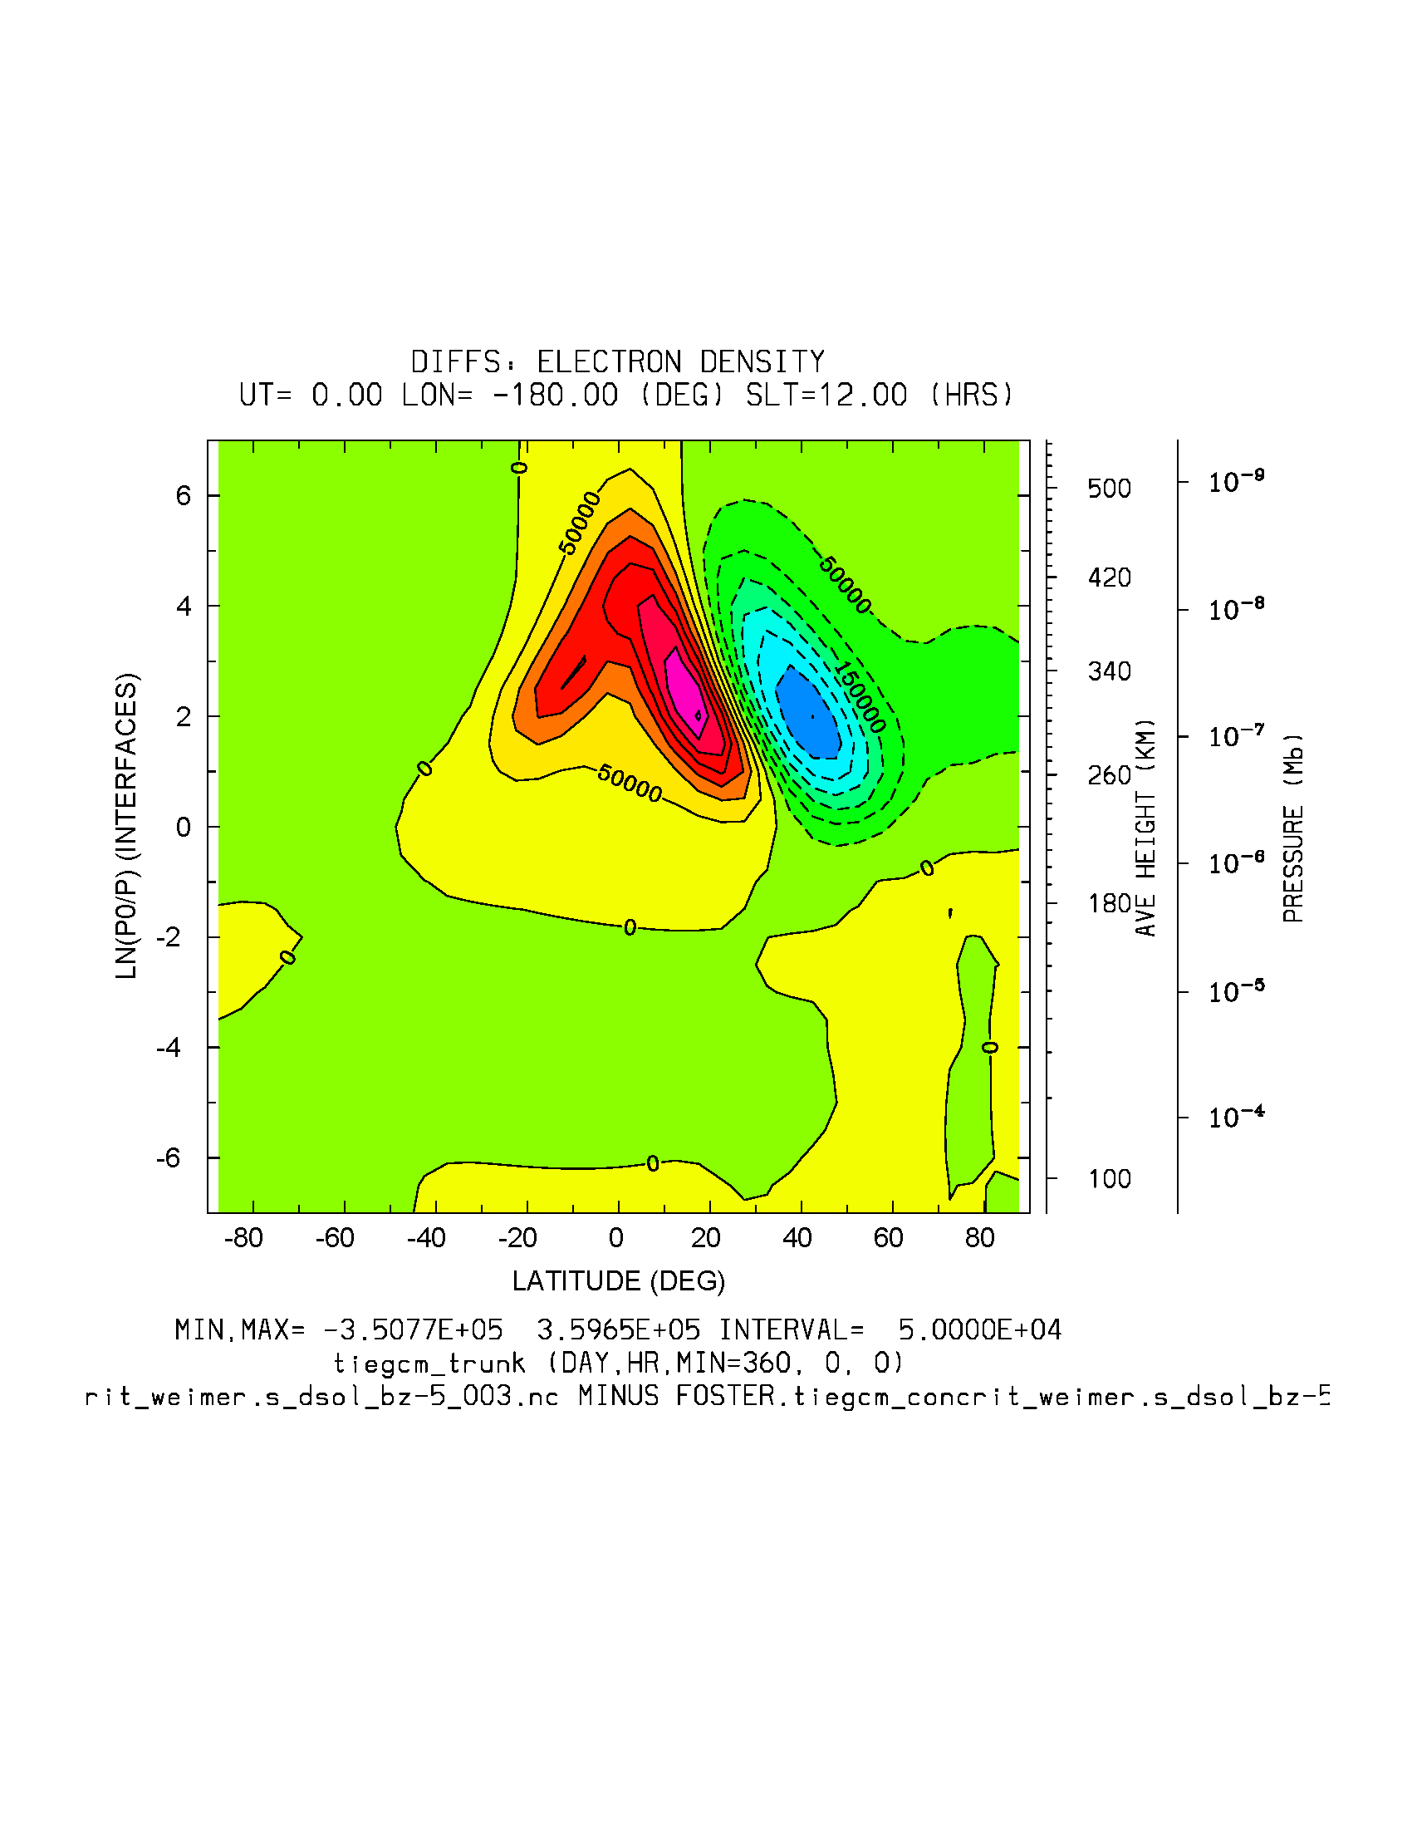
dyncrit
NE: Weimer BZ=-5
concrit
dyn-concrit
%dyn-concrit (-56.5, 56.7%)

