Slide 1
Steady-State 5-day equinox tiegcm runs: Dynamic vs Constant Critical Latitudes
Concrit Heelis c30p8 -> crit = 15., 30.
Dyncrit Heelis c30p8 -> crit = 17.25, 32.25
Concrit Heelis c95p58 -> crit = 15.,30.
Dyncrit Heelis c95p58 -> crit = 21.12, 36.12
Concrit Weimer BZ+5 -> crit = 15.,30.
Dyncrit Weimer BZ+5 -> crit = 17.09, 32.09
Concrit Weimer BZ-5 -> crit = 15.,30.
Dyncrit Weimer BZ-5 -> crit = 20.09, 35.09

Slide 2
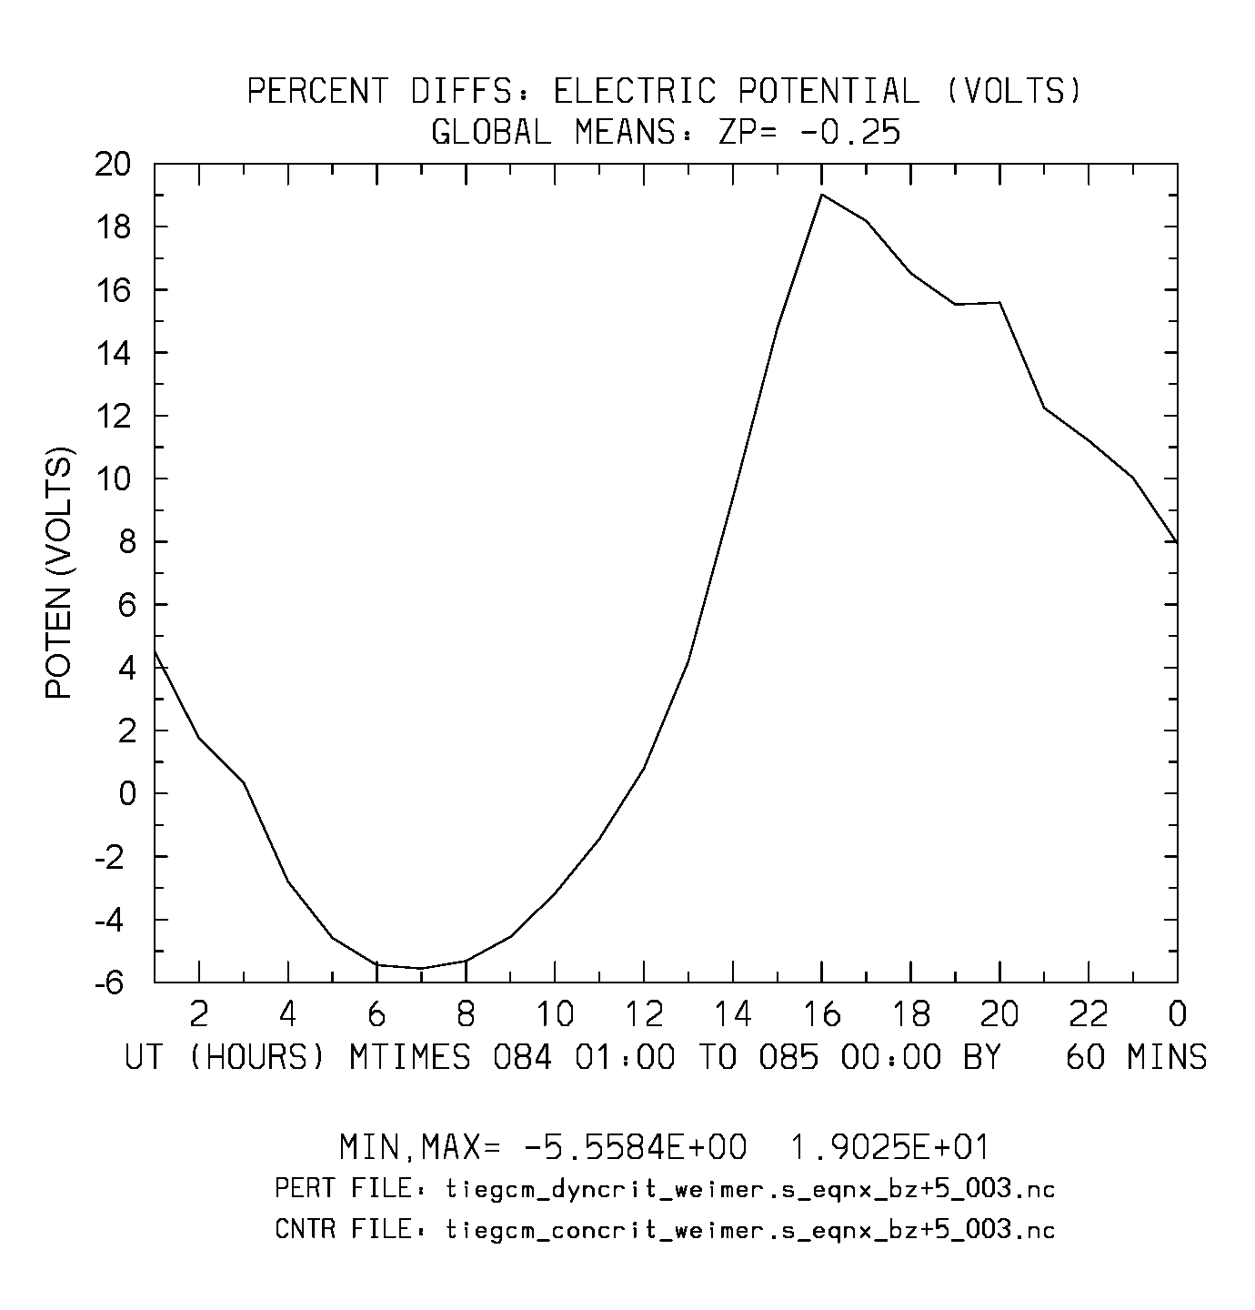
Weimer BZ=+5 (%Diffs: dyncrit-concrit)
%Diffs Min,Max = -5.5, 19.0

Slide 3
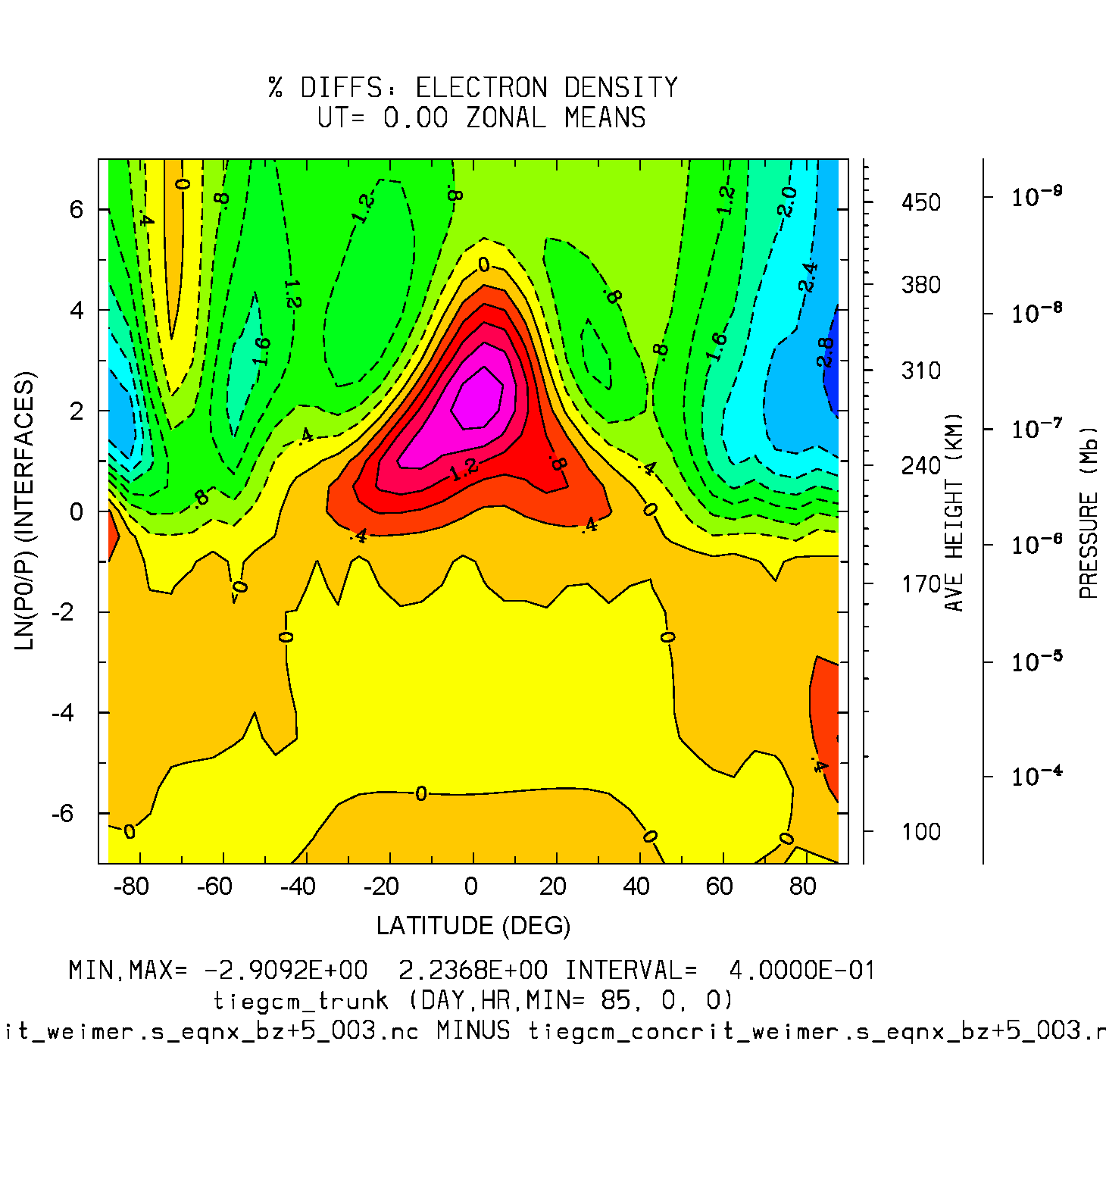
Weimer BZ=+5 (%Diffs: dyncrit-concrit)
%Diffs Min,Max = -2.9, 2.2

Slide 4
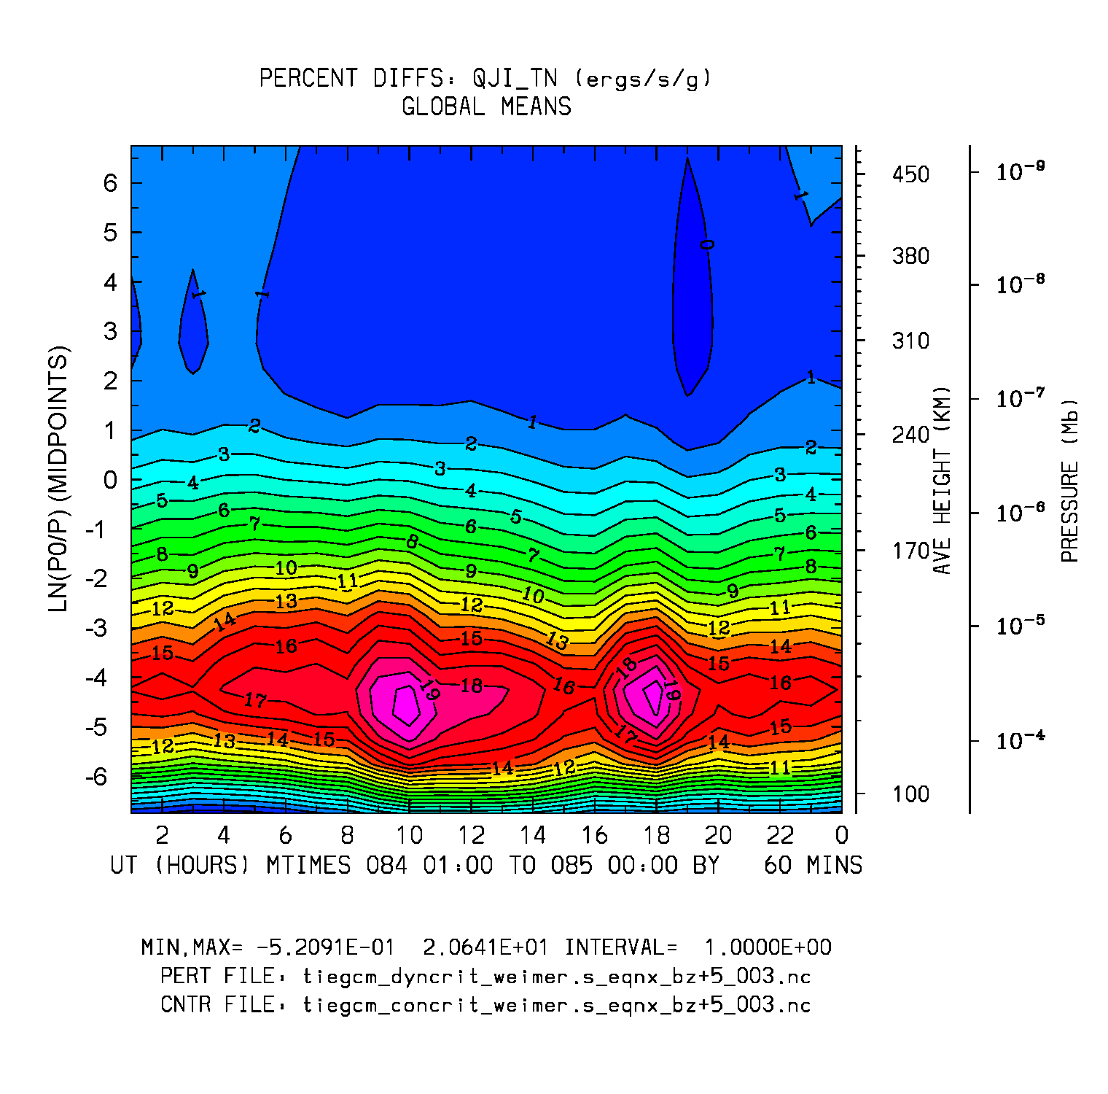
Joule Heating (TN)
Weimer BZ=+5 (%Diffs: dyncrit-concrit)
%Diffs Min,Max = -0.5, 20.6

Slide 5
Electric Potential + UI,VI (full fields)
Concrit: Weimer BZ=-5
Dyncrit: Weimer BZ=-5
Min,Max = -5e+4, 4e+4
Potential fall-off is faster with dyncrit

Slide 6
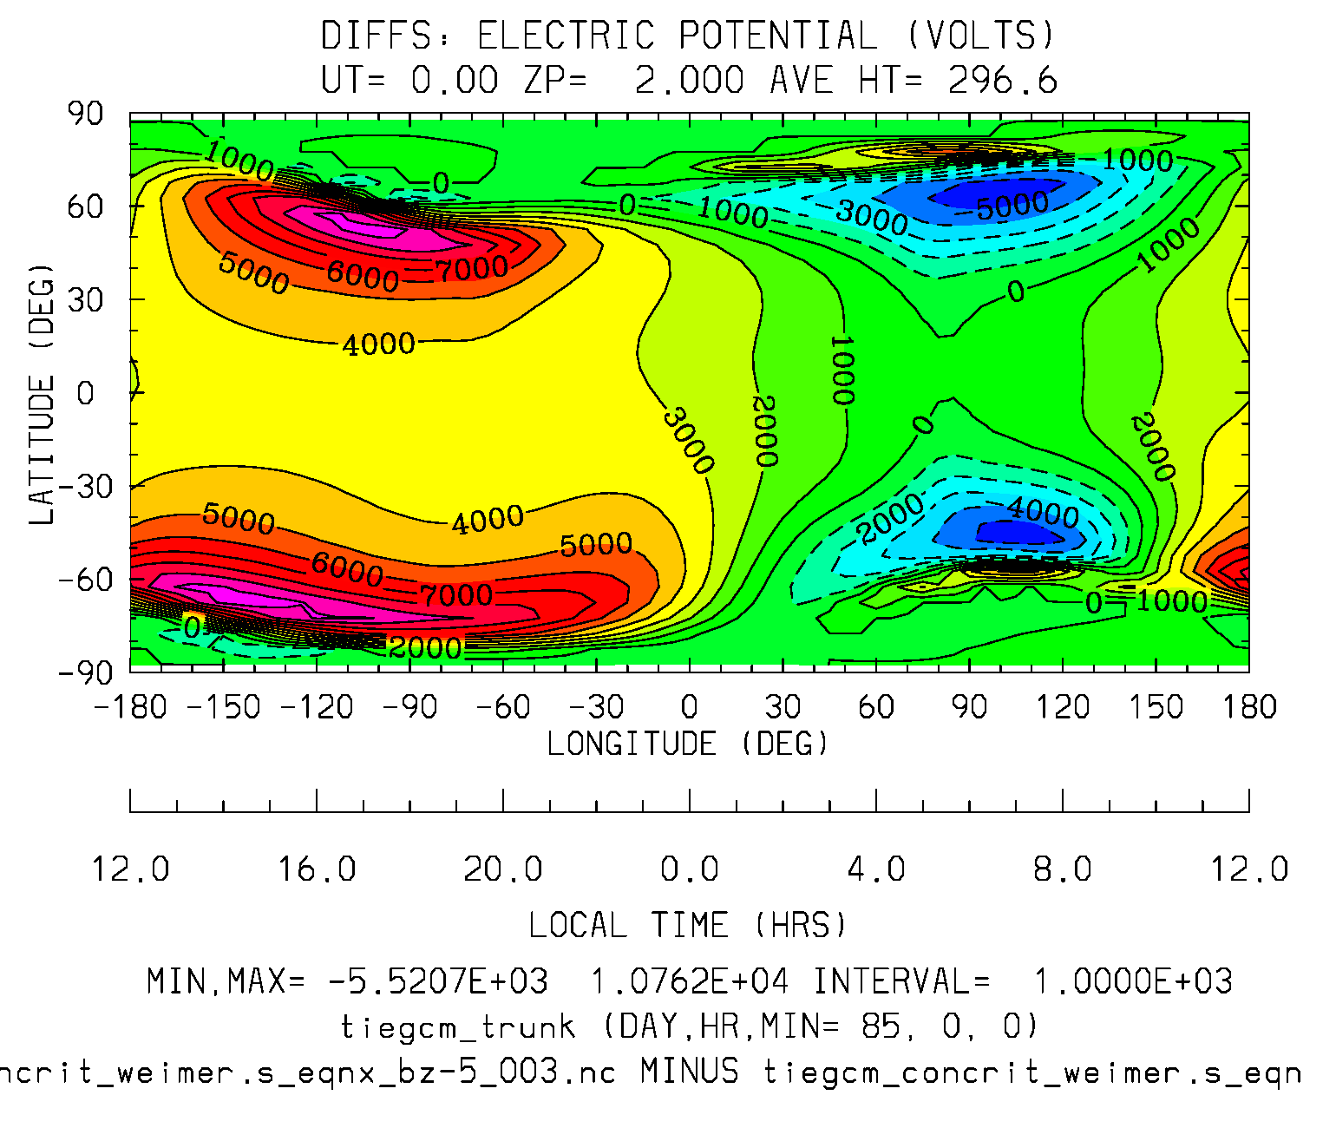
Electric Potential
Weimer BZ = -5 (Diffs: dyncrit-concrit)
Diffs: Min,Max = -5.5,10.7 (kv)

Slide 7
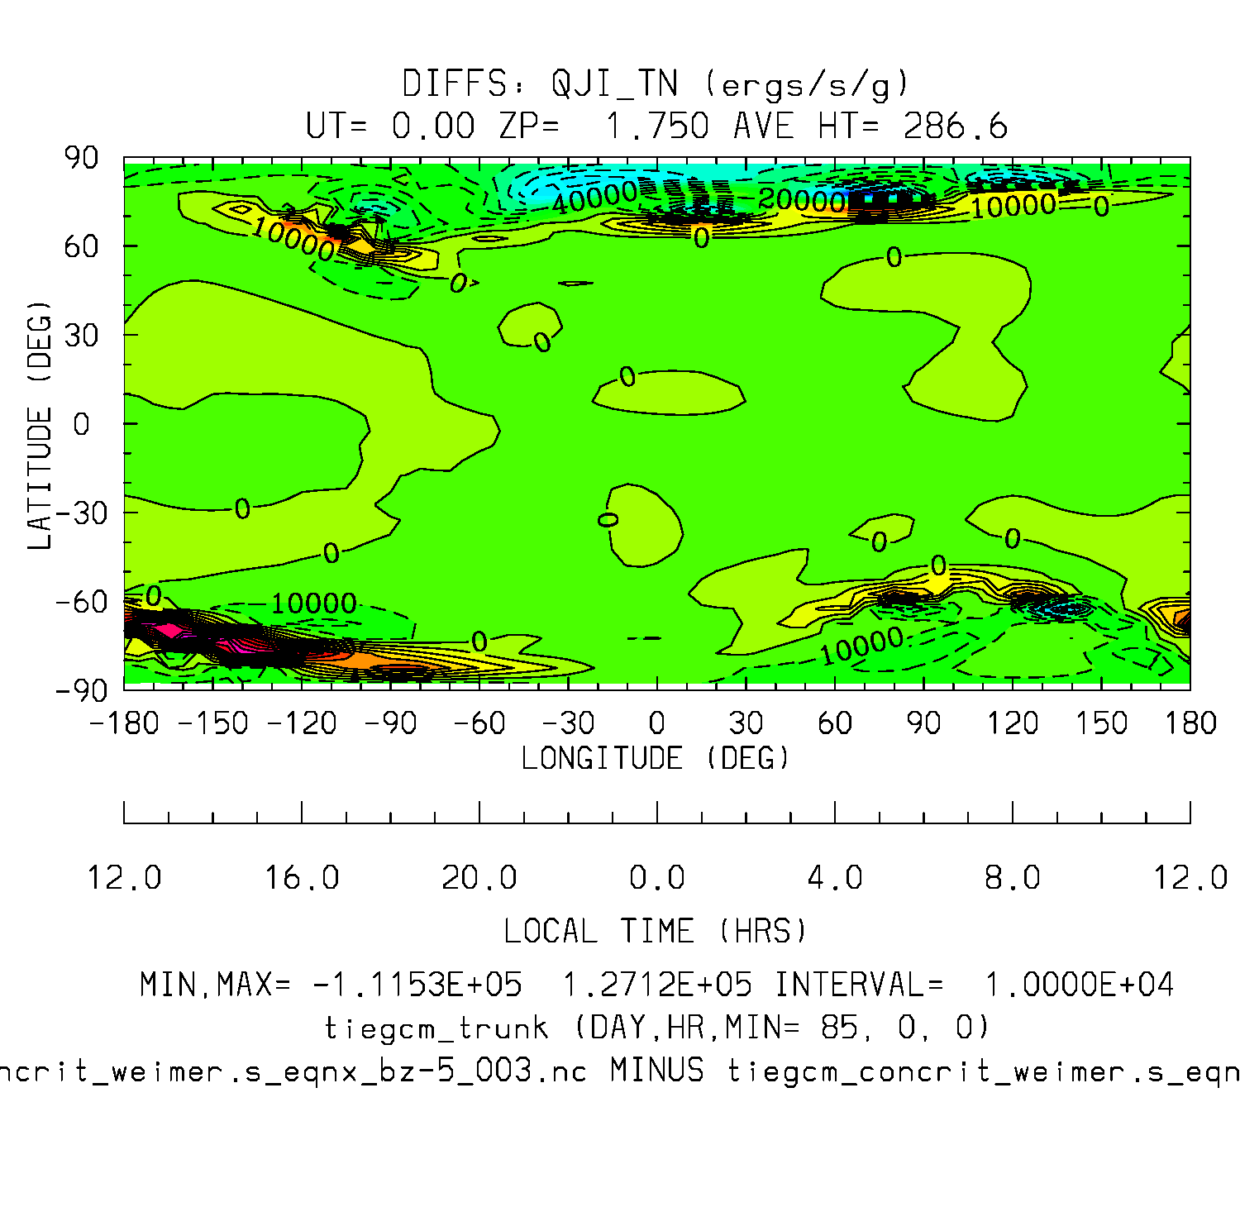
Joule Heating (TN) (Diffs: dyncrit-concrit)
Diffs: Min,Max = -1.1e+5, 1.3e+5

Slide 8
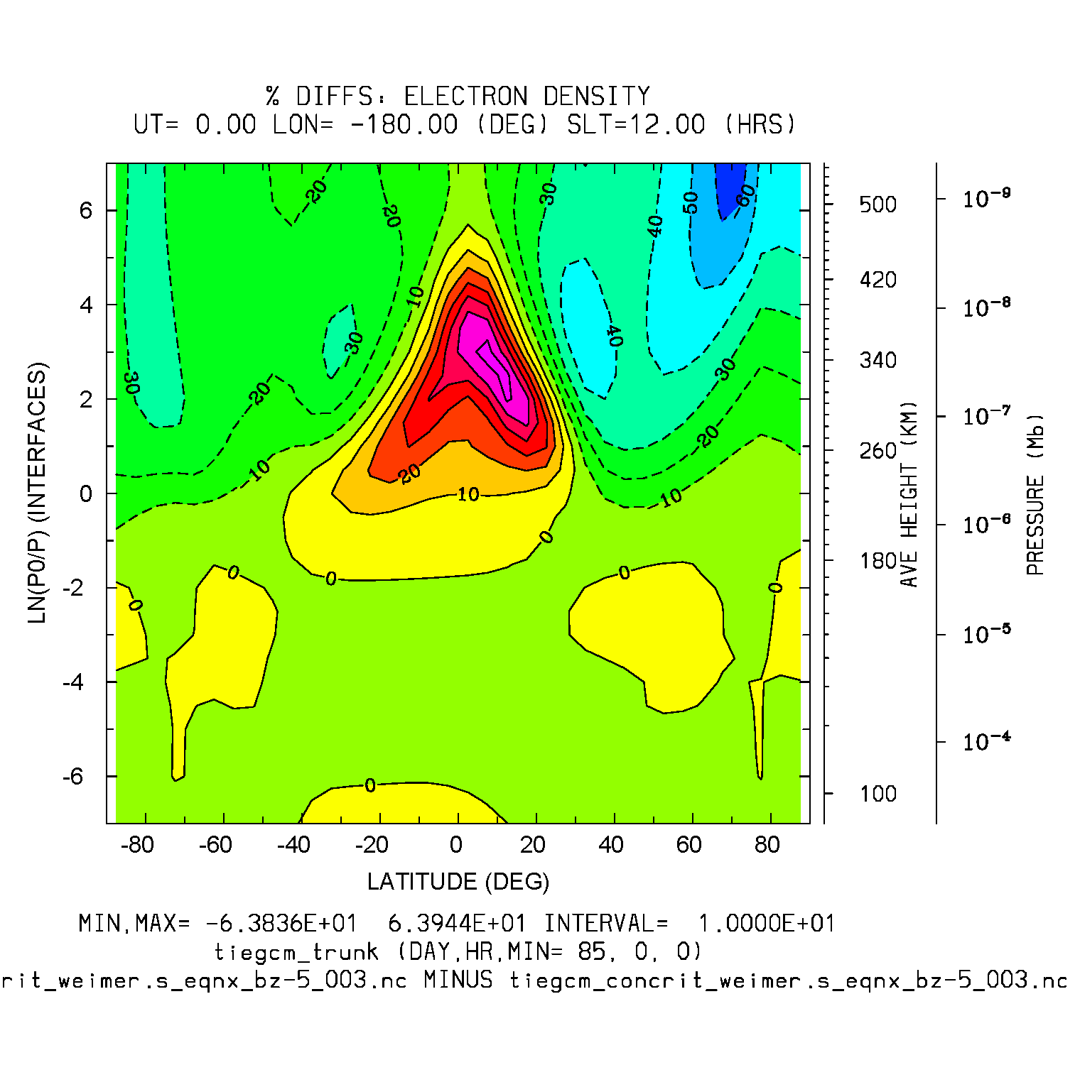
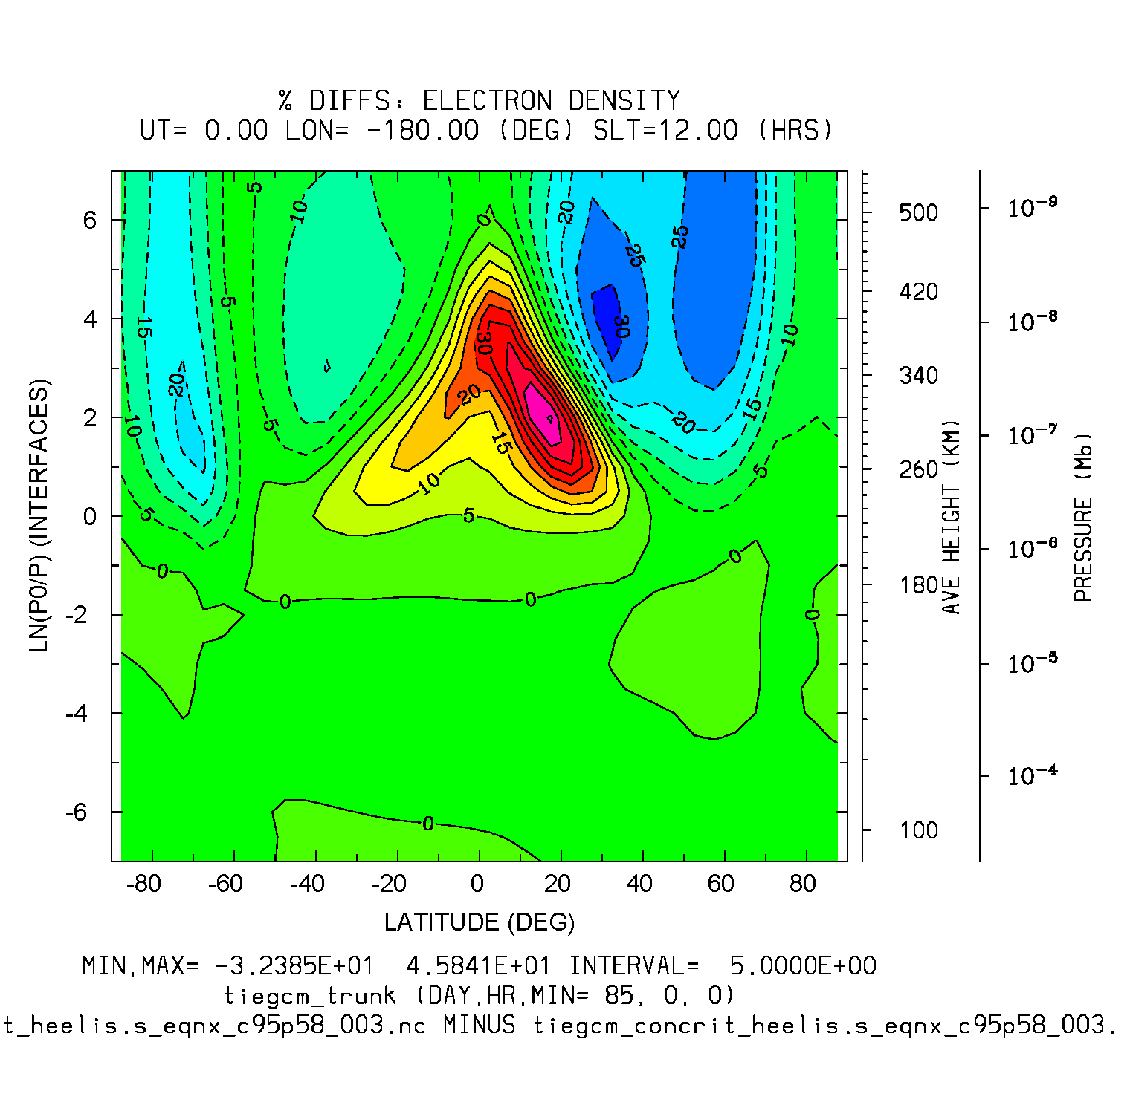
Electron Density (%diffs: dyncrit-concrit)
Weimer BZ=-5 (%Diffs)
Heelis c95p58 (%Diffs)
%Diffs: Min,Max = -64, 64
%Diffs: Min,Max = -32, 46

Slide 9
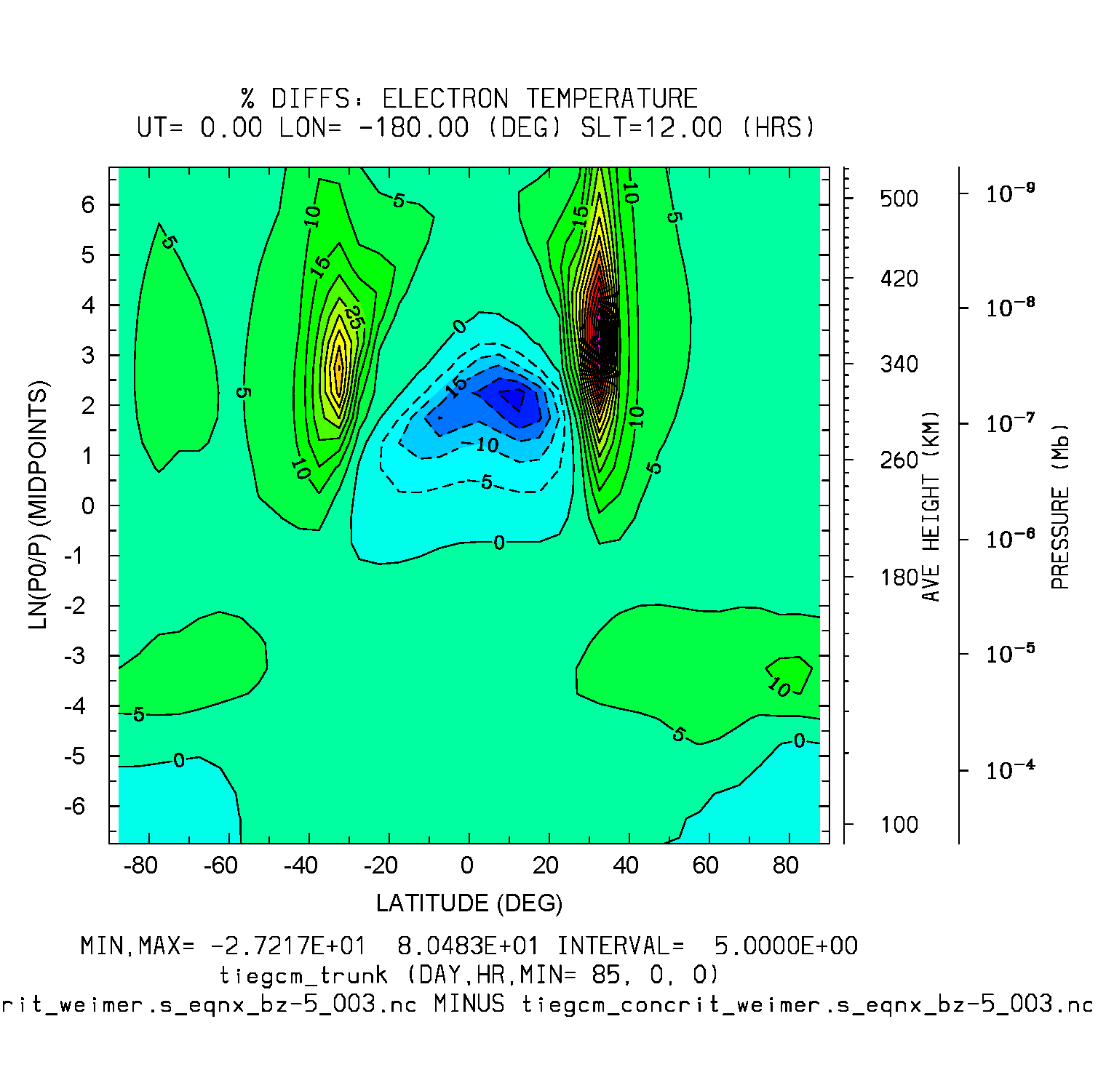
Electron Temperature (%Diffs: dyncrit-concrit)
Weimer BZ = -5
%Diffs Min,Max = -27, 80

Slide 10
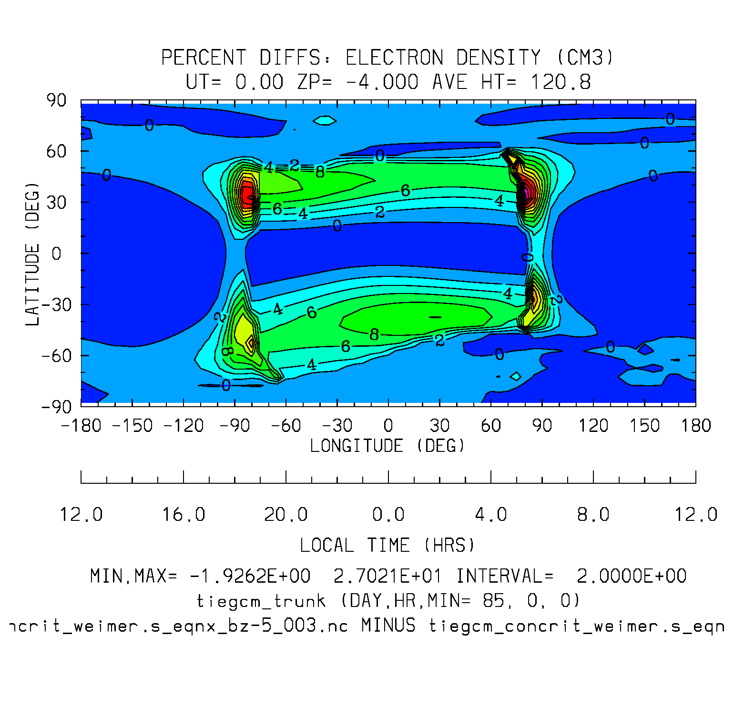
Electron Density (%Diffs dyncrit-concrit)
Weimer BZ = -5
%Diffs Min,Max = -1.9, 27.0

Slide 11
Code structure with proposed changes:
Critical latitudes are declared and initialized in cons.F:
! Critical colatitude limits (15,30 deg) for use of Heelis potential in dynamo:
real :: crit(2) = (/0.261799387, 0.523598775/) -> crit = 15., 30. degrees
Advance calls aurora_cons, which calculates convection theta0:
theta0(isouth) = (-3.80+8.48*(ctpoten**0.1875))*dtr
! Set theta0 = 10 deg so crit(1,2)=15,30 (old values in cons.F) in colath.F for CISM
#if defined(INTERCOMM) || defined(CISMAH)
theta0(isouth) = 10.*dtr
#endif
Advance calls Heelis, Weimer, or None, according to namelist input POTENTIAL_MODEL.
If weimer, theta0=bndyfitr/2. (wei05loc, overwriting aurora_cons)
The potential model calls colath (which is now in its own source file colath.F)

Slide 12
Code structure with crit changes, cont:
Sub colath (colath.F) calculates crit(1:2) from theta0:
! 01/11 bae: Revise crit in rad so crit(1)=theta0(=crad in rad)+5deg,
! crit(2)=crit(1)+15deg
crit1deg = max(15.,0.5*(theta0(1)+theta0(2))*rtd + 5.)
crit1deg = min(30.,crit1deg)
crit(1) = crit1deg/rtd
crit(2) = crit(1) + 15./rtd
Sub colath then calculates fraction of dynamo potential pfrac from crit (pfrac is declared in dynamo module):
pfrac(i,j) = (colatc(i,j)-crit(1))/(crit(2)-crit(1))
if (pfrac(i,j) < 0.) pfrac(i,j) = 0.
if (pfrac(i,j) >= 1.) pfrac(i,j) = 1.
Dynamics calls sub aurora (aurora.F), which places cusp according to theta0.
Advance calls sub dynamo, which calculates ion drift and potential according to pfrac.

