Slide 1
Model Equilibration to Initial Start-up Conditions
Evaluating the rate at which the TIEGCM adjusts to start-up histories that differ in known ways from the model run
Ben Foster NCAR/HAO
January 27, 2011

Slide 2
Example Equilibration Tests:
Evaluate equilibration from a solar minimum startup history to solar maximum conditions.
Evaluate equilibration from a startup history with a temporal/seasonal offset from model start time.
Validation of CCMC output, using HAO runs with different equilibration run times.
Test equilibration rates for any results-changing modification to the source code.

Slide 3
Equilibration from Solar Minimum to Solar Maximum Conditions
Solar Min f10.7=70., Solar Max f10.7=250.
Offset of 180 f10.7 units
Control run (case smax):
Days 80-100, solar maximum conditions, started from solar maximum start-up history.
Offset run (case smin2smax):
Days 80-100, solar maximum conditions, started from solar minimum start-up history.
Difference fields:
Daily histories, offset minus control
UT vs Zp and UT vs Latitude
Assess recovery times and structure

Slide 4
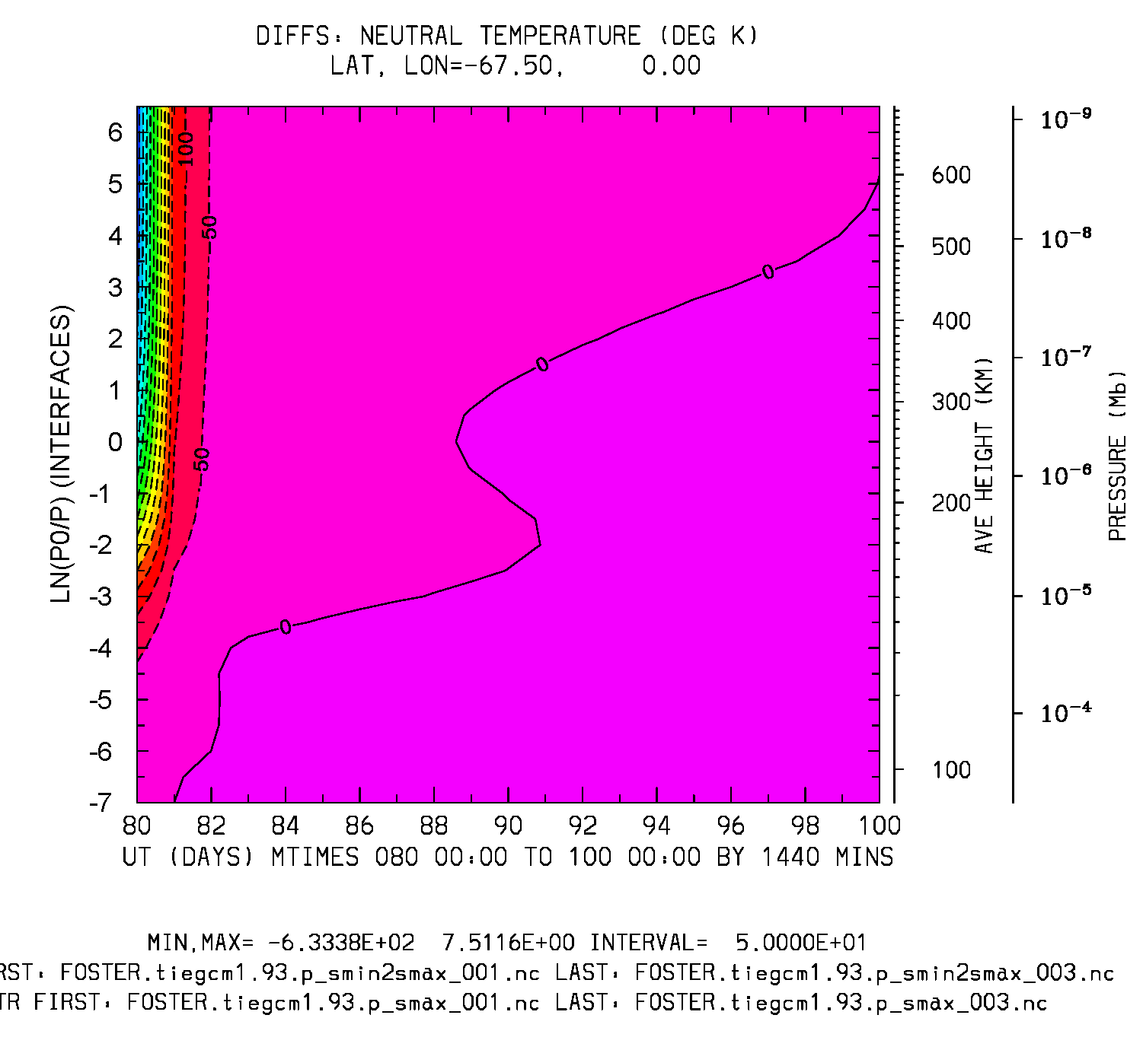
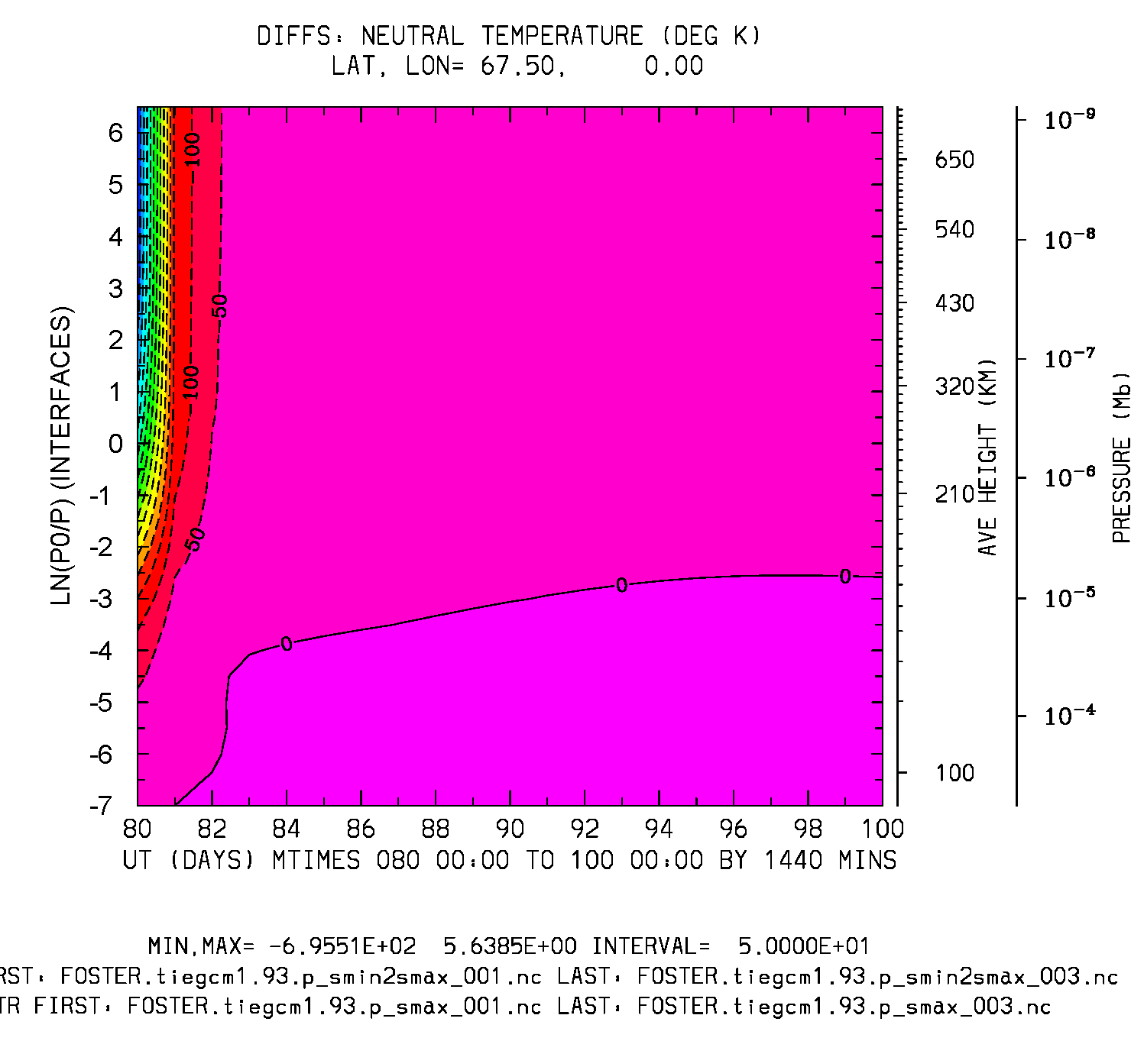
Difference: smin2max minus smax
UT vs ZP (days 80-100)
Neutral Temperature (deg K)
TN: Lat,lon = -67.5,0
TN: Lat,lon = 67.5,0
Min,Max = -633, 7.5
Interval = 50
Min,Max = -695, 5.6
Interval = 50

Slide 5
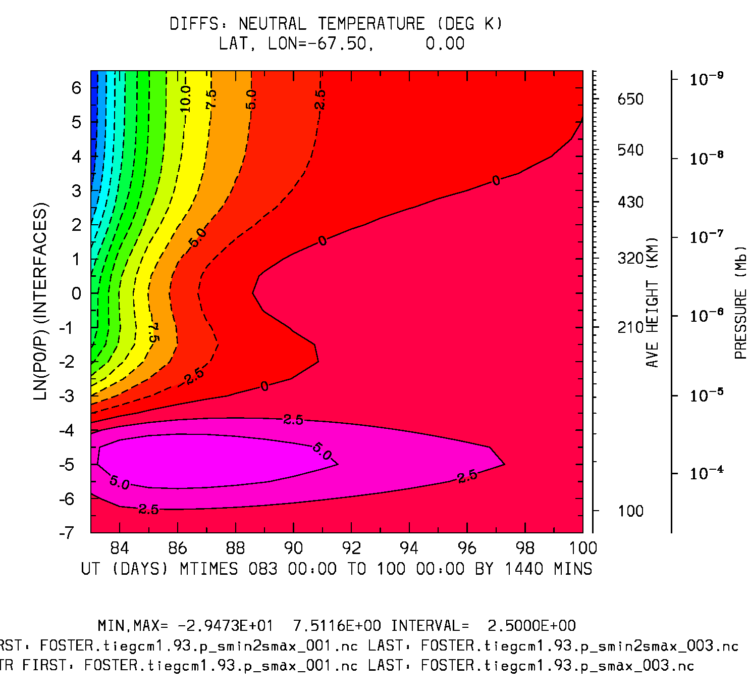
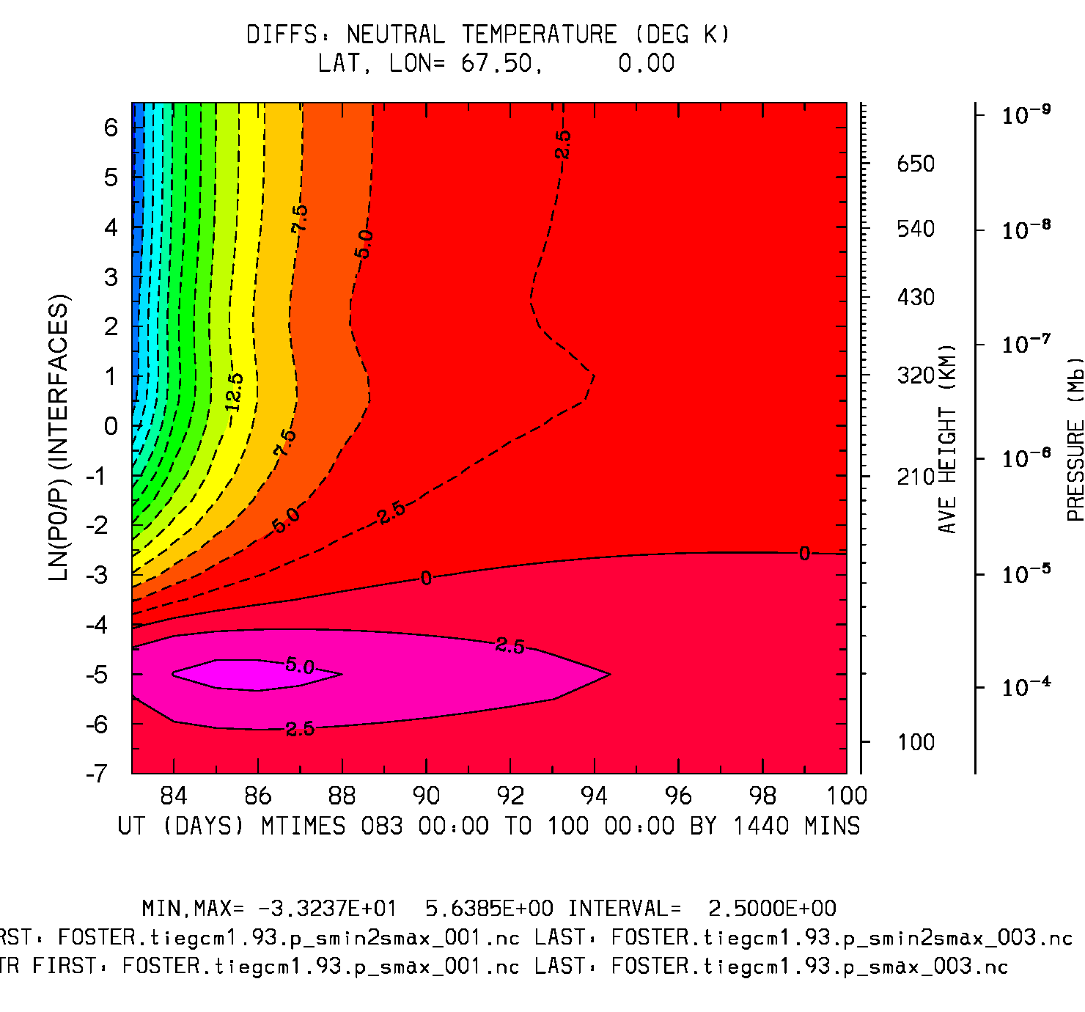
Difference: smin2max minus smax
UT vs ZP (days 83-100)
Neutral Temperature (deg K)
TN: Lat,lon = -67.5,0
TN: Lat,lon = 67.5,0
Min,Max = -29, 7.5
Interval = 2.5
Min,Max = -33, 5.6
Interval = 2.5

Slide 6
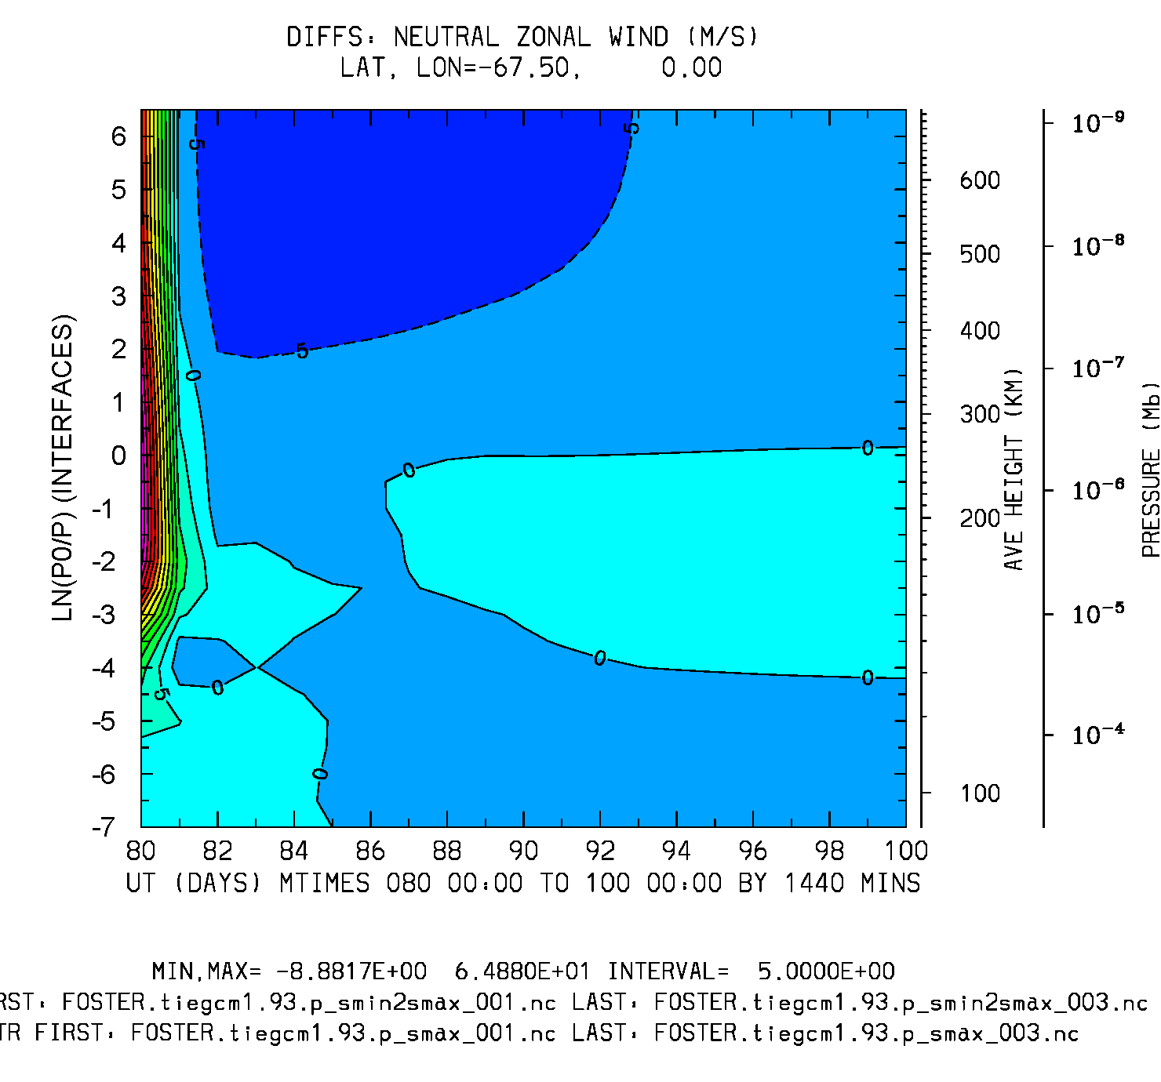
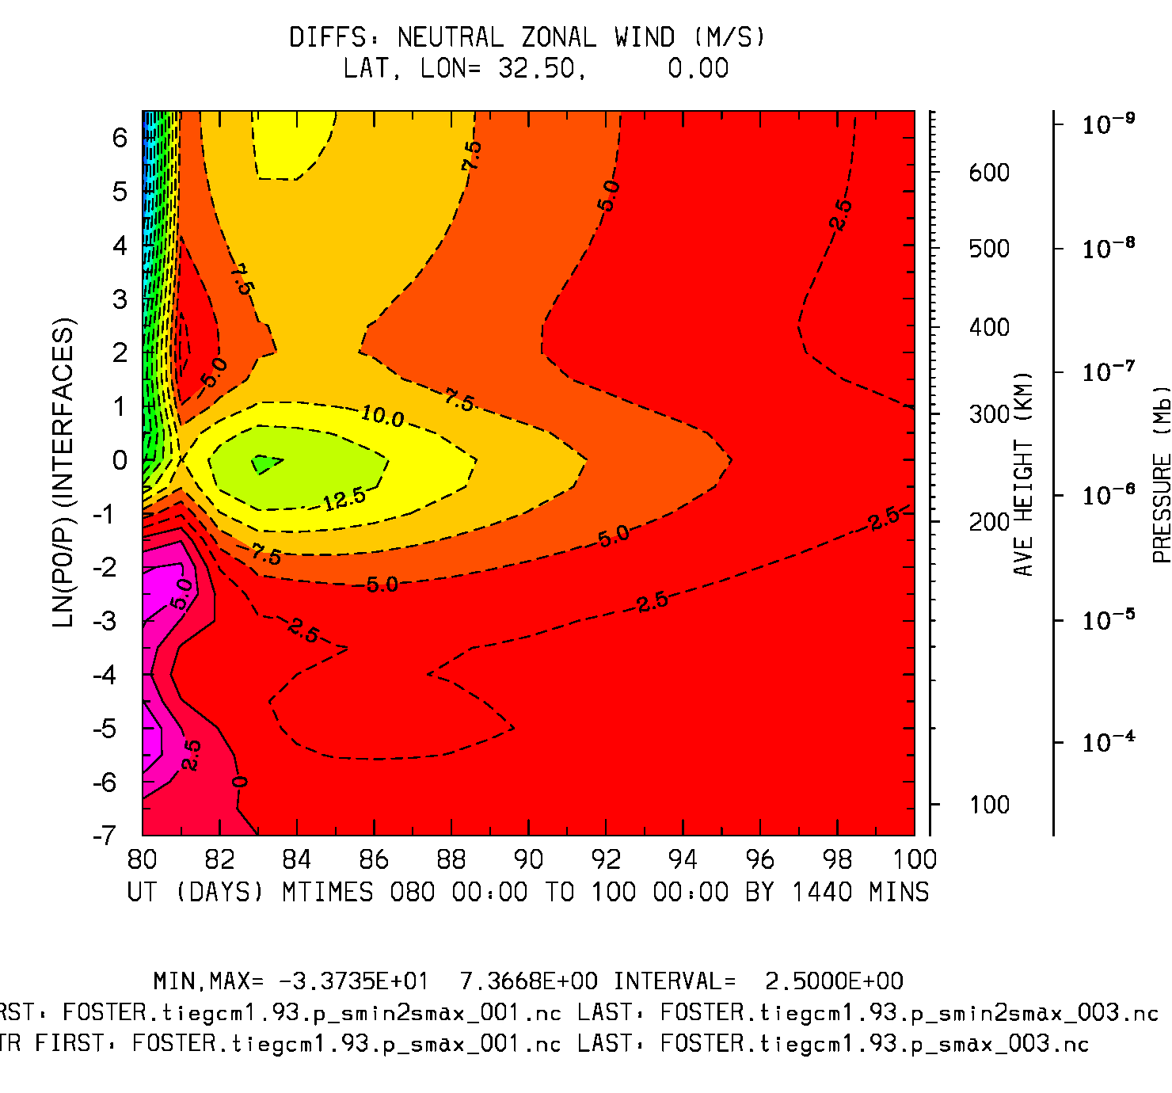
Difference: smin2max minus smax
UT vs ZP (daily histories)
Neutral Zonal Wind (m/s)
Lat,lon = -67.5,0
Min,Max=-9, 65
Interval = 5.
Lat,lon = 32.5,0
Min,Max = -34, 7
Interval = 2.5

Slide 7
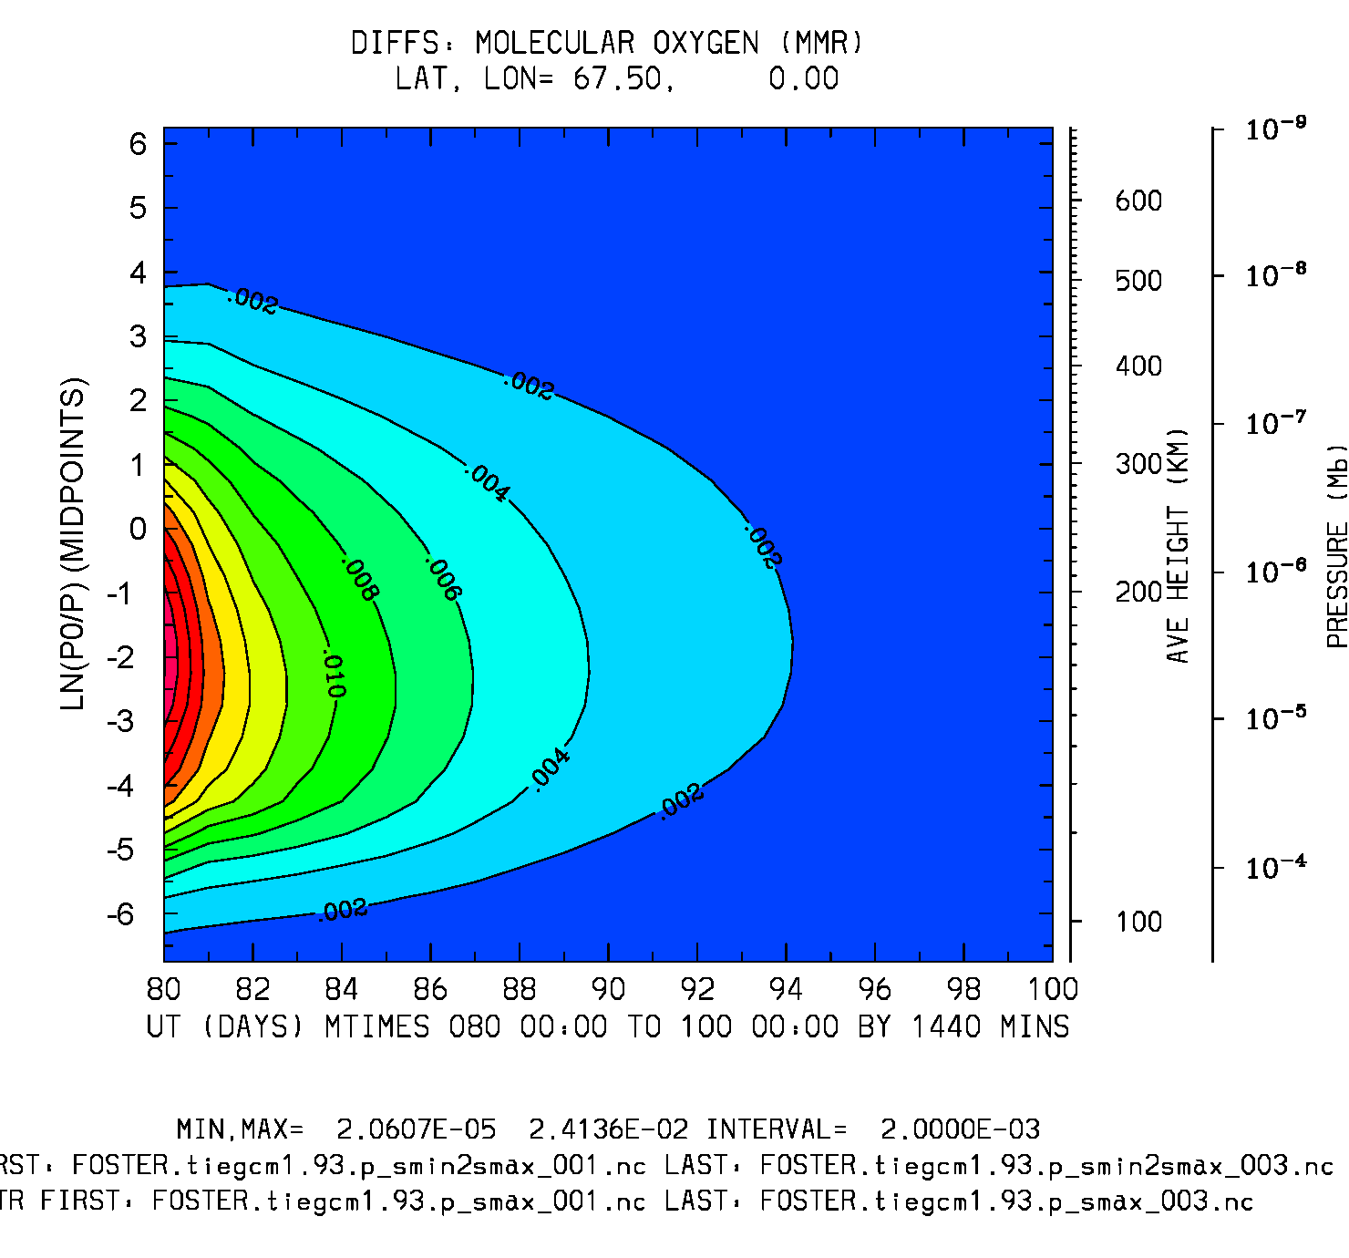
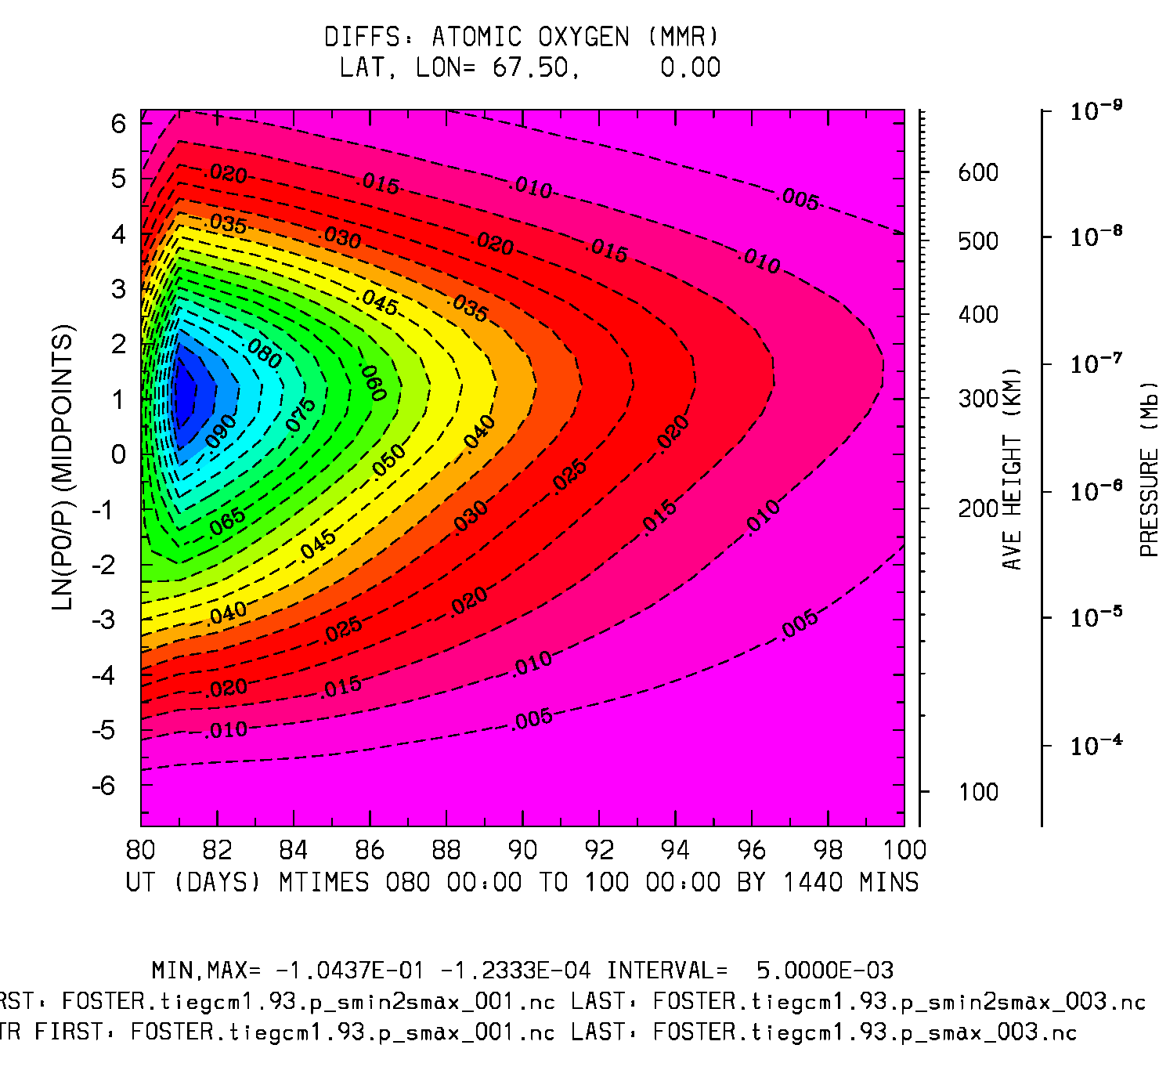
Difference: smin2max minus smax
UT (20 days) vs Zp
O2 (mmr) Lat=67.5
O (mmr) Lat=67.5
Min,Max = 2e-5, .024
Interval = 2.e-3
Min,Max = -.1, -1.2e-4
Interval = 5.e-3

Slide 8
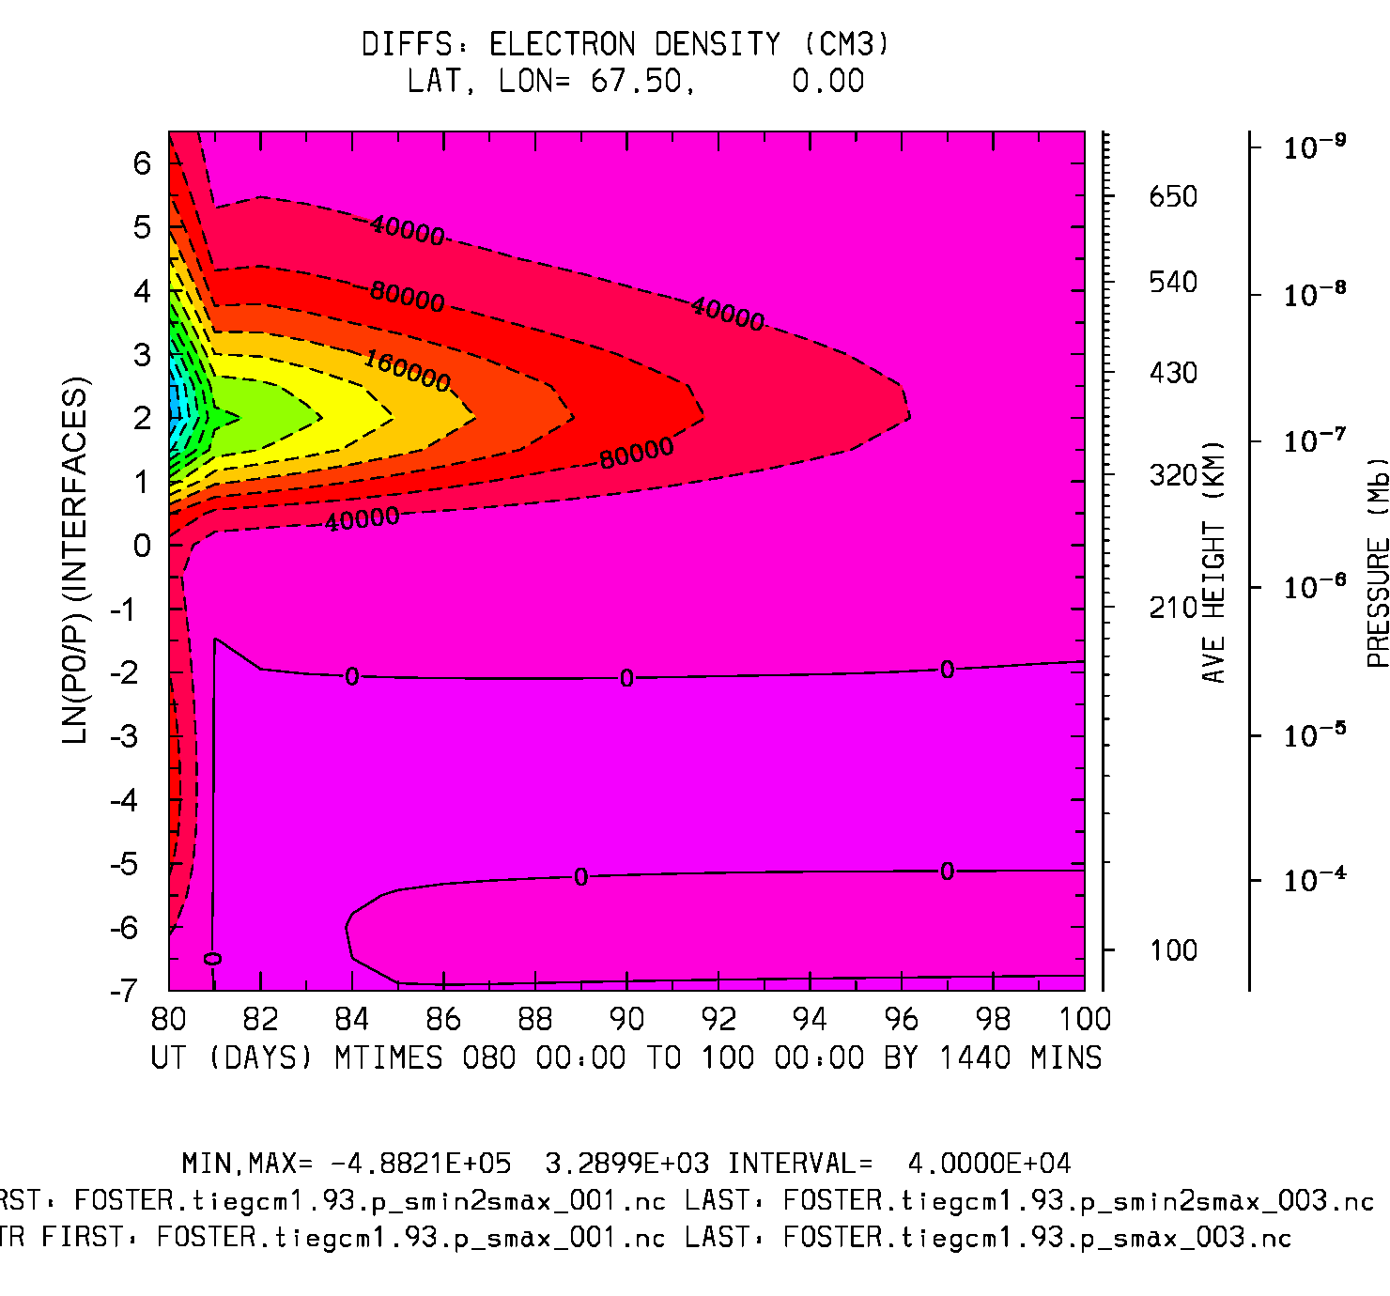
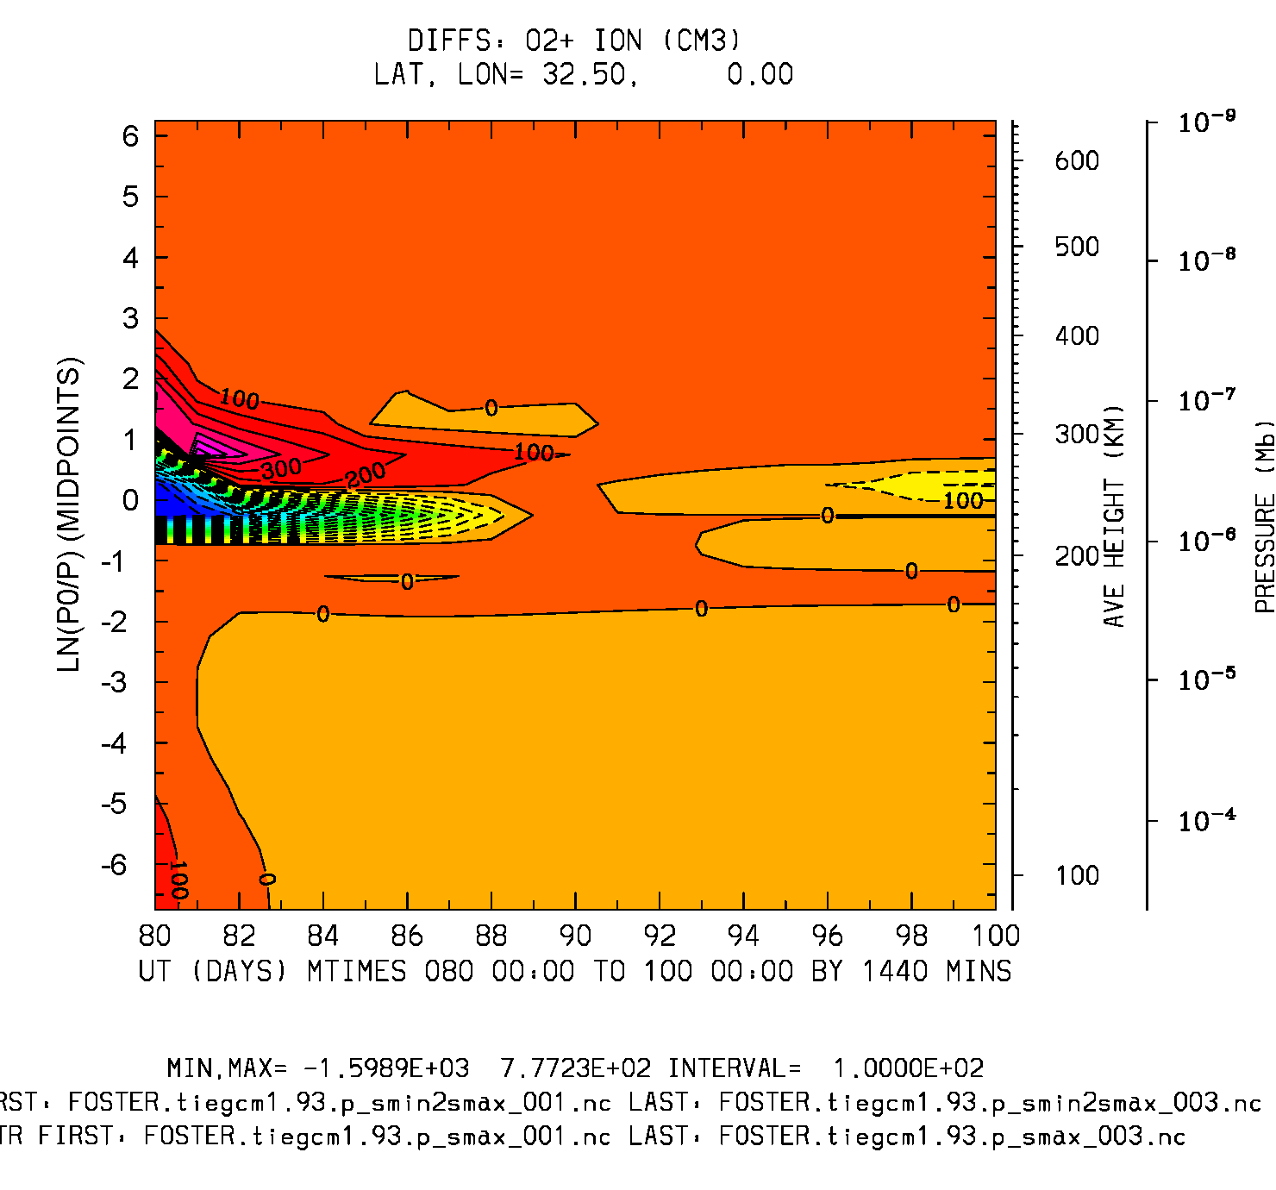
Difference: smin2max minus smax
UT (20 days) vs ZP
NE (cm3) Lat=67.5
O2+ (cm3) Lat=32.5
Min,Max=-5e5,3.3e3
Interval = 40,000
Min,Max=-1600,777
Interval = 100.

Slide 9
Equilibration to a 15-day Temporal Offset from the Source History:
Obtain a day 95 control source history:
Run days 80-95 from steady-state day 80 history
Control Run:
Run days 95-115 from day 95 source (step 1)
Offset Run:
Run days 95-115 from day 80 source (15-day offset)
Plot differences of Offset minus Control runs:
Ut vs Zp and Ut vs Latitude (daily histories)
Assess recovery time and structure

Slide 10
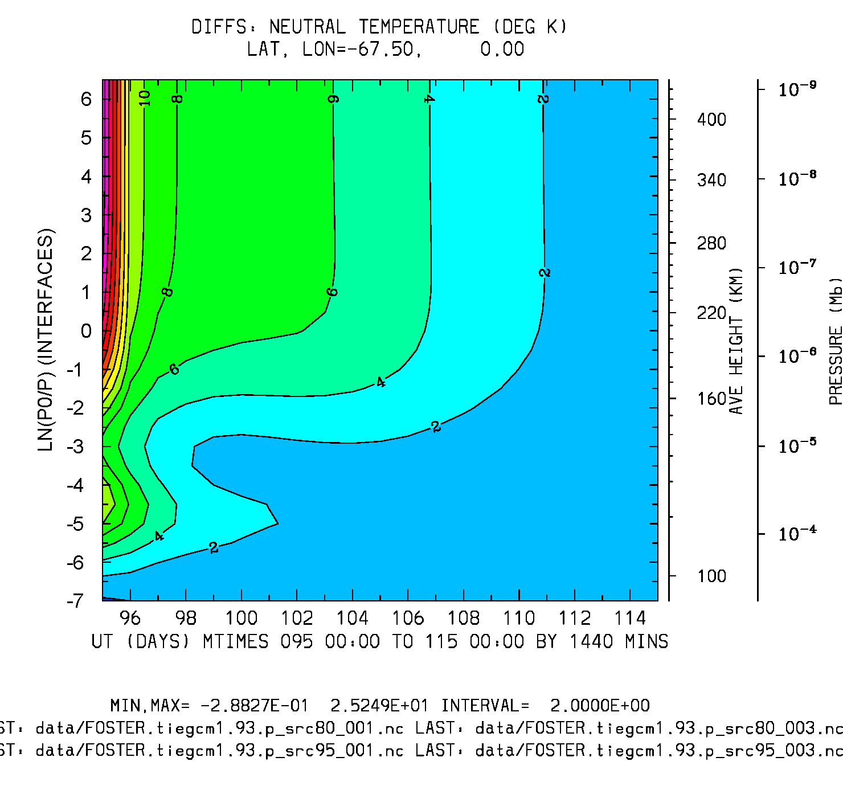
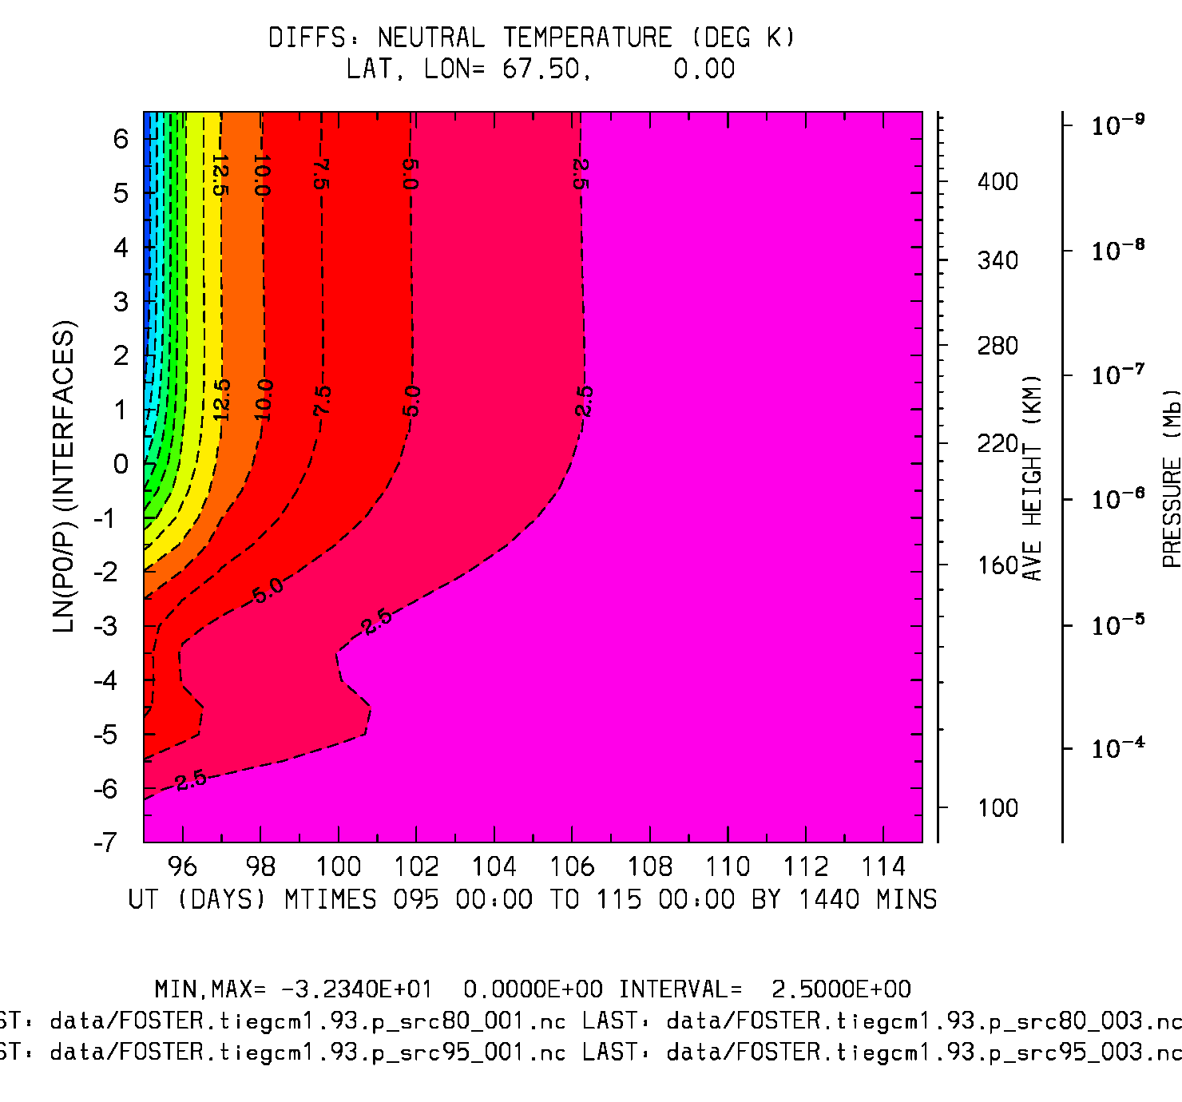
Difference: 15-day Offset run Minus Control
UT (20 days) vs Zp
Neutral Temperature (deg K)
Lat, lon = -67.5, 0
Lat, lon = 67.5, 0
Min,Max = -0.3, 25
Interval = 2.
Min,Max = -32, 0
Interval = 2.5

Slide 11
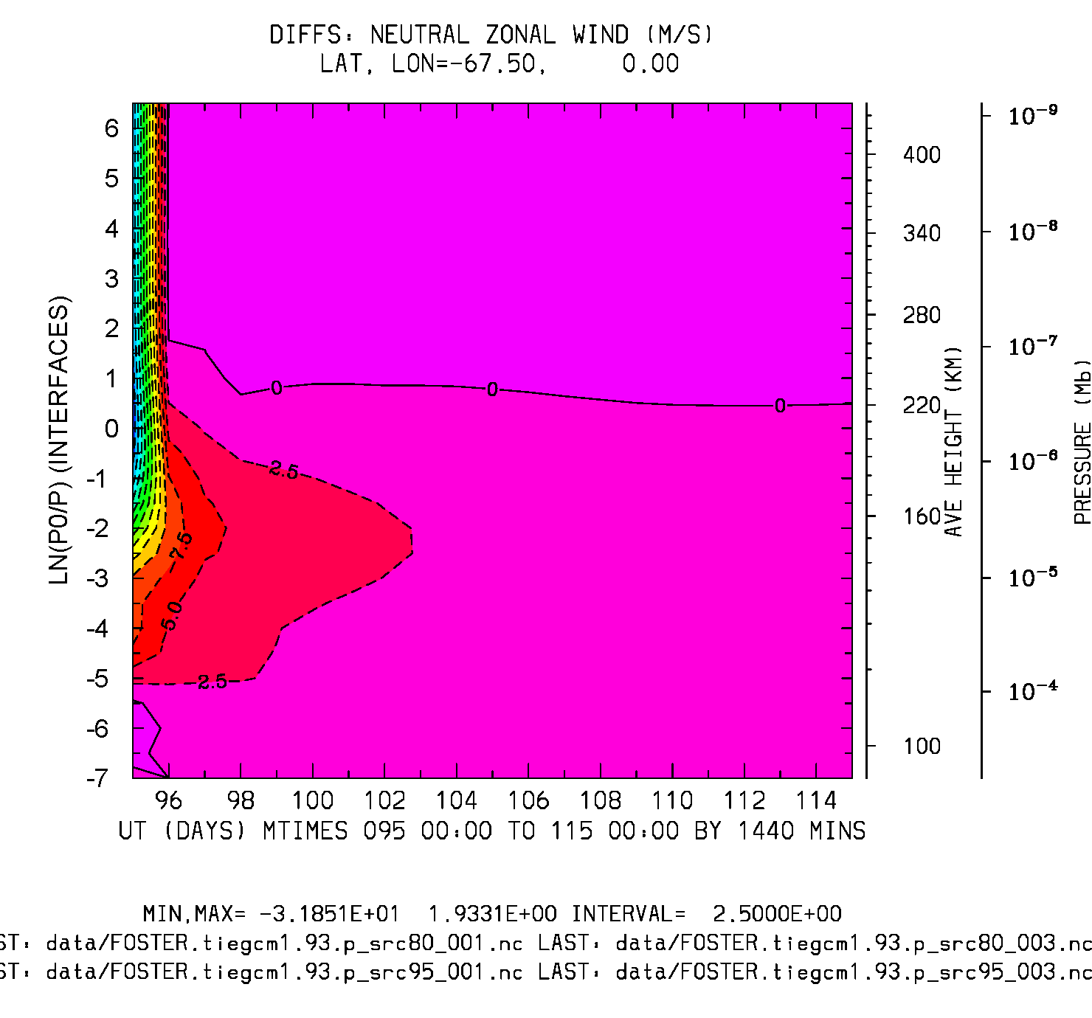
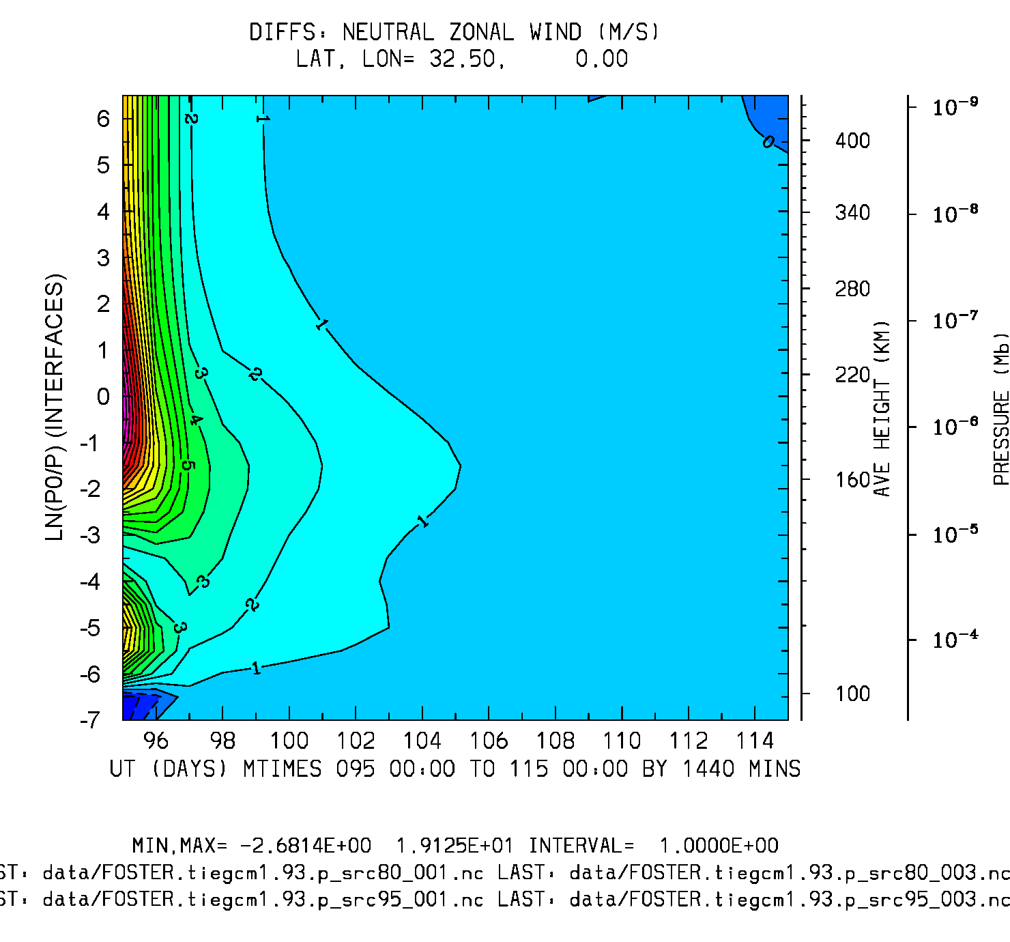
Difference: 15-day Offset run Minus Control
UT (20 days) vs Zp
Neutral Zonal Wind (m/s)
Lat, lon = -67.5, 0
Lat, lon = 32.5, 0
Min,Max = -32, 1.9
Interval = 2.5
Min,Max = -2.7, 1.9
Interval = 1.0

Slide 12
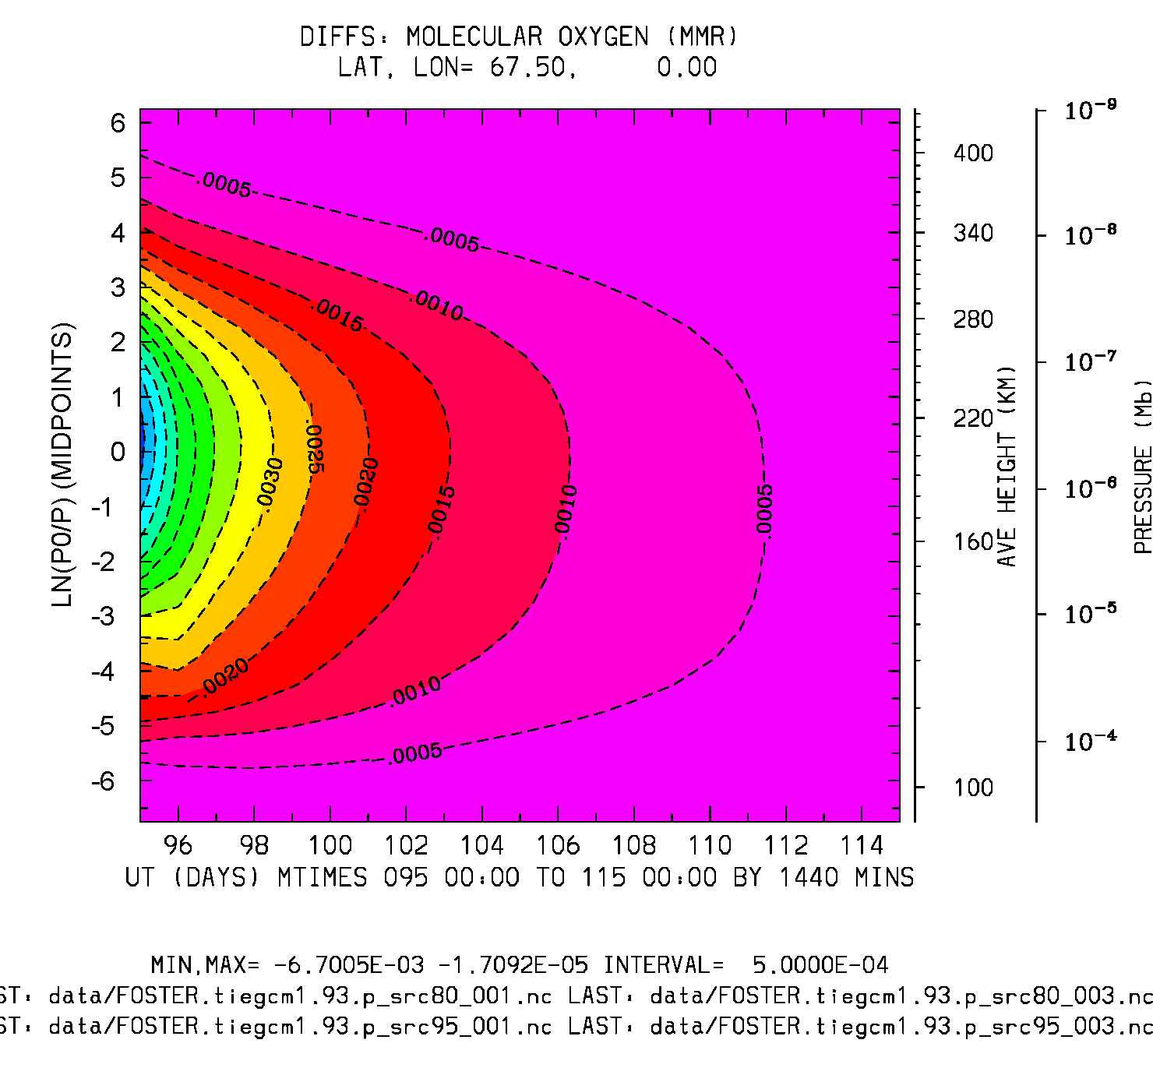
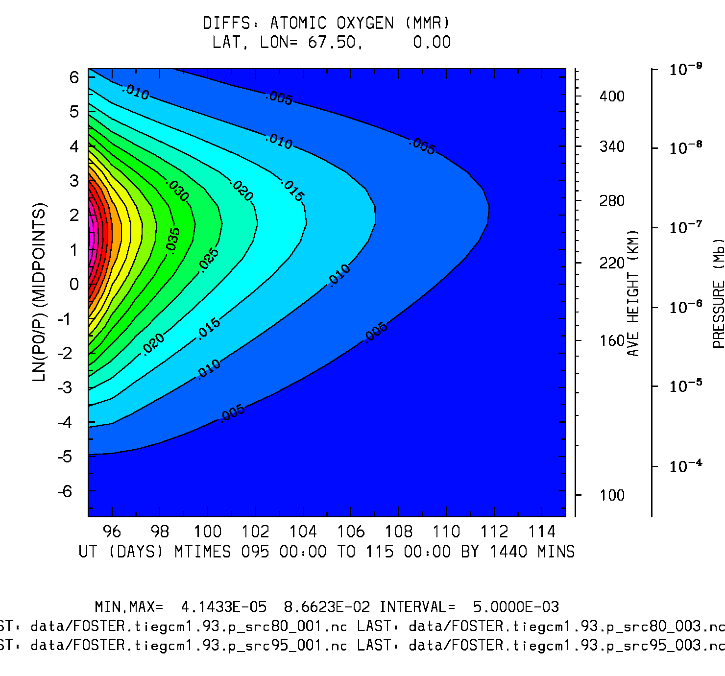
Difference: 15-day Offset run Minus Control
UT (20 days) vs Zp
O2 (mmr)
O (mmr)
Lat, lon = 67.5, 0
Lat, lon = 67.5, 0
Min,Max = -6.7e-3, -1.7e-5
Interval = 5.e-4
Min,Max = 4.1e-5, 8.7e-2
Interval = 5.e-3

Slide 13
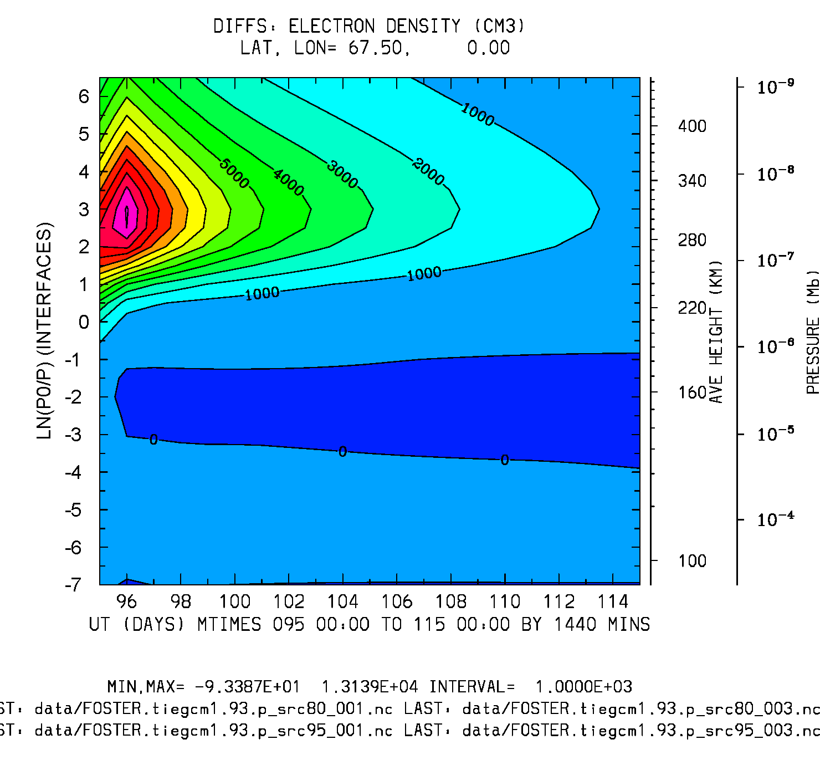
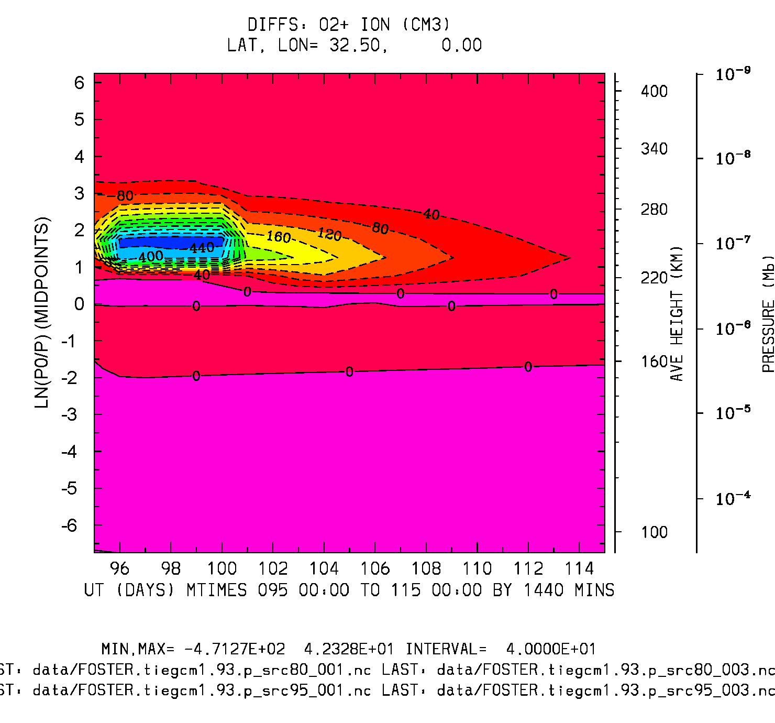
Difference: 15-day Offset run Minus Control
UT (20 days) vs Zp
NE (cm3)
O2+ (cm3)
Lat, lon = 67.5, 0
Lat, lon = 32.5, 0
LBC?
Min,Max = -93, 1.3e4
Min,Max = -471, 42

Slide 14
Side-by-side Comparisons of the two cases: smin2max and 15-day offset

Slide 15
Case Comparisons
TN: Ut vs Zp, Lat -67.5
Differences: smin2smax
Days 83-100
TN: Lat = -67.5
Differences: 15-day Offset
Days 80-100
TN: Lat = -67.5
Min,Max = -29, 7.5
Interval = 2.5
Min,Max = -0.3, 25
Interval = 2.0

Slide 16
Case Comparisons
NE: Ut vs Zp, Lat 67.5
Differences: smin2smax
Differences: 15-day Offset
Min,Max=-5e5, 3.3e3
Interval = 40,000
Min,Max = -93, 1.3e4
Interval = 1000

Slide 17
Replicating CCMC Simulations:
A 5-day GPI/Linux run was made by the CCMC, following a 20-day equilibration run.
A series of equivalent 5-day GPI runs were made on a 64-bit HAO Linux machine (arc), following different equilibration times:
5-day equilibration preceding 5-day production run
10-day equilibration preceding 5-day production run
20-day equilibration preceding 5-day production run
Comparisons are made between CCMC output and the three HAO runs.

Slide 18
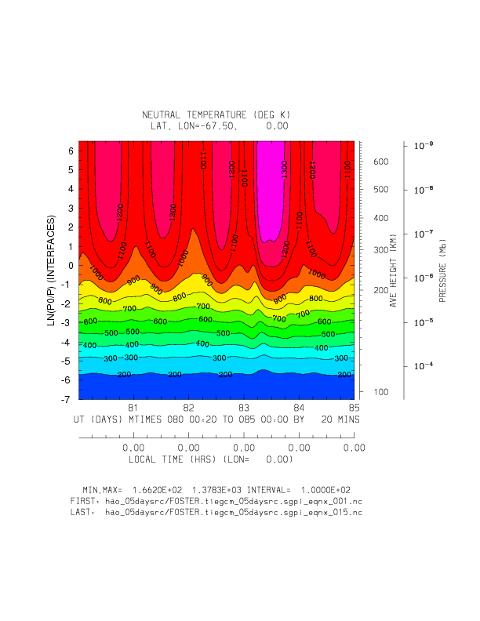
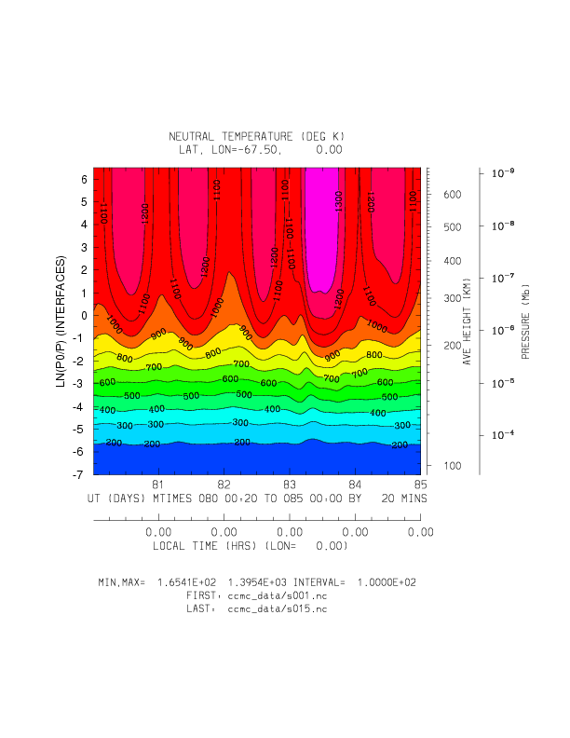
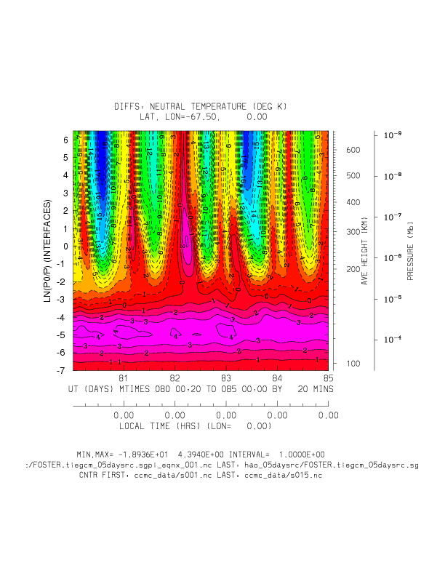
CCMC vs HAO/5-day spinup TN: Ut vs Zp (20-minute histories)
HAO
CCMC
Diffs: HAO-CCMC
Full Field: Min,Max = 165, 1395 (deg K)
Diffs: Min,Max = -19, 4.4 (K)

Slide 19
Differences: HAO minus CCMC (5, 10, and 20 day HAO spinups) TN: Ut vs Zp (20-min histories)
Diffs: 5-day spinup
Diffs: 10-day spinup
Diffs 20-day spinup
Min,Max = -19,4.4 deg K
Interval = 1.
Min,Max = -8,2.5 deg K
Interval = 0.5
Min,Max = 0,0 deg K

Slide 20
The End
(additional plots follow)

Slide 21
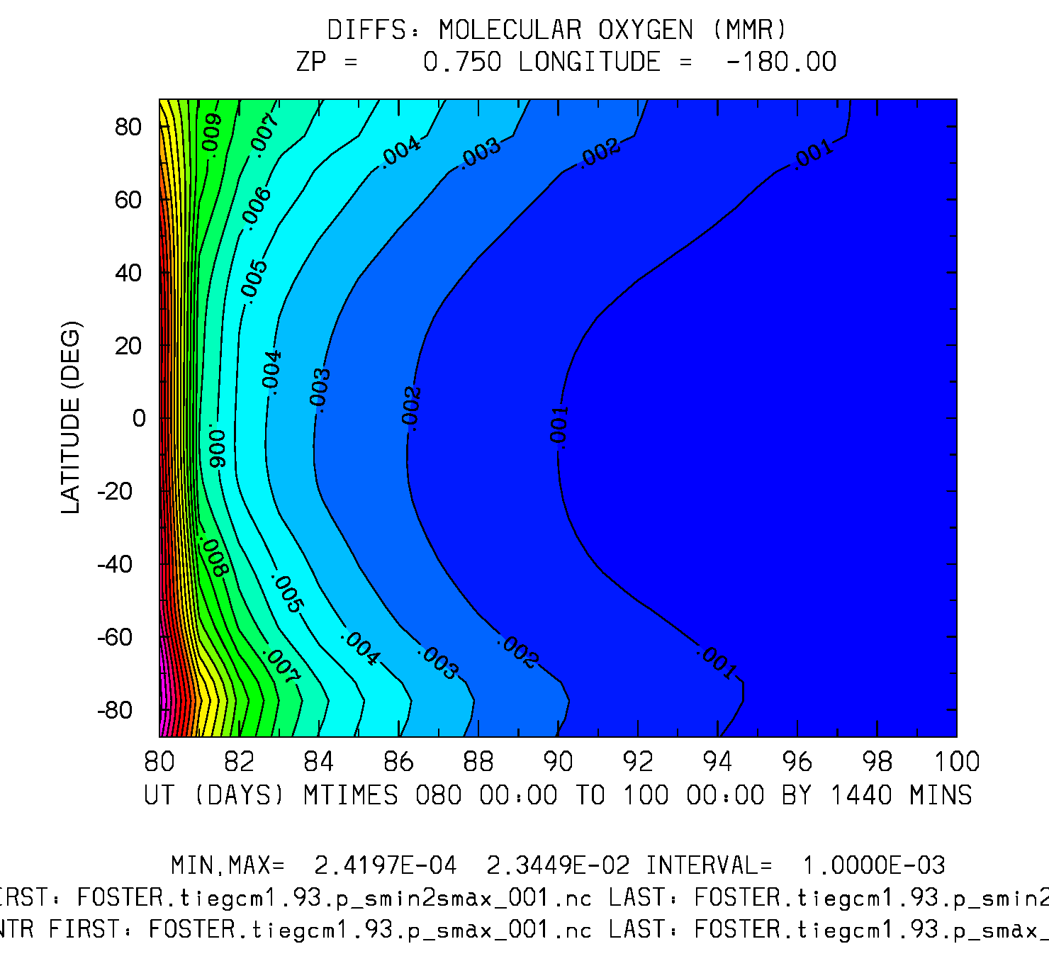
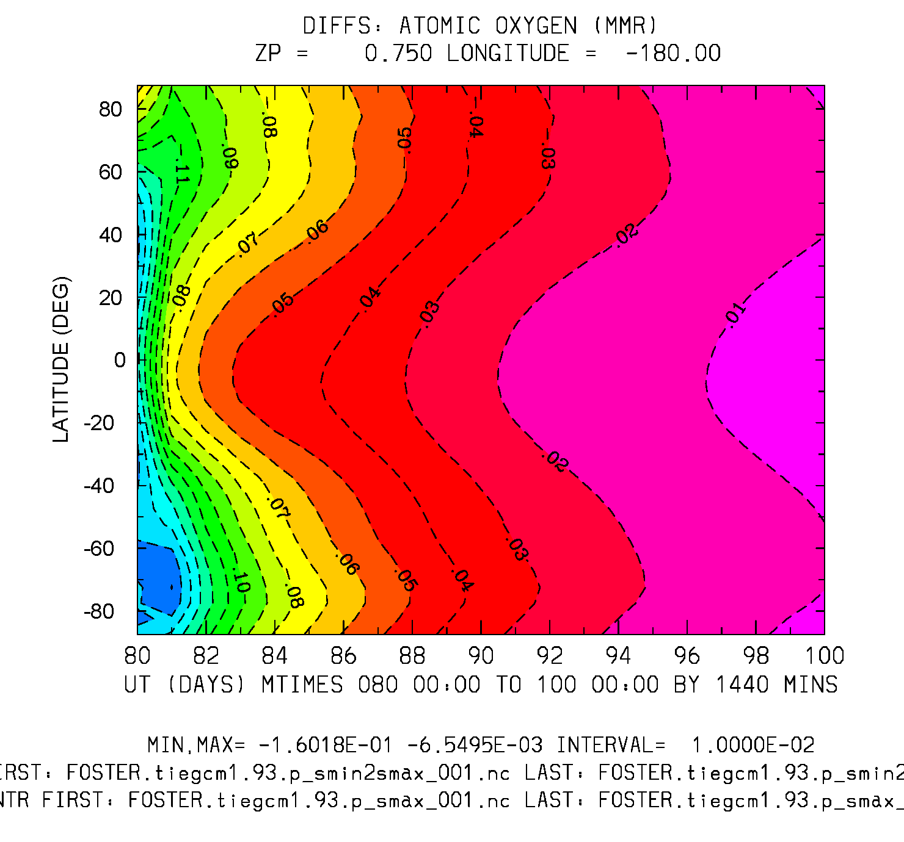
Difference: smin2max Offset minus smax Control
UT (20 days) vs Latitude
O2 (mmr) Zp = 0.75
O (mmr) Zp = 0.75
Min,Max = 2.4e-4, 2.3e-2
Min,Max = -1.6e-1, -6.5e-3

Slide 22
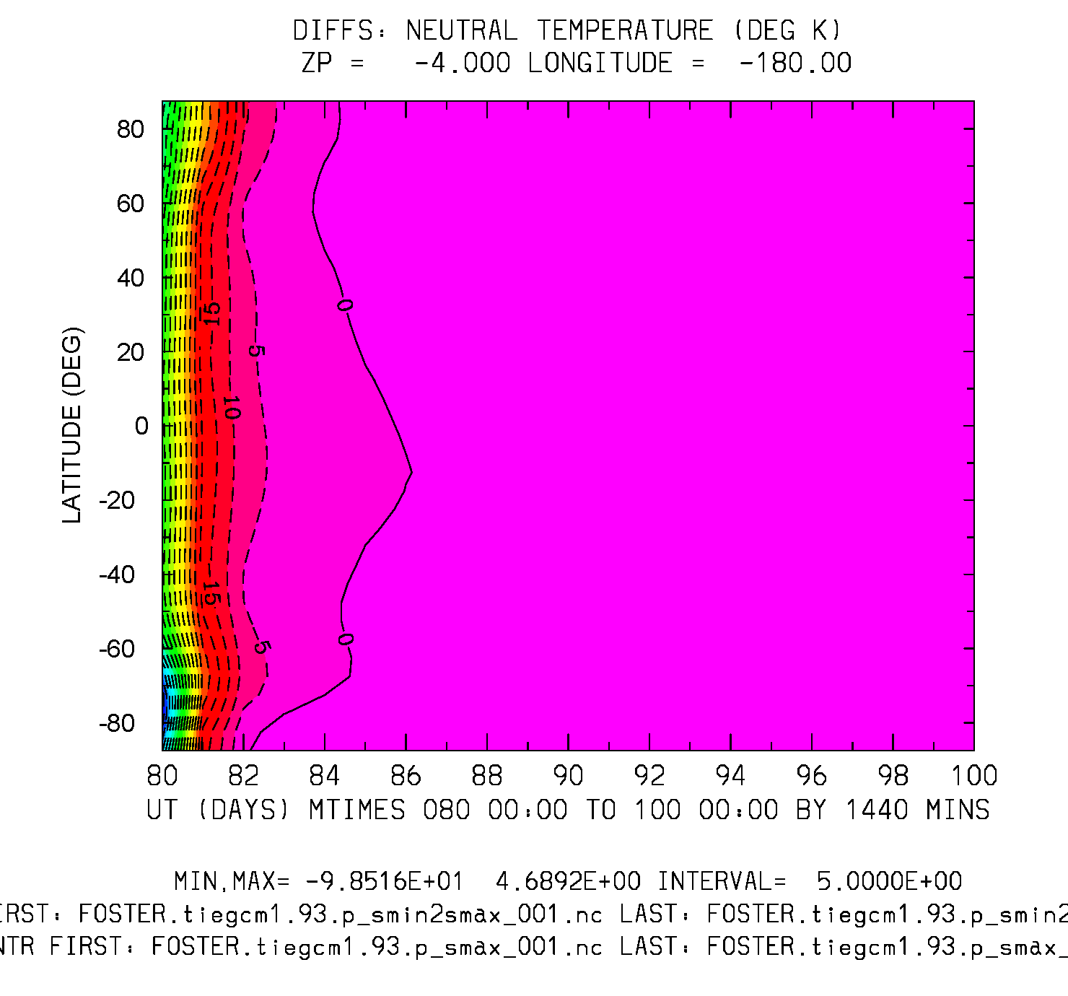
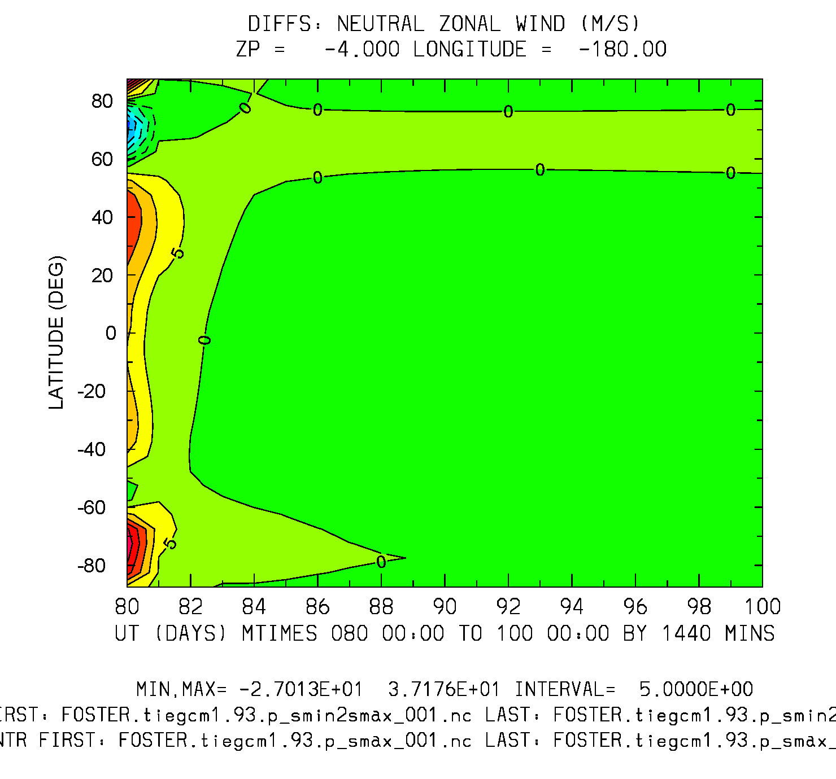
Difference: smin2max minus smax
UT vs Latitude (daily)
TN (deg K) Zp=-4
UN (m/s) Zp=-4
Min,Max = -100, 4.7
Interval = 5.
Min,Max=-27,37
Interval = 5.

Slide 23
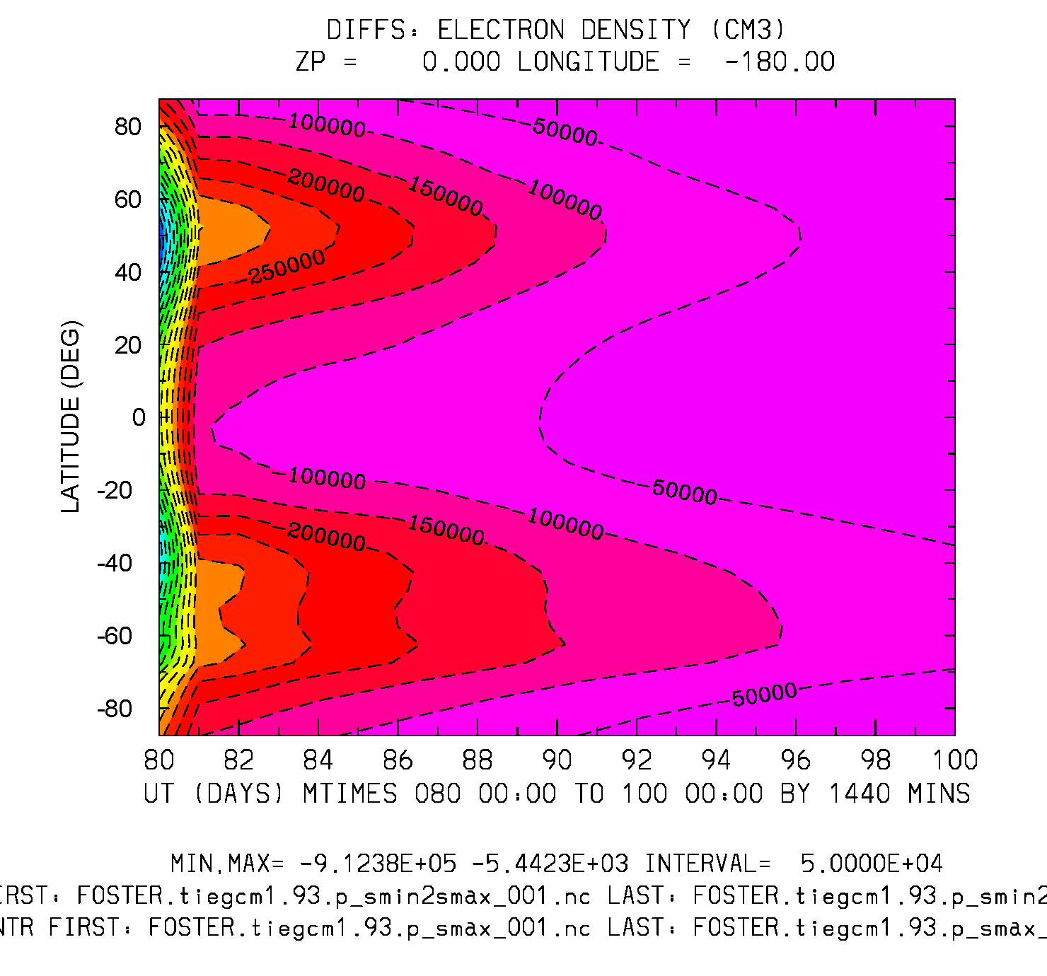
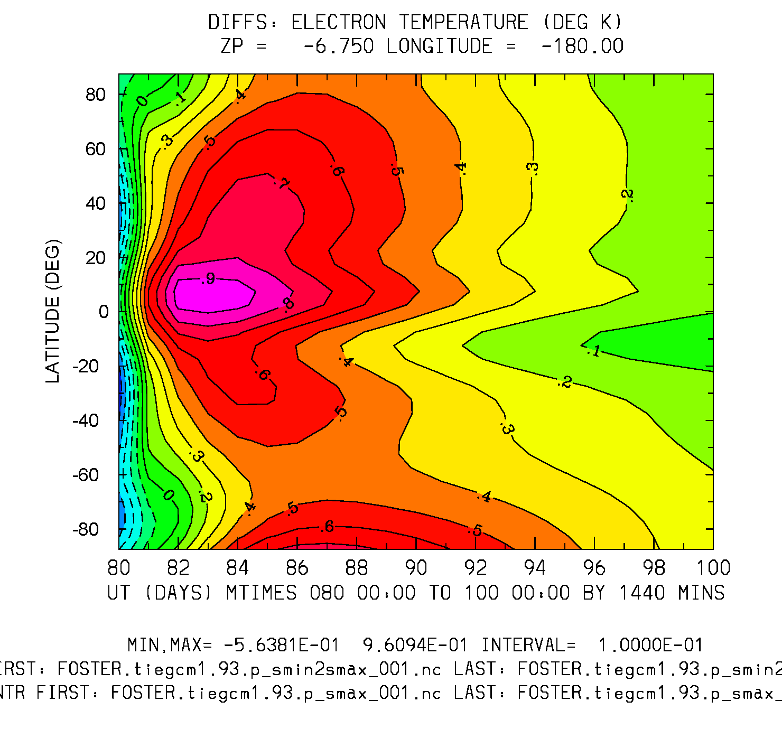
Difference: smin2max minus smax
UT vs Latitude
NE (cm3) Zp = 0
TE (deg K) Zp = -6.75
Min,Max=-9e5,-5e3
Interval = 5.e4
Min,Max=-.5,.96
Interval = 0.1

Slide 24
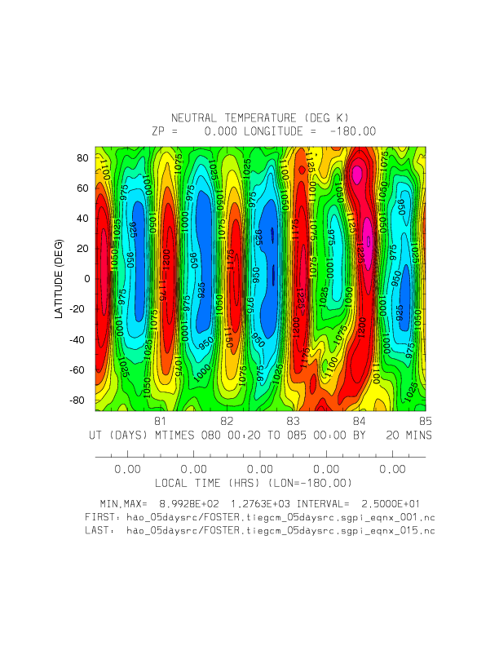
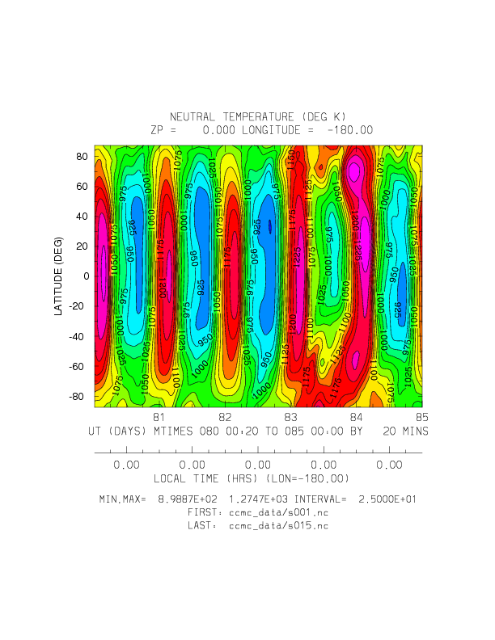
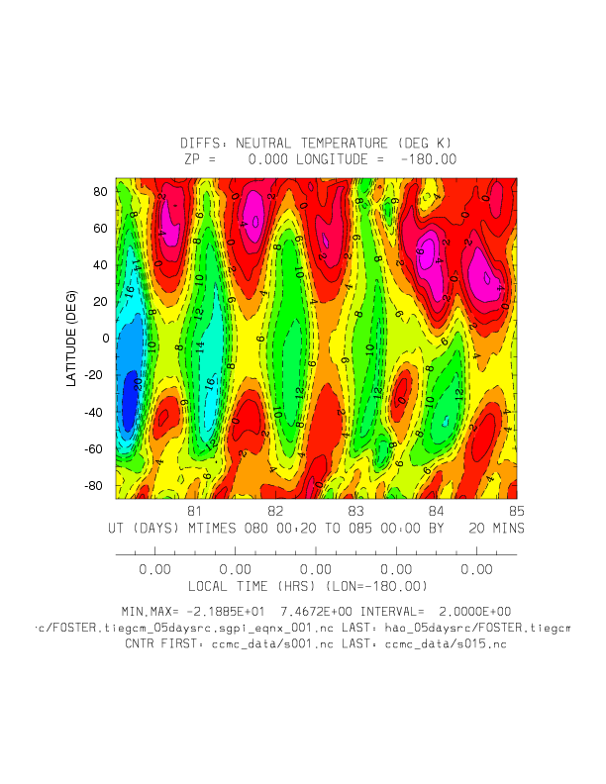
CCMC vs HAO/5-day spinup: TN: Ut vs Latitude (20-minute histories)
HAO
CCMC
Diffs: HAO-CCMC
Full Field: Min,Max = 900, 1275 (deg K)
Diffs: Min,Max = -22, 7.5 (K)

Slide 25
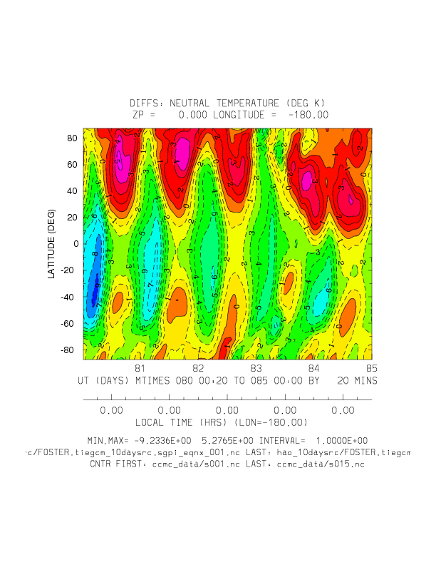
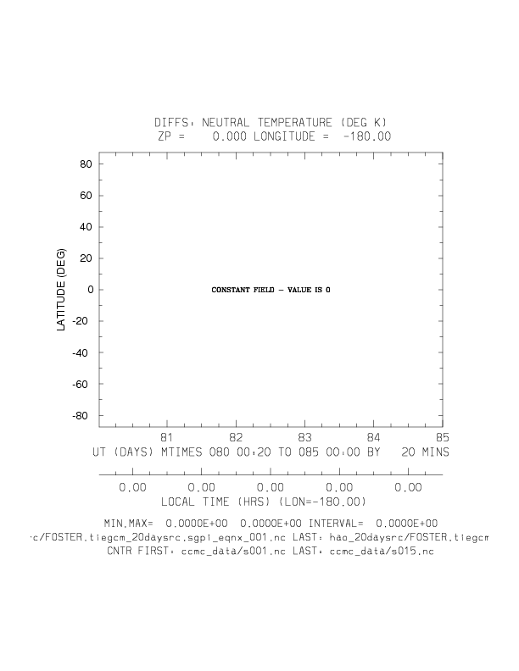
Differences: HAO minus CCMC (5, 10, and 20 day HAO spinups) TN: Ut vs Latitude (20-min histories)
Diffs: 5-day spinup
Diffs: 10-day spinup
Diffs 20-day spinup
Min,Max = -22,7.5 deg K
Min,Max = -9.2,5.2 deg K
Min,Max = 0,0 deg K

Slide 26
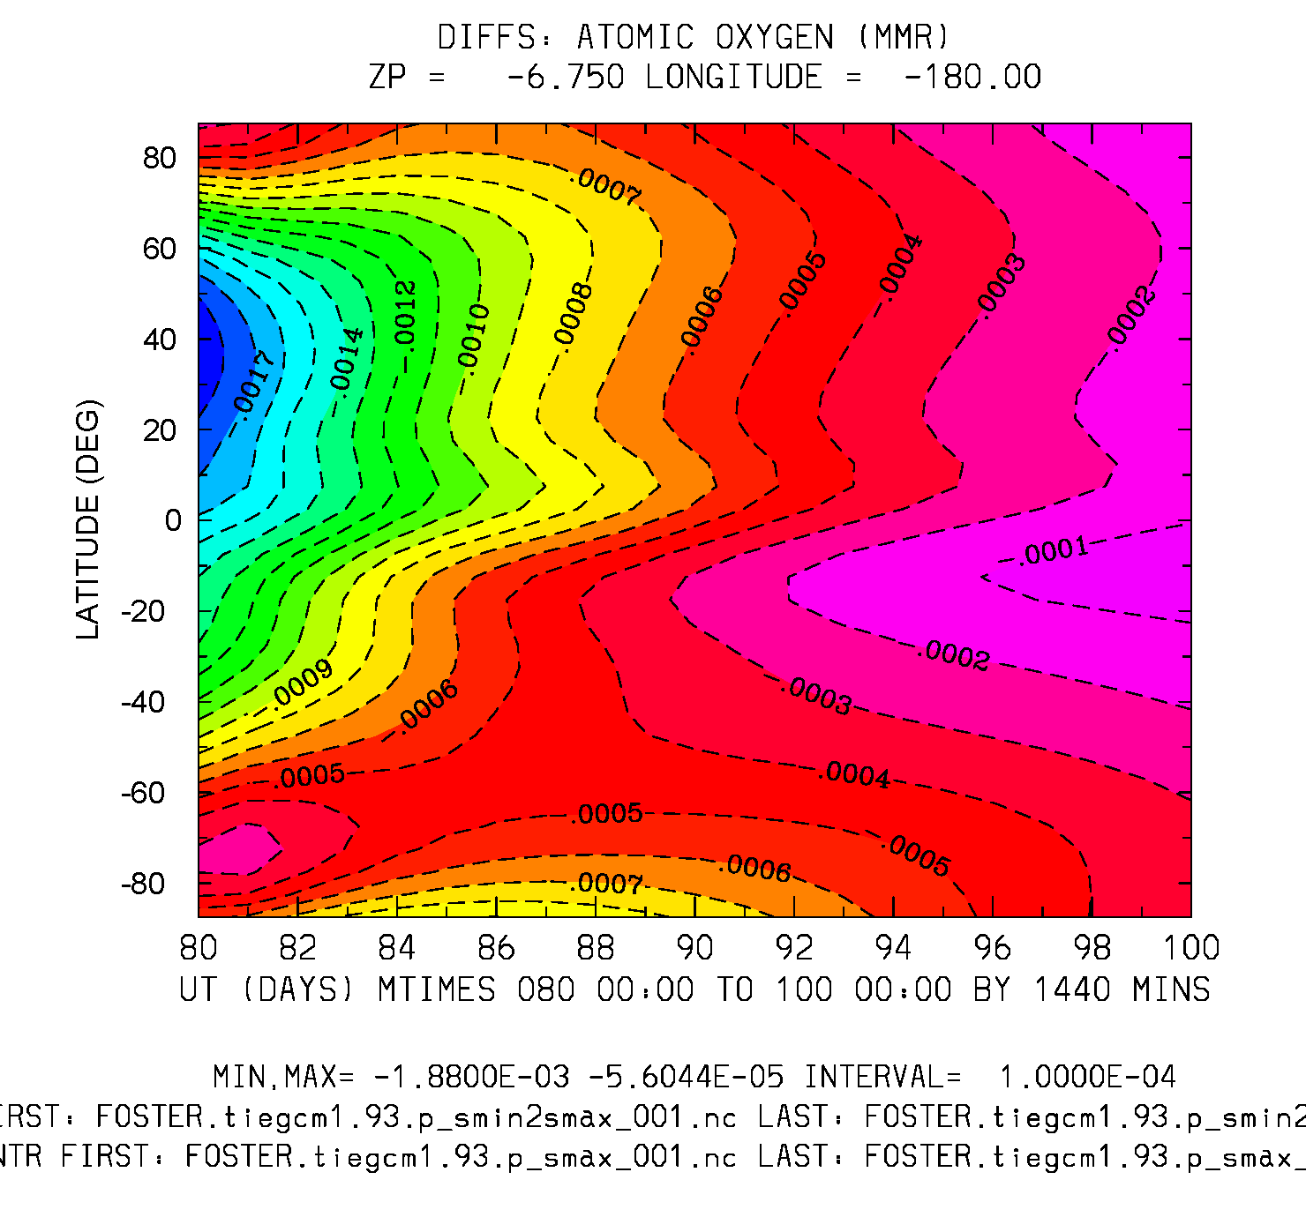
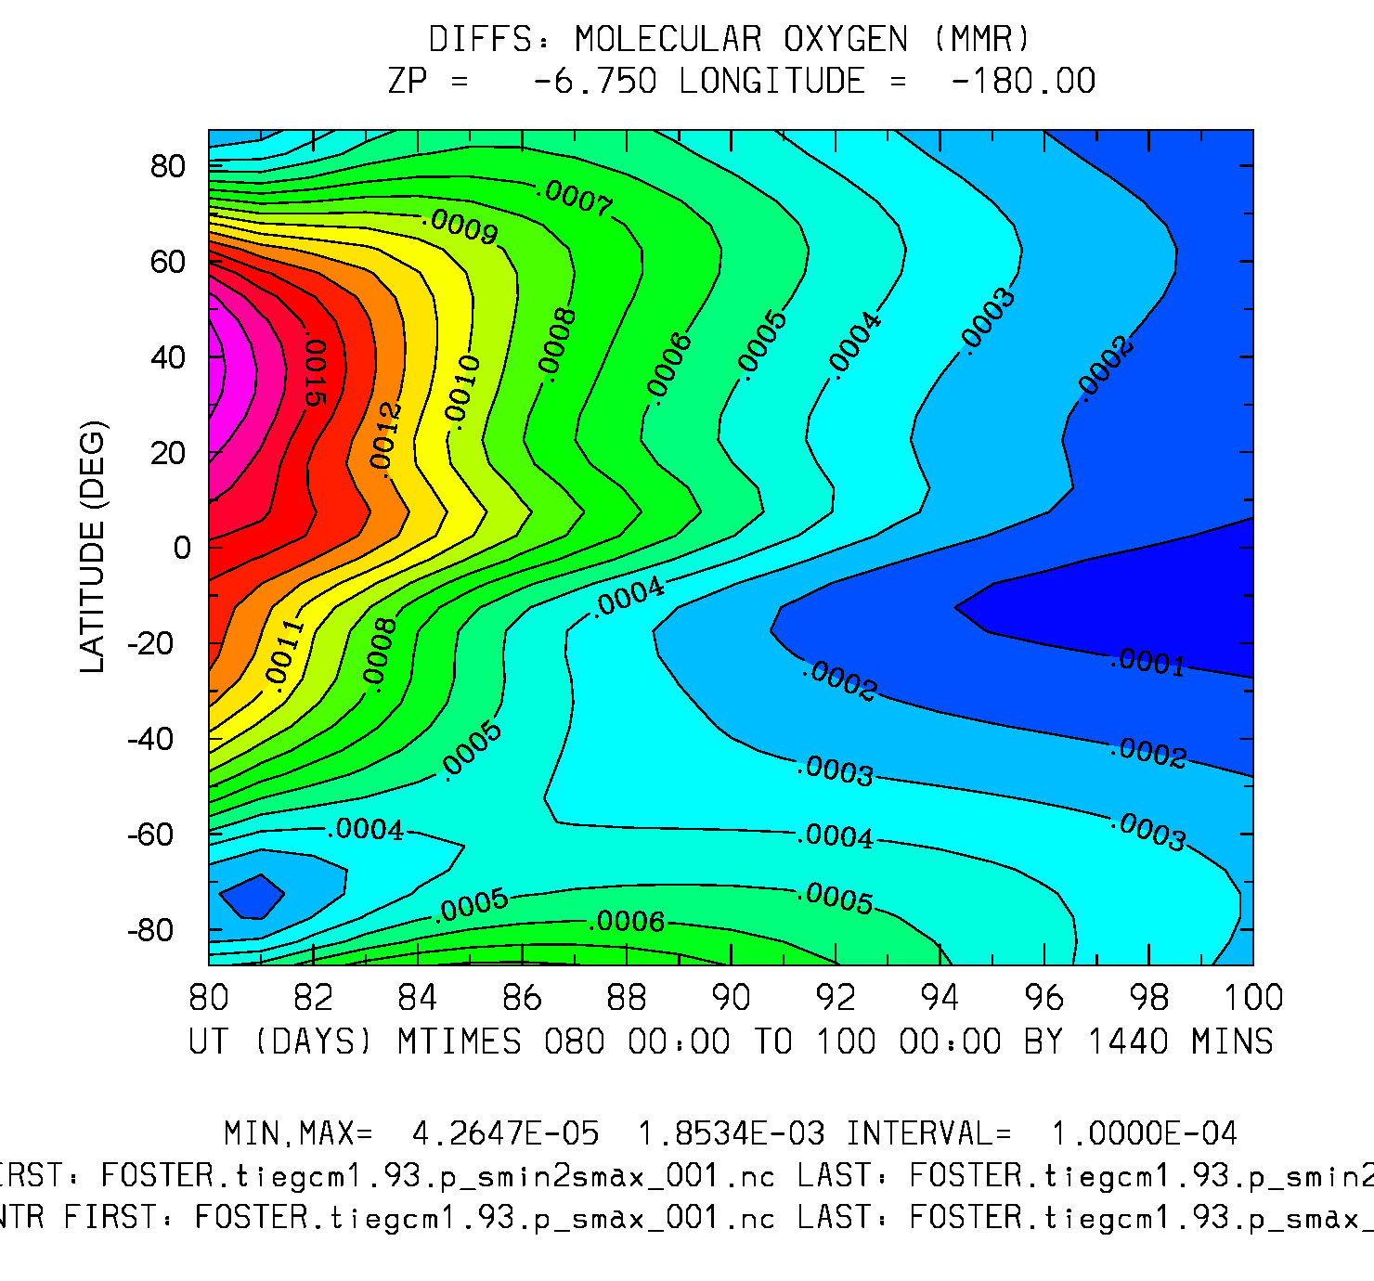
Difference: smin2max minus smax
UT (20 days) vs Latitude
O2 (mmr) Zp = -6.75
O (mmr) Zp = -6.75
Min,Max=4e-5,2e-3
Interval = 1.e-4
Min,Max=-2e-3,-6e-5
Interval = 1.e-4

Slide 27
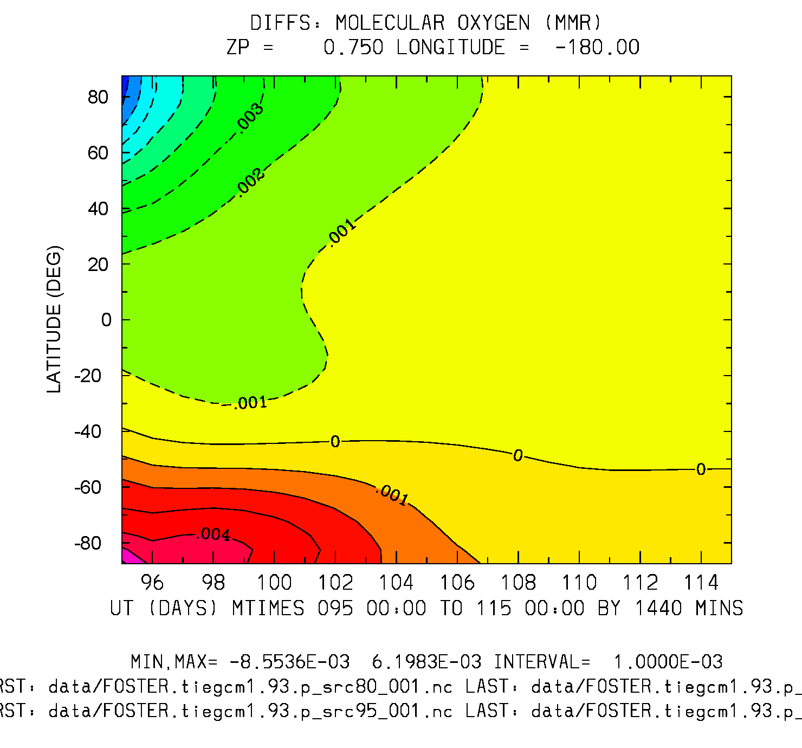
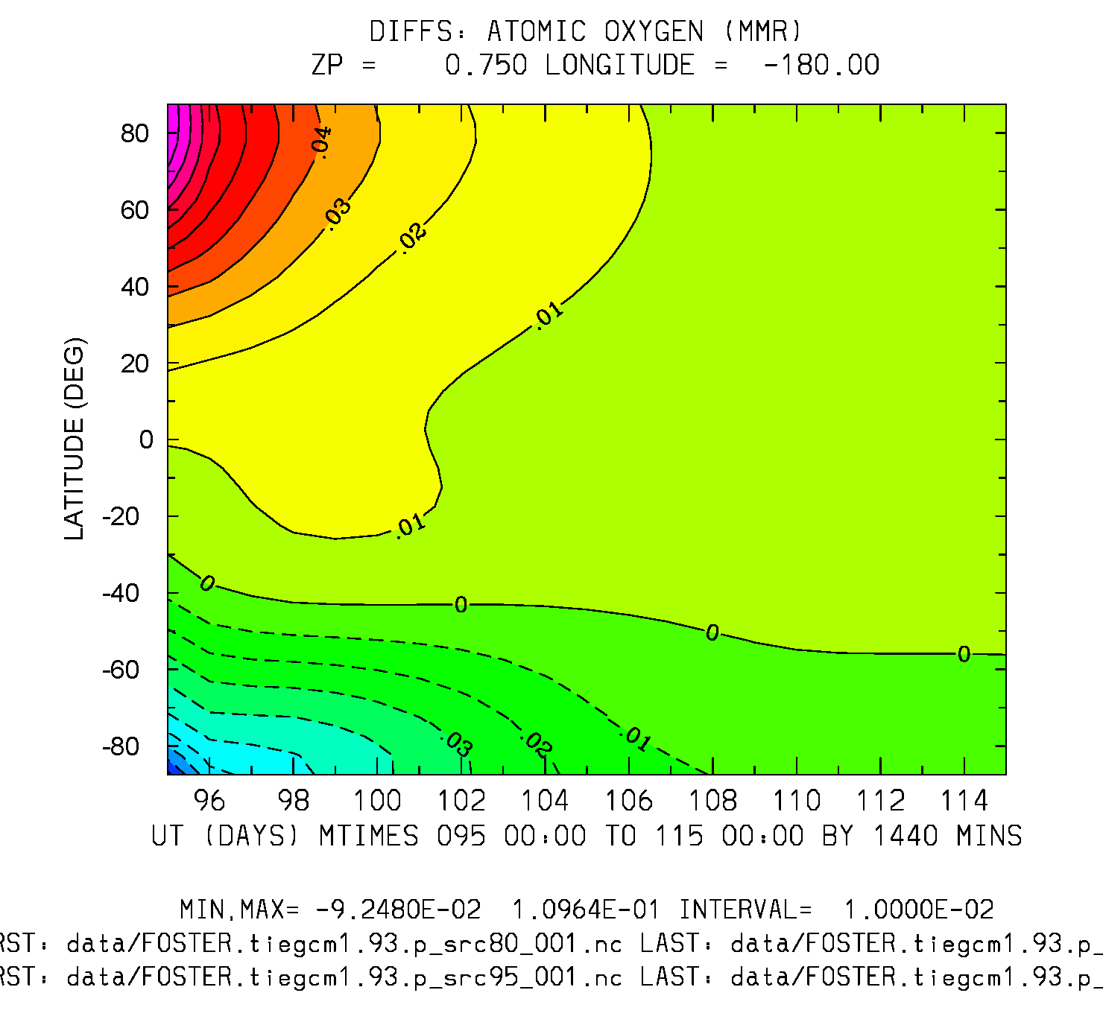
Difference: 15-day Offset run Minus Control
UT (20 days) vs Latitude
O2 (mmr) Zp = 0.75
O (mmr) Zp = 0.75
Min,Max = -8.5e-3, 6.2e-3
Interval = 1.e-3
Min,Max = -9.2e-2, 1.0e-1
Interval = 1.e-2

Slide 28
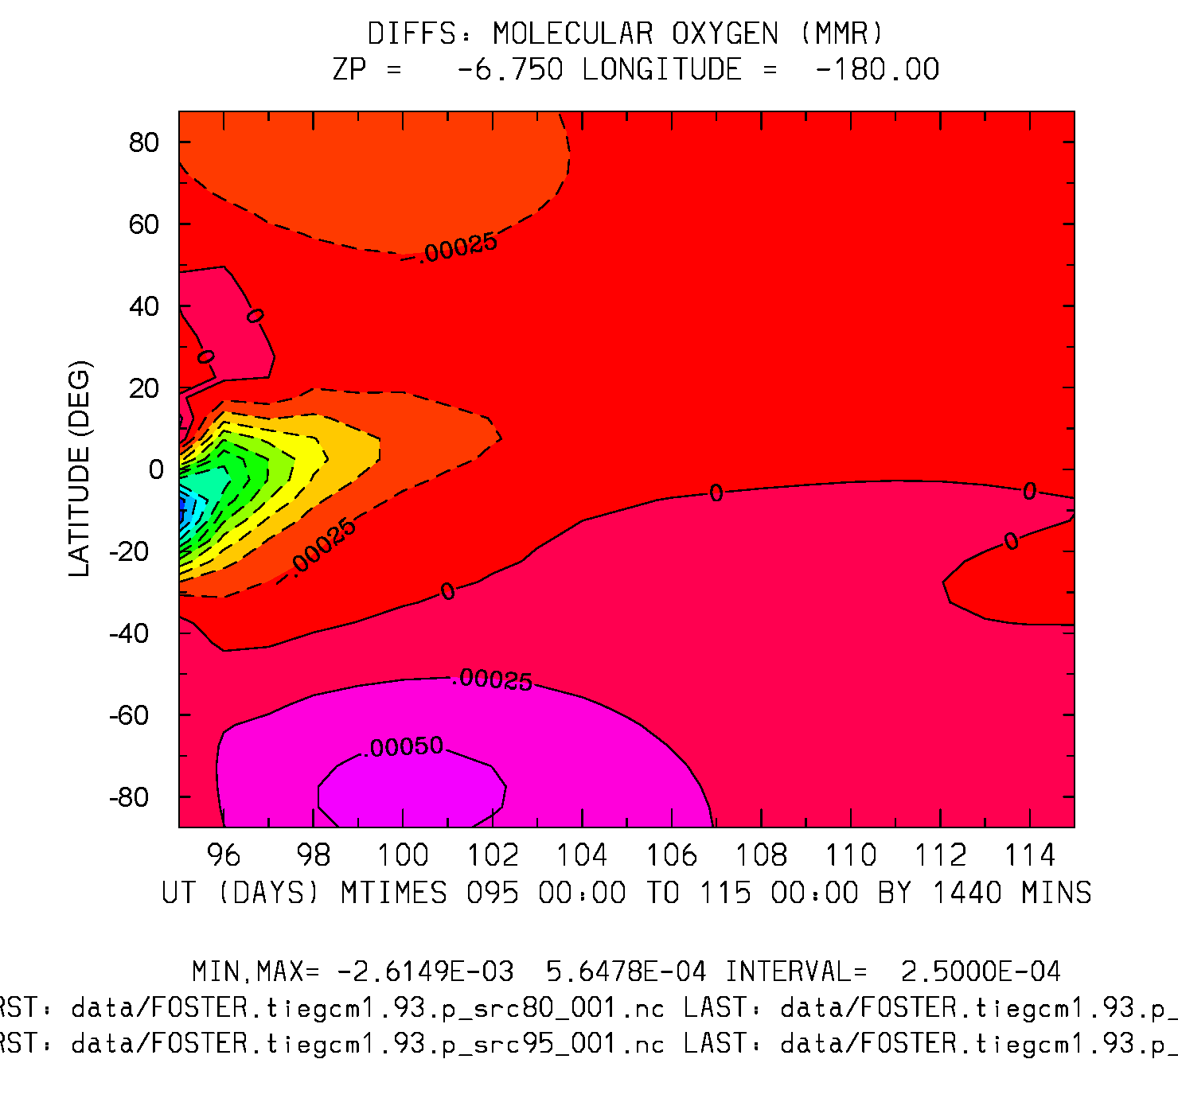
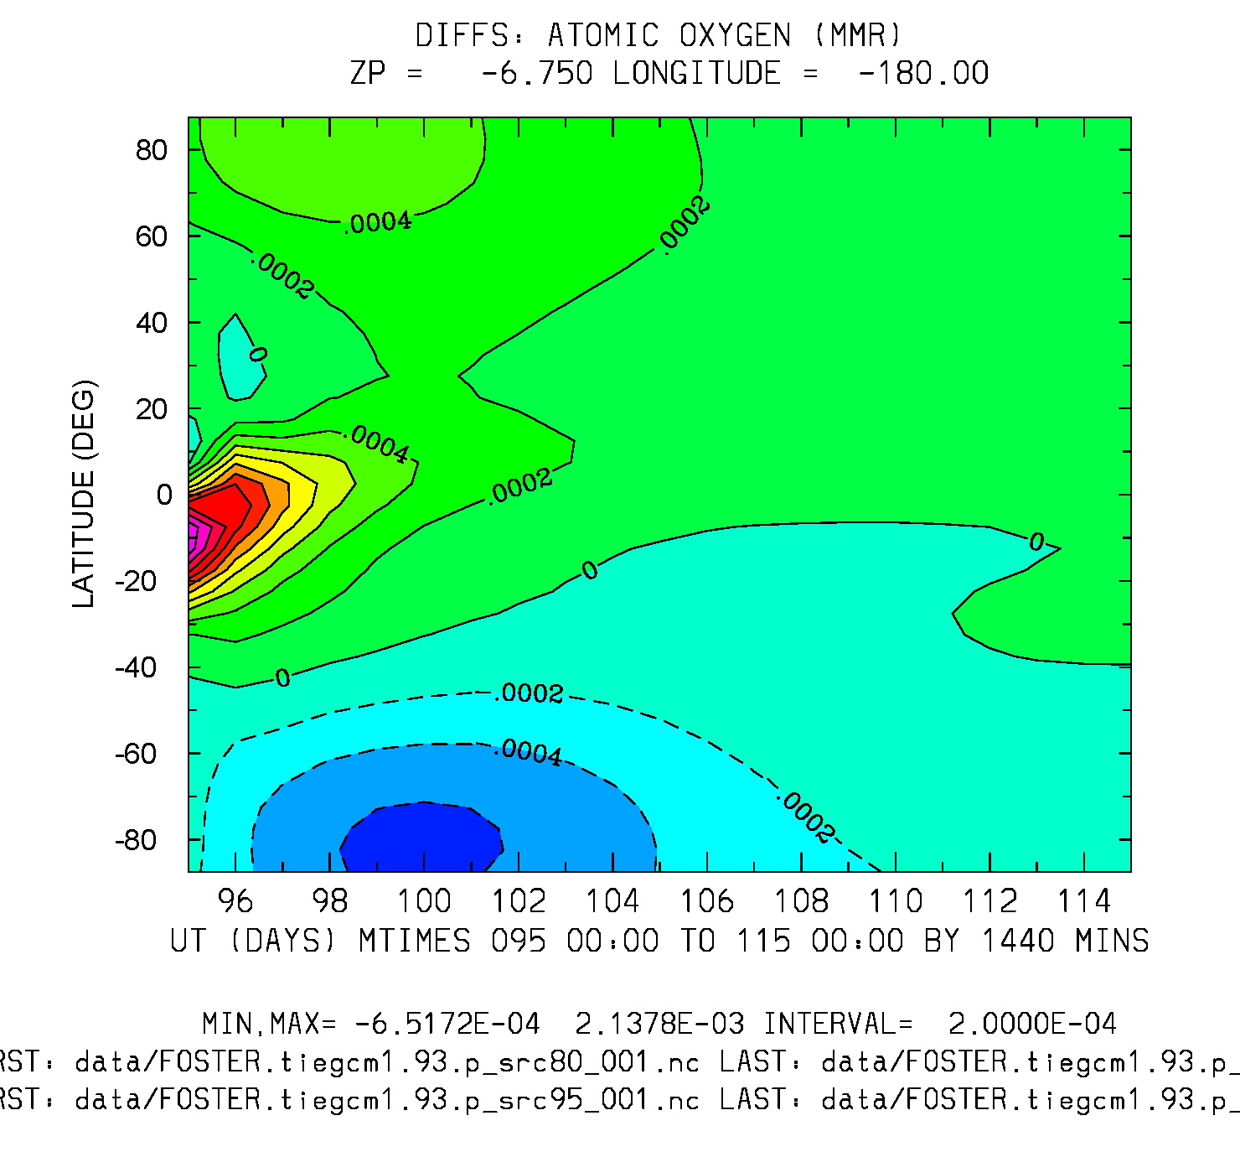
Difference: 15-day Offset run Minus Control
UT (20 days) vs Latitude
O2 (mmr) Zp = -6.75
O (mmr) Zp -6.75
Min,Max = -2.6e-3, 5.6e-4
Interval = 2.5e-4
Min,Max = -6.5e-4, 2.1e-3
Interval = 2.e-4

