Slide 1
TIEGCM “qic bug” Ion Chemistry Heating calculation in qjion.F:
qic(k,i) =
| (avo*(o2(k,i)*rmassinv_o2*(rk1(k,i,lat)*op(k,i)*1.555+
| (rk6*2.486+rk7*6.699)*nplus(k,i)+
| rk9*n2p(k,i)*3.52)+
| op(k,i)*(rk2(k,i,lat)*xn2(k,i)*rmassinv_n2*1.0888+
| rk10*n2d(k,i)*rmassinv_n2d*1.45)+
| o1(k,i)*rmassinv_o1*(rk3(k,i,lat)*n2p(k,i)*0.70+
| rk8*nplus(k,i)*0.98)+
| o2p(k,i)*(rk4*n4s(k,i)*rmassinv_n4s*4.21+
| rk5*no(k,i)*rmassinv_no*2.813))+
| .5*(ne(k,i)+ne(k+1,i))*(ra1(k,i,lat)*op(k,i)*0.854+
| ra2(k,i,lat)*o2p(k,i)*5.2755+
| ra3(k,i,lat)*n2p(k,i)*3.678)/xnmbarm(k,i))*evergs+
| (avo*(((rk16*3.02+rk17*0.7)*xn2(k,i)*rmassinv_n2+
| rk18*o1(k,i)*rmassinv_o1*5.0)*xiop2p(k,i)+
| (rk23*xn2(k,i)*rmassinv_n2*1.33+
| rk24*o1(k,i)*rmassinv_o1*3.31+
| rk26*4.87*o2(k,i)*rmassinv_o2)*xiop2d(k,i))+
| (.5*(ne(k,i)+ne(k+1,i))*((rk19(k,i,lat)*5.0+
| rk20(k,i,lat)*1.69)*xiop2p(k,i)+rk25(k,i,lat)*3.31*
| xiop2d(k,i))-(rk21*5.02+rk22*1.69)*xiop2p(k,i)-
| rk27*3.33*xiop2d(k,i))/xnmbarm(k,i))*evergs
Should be nop(k,i)
(chem rate ra1=NO+ + e)

Slide 2
chemrates.F: ra1 = NO+ +e
!
! ra1: NO+ + e -> (20% N4S + O + 2.75 eV), (80% N2D + O + 0.38 eV)
ra1(k,i,lat)=4.2E-7*(300./te(k,i))**0.85
Differences of original code minus bug-fixed code for 20-day runs
were all zero except UN, VN, OMEGA, and Potential. Differences in
these fields were negligible, i.e., around 10^-7 to 10^-4, and do not
show clear structure. See following slides.

Slide 3
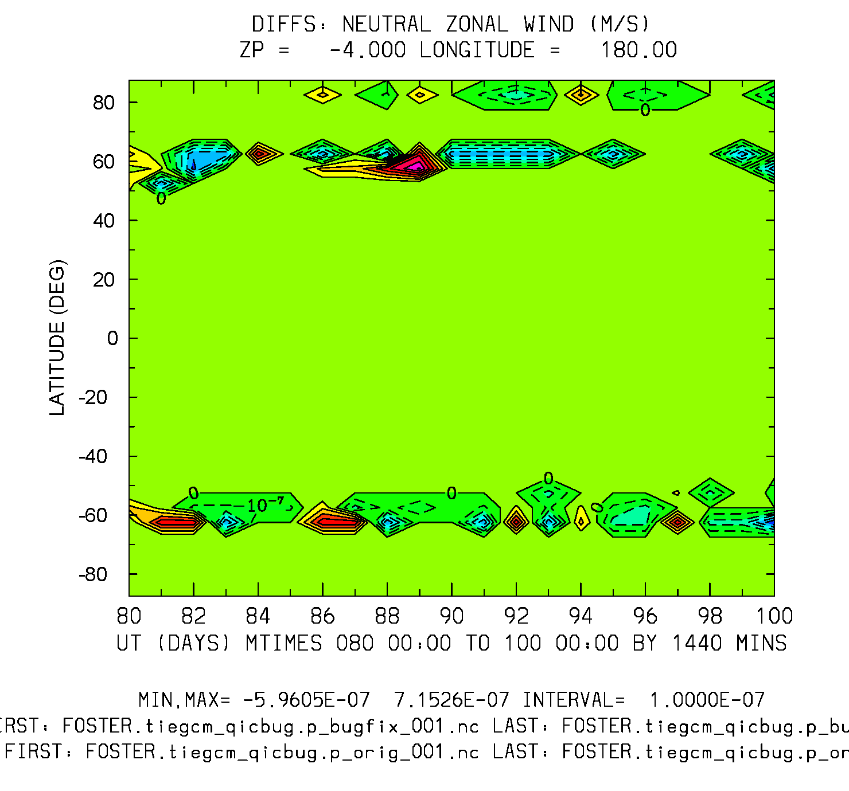
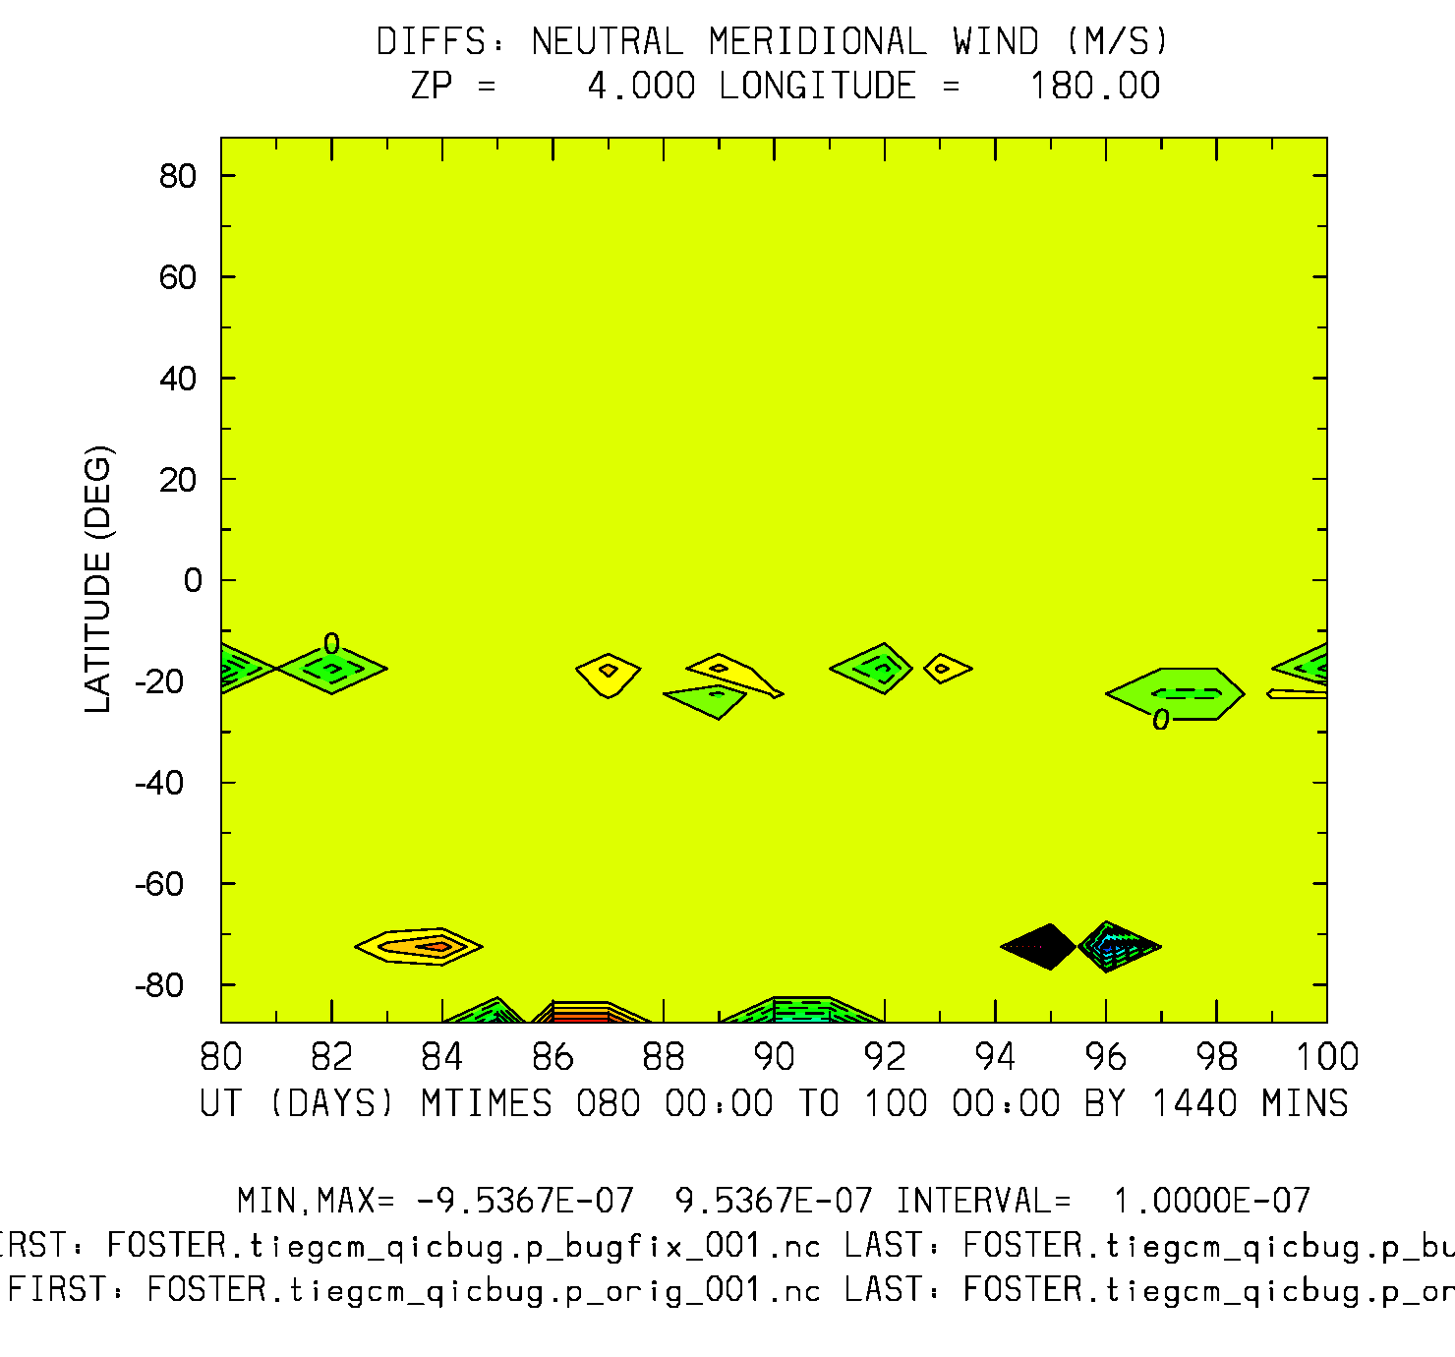
Differences: QIC bugfix minus original UT (20-days) vs Latitude
UN: Zp=-4
UN: Zp=+4
Min,Max = -6e-7, 7e-7
Min,Max = -9.5e-7, 9.5e-7

Slide 4
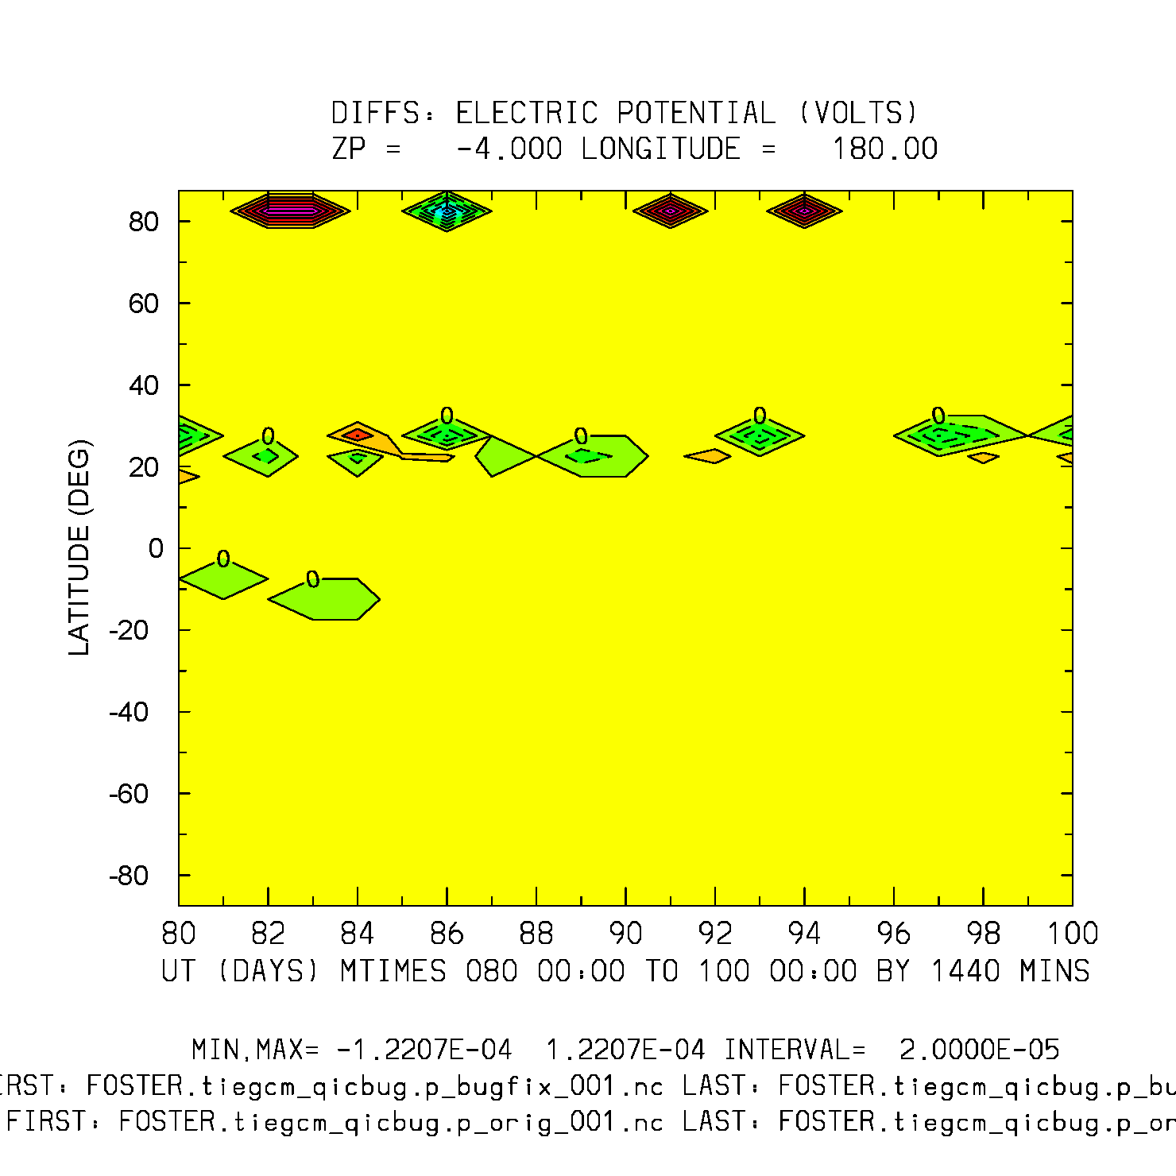
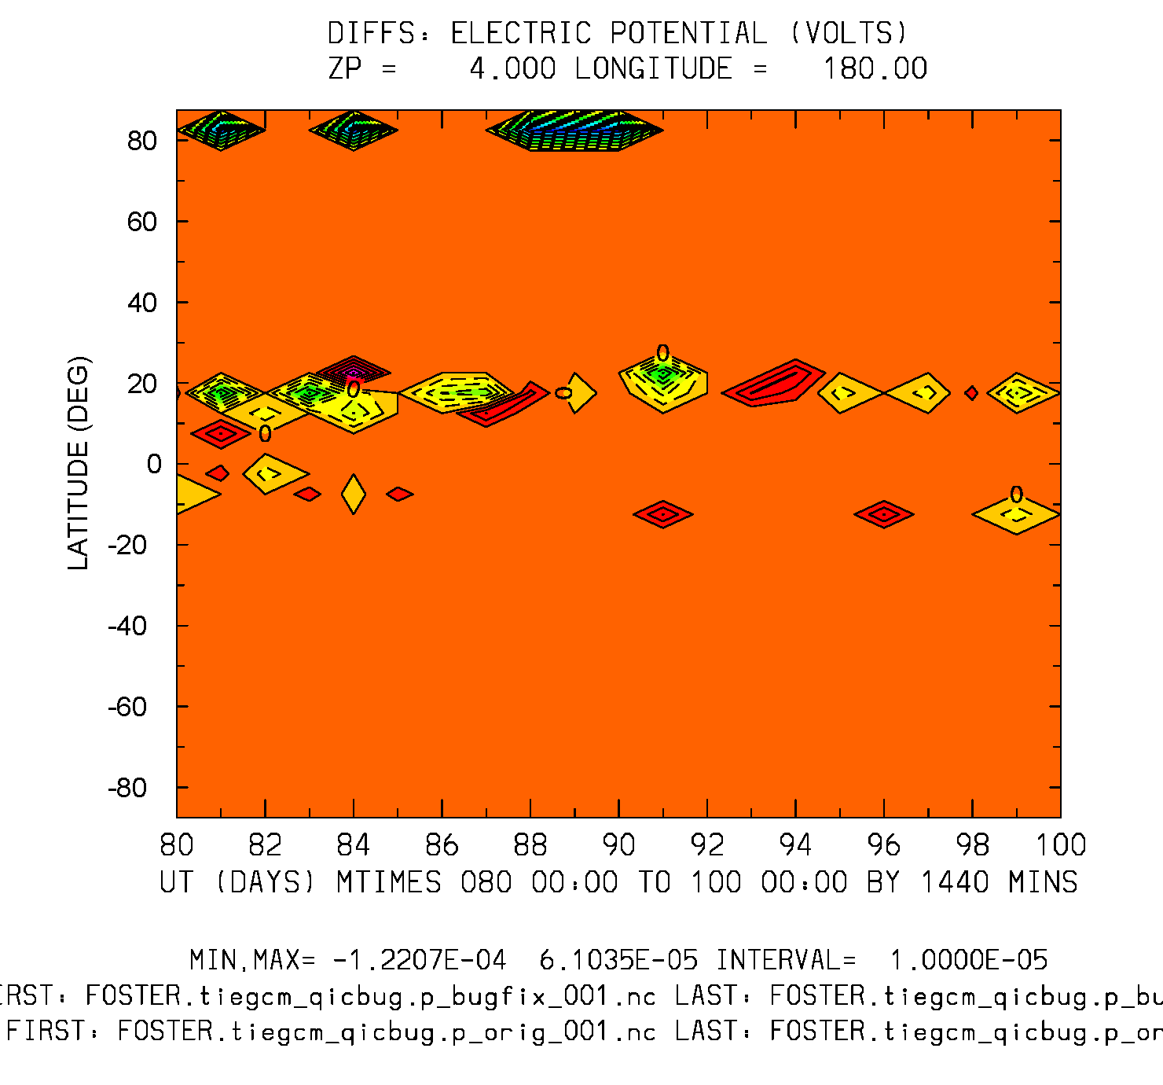
Differences: QIC bugfix minus original UT (20-days) vs Latitude
POTEN: Zp=-4
POTEN: Zp=+4
Min,Max = -1.2e-4, 1.2e-4
Min,Max = -1.2e-4, 6.1e-5

