Slide 1
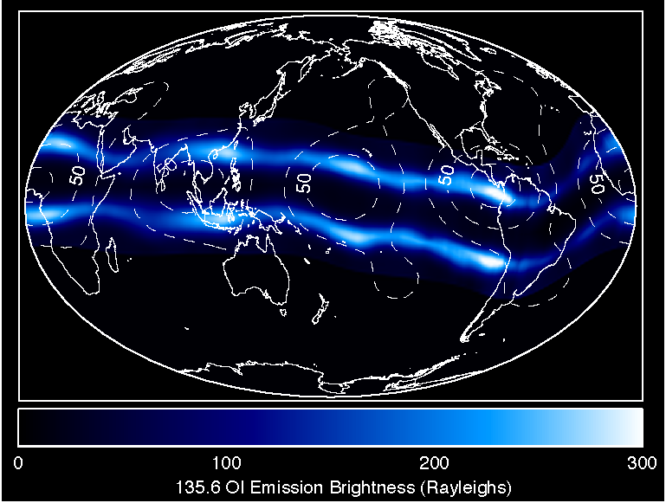
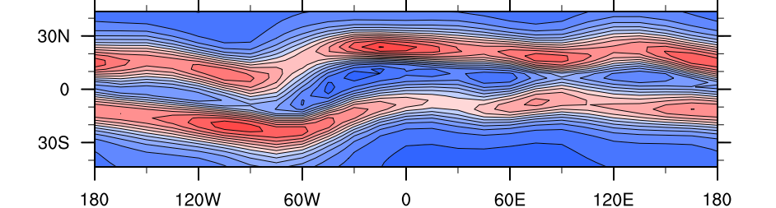
IMAGE FUV Ionospheric Emission
Tropospheric Tidal Effects
in the
Earth’s Ionosphere
March 2002
after Immel et al. (2006)
TIME-GCM Electron Density at 450 km - March
20 LST
after Hagan et al. [2007]

