Slide 1
THE NCAR TGCM’S:
PAST, PRESENT, AND FUTURE
R.G.Roble
HAO/ESSL/NCAR
Boulder,Co

Slide 2
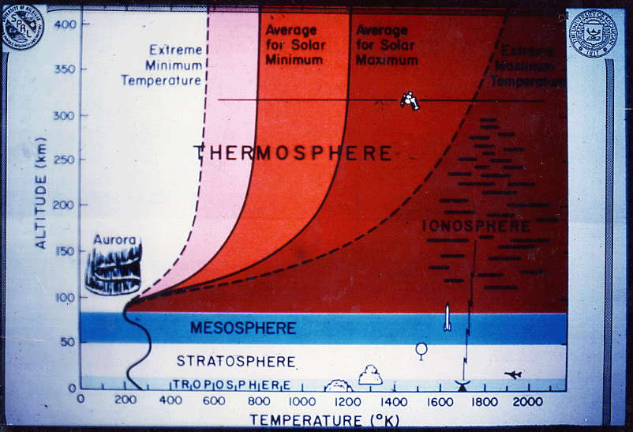

Slide 3
Talk outline
How and why the TGCM’s were developed
at NCAR.
Their present day capability and how they
are being used in CEDAR.
The future modeling efforts in a changing
Climate.

Slide 4
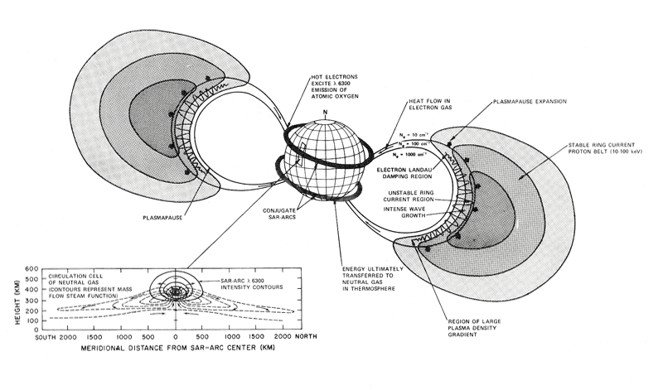

Slide 5
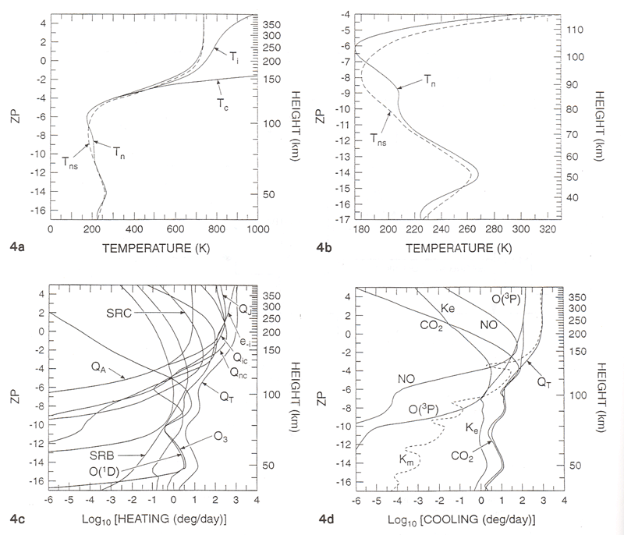

Slide 6
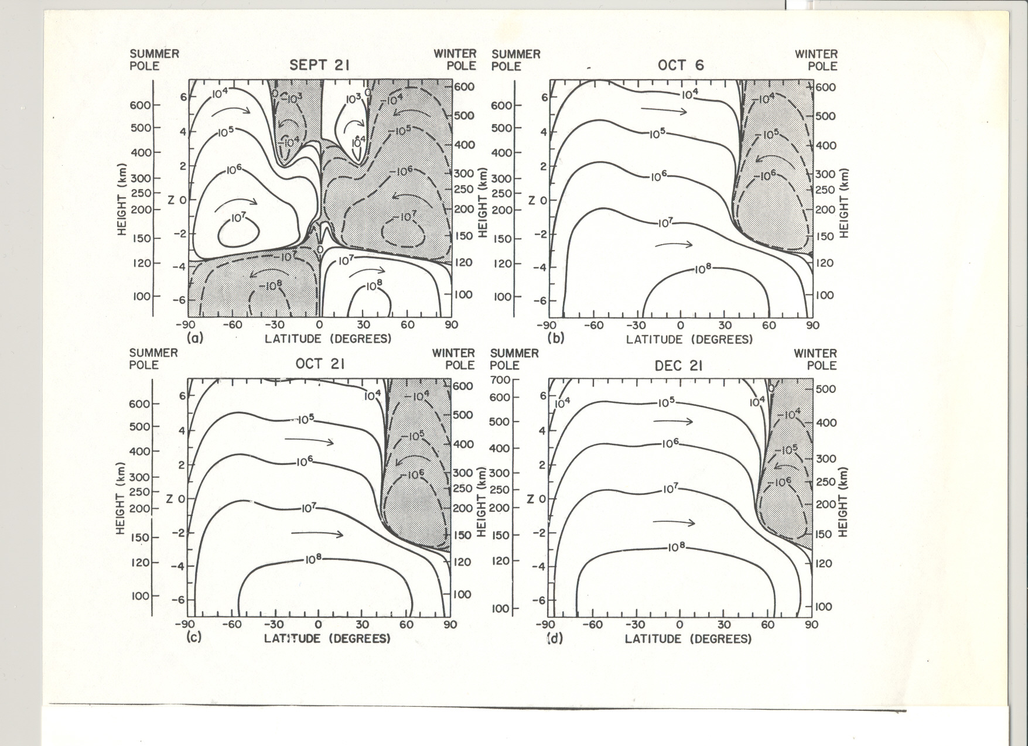

Slide 7
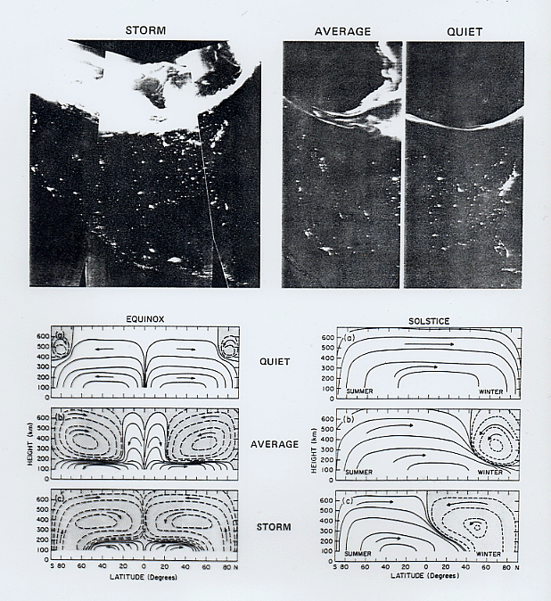

Slide 8
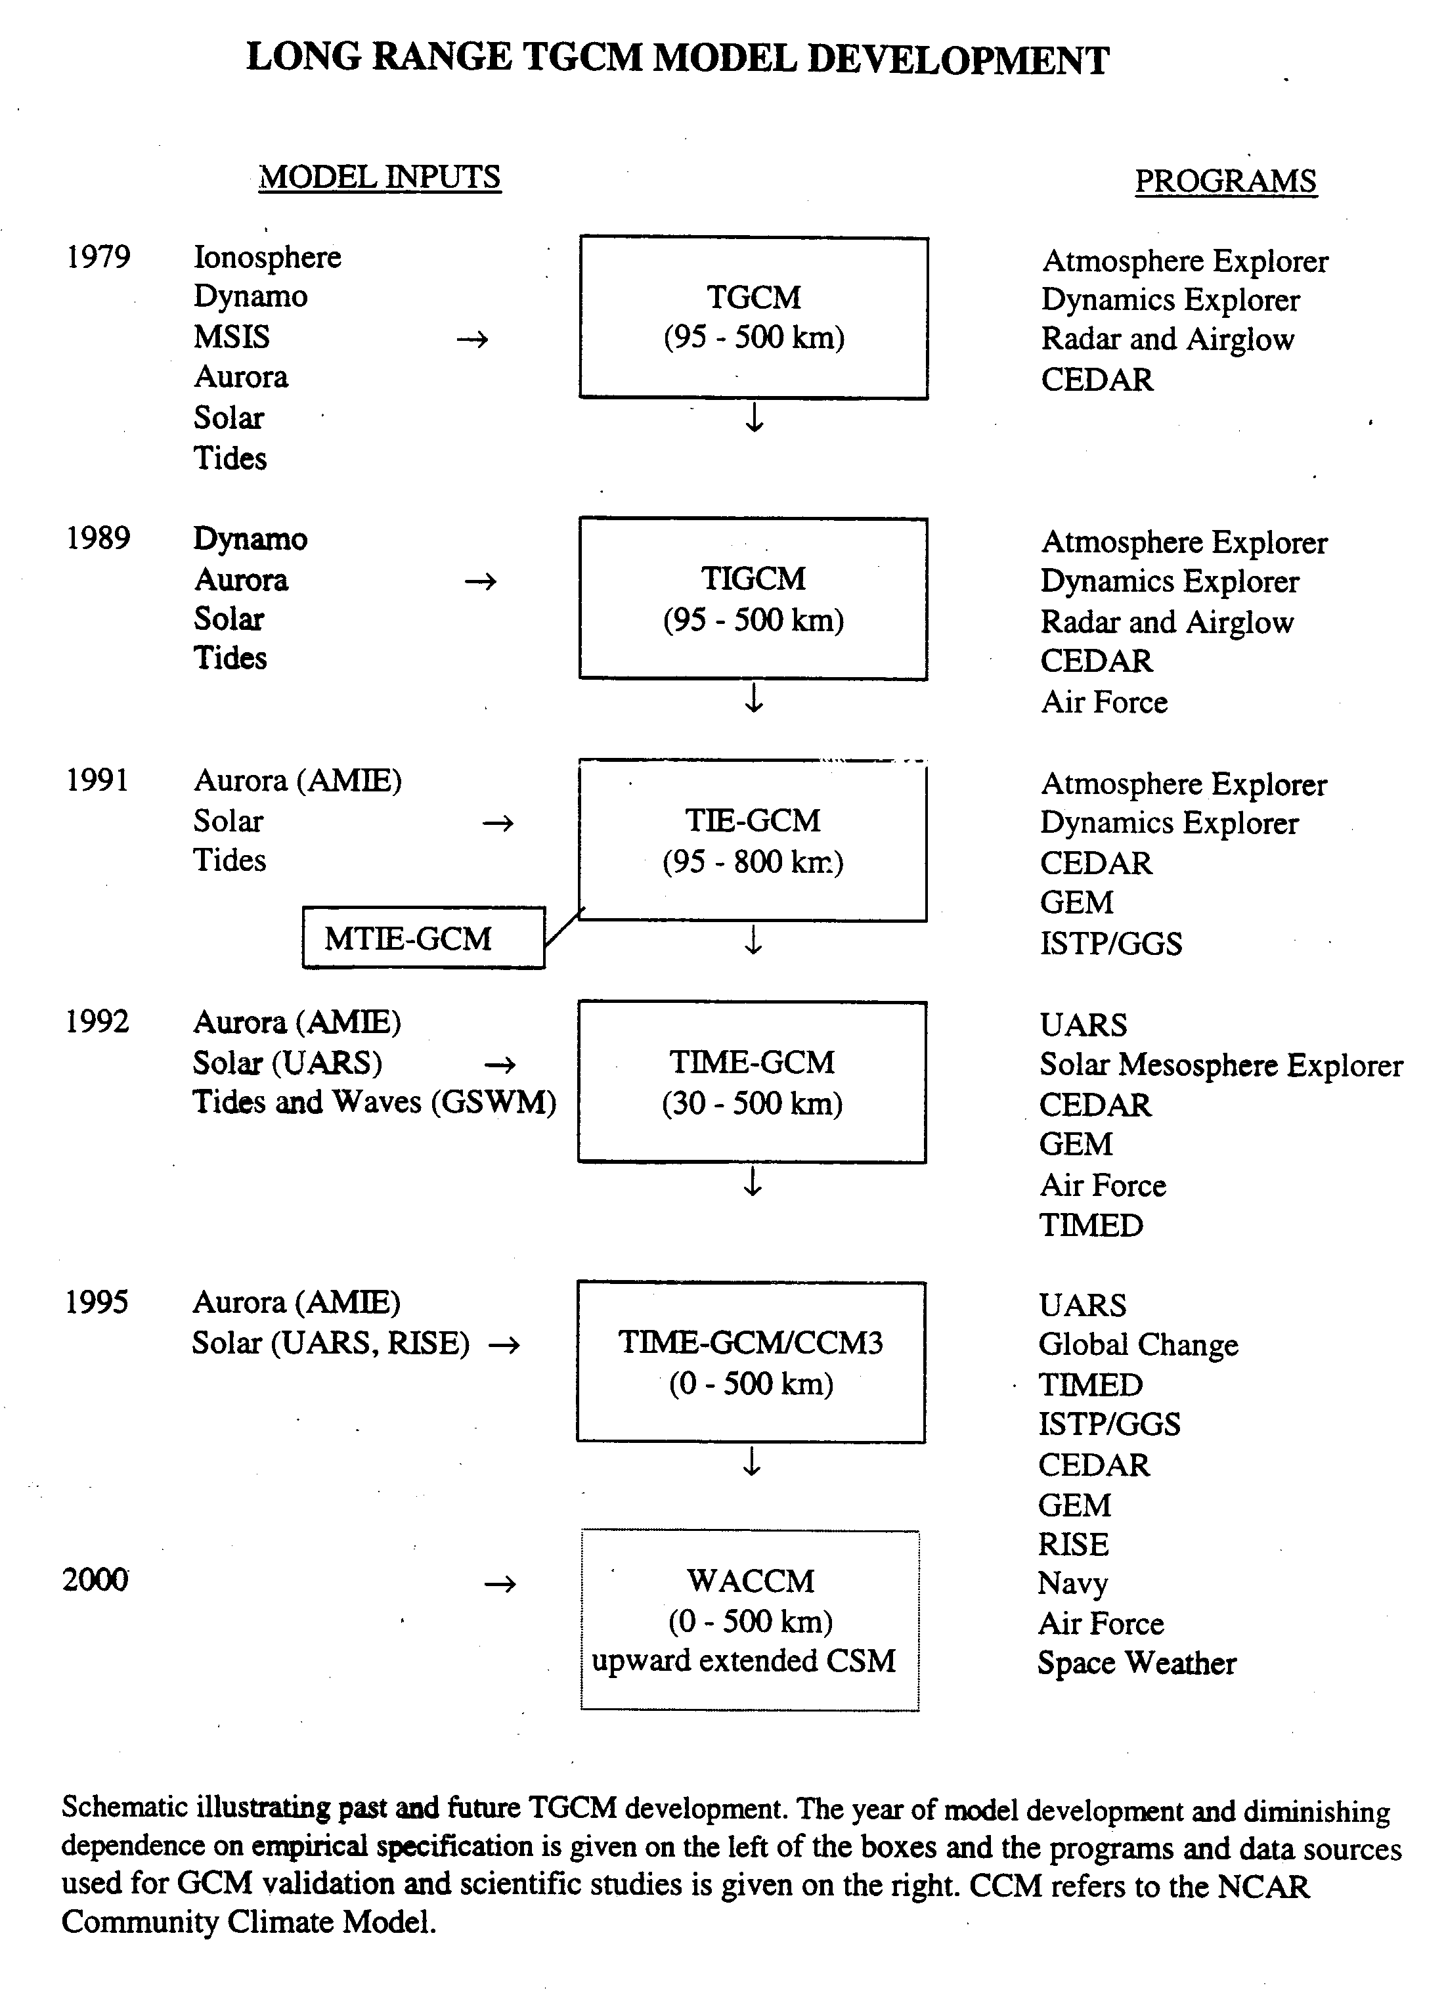

Slide 9
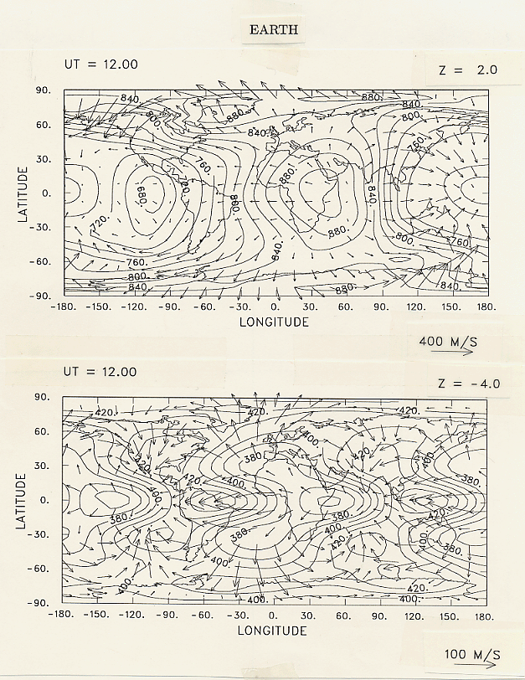

Slide 10
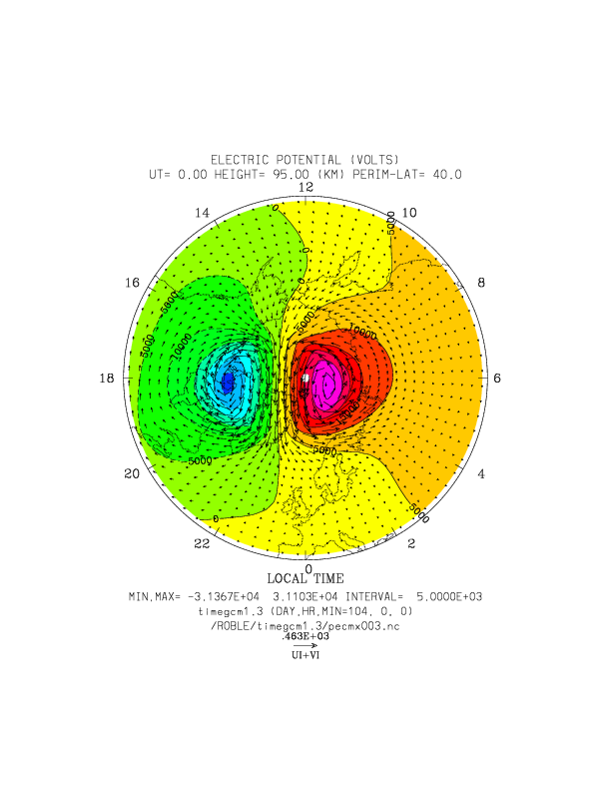

Slide 11
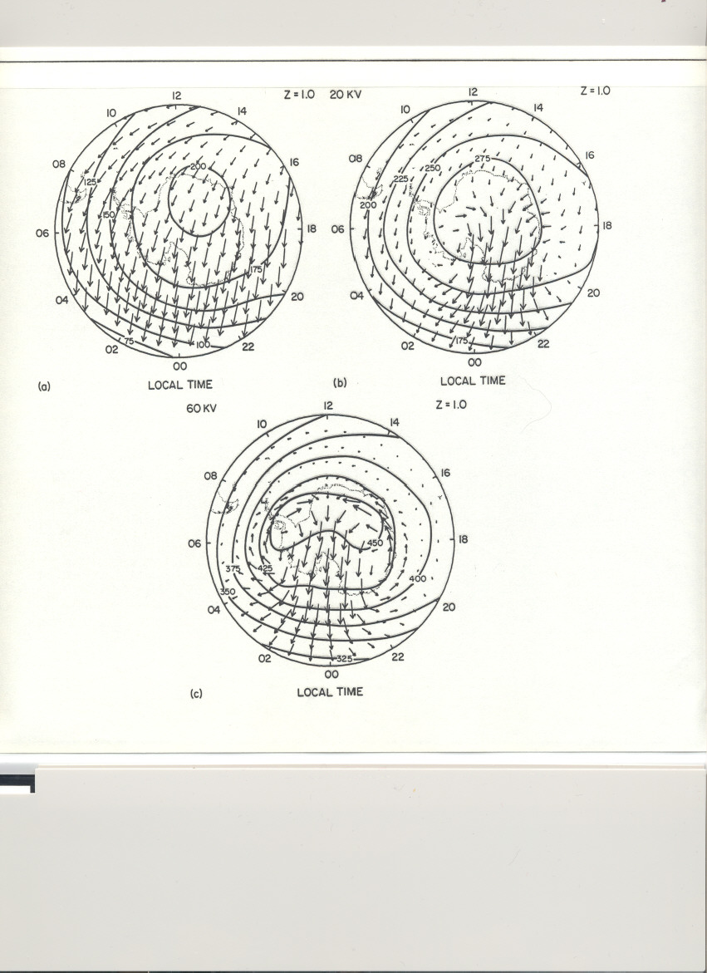

Slide 12
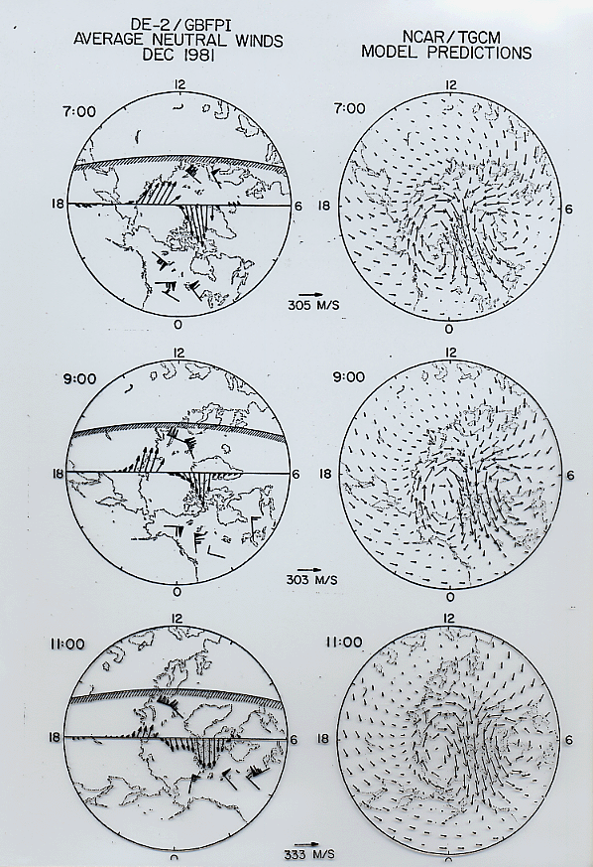

Slide 13
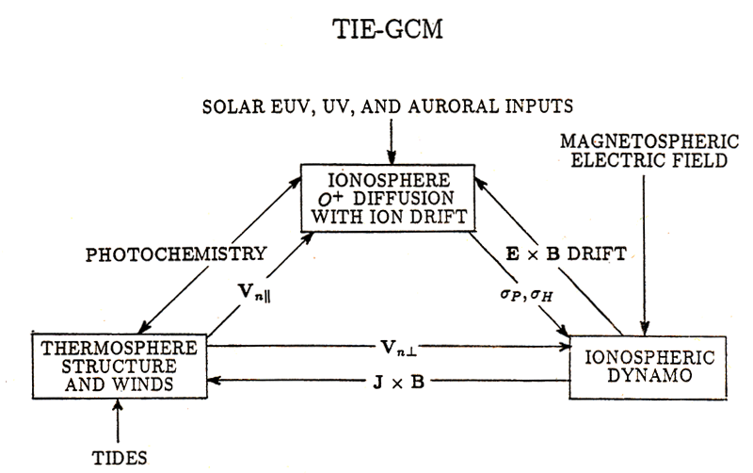

Slide 14
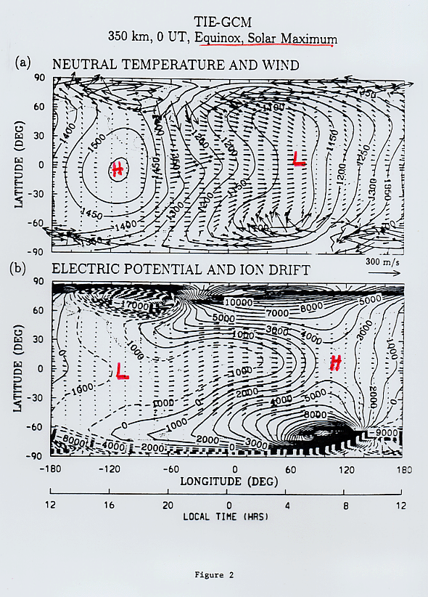

Slide 15
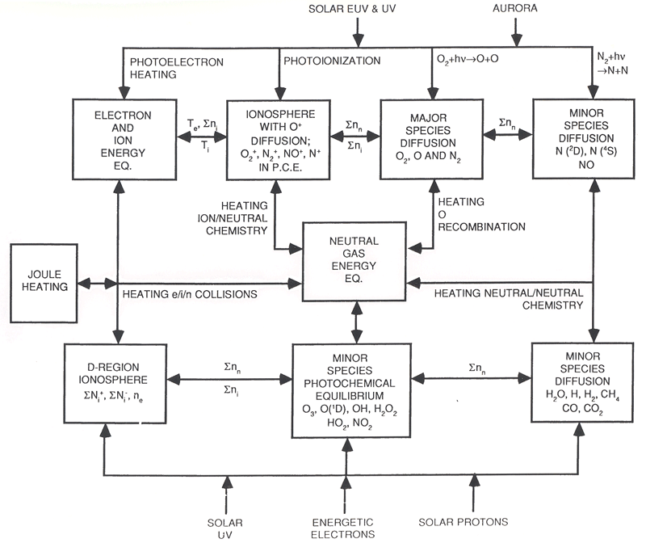

Slide 16
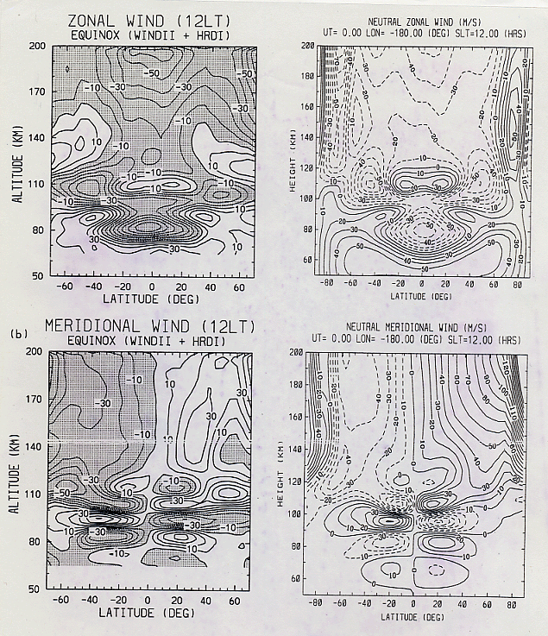

Slide 17
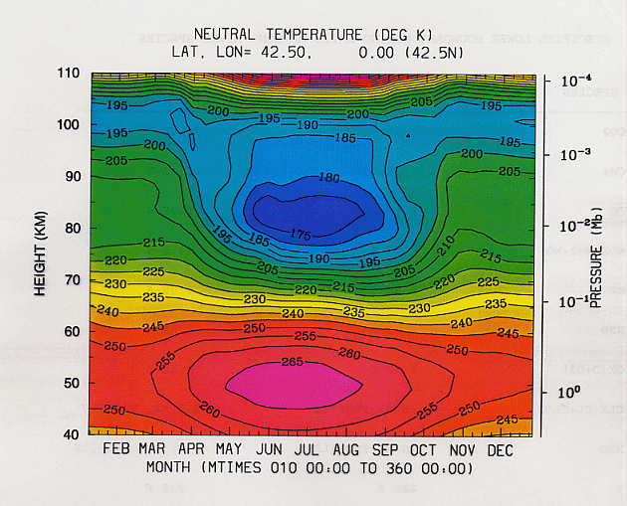

Slide 18
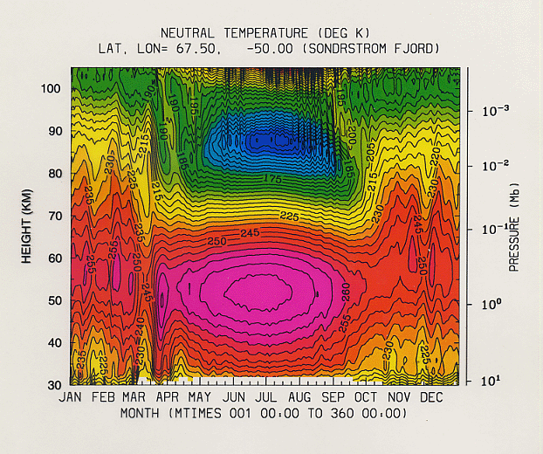

Slide 19
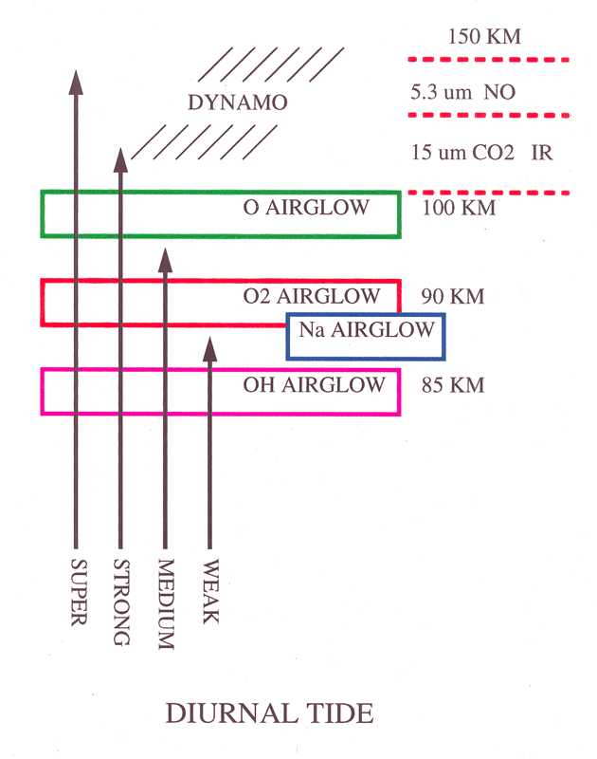

Slide 20
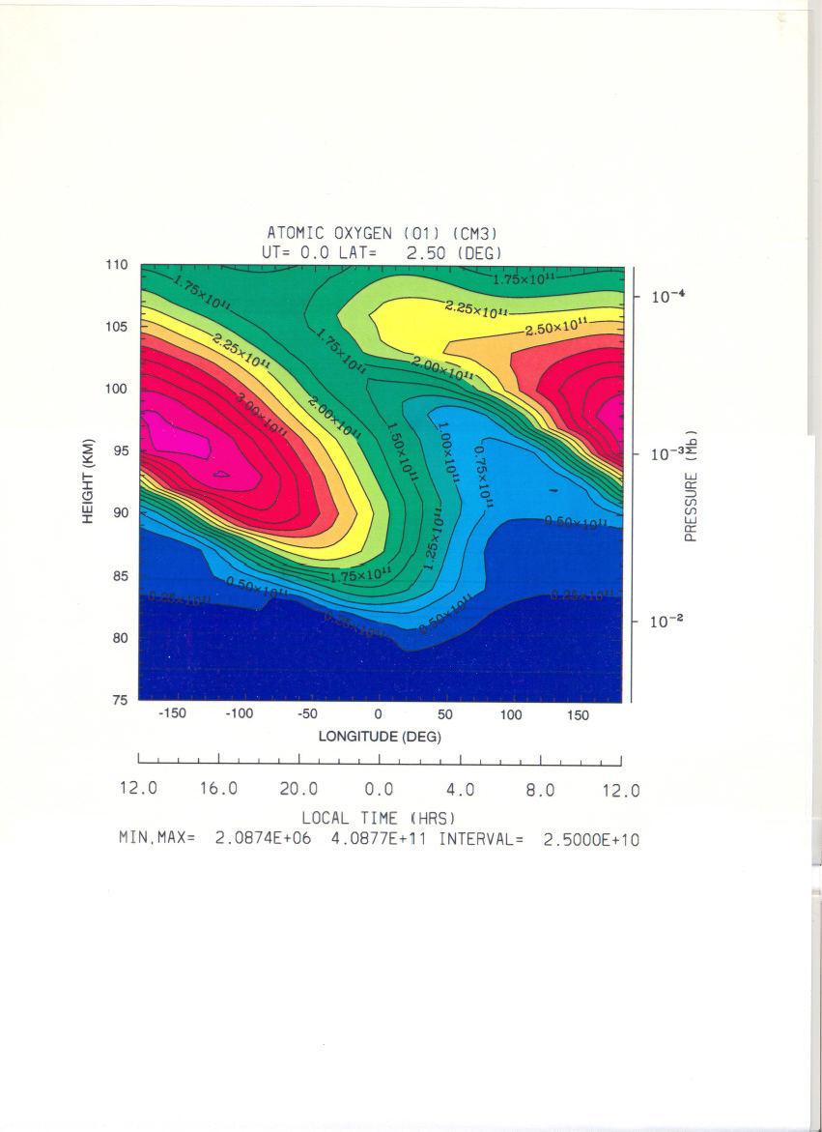

Slide 21
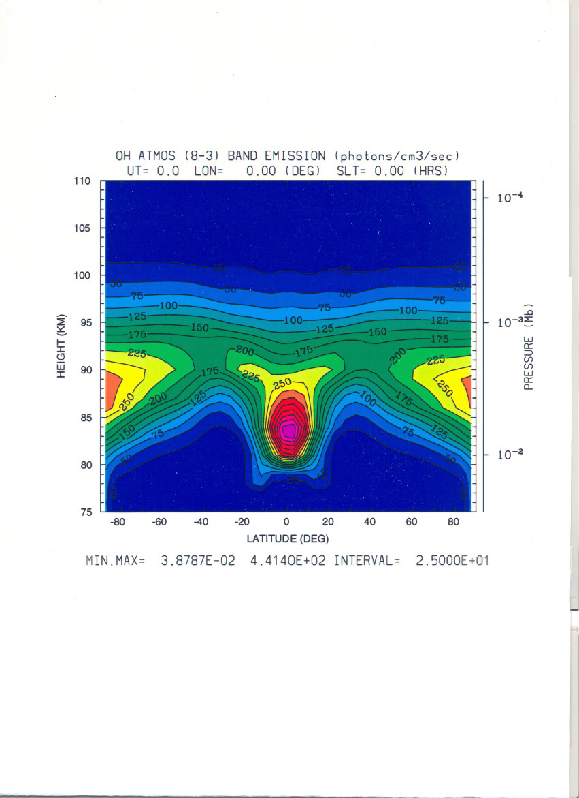

Slide 22
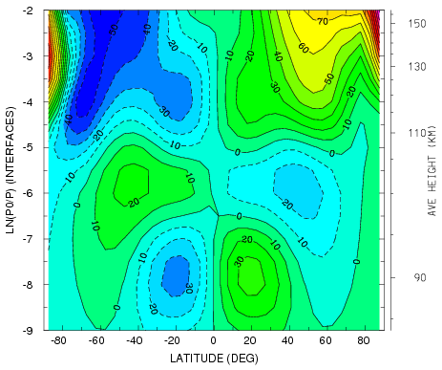
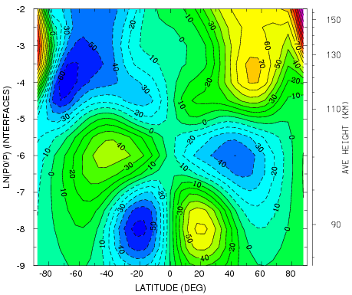
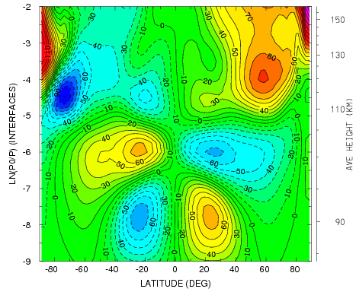
VN SLT=12 AMPLITUDE*1
VN SLT=12 AMPLITUDE*2
VN SLT=12 2.5 deg

Slide 23
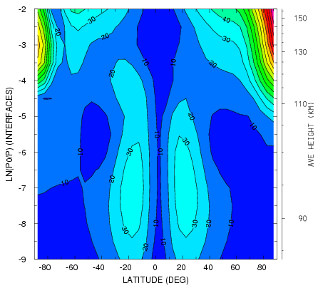
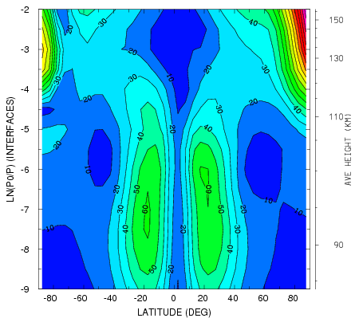
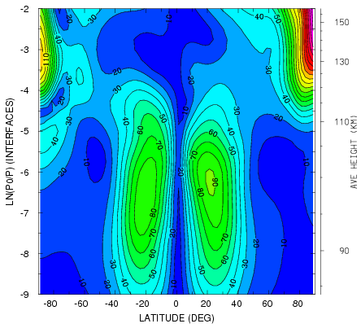
U_{N}
VN WAVE 1 AMPLITUDE*1
VN WAVE 1 AMPLITUDE*2
VN WAVE 1 AMPLITUDE 2.5 deg

Slide 25
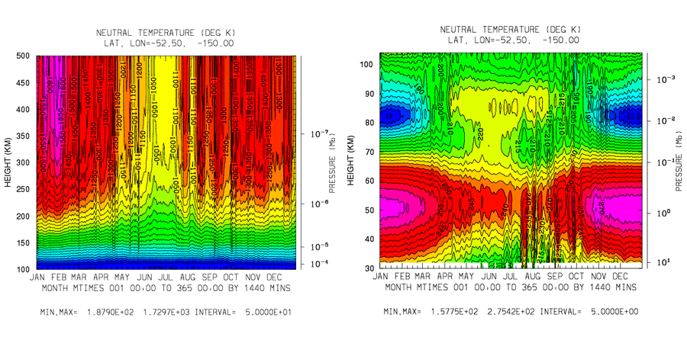

Slide 26
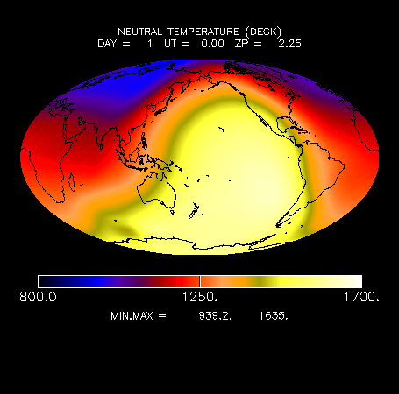

Slide 27
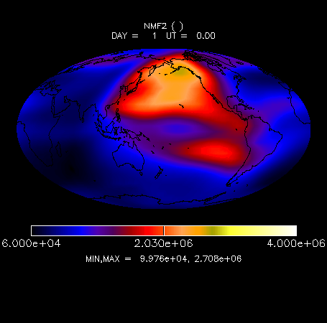

Slide 28
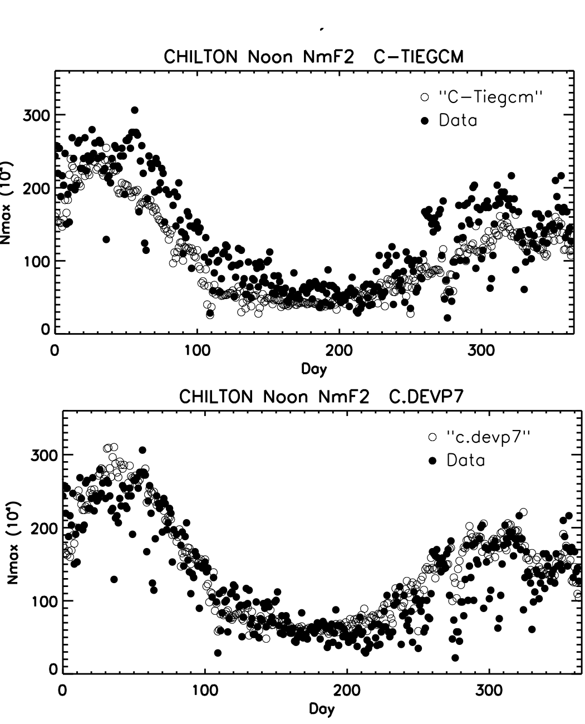

Slide 29
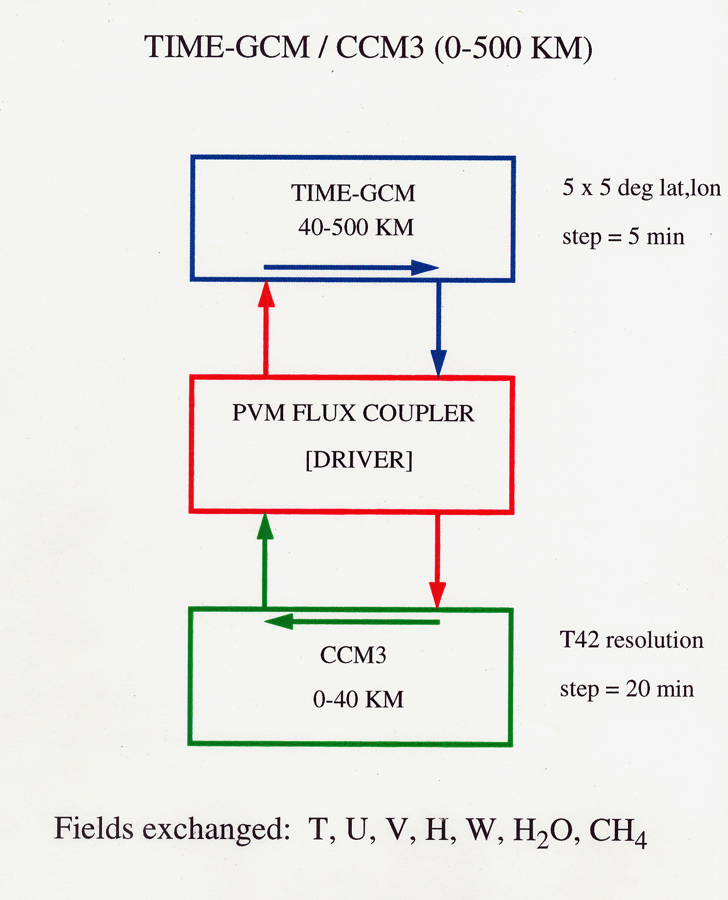

Slide 30
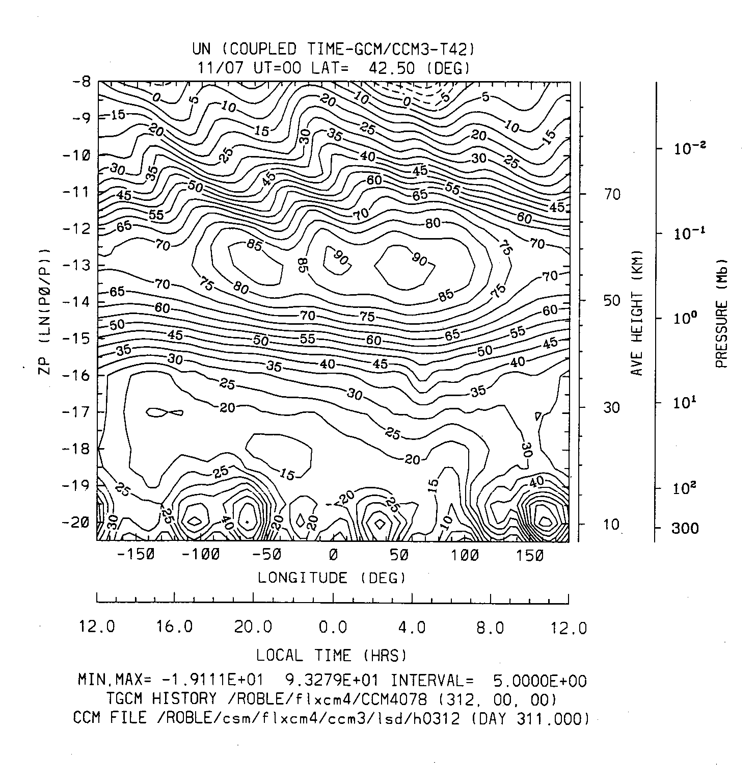

Slide 31
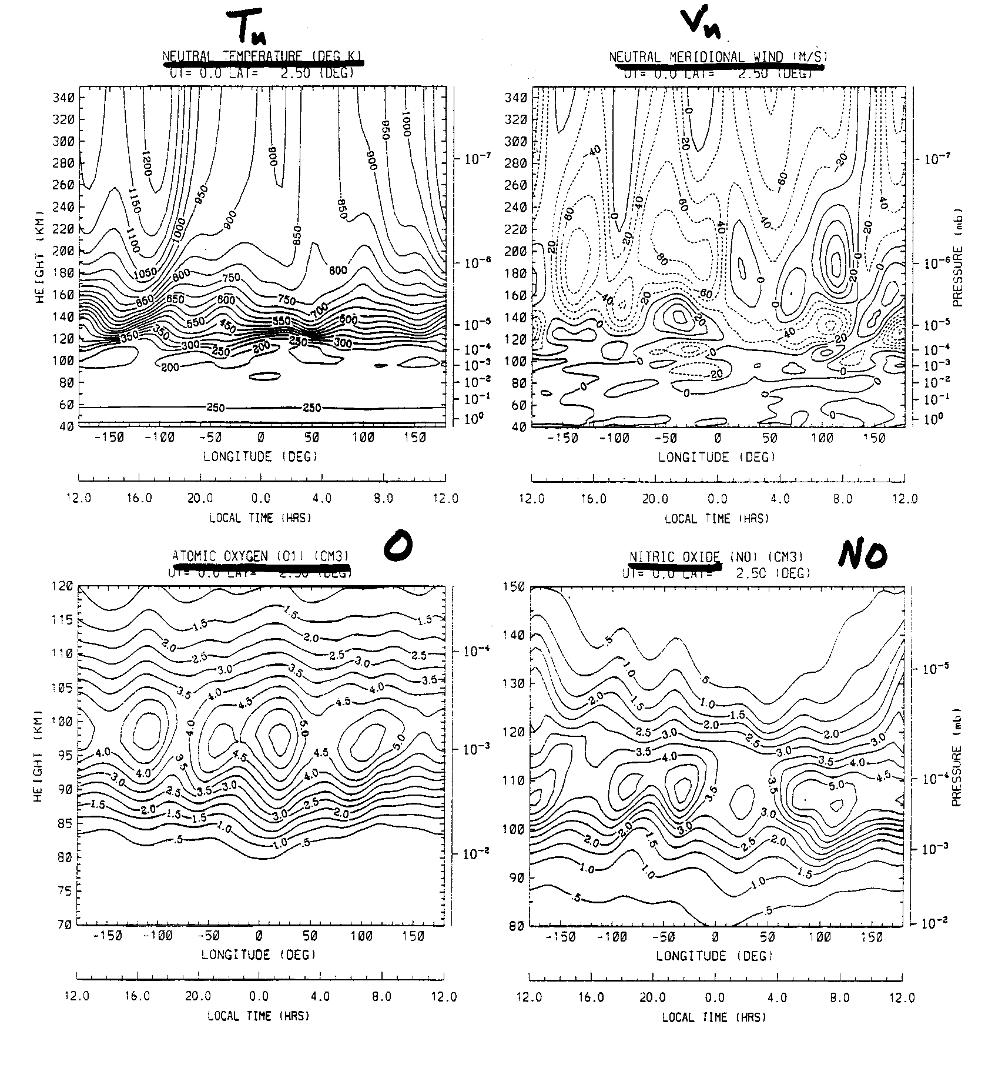

Slide 32
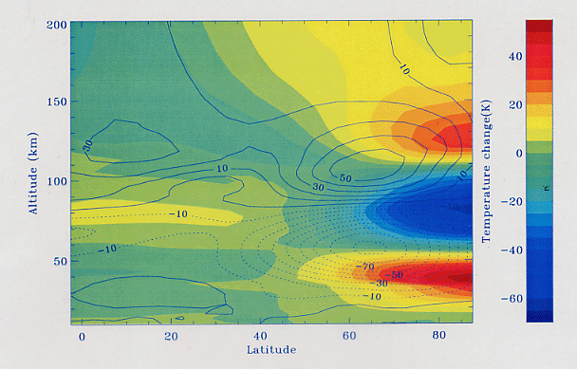

Slide 33
WACCM Components:
A collaboration among 3 NCAR Divisions
TIME GCM
HAO
R. Roble
B. Foster
Mesospheric + Thermospheric Processes
MOZART
+
WACCM
Chemistry
(currently offline)
ACD
R. Garcia
D. Kinnison
Dynamics + Physical processes
plus
additonal collaborators
from all three divisions
MACCM3
CGD
B. Boville
F. Sassi
(Middle Atmosphere CCM)

Slide 34
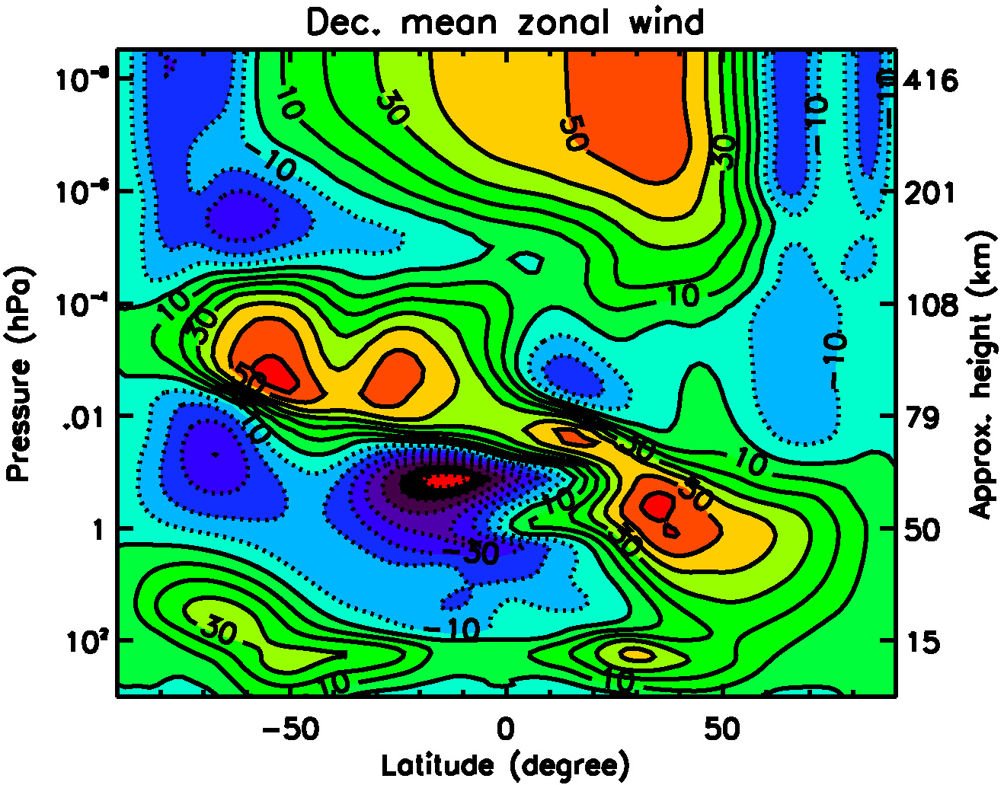
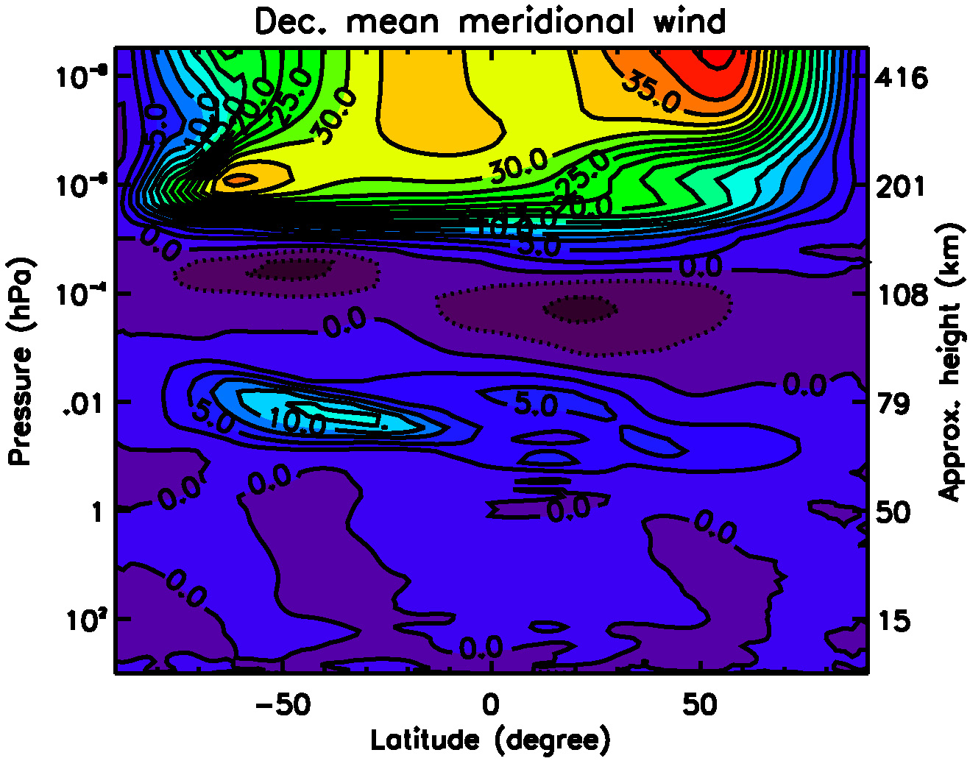
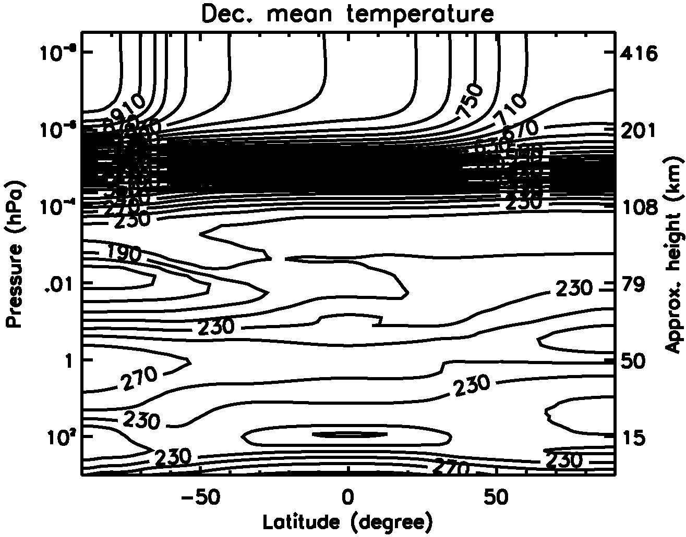
WACCM: Winds and Temperature (December)

Slide 35
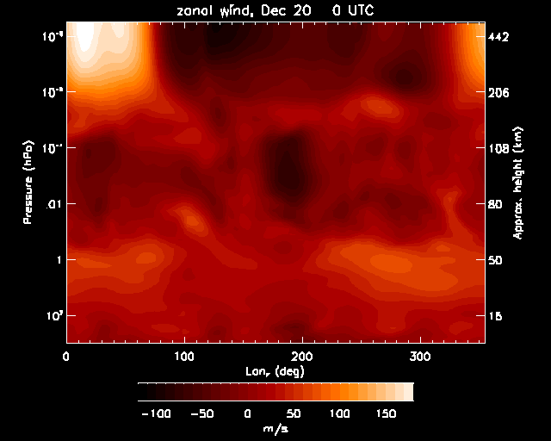

Slide 36
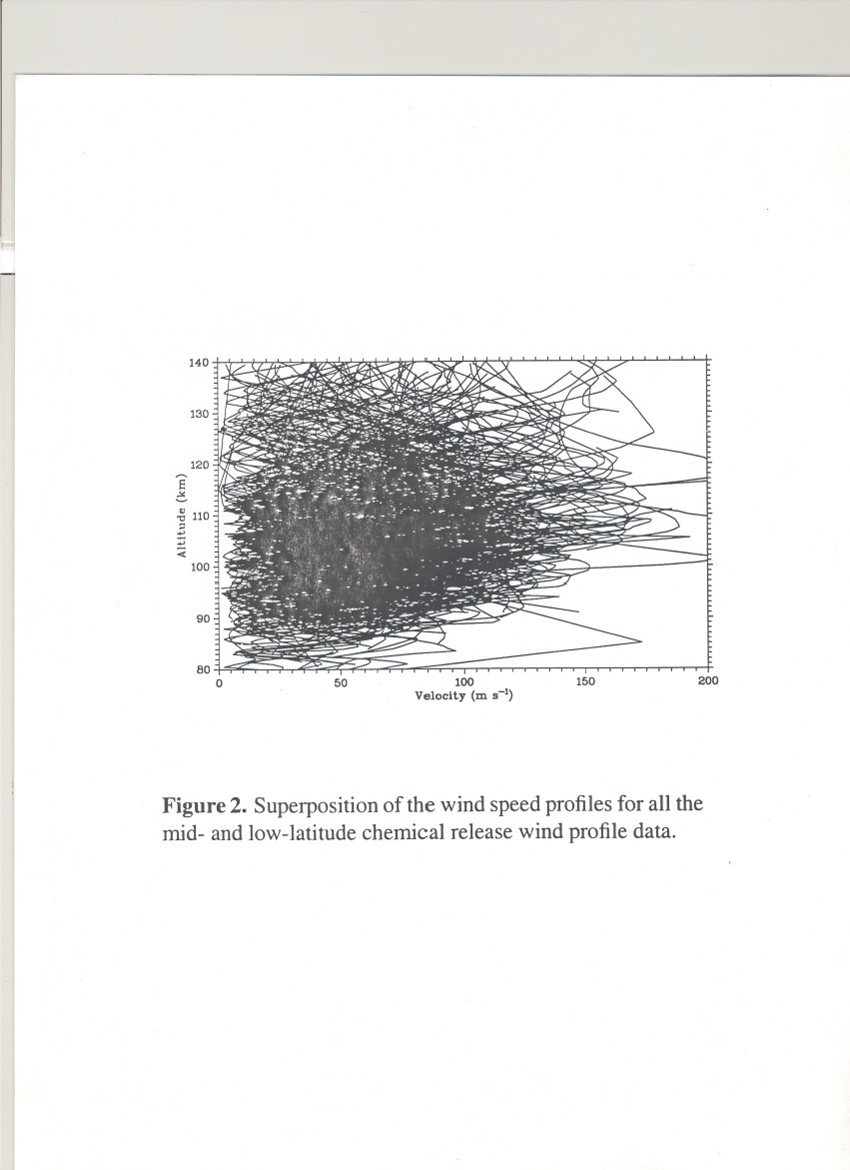

Slide 37
WACCM STUDIES
There are 2 versions of WACCM: Ground-to-140km and Ground-to-500km
WACCM shows that considerable lower atmospheric variability propagates and affects the upper atmosphere and ionosphere
WACCM is a free running climate model whereas TIME-GCM is a campaign model using data at the lower boundary to force the observational period for comparison with ground-based and satellite data

Slide 38
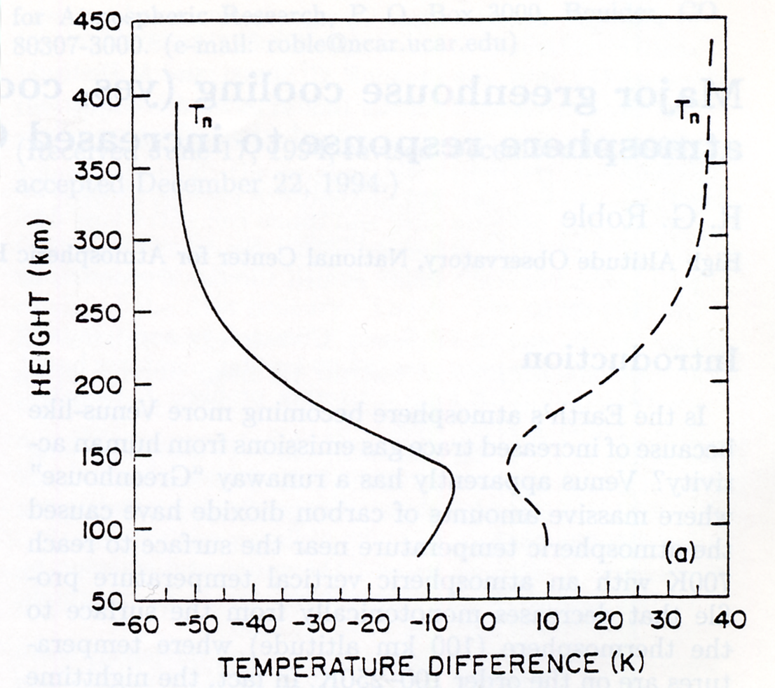
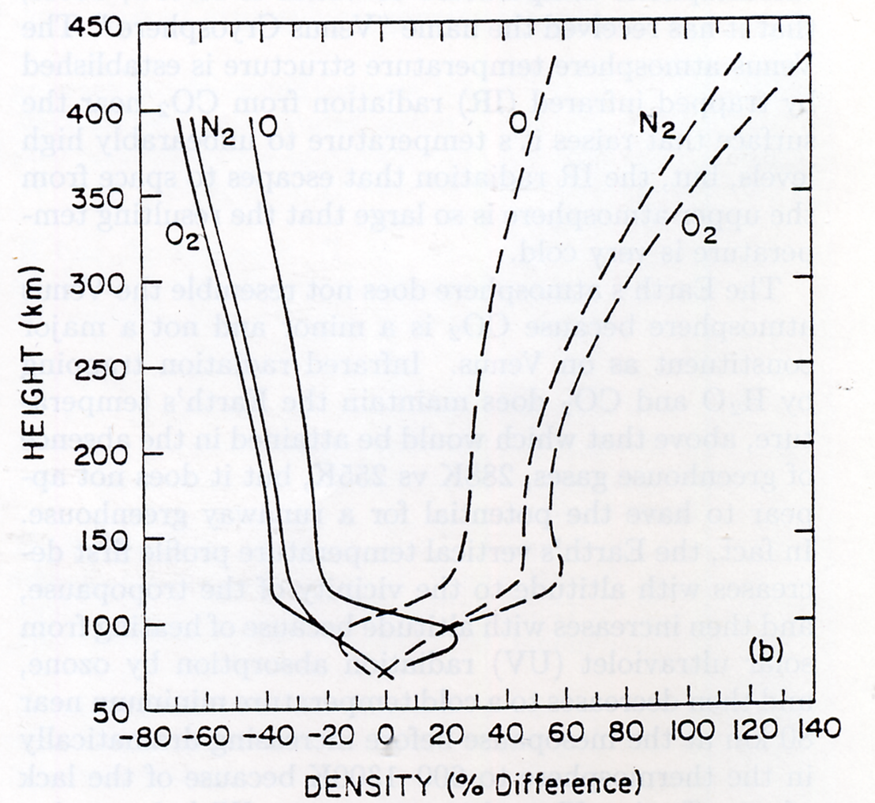
Roble and Dickinson (1989)

Slide 39
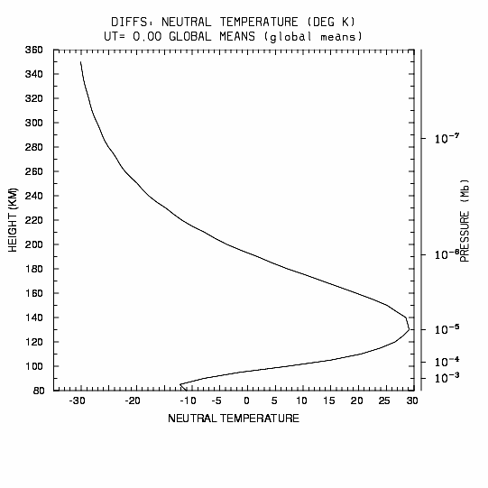
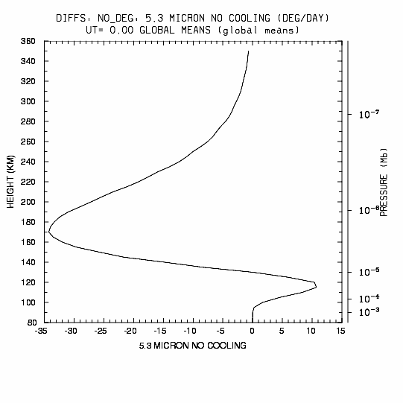
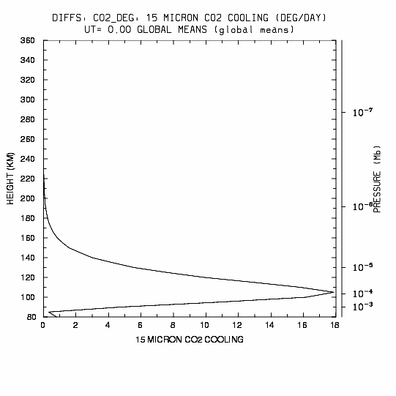
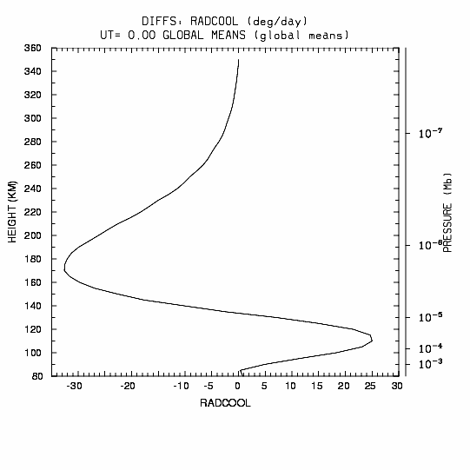
Solar Medium Conditions, GC-NC
T_{N}
5.3 μm
NO Cooling
15 μm CO₂
Cooling
Radiative Cooling

Slide 40
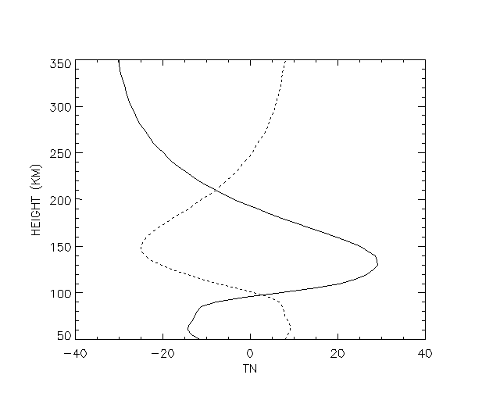
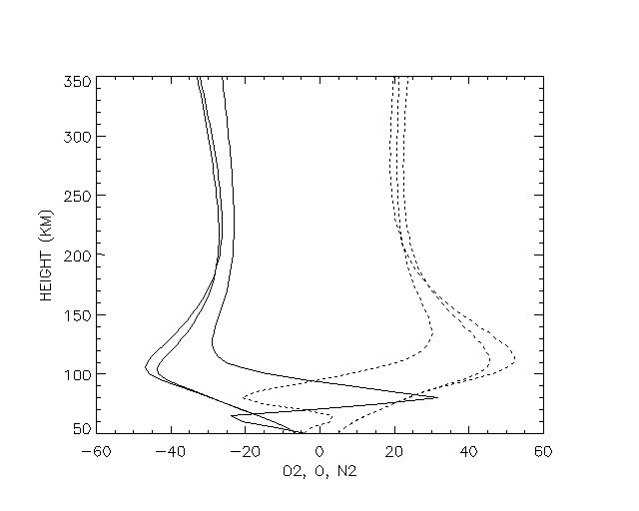
Difference: Neutral temperature (K)
Percent difference: O2, O, N2
N2
N2
TN
O
O2
O2
Global change minus no change
Ice Age minus no change

Slide 41
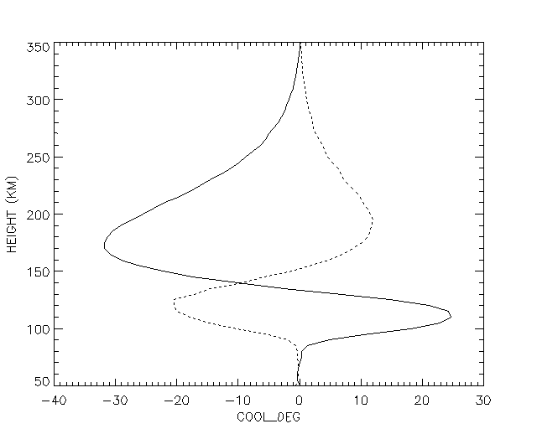
Change in total cooling (deg/day)
TCOOL
Global change minus no change
Ice Age minus no change

Slide 42
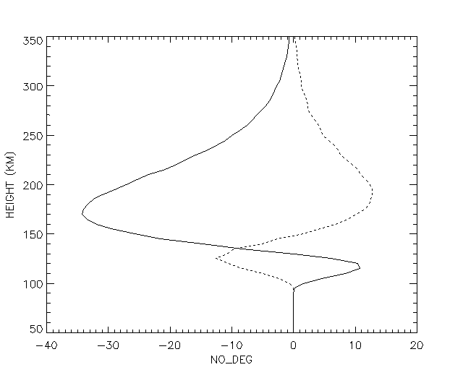
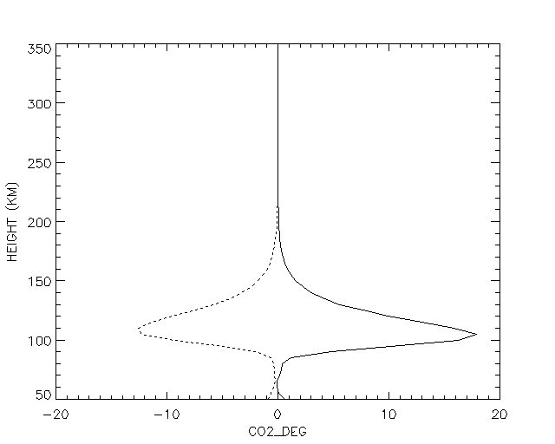
Change in NO and CO2 cooling
5.3 micron NO cooling (deg/day)
15 micron CO2 cooling (deg/day)
NO
CO2
Global change minus no change
Ice Age minus no change

Slide 43
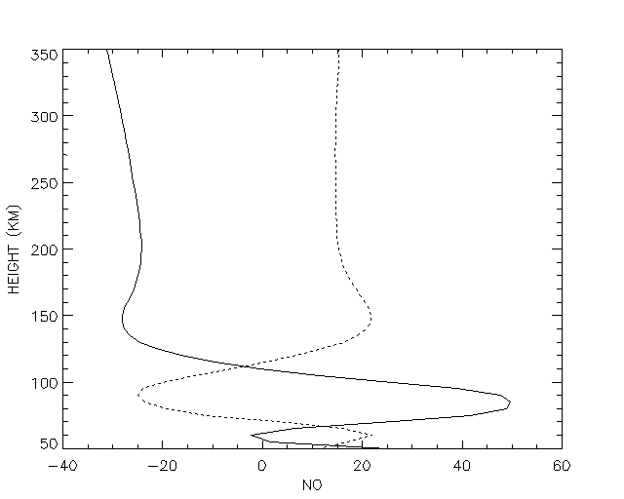

Percent change: NO (cm3)
Percent change: CO (cm3)
CO
NO
Global change minus no change
Ice Age minus no change

Slide 44


Percent change: H (cm3)
Percent change: NE (cm3)
H
NE
Global change minus no change
Ice Age minus no change

Slide 45
Conclusions
• Increased CO₂ and CH₄ levels will cool and contract the upper atmosphere, but the effects vary as a function of altitude, with some altitudes actually warming.
• Effects of NO cooling and chemical heating modulate the thermospheric response to global change as well as to the solar cycle.
• Largest changes are predicted to occur during solar minimum conditions.
• These findings may be commensurate with early inference of density changes from satellite orbit analysis.

Slide 48
Aeronomy of Cooling Processes
• The thermosphere is cooled primarily through radiation from CO₂, NO, and O(³P)
  • CO₂ radiation in 15 μm band; NO radiation in 5.3 μm band modulates solar cycle change
• Primary change in recent model estimates is due to increased levels of NO
  • Older model estimates were tuned to measurements of NO from SME
    Soft X-ray fluxes based on AE-era measurements
  • More recent measurements (HALOE, SNOE, ISSAC, HIRASS) ~5 times higher
    E.g., peak solar minimum low-latitude density ~3x10⁷ instead of ~6x10⁶
    Revised solar soft X-ray fluxes based on TIMED/SEE, SNOE, rockets (EUVAC)
    Model with revised ionization and chemistry in agreement with NO measurements
  • Key uncertainties in chemical rates pertain to branching between N(²D), N(⁴S)
    N₂+e*, NO⁺+e⁻, N(²D)+O
    Temperature dependence of N(⁴S)+O₂ and NO+N reactions also important
  • All of the cooling reactions are modulated by O, so atomic/molecular balance important
• Current model rate coefficients:
  CO₂+O excitation rate:
    1.56x10⁻¹² for T_{n} < 260
    (2.6-0.004*T_{n})x10⁻¹² for 260<Tn<300
    1.4x10⁻¹² for T_{n}>300
  NO+O excitation rate:
    4.2x10⁻¹¹

Slide 49




Solar Medium Conditions, GC-NC, without NO chemistry
T_{N}
15 μm
CO₂ Cooling
63 μm
O₃+ Cooling
Radiative
Cooling

Slide 50
Changes in atmospheric structure
Cooler temperature - smaller scale heights
Dynamics sensitive to basic structure
Gravity wave propagation and breaking
Tidal amplitude and phase
Planetary wave propagation
Solar radiative and auroral responses
Changes affect:
Dynamo dynamics
E-field propagation to F-region
F-region electron densities
Hydrogen densities - topside ionosphere
Magnetosphere/ionosphere/solar wind coupling

Slide 51


Slide 52


Slide 53


Slide 54
GLOBAL MEAN STUDIES
Global mean structure - solar EUV and SRC
/Aeronomy - solar EUV*2
Radiative heating/cooling, molecular and eddy diffusion
Sensitivity studies - variation in rate coefficients, eddy diffusion, topside plasma heat flows from the magnetosphere,etc.

Slide 55


Slide 56


Slide 57


Slide 58


Slide 59



T_{N}
TN WAVE 1 AMPLITUDE*1
TN WAVE 1 AMPLITUDE*2
TN WAVE 1 AMPLITUDE 2.5 deg

Slide 60
TIME-GCM STUDIES
TIE-GCM extended downward to 10hPa (30km) with aeronomy of mesosphere and upper stratosphere(B-S)
NCEP or ECMWF data used as lower boundary forcings and daily solar F10.7 and 3hr Kp
Gravity wave forcing in the mesospere is largest uncertainty and difficult to parameterize
Planetary waves, tides, gravity waves auroral and solar inputs all affect the MLT region dynamics, aeronomy and airglow

Slide 61
TIME-GCM/CCM FLUX COUPLER STUDIES
Feasibility study showed that it is possible to develop a model of the entire atmosphere
Considerable variability is generated in the lower atmosphere that propagates to the MLT region and through dynamo action to the F-2 region
Planetary wave activity can produce a strat-warm, meso-cool and thermosphere warm pattern at high latitudes
Simulations indicate couplings throughout the atmosphere, 6.5 day wave, planetary waves in MLT

Slide 62
TIE-GCM STUDIES
Diurnal variation upper thermosphere/semi-diurnal variation lower thermosphere
High latitude response to ion convection and auroral inputs
Complex thermosphere/ionosphere couplings
Variable solar and auroral inputs lead to large dynamic variability in thermospheric and ionospheric temperature and composition

Slide 64
Global Change in the Thermosphere and Mesosphere?
• Model predictions of thermosphere/mesosphere cooling from increased CO₂, CH₄, etc.:
  Roble & Dickinson, 1989; Rishbeth & Roble, 1992;
  Akmaev & Formichev, 1998; 2000; Gruzdev & Brasseur, 2005
• Considerable recent work on detection of secular trends:
  • Decrease in thermospheric densities from satellite drag measurements:
    Keating et al., 2000; Emmert et al., 2004; Marcos et al., 2005
  • Consequent decrease in peak altitude of F-region (H_{m}F₂)
  Various evidence, interpretation of long-term measurements still uncertain
  • Secular trends in mesopause temperatures
  Various evidence, controversial
  • Possible increase in exospheric hydrogen
  Kerr et al., 2001
• Some review articles:
  Roble, 1995; Thomas, 1996; Beig et al., 2003.

Slide 65


Baseline 2002 Model Atmosphere (NC-2002)
U_{N}

Slide 66


Baseline 2002 Model Atmosphere (NC-2002)
U_{N}
T_{N}

Slide 67


21st Century Global Change Model Atmosphere (GC-2100)

Slide 68


Difference in Geopotential Height
Solar Medium Conditions
GC - NC

Slide 69


Difference in Neutral Temperature
Solar Medium Conditions
GC - NC

Slide 70


Differences in Zonal Mean Neutral Temperature
Solar Min GC-NC
Solar Max GC-NC

Slide 71


Differences in Zonal Mean Total Density
Solar Min GC-NC
Solar Max GC-NC

Slide 72
Solar Medium Conditions, GC-NC, without NO chemistry
T_{N}
15 μm
CO₂ Cooling
63 μm
O₃+ Cooling
Radiative
Cooling

Slide 73
Baseline 2002 Model Atmosphere (NC-2002)
T_{N}
U_{N}

Slide 74
Baseline 2002 Model Atmosphere (NC-2002)
T_{N}
U_{N}

Slide 75
21st Century Mixing Ratios at Model Lower Boundary (30 km)
• Double CO₂
• Double CH₄
• Other minor species based on scenario from Bruhl & Crutzen, 1993:
Species | Year 2000 | Year 2100
CH₄ | O.6E-6 | 1.34E-6
CO₂ | 360E-6 | 720.E-6
H₂ | 0.5E-6 | 1.0E-6
CO | 1.1E-8 | 2.2E-8
H₂O | 4.4E-6 | 8.8E-6
NO | 2.7E-9 | 16.0E-9
NO₂ | 4.2E-9 | 8.4E-9
O₃ | 8.3E-6 | 4.15E-6
T_{N} | 225K | 215K
CL_{X} | S-G | S-G *1.5

Slide 76
21st Century Global Change Model Atmosphere (GC-2100)
T_{N}
U_{N}

Slide 77
Difference in Geopotential Height
Solar Medium Conditions
GC - NC

Slide 78
Difference in Neutral Temperature
Solar Medium Conditions
GC - NC

Slide 79
Differences in Zonal Mean Neutral Temperature
Solar Min GC-NC
Solar Max GC-NC

Slide 80
Differences in Zonal Mean Total Density
Solar Min GC-NC
Solar Max GC-NC

Slide 81
Conclusions
• Increased CO₂ and CH₄ levels will cool and contract the upper atmosphere, but the effects vary as a function of altitude, with some altitudes actually warming.
• Effects of NO cooling and chemical heating modulate the thermospheric response to global change as well as to the solar cycle.
• Largest changes are predicted to occur during solar minimum conditions.
• These findings may be commensurate with early inference of density changes from satellite orbit analysis.

Slide 82
Solar Medium Conditions, GC-NC
T_{N}
5.3 μm
NO Cooling
15 μm CO₂
Cooling
Radiative Cooling

Slide 83




Solar Medium Conditions, GC-NC
O
N₂
NO
Rho

Slide 84




SMIN GC-NC
TN
5.3 micron
NO Cooling
Radiative
Cooling
15 micron CO2
Cooling

Slide 85




SMIN GC-NC
O
N2
NO
Rho

Slide 86


SMED GC-NC
Percent Differences
O
O3

Slide 87


SMED GC-NC
Differences
CO2
CO

Slide 88


SMED GC-NC
Differences
H2O
OH

Slide 89


SMED GC-NC
Percent Differences
O
NO

Slide 90


Percent Difference: Electron Density
SMED: GC-NC

Slide 91


Percent Difference: Hydrogen
SMED: GC-NC

Slide 92




Difference
SMED GC-NC
QSOLAR
RADCOOL

Slide 93


GC-2100
TN
UN

Slide 94


15 Micron CO2 Cooling (difference)
SMED GC-NC

Slide 95


5.3 Micron NO Cooling (difference)
SMED GC-NC

Slide 96


Neutral Temperature (difference)
SMED GC-NC

Slide 97




SMED GC-NC without NO chemistry
O
N2
O2
Rho

Slide 98




SMAX GC-NC
TN
5.3 micron NO
Cooling
15 micron CO2
Cooling
Radiative
Cooling

Slide 99




SMAX GC-NC
O
N2
O2
NO

Slide 100
SMED GC-NC
Percent Differences
O
O3

Slide 101
SMED GC-NC
Differences
CO2
CO

Slide 102
SMED GC-NC
Differences
H2O
OH

Slide 103
SMED GC-NC
Percent Differences
O
NO

Slide 104
Percent Difference: Electron Density
SMED: GC-NC

Slide 105
Percent Difference: Hydrogen
SMED: GC-NC

Slide 106
Difference
SMED GC-NC
QSOLAR
RADCOOL

Slide 107
GC-2100
TN
UN

Slide 108
15 Micron CO2 Cooling (difference)
SMED GC-NC

Slide 109
5.3 Micron NO Cooling (difference)
SMED GC-NC

Slide 110
Neutral Temperature (difference)
SMED GC-NC

Slide 111
SMED GC-NC without NO chemistry
O
N2
O2
Rho

Slide 112
SMAX GC-NC
TN
5.3 micron NO
Cooling
15 micron CO2
Cooling
Radiative
Cooling

Slide 113
SMAX GC-NC
O
N2
O2
NO

Slide 114



Zonal Mean U, V, T: WACCM
Notes:
These are zonal mean zonal wind, meridional wind, and temperature from the WACCM under January conditions.

