Slide 1
On Global Change in the Upper Atmosphere R.G.Roble HAO/NCAR

Slide 2
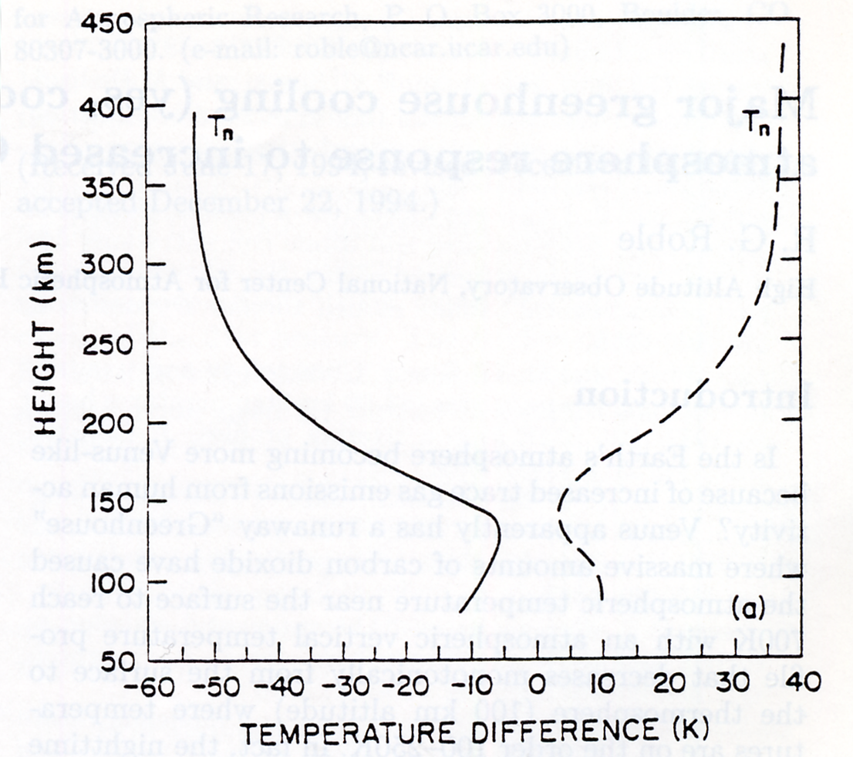
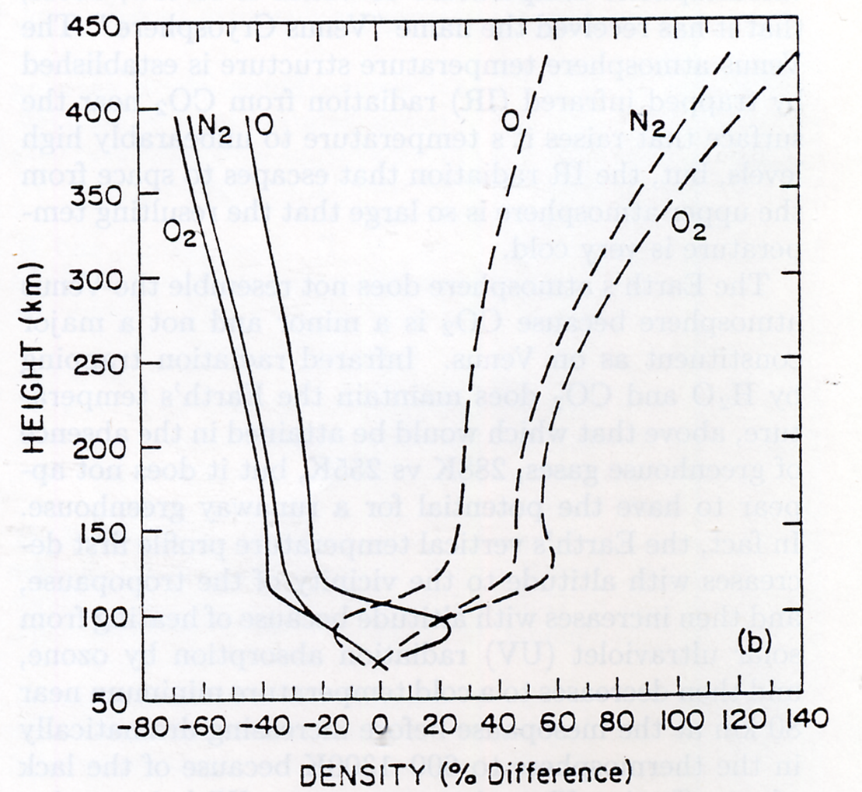
Roble and Dickinson (1989)

Slide 3
Aeronomy of Cooling Processes
• The thermosphere is cooled primarily through radiation from CO₂, NO, and O(³P)
• CO₂ radiation in 15 μm band; NO radiation in 5.3 μm band modulates solar cycle change
• Primary change in recent model estimates is due to increased levels of NO
• Older model estimates were tuned to measurements of NO from SME
Soft X-ray fluxes based on AE-era measurements
• More recent measurements (HALOE, SNOE, ISSAC, HIRASS) ~5 times higher
E.g., peak solar minimum low-latitude density ~3x10⁷ instead of ~6x10⁶
Revised solar soft X-ray fluxes based on TIMED/SEE, SNOE, rockets (EUVAC)
Model with revised ionization and chemistry in agreement with NO measurements
• Key uncertainties in chemical rates pertain to branching between N(²D), N(⁴S)
N₂+e*, NO⁺+e⁻, N(²D)+O
Temperature dependence of N(⁴S)+O₂ and NO+N reactions also important
• All of the cooling reactions are modulated by O, so atomic/molecular balance important
• Current model rate coefficients:
CO₂+O excitation rate:
1.56x10⁻¹² for T_{n} < 260
(2.6-0.004*T_{n})x10⁻¹² for 260<Tn<300
1.4x10⁻¹² for T_{n}>300
NO+O excitation rate:
4.2x10⁻¹¹

Slide 4
21st Century Mixing Ratios at Model Lower Boundary (30 km)
• Double CO₂
• Double CH₄
• Other minor species based on scenario from Bruhl & Crutzen, 1993:
Species | Year 2000 | Year 2100
CH₄ | O.6E-6 | 1.34E-6
CO₂ | 360E-6 | 720.E-6
H₂ | 0.5E-6 | 1.0E-6
CO | 1.1E-8 | 2.2E-8
H₂O | 4.4E-6 | 8.8E-6
NO | 2.7E-9 | 16.0E-9
NO₂ | 4.2E-9 | 8.4E-9
O₃ | 8.3E-6 | 4.15E-6
T_{N} | 225K | 215K
CL_{X} | S-G | S-G *1.5

Slide 5
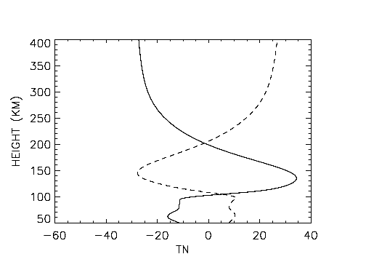
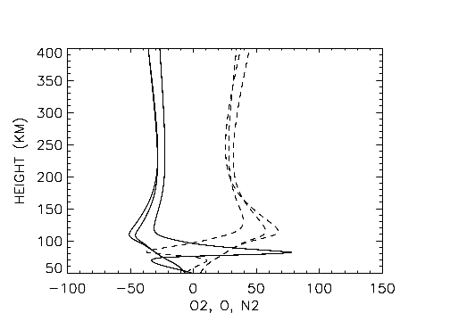
Solar Medium
Difference: Neutral temperature (K)
Percent difference: O2, O, N2
TN
N2
N2
O
O2
O2
Global change minus no change (gc-nc)
Ice Age minus no change (hc-nc)

Slide 6
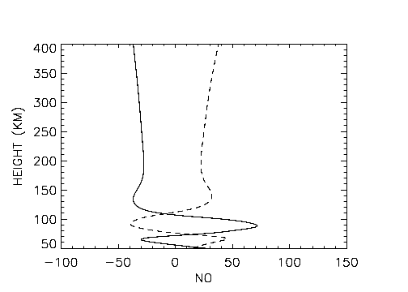
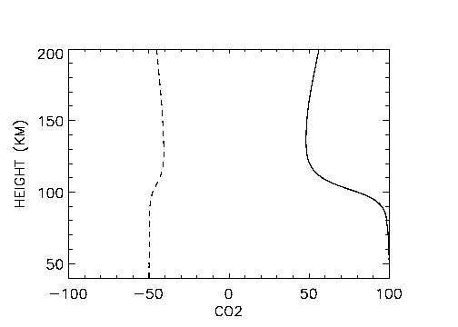
Solar Medium
Percent difference: NO
Percent difference: CO2
Global change minus no change (gc-nc)
Ice Age minus no change (hc-nc)

Slide 7
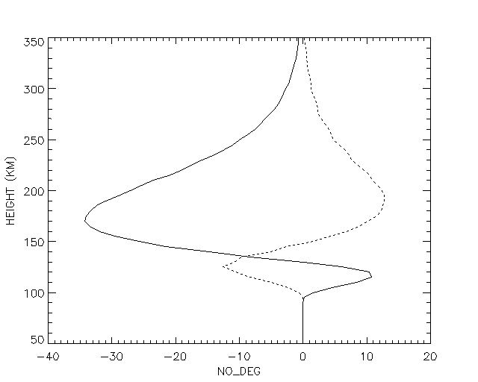
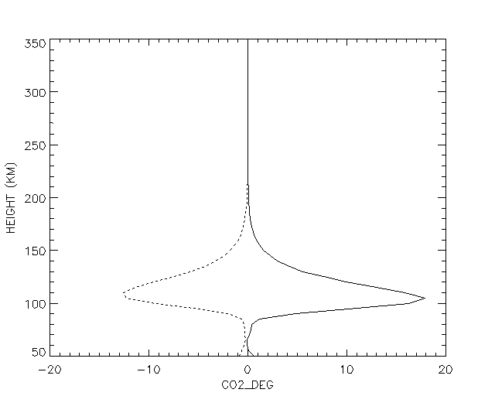
Change in NO and CO2 cooling
5.3 micron NO cooling (deg/day)
15 micron CO2 cooling (deg/day)
NO
CO2
Global change minus no change
Ice Age minus no change

Slide 8
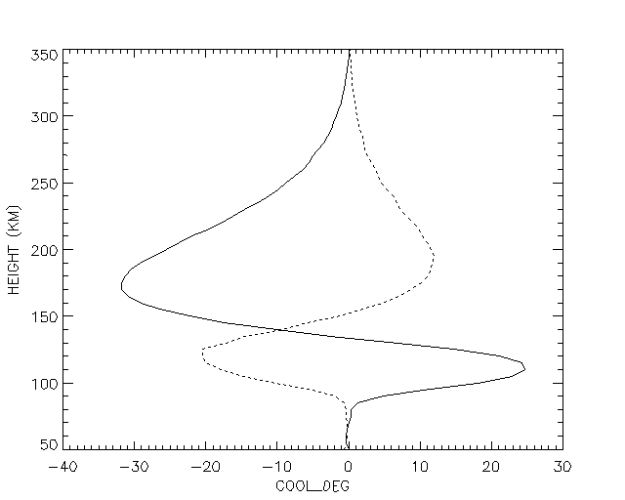
Change in total cooling (deg/day)
TCOOL
Global change minus no change
Ice Age minus no change

Slide 9
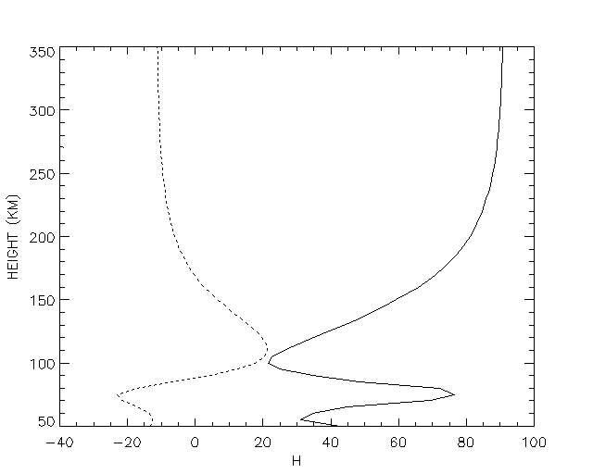
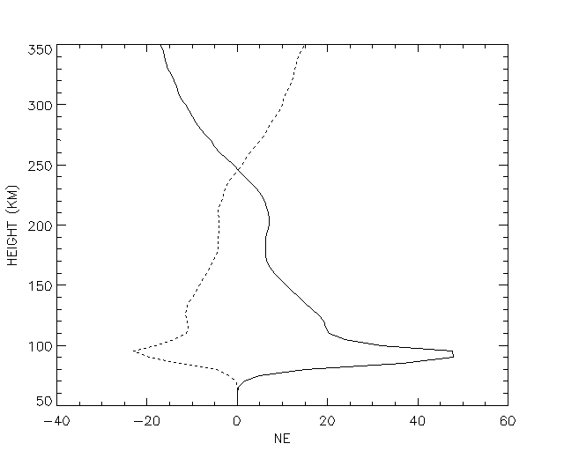
Percent change: H (cm3)
Percent change: NE (cm3)
H
NE
Global change minus no change
Ice Age minus no change

Slide 10
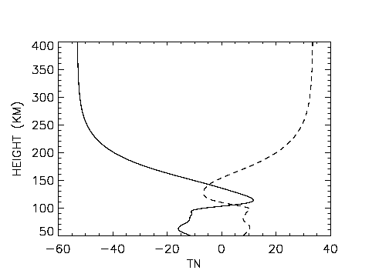
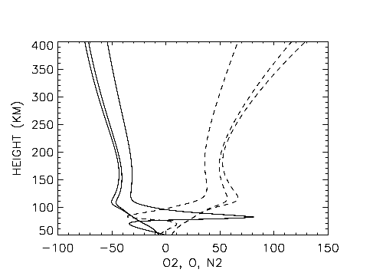
Solar Minimum
Difference: Neutral temperature (K)
Percent difference: O2, O, N2
O
TN
N2
N2
O2
O2
Global change minus no change (gc-nc)
Ice Age minus no change (hc-nc)

Slide 11
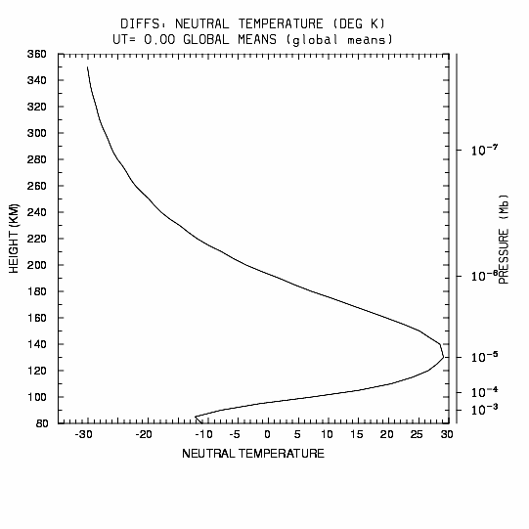
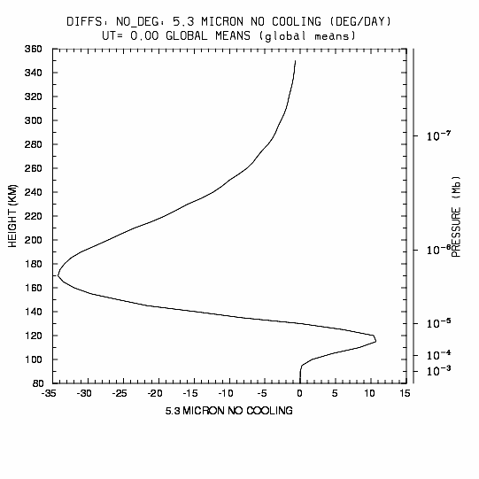
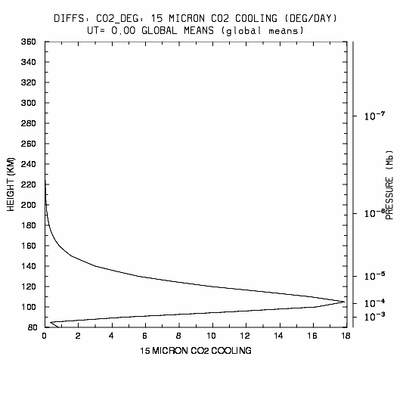
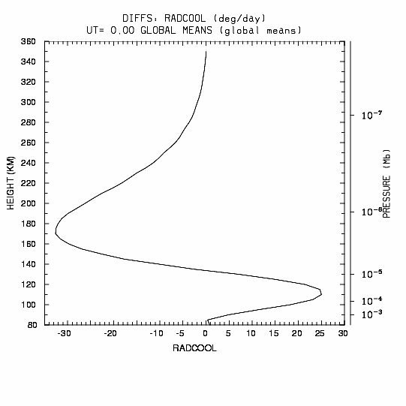
Solar Medium Conditions, GC-NC
T_{N}
5.3 μm
NO Cooling
15 μm CO₂
Cooling
Radiative Cooling

Slide 12
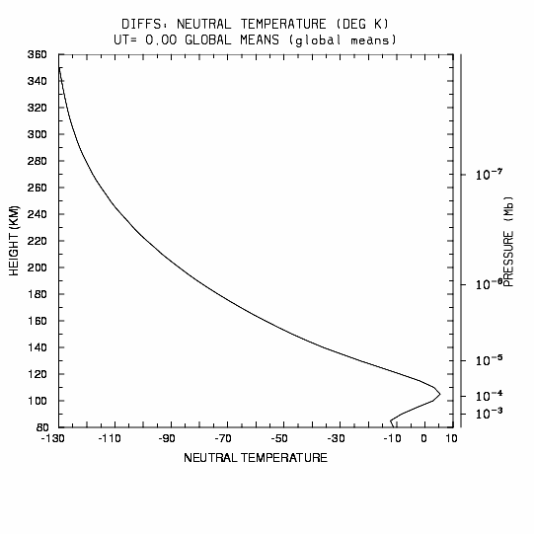
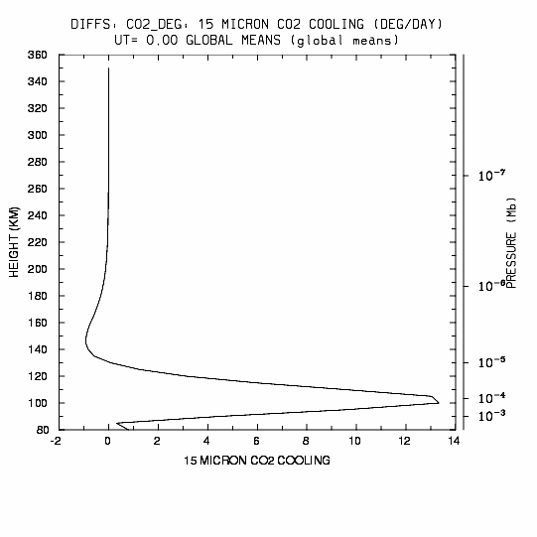
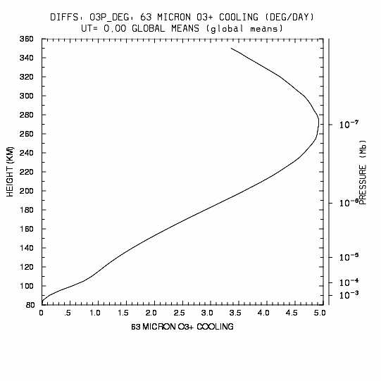
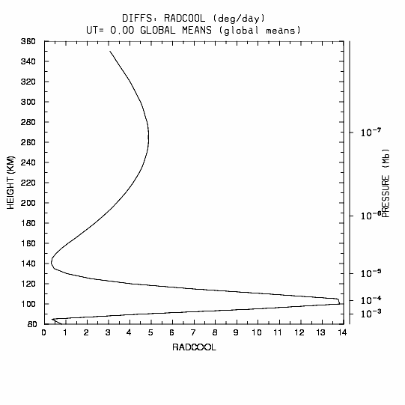
Solar Medium GC-NC, without NO
T_{N}
15 μm
CO₂ Cooling
63 μm
O₃+ Cooling
Radiative
Cooling

Slide 13
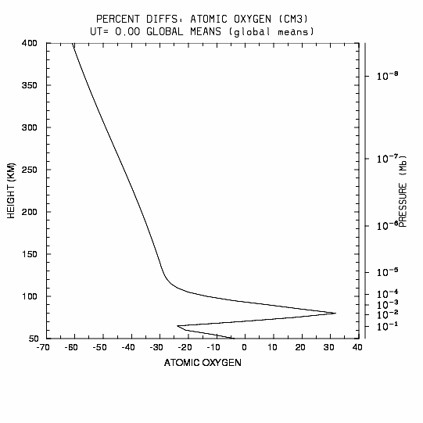
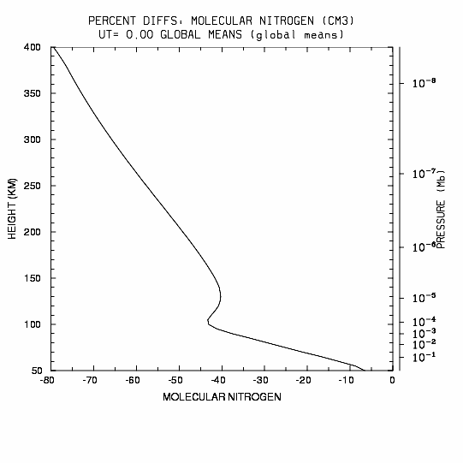
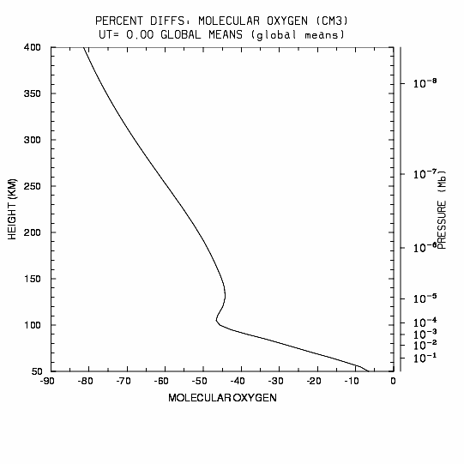
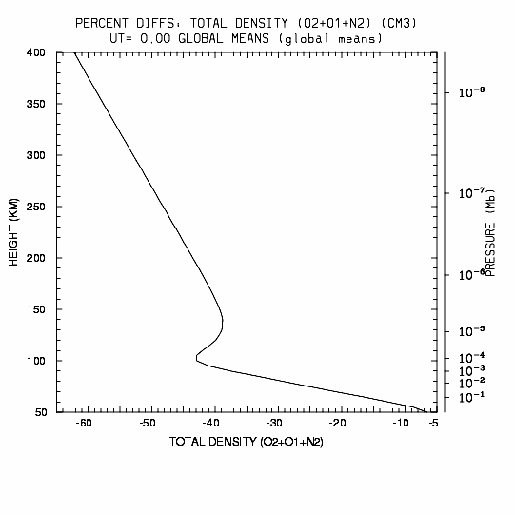
SMED GC-NC without NO chemistry
O
N2
O2
Rho

Slide 14
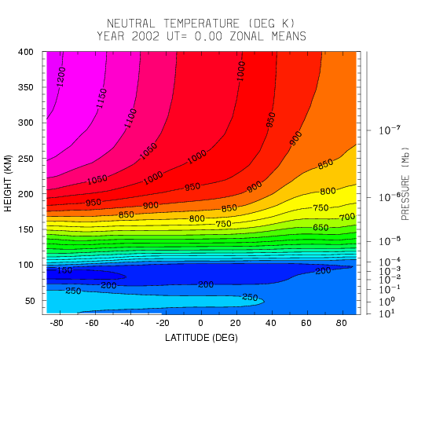
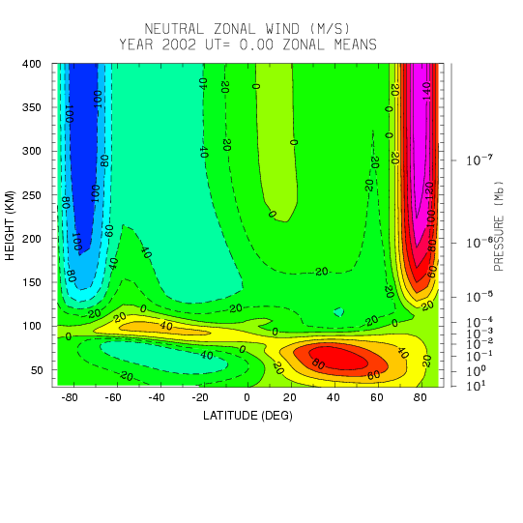
Baseline 2002 Model Atmosphere (NC-2002)
T_{N}
U_{N}

Slide 15
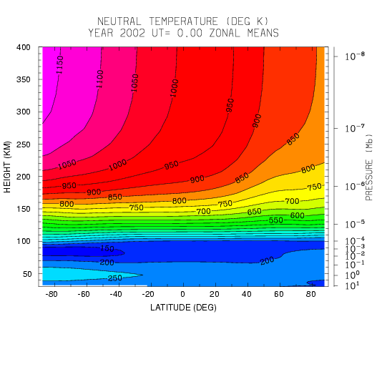
21st Century Global Change Model Atmosphere (GC-2100)
T_{N}
U_{N}

Slide 16
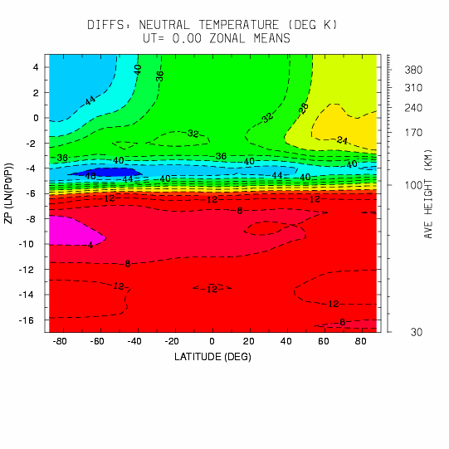
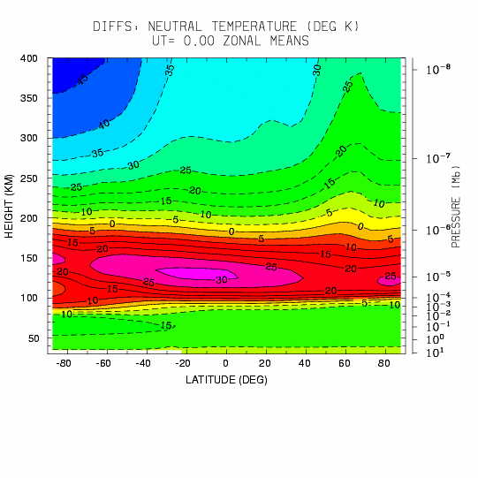
Difference in Neutral Temperature
Solar Medium Conditions
GC - NC

Slide 17
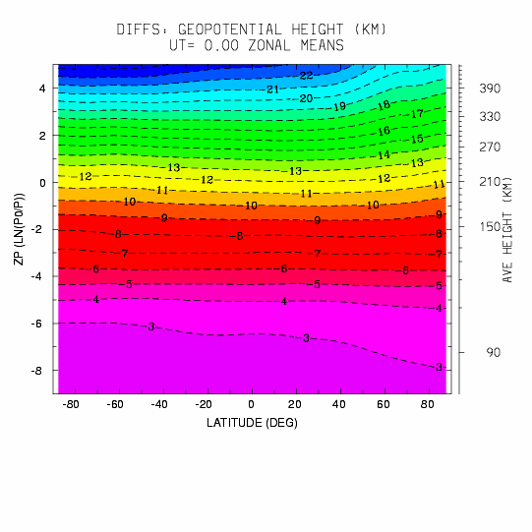
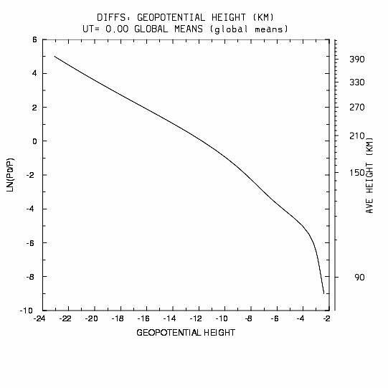
Difference in Geopotential Height
Solar Medium Conditions
GC - NC

Slide 18
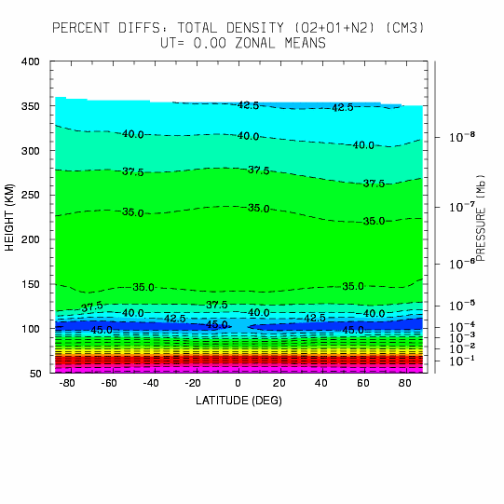
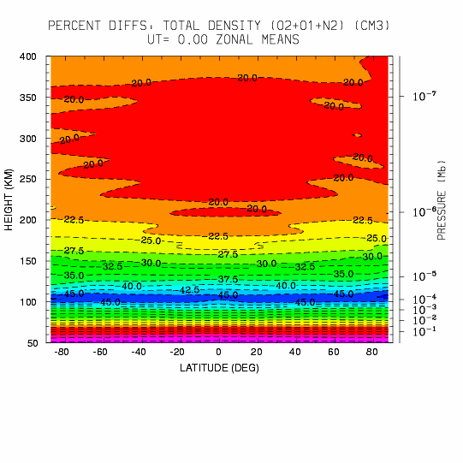
Differences in Zonal Mean Total Density
Solar Min GC-NC
Solar Max GC-NC

Slide 19
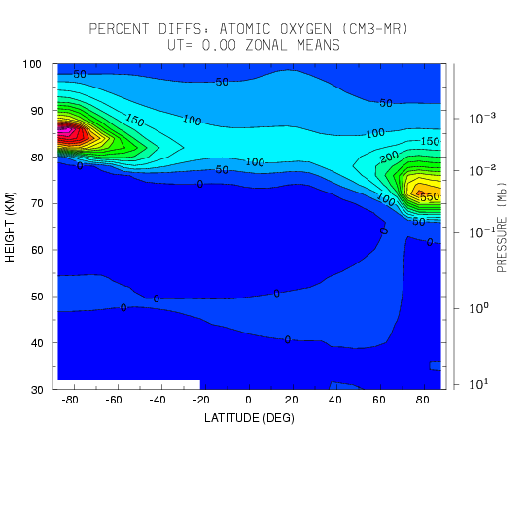
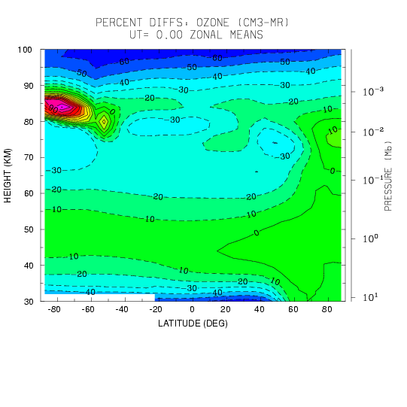
SMED GC-NC
Percent Differences
O
O3

Slide 20
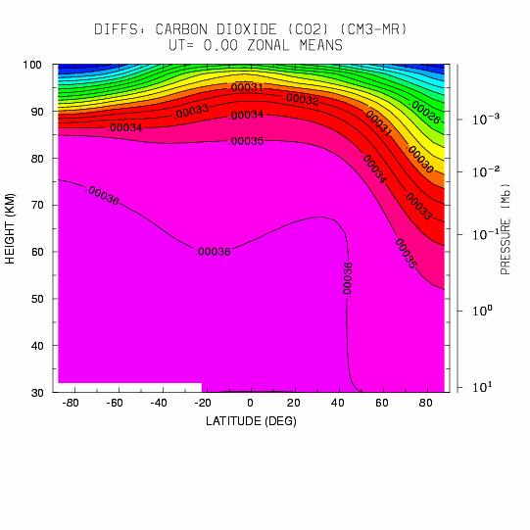
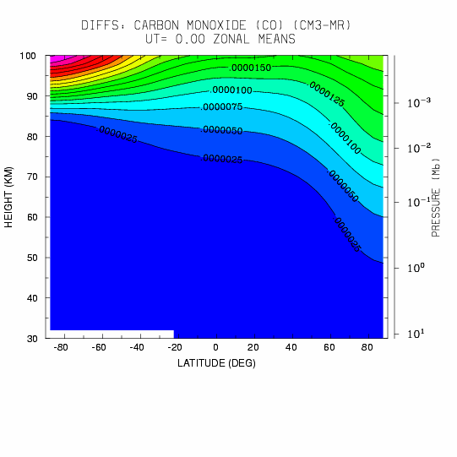
SMED GC-NC
Differences
CO2
CO

Slide 21
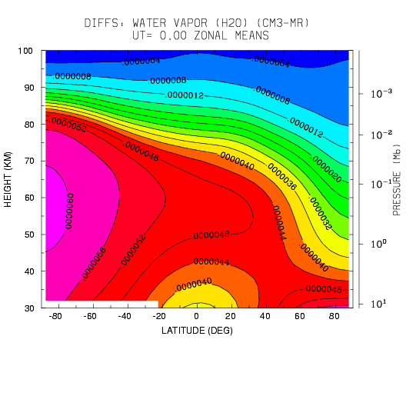
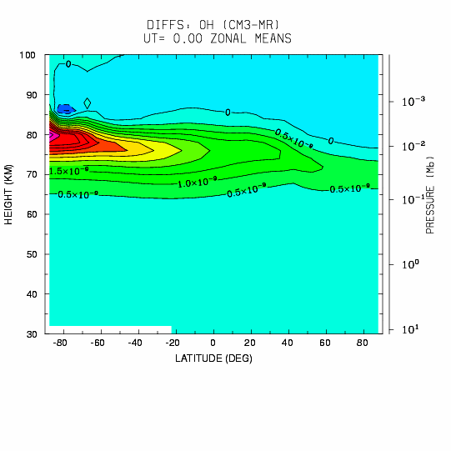
SMED GC-NC
Differences
H2O
OH

Slide 22
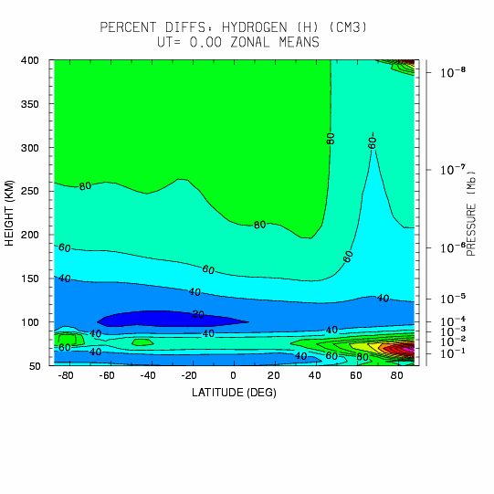
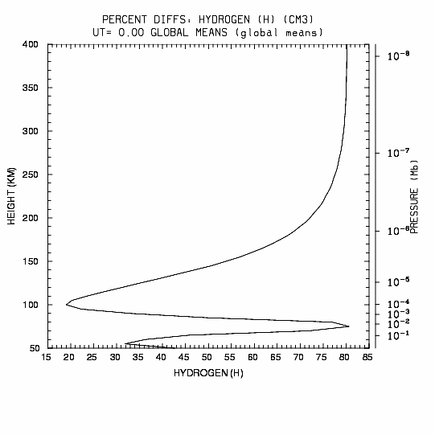
Percent Difference: Hydrogen
SMED: GC-NC

Slide 23
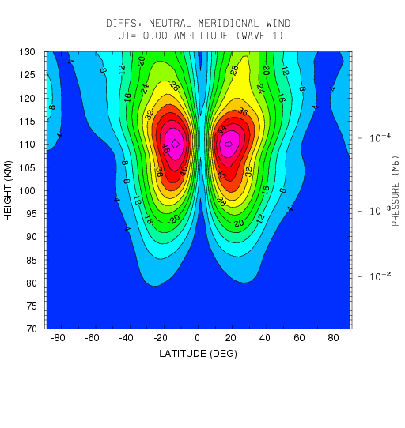
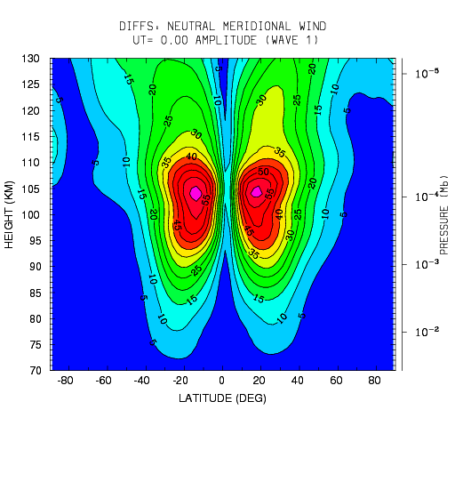
Tidal Amplitude Wave 1
hc-nc
gc-nc

Slide 24
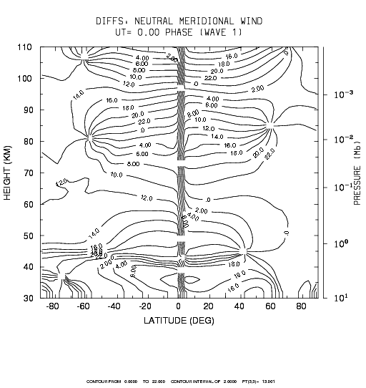
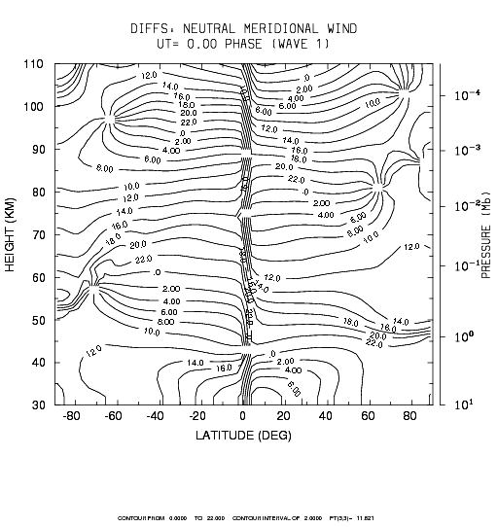
Tidal Phase Wave 1
hc-nc
gc-nc

Slide 25
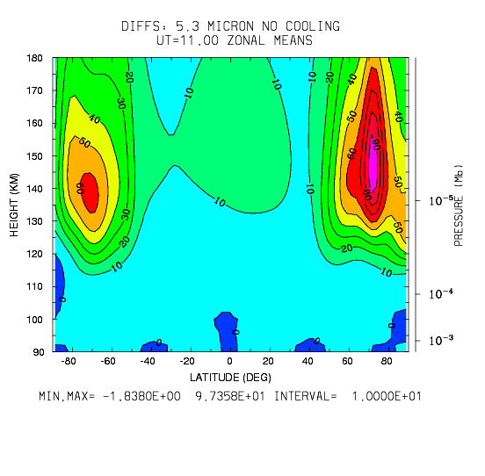
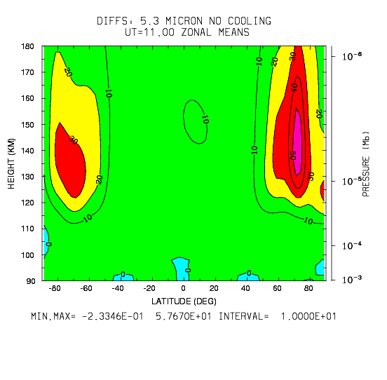
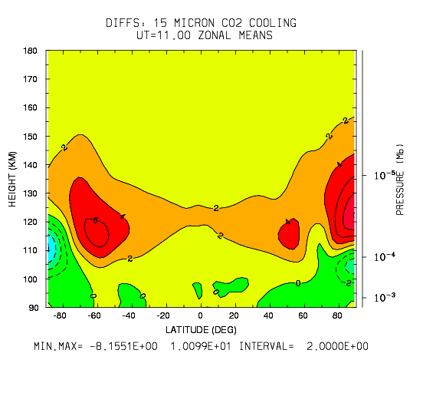
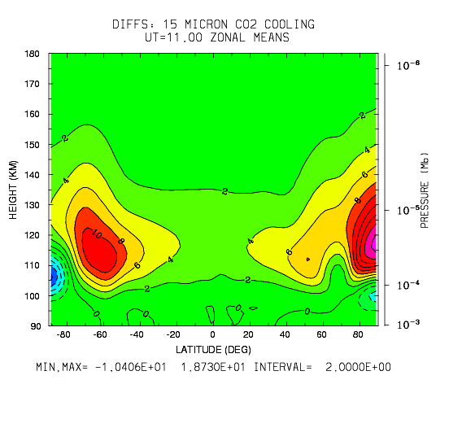
Difference: NO, CO2 Cooling

Slide 26
Difference: NO, O Density

Slide 27
SUGGESTIONS FOR FUTURE RESEARCH
CO2 – O excitation rates - 1.e-12 to 6.e-12
NO-O excitation rates - 2.7e-11 to 4.2e-11
N(2D) – N(4S) branching ratios for photoelectron and auroral electron dissociation
Temperature dependent rate coefficients for thermospheric and mesospheric chemistry
Tidal variations in a changed basic state
Planetary wave propagation/sudden strat-warms/2-day wave propagation effects
Auroral particle and electrodynamic couplings in a changed basic atmosphere
Solar wind/magnetosphere/ionosphere/atmosphere couplings in a changed basic atmosphere
Global electric circuit couplings – lower atmosphere coupling through the dynamo region
Gravity wave propagation and interactions in a changed basic atmosphere
Noctilucent clouds and climate
Satellite orbital changes, ionospheric variability and orbital re-entry in a changed basic atmosphere
Airglow changes as a sensitive indicator of global change
Hydrogen escape to space – decreased/increased ?
Aerosol influences – electrical conductivity, clouds, layers, metallic chemistry
Ionospheric electrodynamics – changes in current systems
Local upper atmosphere climate change

Slide 28
Conclusions
• Increased CO₂ and CH₄ levels will cool and contract the upper atmosphere, but the effects vary as a function of altitude, with some altitudes actually warming.
• Effects of NO cooling and chemical heating modulate the thermospheric response to global change as well as the solar cycle.
• Largest changes are predicted to occur during solar minimum conditions.
• These findings are consistent with inferences of density changes from satellite orbit analysis and ionospheric analyses.

Slide 31
Baseline 2002 Model Atmosphere (NC-2002)
U_{N}
T_{N}

Slide 32
GC-2100
TN
UN

Slide 33
Neutral Temperature (difference)
SMED GC-NC

Slide 34
Differences in Zonal Mean Neutral Temperature
Solar Min GC-NC
Solar Max GC-NC

