Slide 1
TIE-GCM Develoment Meeting 12 January 2011

Slide 2
Agenda
NO⁺ bug & fix (Wenbin/Ben) Weimer model implementation (Stan) IMF inputs: Filtering Implementation Crossover latitudes for potential solver: Definition of proposed variable crossover latitudes Implementation for Heelis and Weimer Ramifications for CMIT and AMIE Test plan: What to test for? Intervals to test? Who is doing what? Spinup-equilibration study (Ben) Overview of findings Implications for spinup procedure

Slide 3
TIEGCM “qic bug” Ion Chemistry Heating calculation in qjion.F:
qic(k,i) =
| (avo*(o2(k,i)*rmassinv_o2*(rk1(k,i,lat)*op(k,i)*1.555+
| (rk6*2.486+rk7*6.699)*nplus(k,i)+
| rk9*n2p(k,i)*3.52)+
| op(k,i)*(rk2(k,i,lat)*xn2(k,i)*rmassinv_n2*1.0888+
| rk10*n2d(k,i)*rmassinv_n2d*1.45)+
| o1(k,i)*rmassinv_o1*(rk3(k,i,lat)*n2p(k,i)*0.70+
| rk8*nplus(k,i)*0.98)+
| o2p(k,i)*(rk4*n4s(k,i)*rmassinv_n4s*4.21+
| rk5*no(k,i)*rmassinv_no*2.813))+
| .5*(ne(k,i)+ne(k+1,i))*(ra1(k,i,lat)*op(k,i)*0.854+
| ra2(k,i,lat)*o2p(k,i)*5.2755+
| ra3(k,i,lat)*n2p(k,i)*3.678)/xnmbarm(k,i))*evergs+
| (avo*(((rk16*3.02+rk17*0.7)*xn2(k,i)*rmassinv_n2+
| rk18*o1(k,i)*rmassinv_o1*5.0)*xiop2p(k,i)+
| (rk23*xn2(k,i)*rmassinv_n2*1.33+
| rk24*o1(k,i)*rmassinv_o1*3.31+
| rk26*4.87*o2(k,i)*rmassinv_o2)*xiop2d(k,i))+
| (.5*(ne(k,i)+ne(k+1,i))*((rk19(k,i,lat)*5.0+
| rk20(k,i,lat)*1.69)*xiop2p(k,i)+rk25(k,i,lat)*3.31*
| xiop2d(k,i))-(rk21*5.02+rk22*1.69)*xiop2p(k,i)-
| rk27*3.33*xiop2d(k,i))/xnmbarm(k,i))*evergs
Should be nop(k,i)
(chem rate ra1=NO+ + e)

Slide 4
Testing of Bug Fix
Differences of original code minus bug-fixed code for 20-day runs were all zero except UN, VN, OMEGA, and Potential. Differences in these fields were negligible, i.e., around 10^-7 to 10^-4, and do not show clear structure.

Slide 5
Weimer Model Implementation
IMF Inputs
Bz (nT, GSM coordinates)
By (nT, GSM coordinates)
Vsw (km/s) (magnitude of solar wind velocity vector)
n (cm⁻³) (note that namelist input overrides)
Derived from OMNI 1-minute data files (already adjusted for L1 travel time)
Gaps filled by linear interpolation (and flagged with data quality parameter)
All parameters smoothed with trailing 15-minute average, lagged by 5 minutes
i.e.: f’(t) = mean(f((t-19):(t-5)))
Calculated at at 5-minute intervals by Pete’s OMNI data processing program
Stored in files, 1 year per file
TIE-GCM reads file, interpolates values to model time

Slide 6
Weimer Model Implementation
Crossover Latitudes
Current trunk has fixed co-latitudes defining crossover between imposed high-latitude potential and dynamo potential solution.
Those co-latitudes are:
crit(1) = 15°
crit(2) = 30°
magnetic coordinates (centered on location of convection center)
This seems to work pretty well for Heelis and CMIT, but not very well for Weimer, because it has a larger convection radius.
Proposal:
crit(1) = theta0 + 5° 15° < crit(1) < 30°
crit(2) = crit(1) + 15°
Note that for theta0 = 10°, typical of low-activity conditions, nothing changes.

Slide 7
Weimer Model Implementation
Crossover Latitudes
What defines theta0?
Heelis: empirical function of ctpoten (runs ~10° to 20°)
Weimer: theta0 = convection radius = (zero potential radius) / 2 (runs ~ 10° to 25°)
CMIT: code exists for making theta0 a function of ctpoten, but implementation line is commented out. Therefore, nothing changes for CMIT *yet*. Need to evaluate size of LFM potential pattern and ctpoten as a function of activity, which is a much more complex issue requiring further study.
AMIE: As long as theta0=10°, nothing changes. However, if an AMIE run specifies ctpoten and the TIE-GCM allows theta0 to vary with ctpoten (as in a Heelis run) then crit(1,2) will vary. This needs further study!

Slide 8
Code structure with proposed changes
Critical latitudes are declared and initialized in cons.F:
! Critical colatitude limits (15,30 deg) for use of Heelis potential in dynamo:
real :: crit(2) = (/0.261799387, 0.523598775/)
Advance calls aurora_cons (every timestep), which calculates convection reversal boundary theta0:
theta0(isouth) = (-3.80+8.48*(ctpoten**0.1875))*dtr
! Set theta0 = 10 deg so crit(1,2)=15,30 (old values in cons.F) in colath.F for CISM
#if defined(INTERCOMM) || defined(CISMAH)
theta0(isouth) = 10.*dtr
#endif
Advance calls Heelis, Weimer01, or Weimer05, or None, according to namelist input POTENTIAL_MODEL.
If Weimer05, theta0 is reset in sub wei05loc
The requested potential model calls colath (which is now in its own source file colath.F)

Slide 9
Code structure with crit changes, cont.
Sub colath (colath.F) calculates crit(1:2) from theta0:
! 01/11 bae: Revise crit in rad so crit(1)=theta0(=crad in rad)+5deg,
! crit(2)=crit(1)+15deg
crit1deg = max(15.,0.5*(theta0(1)+theta0(2))*rtd + 5.)
crit1deg = min(30.,crit1deg)
crit(1) = crit1deg/rtd
crit(2) = crit(1) + 15./rtd
Sub colath then calculates fraction of dynamo potential pfrac from crit (pfrac is declared in dynamo module):
pfrac(i,j) = (colatc(i,j)-crit(1))/(crit(2)-crit(1))
if (pfrac(i,j) < 0.) pfrac(i,j) = 0.
if (pfrac(i,j) >= 1.) pfrac(i,j) = 1.
Dynamics calls sub aurora (aurora.F), which places cusp according to theta0.
Advance calls sub dynamo, which calculates ion drift and potential according to pfrac.

Slide 10
Procedure to obtain this code for testing
Check out tiegcm trunk (call it tiegcm_crit):
svn checkout $SVN/tiegcm/trunk tiegcm_crit
Go to the source directory:
cd tiegcm_crit/src
Copy patch file from hao ftp site:
cp /hao/ftppub/foster/tiegcm_crit/crit.patch .
Apply the patch (unix patch command):
patch –p0 < crit.patch
Confirm svn status:
svn status

Slide 11
Results of svn status after applying crit.patch:
? crit.patch
M advance.F
A colath.F
M aurora.F
M heelis.F
M wei05sc.F
M input.F
M cons.F
M wei01gcm.F
M cism_coupling.F

Slide 12
Test Plan
What to test for?
• Heelis old/new
• Weimer old/new
• Global Electric Potential (m/m) (Art & Astrid)
• Joule Heating (m/m) (Alan)
• Winds (m/m) (Alan)
• Tn, Ti, Te (m/m) (Alan)
• Vertical Drifts at Magnetic Equator (m/d) (Wenbin/Barbara)
• Electron Density (NmF2, HmF2?, TEC) (m/d) (Wenbin/Jiuhou)
• Density (and composition) (m/d) (Liying/Stan)
• Minor species chemistry (NO) (byproduct of density studies)

Slide 13
Test Plan
Steady State Runs (Ben)
• Moderate solar, low activity (just to make sure nothing changed much)
• Moderate solar, moderate/high geomagnetic (~150 CP)?
• Limited test at high-res
GPI/IMF Runs
• October-November 2003 (Halloween Storm) (Ben)
• ~2004 Jicamarca Comparison (Wenbin/Barbara)
• 2005 (moderate solar activity; HSS/CIR) (Liying)
• December 2006 (AGU Storm) (Wenbin/Jiuhou)
• March-April 2008 (WHI interval) (Wenbin/Barbara)

Slide 14
Some Tests That Barbara Has Already Done
(but most of these were done with a 10° crossover width)
Nov 10, 2004, 630 UT – better Viz at Jicamarca (and Apr 2002 Viz)
Dec 2006 day 348 – better TEC for Weimer
WHI #1 2008 day 80-110 – better NmF2 for both Heelis and Weimer

Slide 15
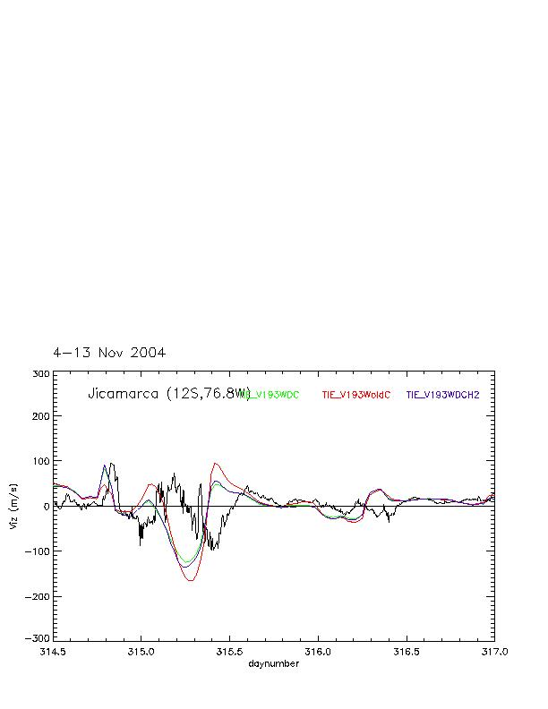
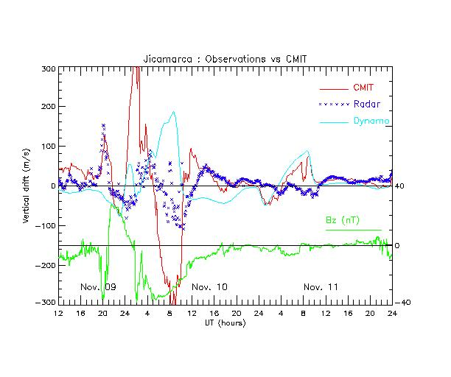
Jicamarca Viz (ExB VperpN)
Test crit for 10 Nov 2004 630 UT at time of max recorded Viz (-110 m/s) from Jicamarca.

Slide 16
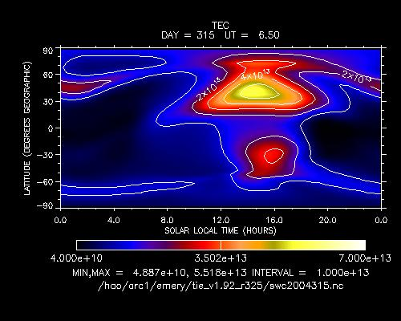
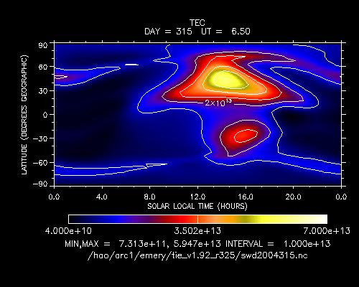
TEC for 10 Nov 2004 0630 UT
Old constant crit1,2
Dynamic crit1,2
Less NH auroral TEC, more in mid-lats with dynamic crit. Not big differences.
Bz=-24.7 nT, By=-7.2nT, Kp=9-

Slide 17
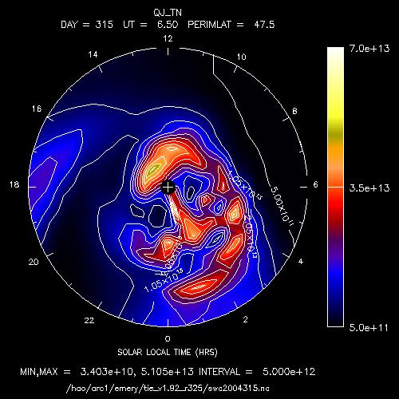
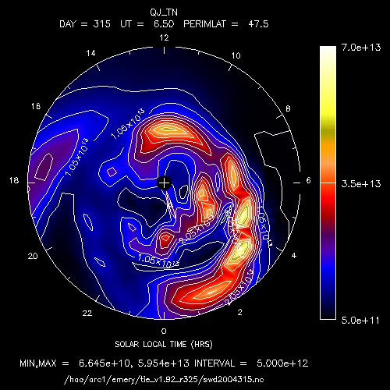
Ht-int QJ for NH 04315 0630 UT
Old constant crit1,2
Dynamic crit1,2
NH get more Joule heat on dawn side with dynamic crit, and less in polar cap, but TEC was less in auroral region with dynamic crit and more in mid-lats.

Slide 18
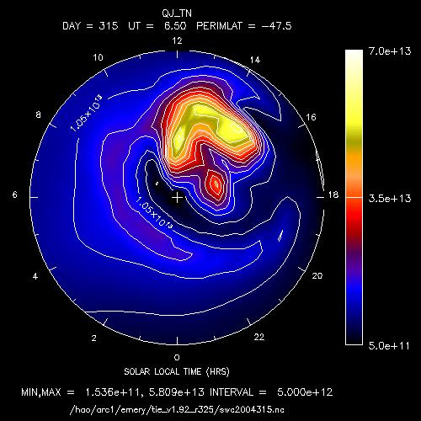
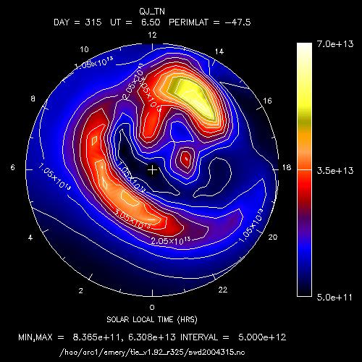
SH QJ for 10 Nov 2004 0630 UT
Old constant crit1,2
Dynamic crit1,2
SH big change to get more Joule heat on dawn side with dynamic crit.

Slide 19
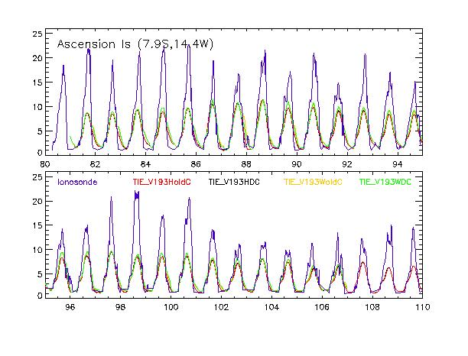
WHI 2008 Ionosonde Stations
10 stations
Heelis Dyn Crit better for all but Millstone Hill (highest mlat)
Weimer Dyn Crit better on largest variation days 86-88 for all but Camden on day 88

